Slide 1
LHC Status Thu Morning 19-Mai
Bernhard Holzer, Gianluigi Arduini et al
Tentative Planning
Wed 10:00h – 21:00h | TOTEM / ALFA alignment studies,special fill pattern including loss maps for the pots
Wed 22:00h | dump, cycle, injection: loss maps 450 GeV: beam-2 vertical, beam 1 & 2 Δp/p set up 768 x 768 bunches, (72 bunch train transfer) ramp, squeeze, lumia nice long luminosity run.
Thu moning | change acceleration rate for rf trims (Andy Butterworth) re-check injection of 108-144 bunches and inject up 1200 – 1380
Tue late | set up 768 x 768 bunches, (108 bunch train transfer)

Slide 2
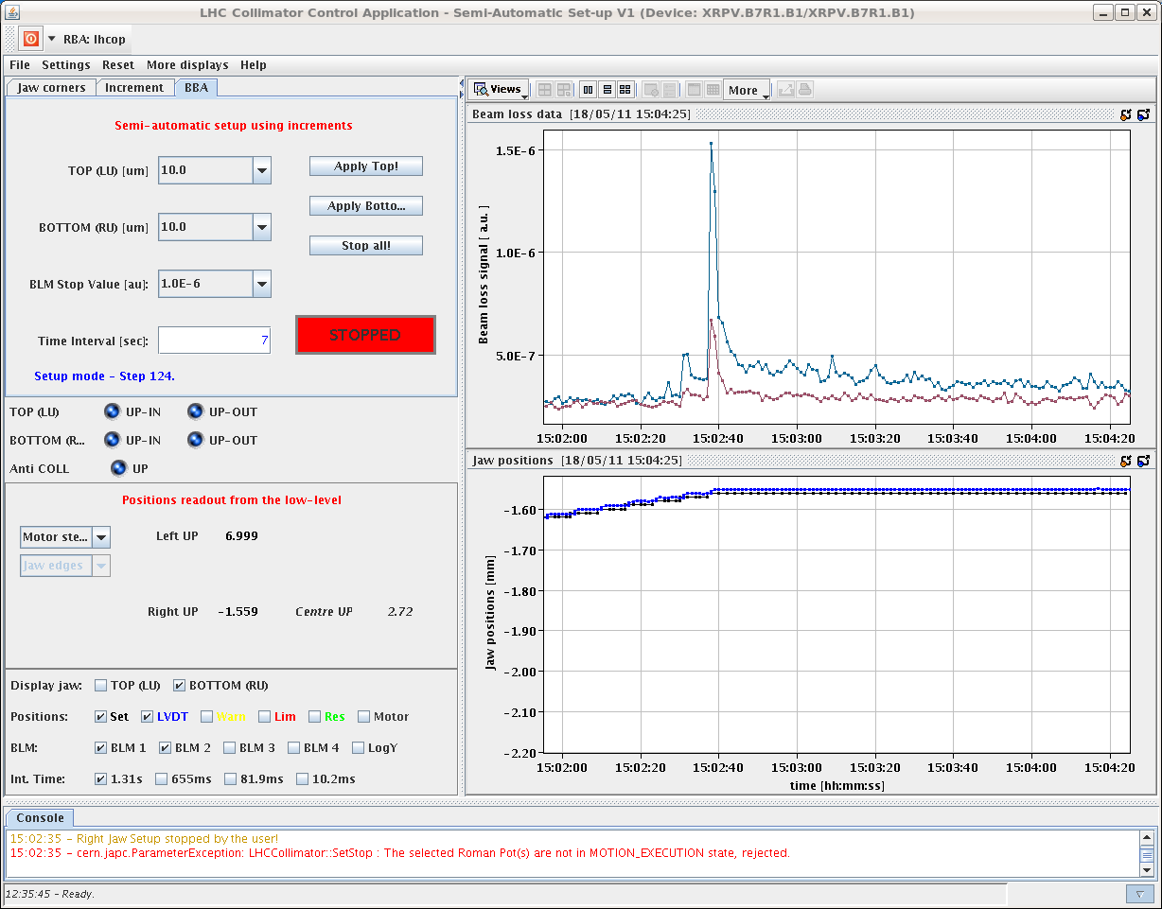
Wed morning
ALFA / TOTEM Alignment studies

Slide 3
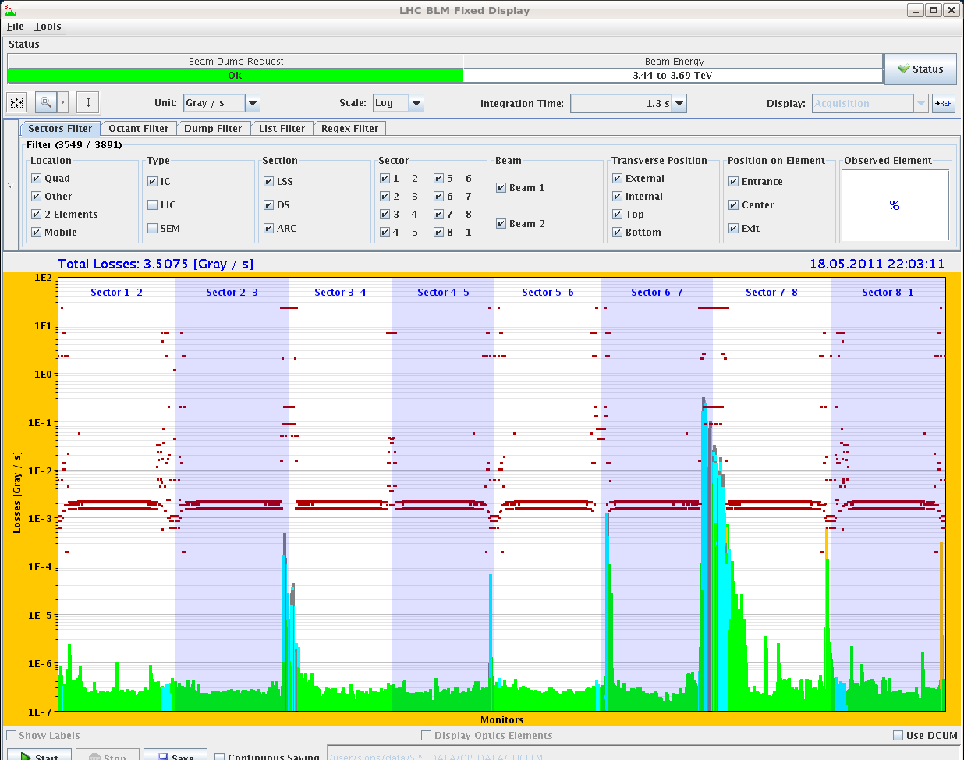
Wed late
17:28h TOTEM: found edge with XRPH.A6R5.B1 at 0.6mm.
All TOTEM pots aligned.
17:44h ALFA: all pots aligned and retracted to 7mm.
22:03h loss maps to
verify hierarchy of
collis & pots
22:18h Dump:
Orbit excursion interlock
(BPMs in IR6)Operator /
Comment: exploration of the
VERY RELAXED flag during
loss maps at 3.5 TeV with
RPs at 14 sigmas
-> off momentum loss maps still to be done ....

Slide 4
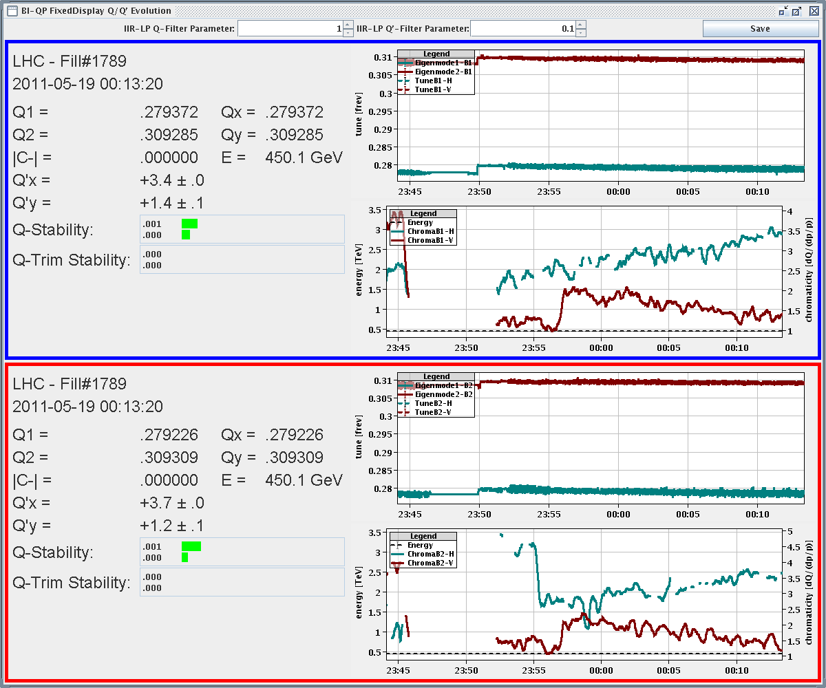
Wed night
00:13h set up injection
FIDEL is not in good shape...
chromaticity is drifting

Slide 5
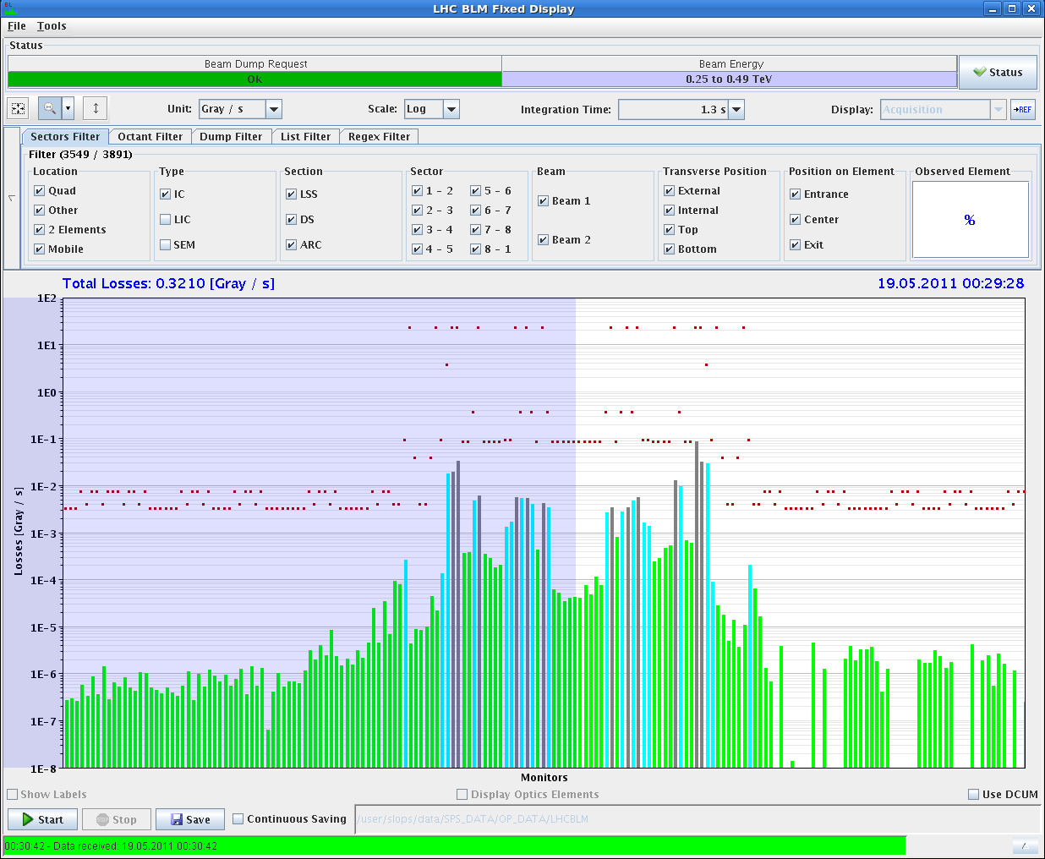
Wed night
00:23h loss maps at 450 GeV (routine checks)
The loss maps look good, so we go for the preparation
of the physics fill.

Slide 6
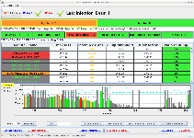
Wed night / Thu morning:
02:06h preparing injection
72 bunch trains, goal 768 bunches
B1 first injection of 72 bunches: losses to 37% of threshold, but IQC OK.
IQC 37% threshold
02:40h start ramp ... dump
Dump Classification: Vacuum system trigger

Slide 7
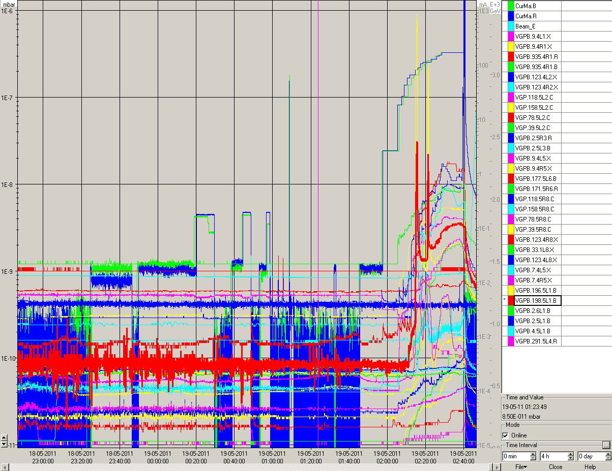
Wed night / Thu morning:
02:40h start ramp ... dump
Dump Classification: Vacuum system trigger
We called the vacuum piquet: apparently there VGPB123.4L8.X was about threshold, and the valves around IP8 closed.

Slide 8
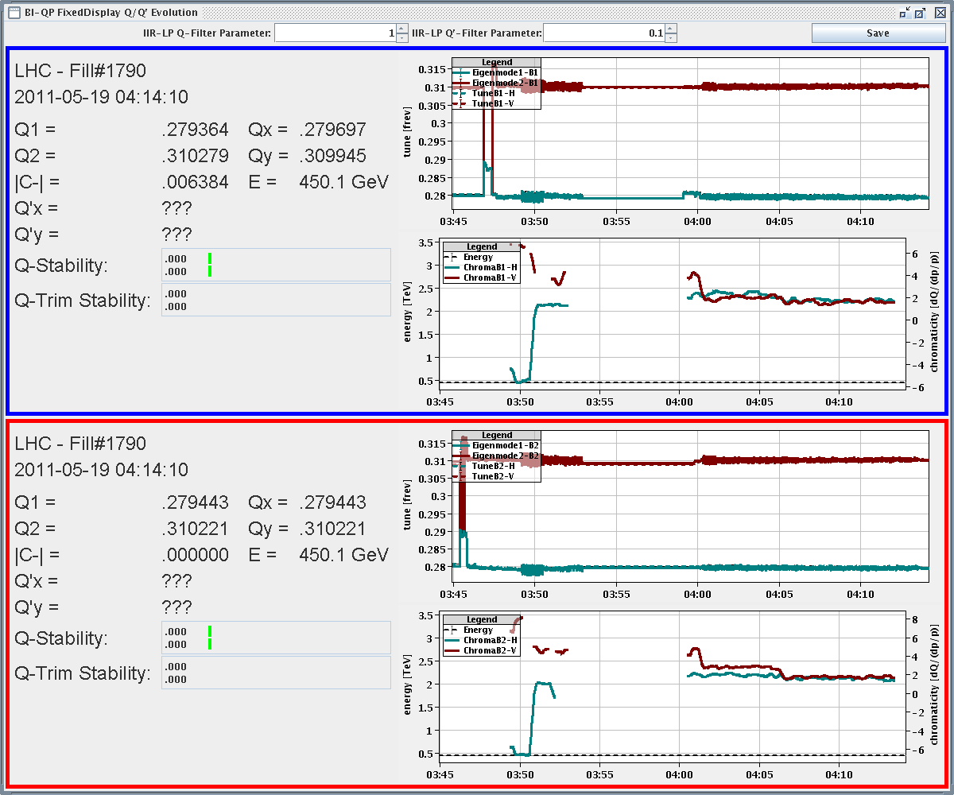
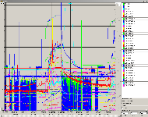
Wed night / Thu morning:
04:13h
BEAM MODE changed to INJECTION PHYSICS BEAM
chroma stable now
04:36h
We had to stop the injections, since the vacuum was degrading at IP8 (300-264 bunches).

Slide 9
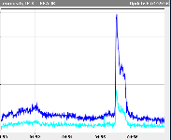
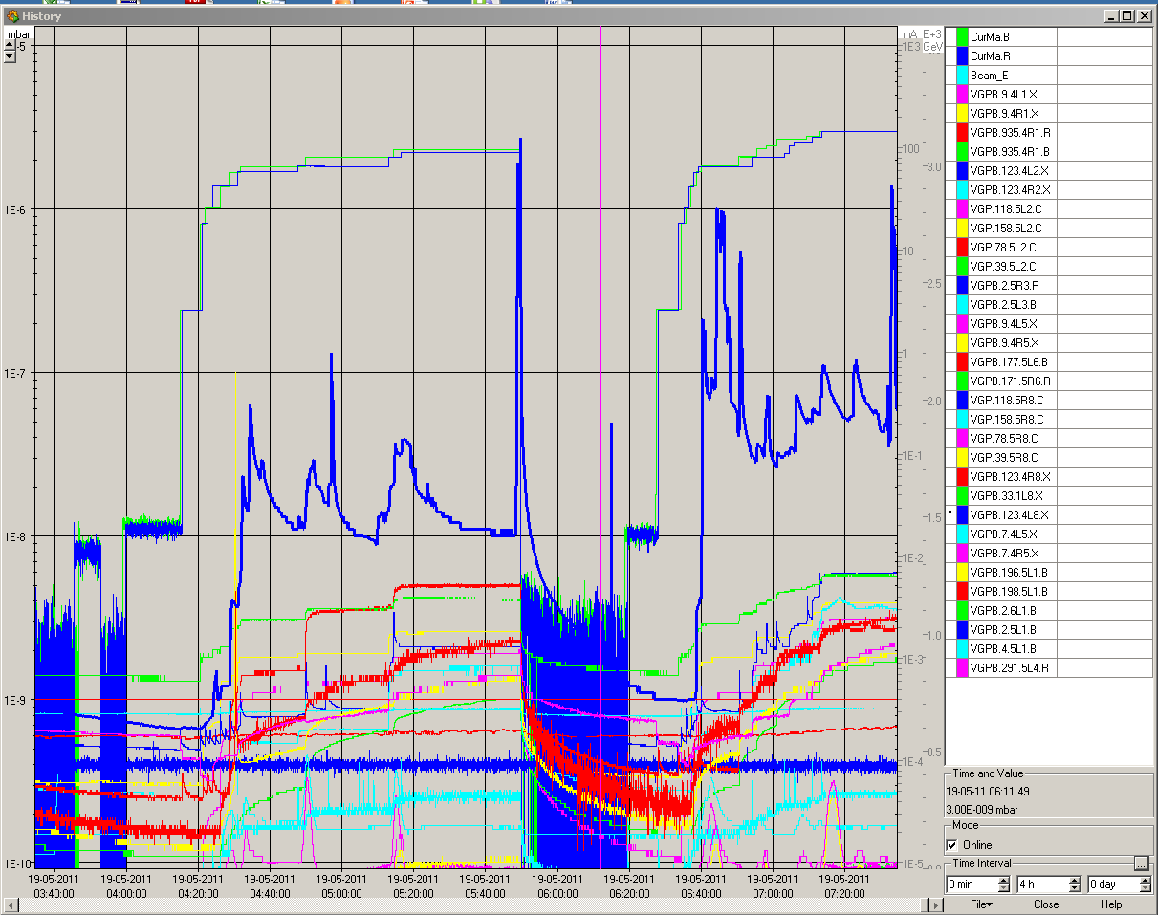
Wed night / Thu morning:
Most of the solenoids appears to be off
Bran snapshot. This big signal was coming when there was
no injection but the vacuum increased at same time
Vincent Baglin called: he suggested
to switch on the solenoids around point 8.
Vac pressures ... latest fluctuation was without any injection ( see vac spike of factor 50)

Slide 10
Tentative Planning
Wed 10:00h – 21:00h | TOTEM / ALFA alignment studies,special fill pattern including loss maps for the pots
Wed 22:00h | dump, cycle, injection: loss maps 450 GeV: beam-2 vertical, beam 1 & 2 Δp/p
Thu morning | change acceleration rate for rf trims (Andy Butterworth) check & solve vacuum problem set up 768 x 768 bunches, (72 bunch train transfer) ramp, squeeze, lumi, a nice long luminosity run. re-check injection of 108-144 bunches and inject up 1200 – 1380
Tue night | set up 768 x 768 bunches, (108 bunch train transfer)
✔
✔
✔

