Slide 1
Tuesday 17/5
10:00 3.5 TeV - colliding. Start roman pot alignment ...
10:54 beam dump due to roman pot movement
11:50 sector 81 & 12 tripped during cycle (SPS em noise ?)
13:06 end of pre-cycle, trip of sector 78
13:00 - 18:00 Investigations on the trips of Sector 78 main quadrupoles.
18:30 finally successful pre-cycle after restoring threshold on nQPS (B11). No injection permit from CMS
19:00 Injection of beam 2 only. TI2 Power converter problem on RBIH.610337
19:30-01:00 Injection setting-up up to 144 bunches
01:00-06:30 Fill #1787 – 480 bunches with 72 bunches/train – 4.4x10³² cm⁻²s⁻¹ initial luminosity – 3.4 pb⁻¹ in 2.3 hours. End of fill test of measurement of transient beam loading when switching off a cavity.
06:30 – now: ALPHA/TOTEM roman pot beam based alignment

Slide 2
ALPHA/TOTEM Roman pot
Started at 9 AM
9 pilots + 1 nominal - 8 x10¹⁰ p/bunch: Emittance for the “nominal” bunch on the low side (2.5 μm instead of 3.5 μm)
Dumped by BLMs at 10:54 by error in the trim value sent for the roman pot position (100 μm step instead of 10 μm step) ➔ problem fixed afterwards
Decided to stop and move to injection setting-up

Slide 3
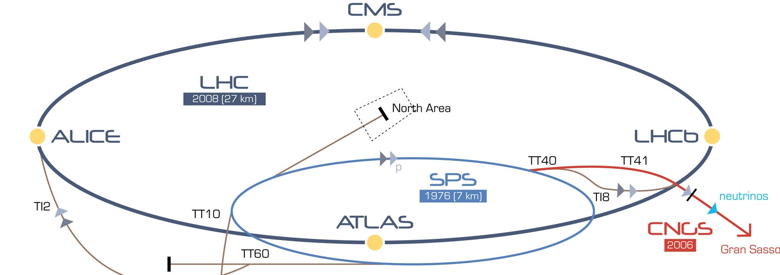
Sector 81/12 trips
Un-notified test of one main quadrupole power supply chain in the SPS
➔ transformer effect in this case SPS is the primary and LHC is the secondary at the origin of the oscillation
Same as on 30/3/2010
QF
QD

Slide 4
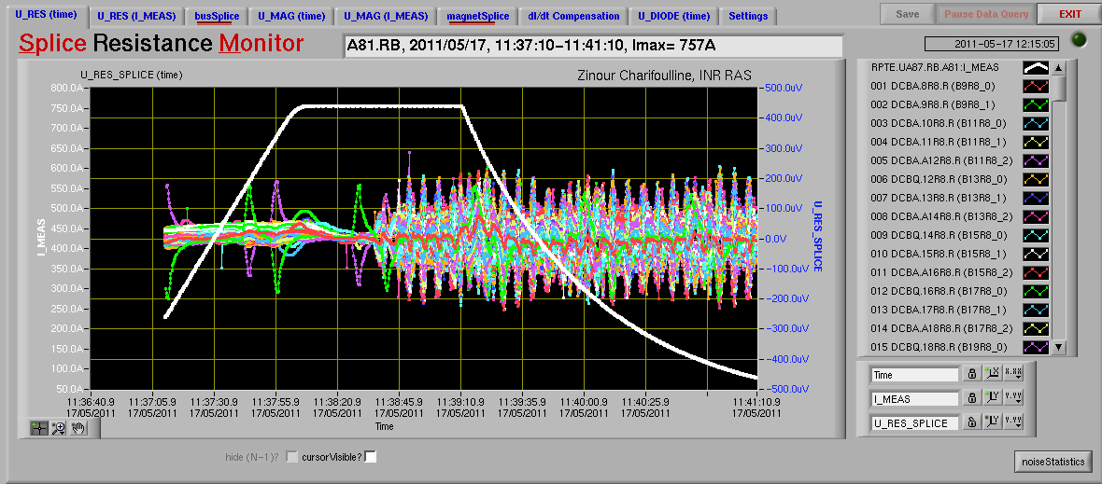
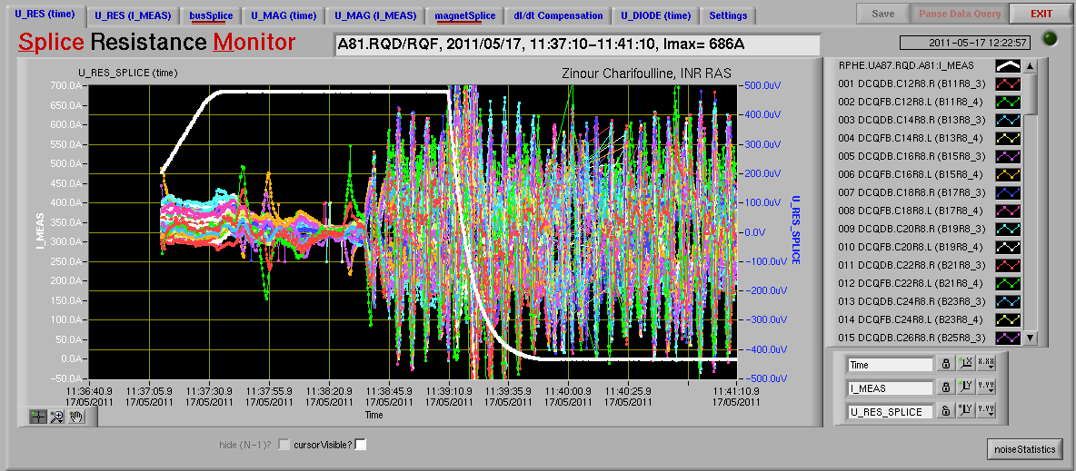
Sector 81/12 trips

Slide 5
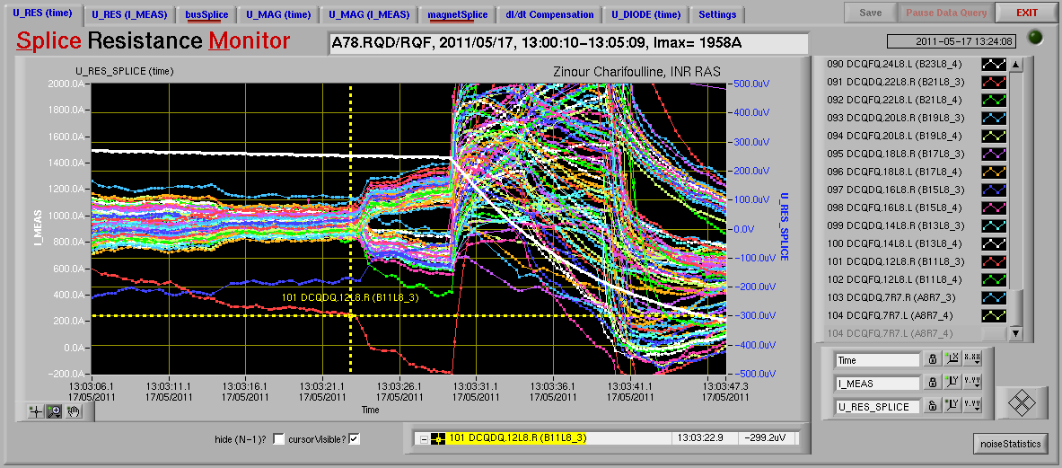
Sector 78 trip
No blow-up along the trains

Slide 6
Sector 78 trips (Z. Charifoulline, K. Dahlerup, J. Steckert)
Circuit tripped always at the end of a precycle at around 1400A. This happened only if all the circuits are pre-cycled together. If only RQ is cycled no trips occur. RQ + RB don't trip either but BS-board signal show an slight increase.
It was found that the BS board B11L8_3 was set to an increased threshold of 600uV in march 2010. In April 3 2011 this crate was power cycled and the board was probably switched back to its default value of 500uV. For some reason this circuit didn't trip until today. We set the threshold back to 600uV and wrote it to flash.
A precyle with all circuits was successfully completed without the BS board triggering. The maximal splice voltage was ~490uV. This could explain why the precycle sometimes work and sometimes not... We're just pretty close to the threshold. Further tests are required to find out which circuits causes the xtalk on the B11L8_8 card.

Slide 7
Injection setting-up (W. Bartmann, C. Bracco)
Injection of 36 bunches showed losses-to-dump ratio of 36% for Beam 1 and 11% for Beam 2 Trajectory in TI 2 transfer line was steered in both planes Injection was then extremly clean: losses-to-dump thresholds 1% Emittance in the SPS was about 3 um for 72 bunches We tried to inject with a more relaxed setting of the SPS scraper but losses-to-dump ratio reached 85% for beam 1 Nominal scraping was used (as for 2-2.5um emittance) but this induced high losses and all SPS BLM had to be masked With this setting losses were always smaller than 25% for Beam 2 and 10% for Beam 1 Emittance in the SPS back to ~2um for 108 bunches, trajectories and injection oscillations were very good and injection extremely clean. First injection of 144 bunches worked fine for both beams with losses smaller than 50%, emittance is now 2.6 um Second injection of Beam 1 dumped the beam We tried again and we managed to inject 3 times 144 bunches (85% losses for B1 and ~40% for B2) we are satisfied and we stop here: mission accomplished! New TI 2 settings copied to all the other users

Slide 8
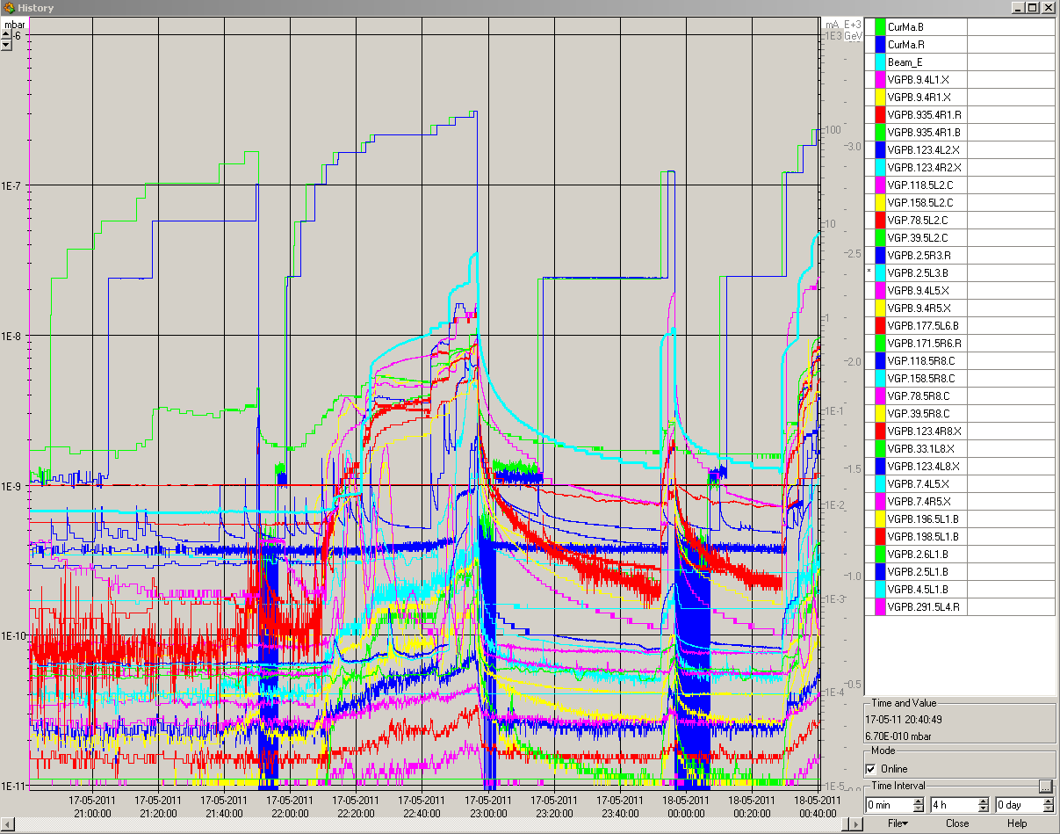
Injection setting-up (W. Bartmann, C. Bracco)

Slide 9
Pending
TI2 – TCDI alignment? Needed for 144 bunches
Abort Gap Keeper: need another fine adjustment (1 Hour). It might imply limiting the last injection bucket 31171?
Loss maps at injection: Vertical and off-momentum for B1
Change acceleration rate for RF frequency trims to minimize transients for high intensity
Update of the OFSU (need a test ramp afterwards) ➔ not urgent

Slide 10
Plan
Day:
TOTEM/ALPHA roman pot beam based alignment
Evening:
Change acceleration rate for RF frequency trims to minimize transients for high intensity
Loss maps at 450 GeV
Night:
Fill for physics with 768 bunches (trains of 72 bunches)
Tomorrow:
TCDI alignment
AGK fine adjustment
RE-visit injection of 108-144 bunches and inject up 1200 – 1380 bunches

