Slide 1
Saturday 7th May
Machine Status: OK
Sat – Sun night
2 hours lost due to linac 5 V power supply problem
03:45 Start 2. ramp for collimation
05:20 Dumped beam from collimation
RF getting the beams ready in the SPS
06:00 Ready to inject for RF multi-bunch instability MD
QPS OK MB.A28R4 lost – checked
06:40 RF MD going, getting the right beams in the SPS
There seems to be some features with the tune as seen by the BBQ. It seems that there is an influence from an external source at 0.43 *frev
08/05/2011

Slide 2
Saturday 7th May
MD Status: Also OK ->
Summary from Ralph
Day | Time | MD
Sat | 04:00 | 0.45 TeV: Investigation on CODs
Sat | 10:00 | 0.45 TeV: ATS (including cycle to new injection settings)
 | 20:00 | 0.45 – 3.5 TeV: Nominal collimation, single bunch tune shift
 | 04:00 | Ramp down, cycle
Sun | 06:00 | 0.45 TeV: RF multi-bunch instabilities
 | 10:00 | 0.45 → 3.5 TeV: Coupled-bunch instability rise times
 | 18:00 | Ramp down, cycle
 | 20:00 | 0.45 → 3.5 TeV: Quench test in the DS of IR7
Mon | 06:00 | Technical Stop
Lost | 6h | 3.5 TeV: Tune scan – beam-beam optimization, lifetime, losses
08/05/2011

Slide 3
0.45 TeV: Investigation on CODs
Nuria, Matteo, et al
Investigation done on the following CODS:
1 - RCBYHS5.R8B1
2 - RCBYV5.L4B2
3 - RCBYH4.R8B1
4 - RCBYHS4.L5B1
5 - RCBCV8.L1B2
Procedure:
Bump with each of the correctors observing leakage to machine.
Data acquired at 25Hz has to be analyzed online, but some hints suggested good results (especially the corrector 2 showed a large dynamic response).
Further analysis has been done on correctors 1 and 5 sending a sinusoidal current at different frequency.
Results to be analyzed. Ongoing.

Slide 4
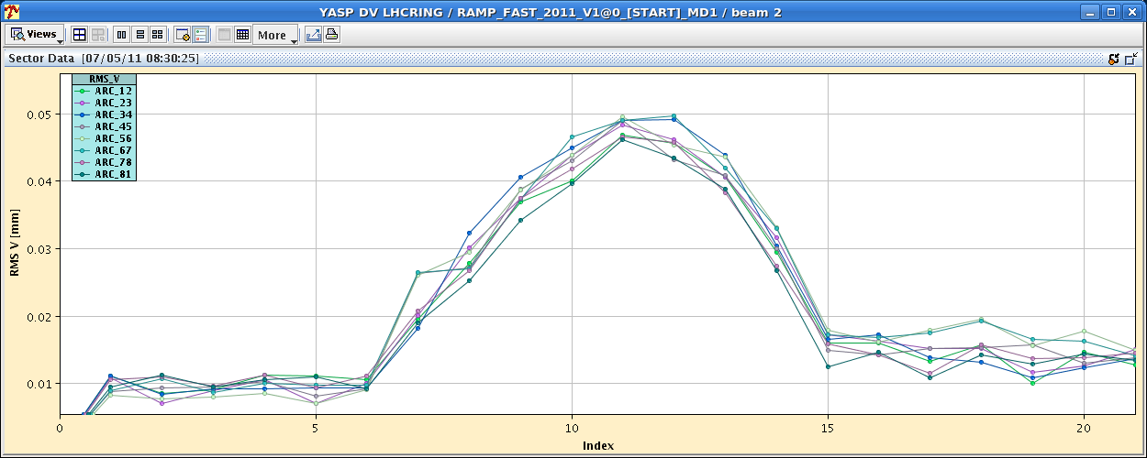
0.45 TeV: Investigation on CODs
Nuria, Matteo, et al
Dynamic orbit effect while ramping bump with correctors.

Slide 5
New ATS Optics
S. Fartoukh et al
New injection optics (ATS optics) tested and ramped successfully up to 3.5 TeV
crossing scheme off (TCT, TDI, TCLI opened with probe beam
successfull inject and dump test
damper new settings OK (with new phases of the ATS optics)
no emittance blow up during the ramp
new integer tunes measured at injection 62/60 (instead of 64/59)
CO, tune, coupling, chromaticity measured and corrected at injection and flat top
new tune, chroma and coupling knobs operational
orbit and tune feed-back successfull during the ramp.
beta-beat measurement
30% at injection, 10-15% at flat top w/o any specific correction
H and V dispersion measured
H: +/- 50 cm (compared to 2 m) for Dx at injection, +/- 20 cm at flat top.
V: 15-20 cm peak at injection, about 10 cm at flat top.

Slide 6
New ATS Optics
S. Fartoukh et al
Next steps:
inject and ramp with crossing scheme (170 murad, 2 mm in all IP's kept constant during the ramp).
pre-squeeze to bstar=1.2 m w/o crossing scheme.
measure/correct the off-momentum beta-beating, and non-linear chromaticity.
switch on the crossing scheme at bstar=1.2 m and measure/correct the spurious dispersion.

Slide 7
ATS New Injection Orbit – Ramp

Slide 8
ATS New Injection Orbit – Dispersion

Slide 9
Nominal collimation, single bunch tune shift
Initial blow-up tests with transverse damper.
Injection scraping during short delay from injectors.
Nominal 3.5 TeV collimation settings achieved for b1 &b2:
TCP = 5.7 sigma (nom)
TCSG = 6.7 sigma (nom)
TCLA = 9.7 sigma (nom)
TCSG-IP6 = 7.2, TCDQ-IP6 = 7.7 sigma (nom)
Octupoles trimmed to 350A for beam 1.
For b1 moved towards nominal 7 TeV settings. Limited by TCSG losses close to IP7. Valid setup reached:
TCP = 4.0 sigma (nom) (equiv. to 7.TeV nominal 5.7sigma)
TCSG = 6.0 sigma (nom)
TCLA = 8.0 sigma (nom)
TCSG-IP6 = 7.0, TCDQ-IP6 = 7.5 sigma (nom)

Slide 10
Nominal collimation at 3.5 TeV
Smallest gap: 2.2 mm
Beam lifetime: > 100 hours
Tune shift measured: ~3e-4
Efficiency measured: 3e-5 – 1e-4

Slide 11
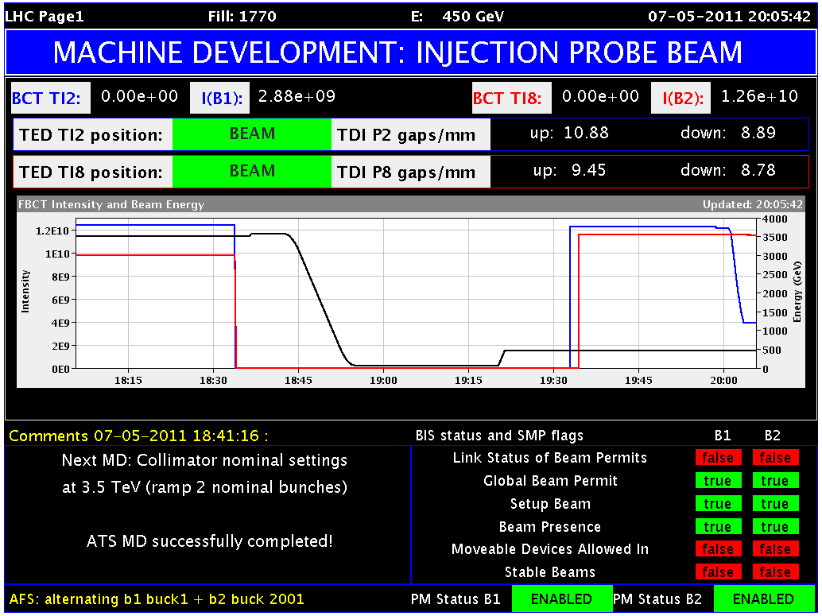
Blowup Test Transverse Damper

Slide 12
Settings b1 first loss-maps

Slide 13
Settings b2 first loss-maps

Slide 14
Lifetime small collimation gaps

Slide 15
Vertical tune shift – collimator movement
Clearly seen in vertical plane when moving collimtors out by 4 sigma and back in, etc…
Magnitude: ~0.0003

Slide 16
Efficiency measured – here b1, horizontal
4e-5

Slide 17
Nominal collimation
Tune shifts of the order of 1e-4 to 3e-4 could be observed at flat top when synchronously moving a fraction of the collimators from nominal settings by 4 sigma.
The tune signals were again very noisy and drifting, and both damper gains and octupole currents should be lowered to increase the signal/noise ratio.
However, the signals were clear enough during the first ramp in the vertical plane and there was no time to observe in real time during the second ramp, so that we did not try to decrease these gains that could have jeopardized the loss maps.
Many thanks to the OP teams for their help and very quick reaction to the several issues that occurred during the MD!
Conclusion from second ramp: Tight settings, very close to 7 TeV settings, have been qualified for B2. In B1, larger retractions between primary and secondary colliamtors are needed (2 sigma worked).

