Slide 1
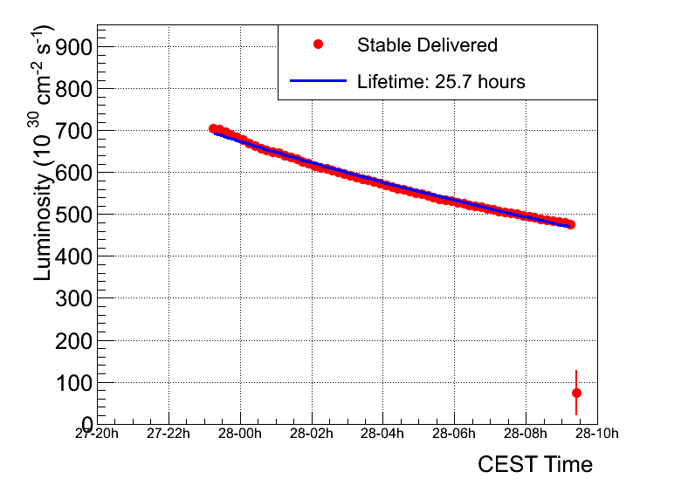
Fill 1743
Peak luminosity | ~6.7 e32
Integratated lumi | ~20 pb-1
Stable beams | 10 hours 2 minutes
Colliding bunches | 598
Average emittance from lumi | 2.6 micron

Slide 2
Friday 29th
11:00 Dump #1745
26 pb⁻¹ in 13 hours 22 minutes
We then ramped down and prepared for the access for: - QPS to fix a controller, down because of a SEU during the night; - LBDS team profited to do some local pulsing to check degradation of contacts; - R. Steinhagen profited as well to access UX451 to replace a faulty board on the BBQ. Unfortunately, following the QPS intervention, we lost the sector 45 and we had to precycle it.
15:15 Beam back

Slide 3
Friday afternoon - AGK
15:30 LHCb Dipole tripped due to power glitch.
For B2 scanned buckets 31181, 31183, 31185 and 31187. Beam entered each injection for the first 3 buckets. The delay between the AGK window and the beam, as measured on OASIS, was within the resolution of the measurement which is 25 ns.
For bucket 31187 two injections were stopped by the AGK and one entered, so this is the limit at the bucket. B1 was not tested as the machine became unavailable due to another power glitch. Conclusion: AGK for B2 (which had the missing pre-pulse on 27/04/2011) seems to be fine and has a margin of 5 * 2.5 ns = 12.5 ns which should be sufficient for the system to be reliable. No changes relative to initial set-up on 11/03/2011.
Etienne Carlier, Jan Uythoven

Slide 4
Friday atfternoon
16:45 Power glitch...ALICE both magnets, ATLAS both magnets and RF tripped. Lost 6 sectors and the undulator R4.
Pick-up the pieces
21:25 beam back – dynamic correction of b3 decay on flat bottom in shadow of Atlas ramp-up
The FIDEL trimming kept the chromaticity stable at the values it was adjusted to.
The injection plateau with b3 correction on was then followed by a test ramp with chromaticity measurement.
Chromaticity trimmed during snapback
Looks good

Slide 5
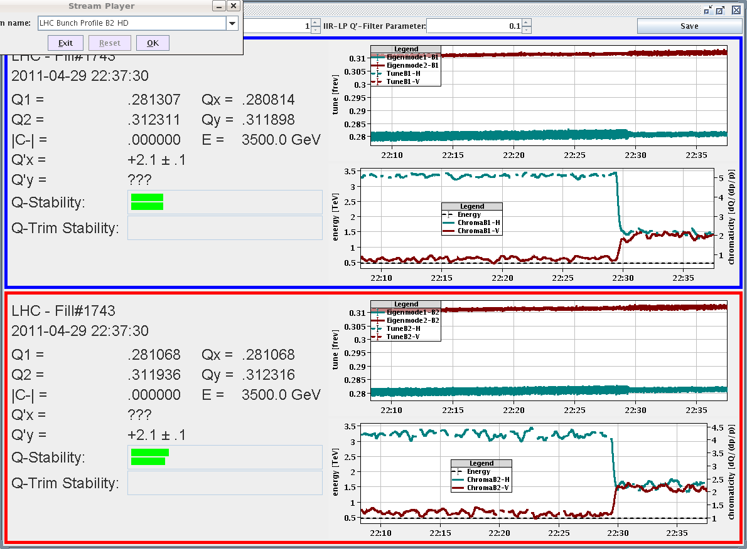
Chromaticity at 450 GeV
Marek Strzelczyk

Slide 6
Friday night
Back round for physics
“We had put chroma to 2 before the ramp last fill and it came back at about 2. Brilliant!!.”
02:28 Ramp started
Beams dumped just before the flat top, vacuum triggered... Vacuum valves closed. Lifetimes were very good at the time though. Losses only in pt 6 due to the dump. Dump was clean and XPOCs are happy.

Slide 7
Vacuum – point 2
The valves closed as we exceeded the interlock pressure of 1e-6... one of the measures could be to increase the interlock level and then it might be that the dumps would be triggered by the BLMs rather than the vacuum.
Interlock level increase to 2e-6 in all triplets Switched on the solenoids in point 2.
Giuseppe Bregliozzi Giulia Lanza

Slide 8
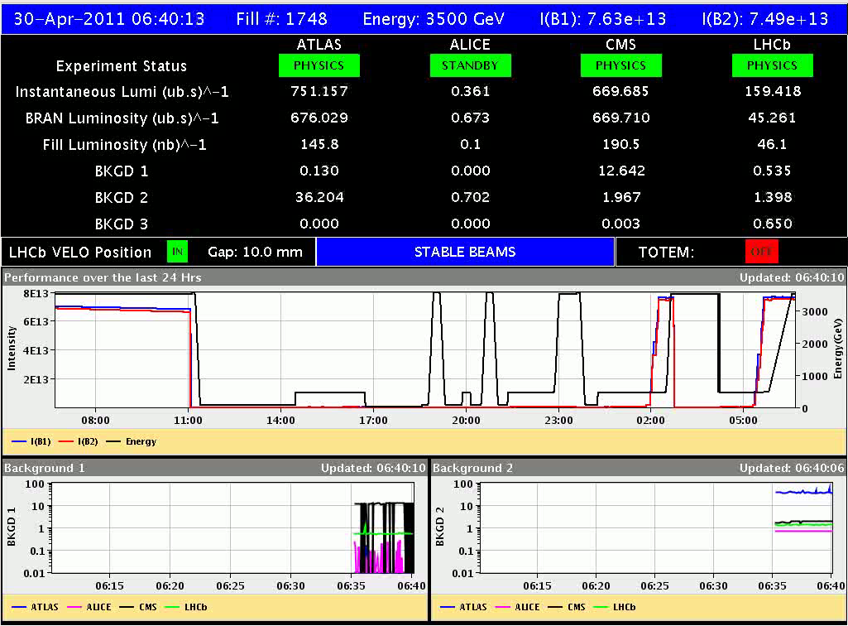
1748
Lost around 08:20 to Octupole power converter trip

Slide 9
Friday night… follow-up
Additionally: - RF modulation amplitude is tricky to set in the tune viewer; - chromaticity measurement depends on RF modulation amplitude, measurement with dp/p=0.0002 seems to be correct, but not with 0.0004; - a couple of BQMLHC acquisitions missing while injecting, delayed acquisition by one turn; - MKI in IQC bad once for b2, minorly; - QFB did not go on once when set with the task, no errors returned; - plenty of problems with communication/DIP servers: energy plots on page 1 are wrong and we optimized the experiments on the BRAN signals/on the phone; finally a restart of DIP-SERVICES seems to have sorted it out (after having restarted half of diamon CMW services); - had to remove one BPM (b1h, around IP1) with unreasonable values; - done one reset on XPOC2 (bad filling pattern).
Giulia Papotti

Slide 10
Incoming
One or two more 624 bunch fills
Probably step up to 768 Sunday morning

