Slide 1
LHC Status Thu Morning 28-April
B. Holzer, Mike Lamont et al
1.) ... 07:07h luminosity, collisions 480 x 480 bunches
2.) 07:08h Cryo – Problem, turbine lost in S 78
beam dump, ramp down
08:30h ATLAS access request
in the shadow... access for TCTH.4L1.B1 and TCTVA.4L1.B1: motor controller
09:35h Cryo ok .. waiting for ATLAS
3.) 16:05h injection b3 decay compensation
4.) 19:00h loss maps at injection
5.) 20:00h injection 624 bunches: problematic fill pattern
6.) 24:00h 624 x 624 bunches: lumi

Slide 2
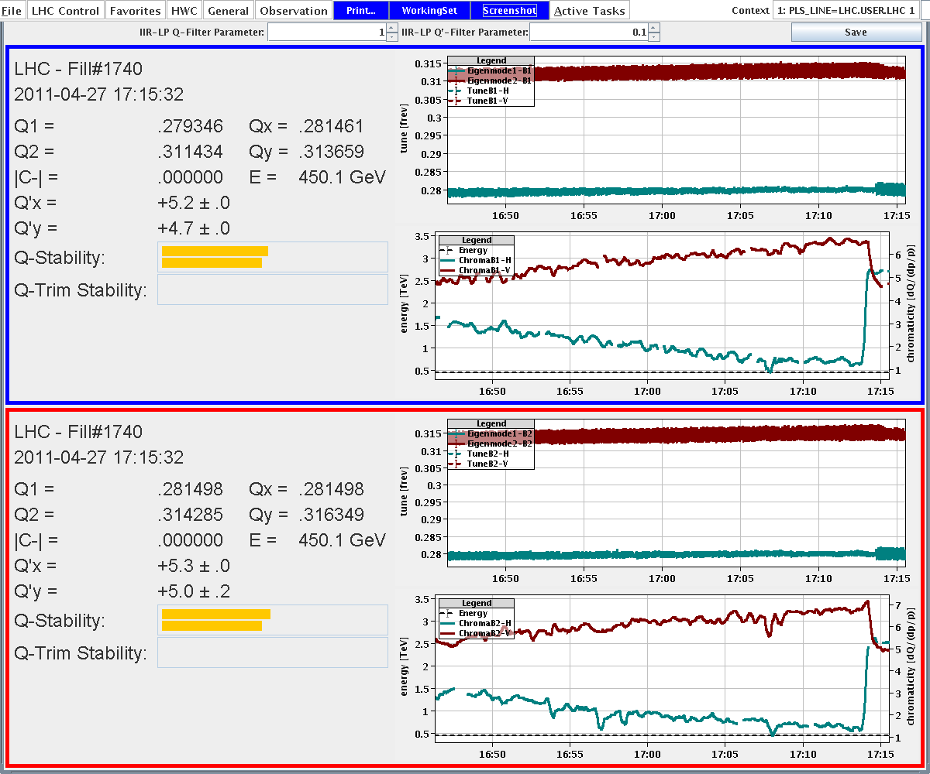
Wednesday Morning:
persistent current decay compensation
tunes: stable
chromaticity: needs further investigation

Slide 3
Wed Late: injection for 624 bunches
on the very last injection (72 bunch transfer) we get ...
Both beams dumped, probably on the TDI, MKI did not kick.
BLMs have been red for a while.
Problem: injection into bucket 31181 is prohibited by the abort gap keeper..... ???
after the missing MKI kick, we tried to inject probes in bucket 31181, and they passed
(For kicker experts to follow up);

Slide 4
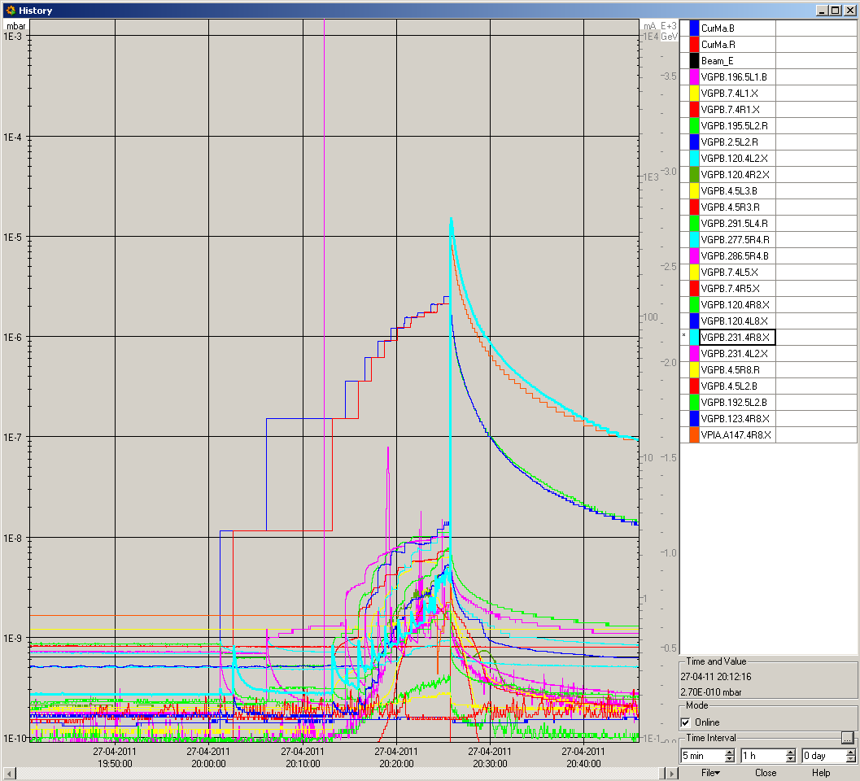
Wed Late: preparing for 624 bunch operation
injection kickers blocked
by abort gap keeper
10 ⁻⁵
nice spike in the vacuum
but should the valves close ?

Slide 5
Wed Late: preparing for 624 bunch operation
new filling scheme: last batch 50 ns earlier
23:00h inject, ramp, squeeze, collide.
... very smooth behavior
lifetime from 450 GeV to 3.5 TeV τ ≈ 25 h

Slide 6
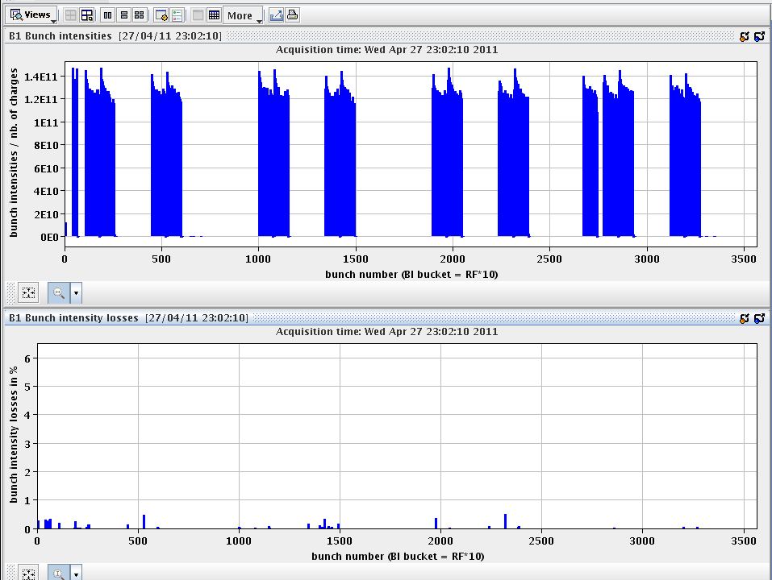
losses on ramp

Slide 7
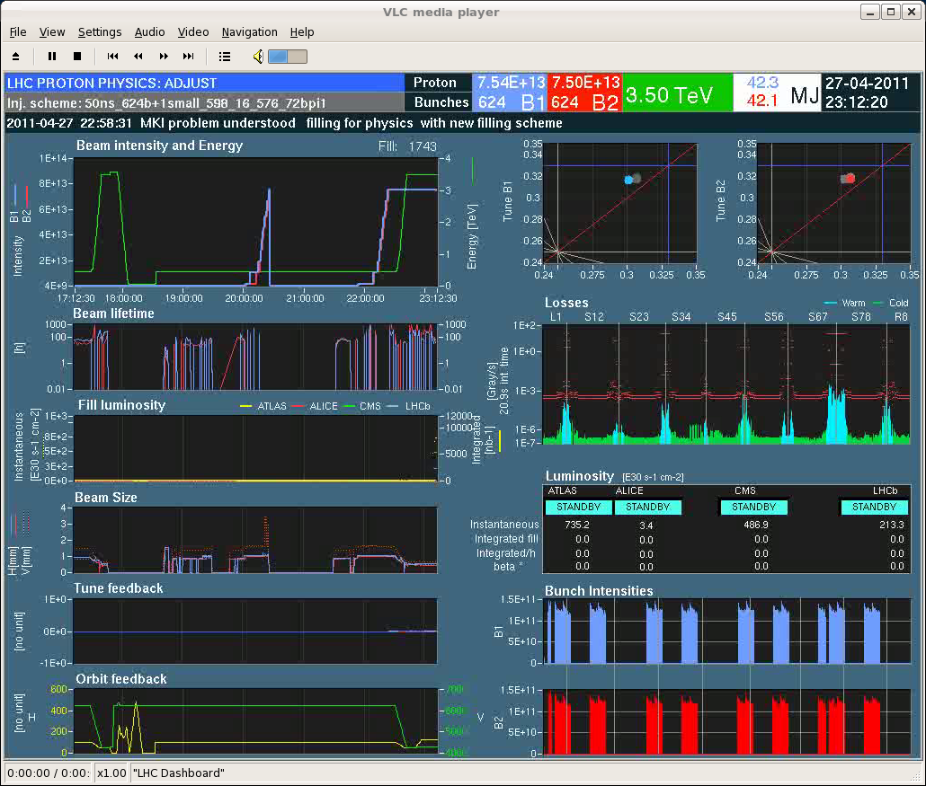
stored beam energy
... needless to mention ?

Slide 8
bunch intensity distribution
bunch emittance
distribution after 6h run

Slide 9
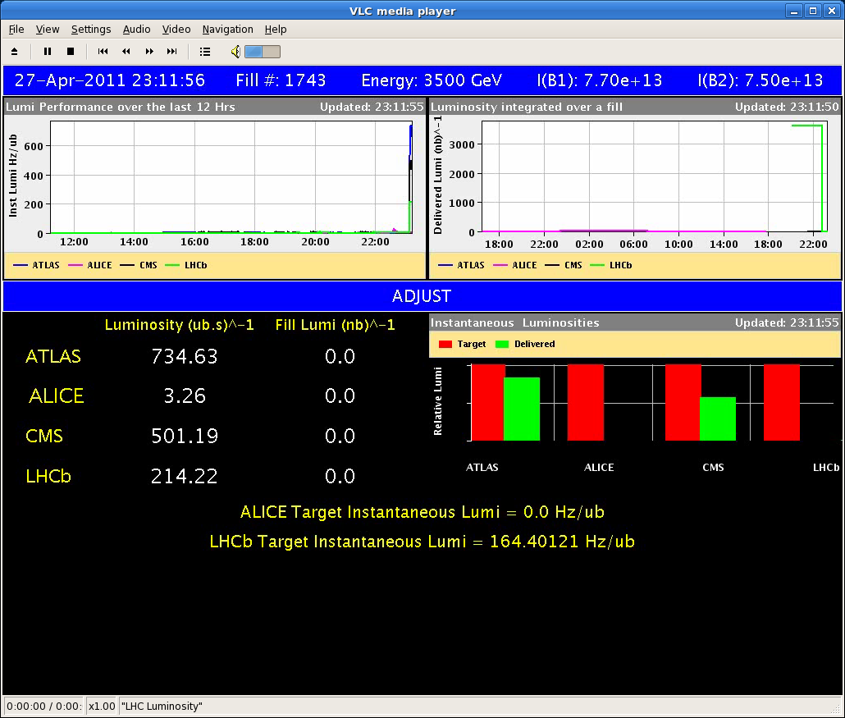
luminosity

