Slide 1
Saturday 23/4
09:30 Important blow-up during filling due to large drift in chromaticity. Dump and re-fill.
10:20 Beam 1 kicker not firing due to missing pre-pulse. Beam (36 bunches) on TDI cleanly
12:30 Stable beams #1732. 480 bunches/beam. Initial luminosity up to ~5.2x10³² cm⁻² s⁻¹ (ATLAS)/~4.8x10³² cm⁻² s⁻¹ (CMS).
06:20 Power glitch. End of fill #1732
Close to 24 pb⁻¹ in ATLAS after almost 18 hours in physics.
Integrated 25.6 pb⁻¹ in one day.
We are now at 132 pb⁻¹ delivered.
We are now recovering (6 sectors tripped)

Slide 2
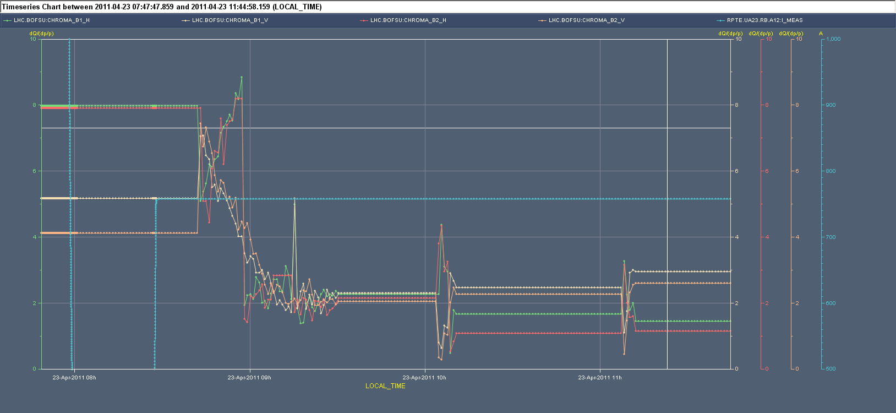
Chromaticity decay
After 1.5 h form injection field still drifting by +2.5/hour H and -2/hour V

Slide 3
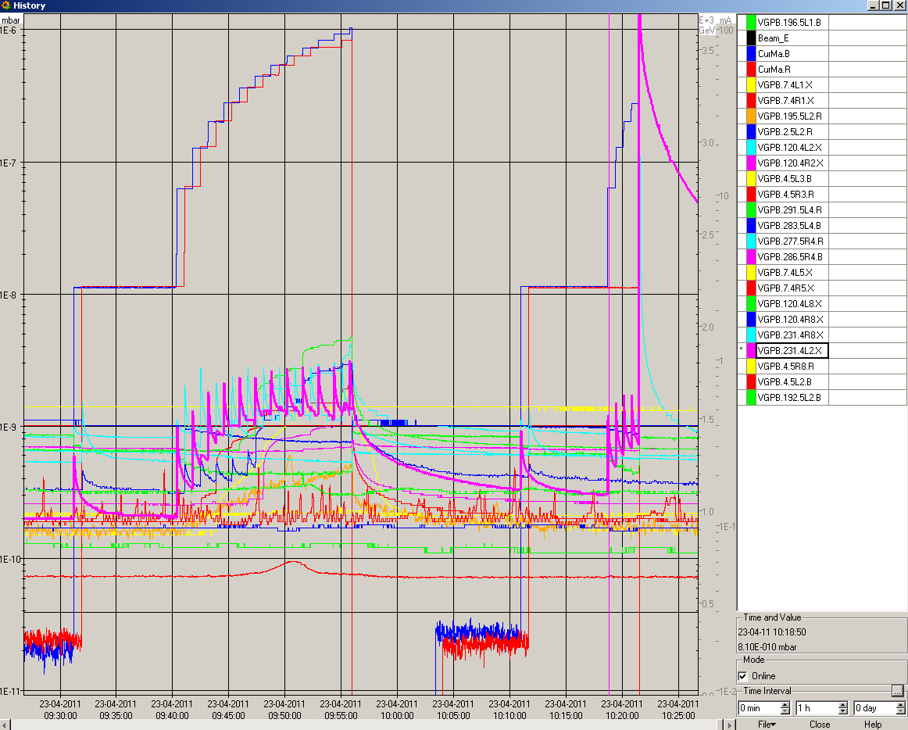
Failed injection
Missing pre-pulse form LHC RF distribution while injecting Beam 1 only ➔ logging going to be implemented to understand behaviour in the future
Beam (36 bunches) on TDI ➔ ALICE detector triggered the beam dump+BLMs
Vacuum valves closing near to TDI due to outgassing. Fast recovery.

Slide 4
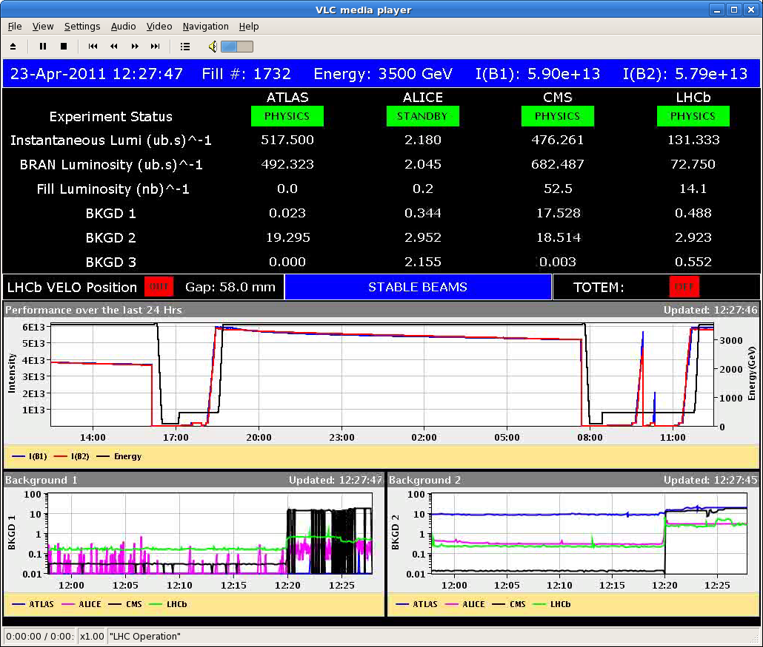
#1732
>0.5 x 10³³ cm⁻² s⁻¹

Slide 5
#1732
Need tight control of the chromaticity at injection within 2 units
Reason for tighter limits as compared to scrubbing not clear, yet:
Different filling pattern?
Operation of the damper to be optimized?

Slide 6
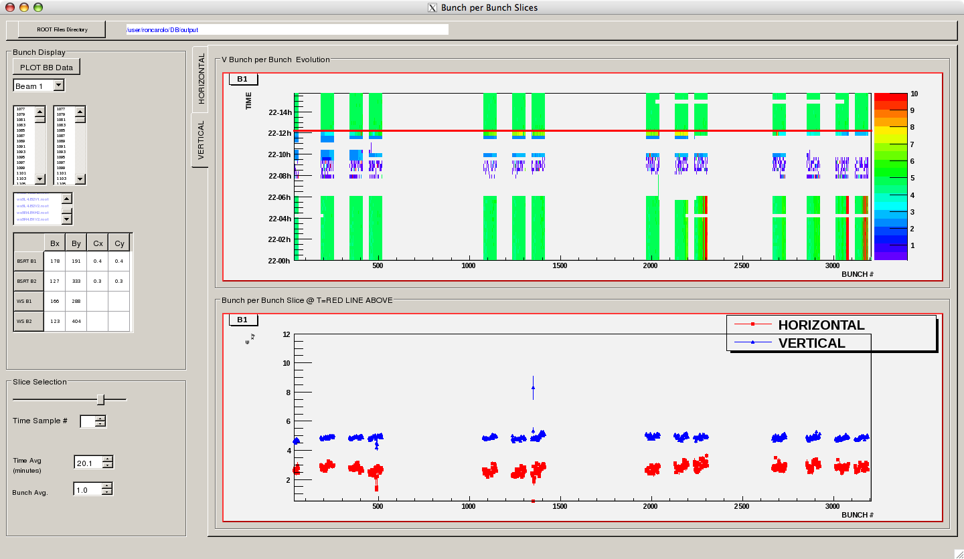
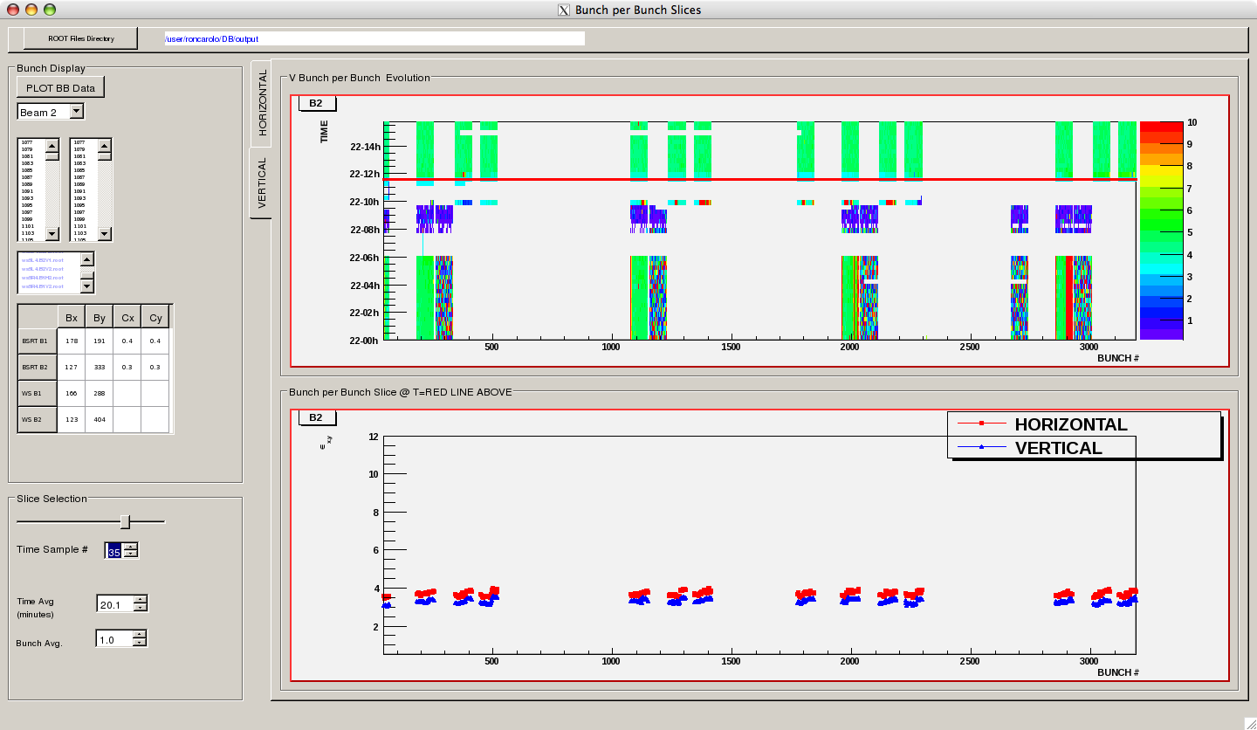
#1732
No blow-up along the trains

Slide 7
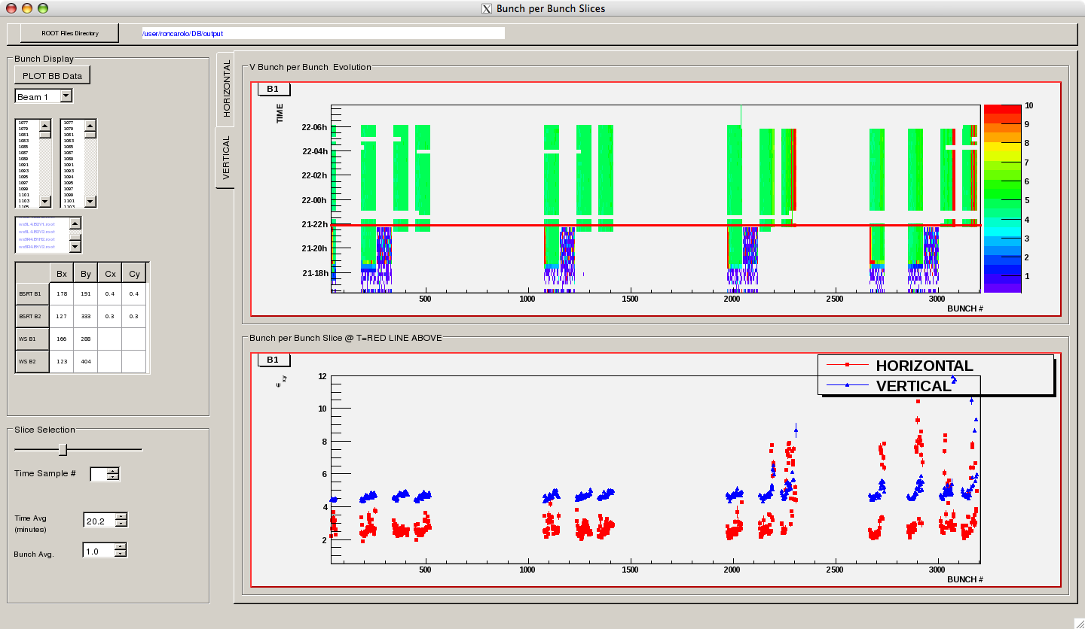
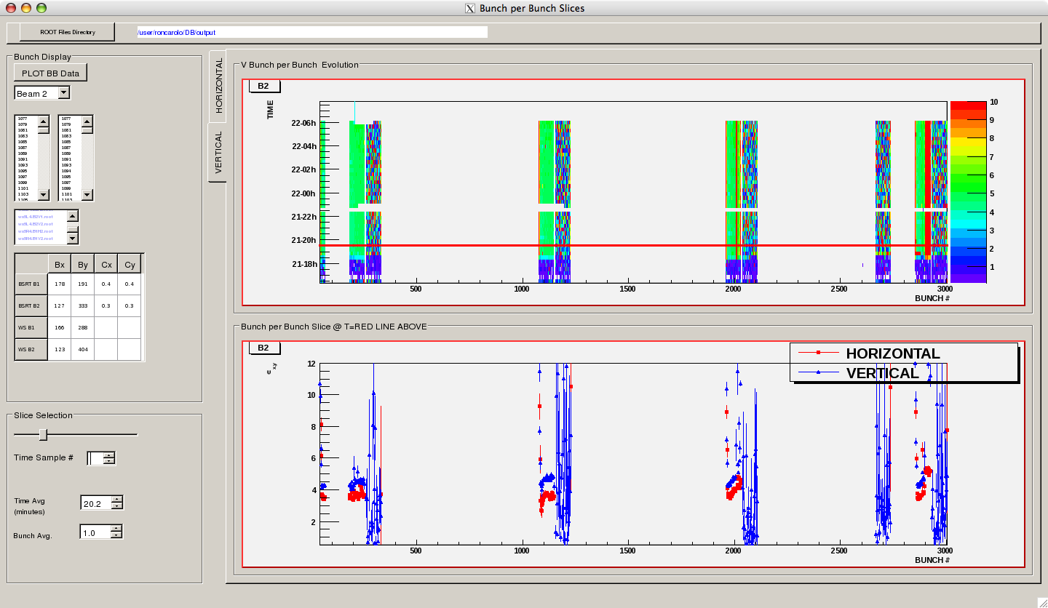
#1731
Blow-up observed along the trains responsible for the poorer performance

Slide 8
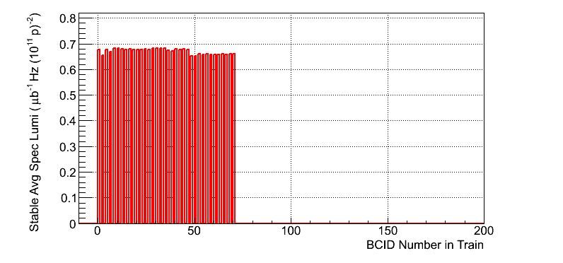
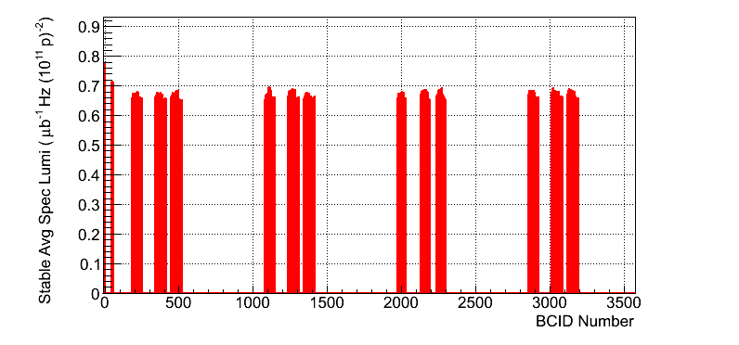
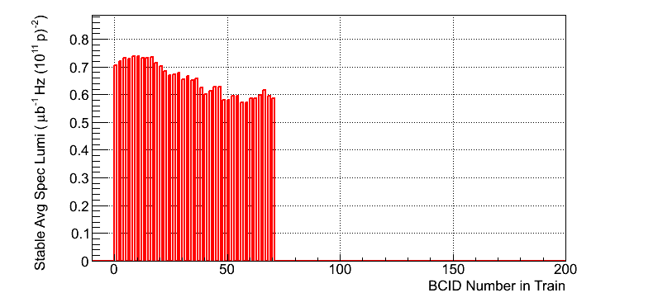
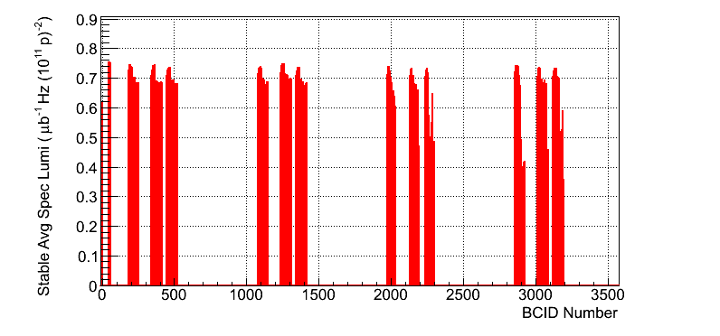
#1732 vs. #1731
ATLAS:
1732
1731

Slide 9
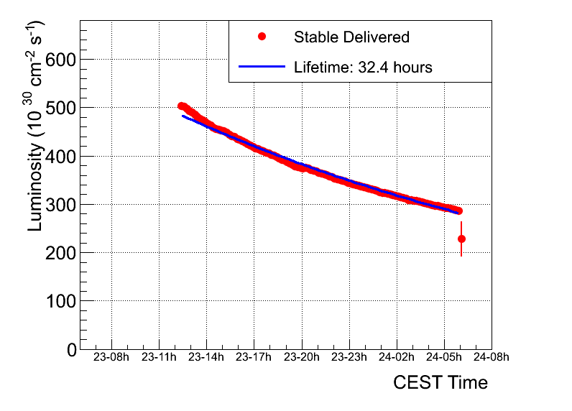
#1732

Slide 10
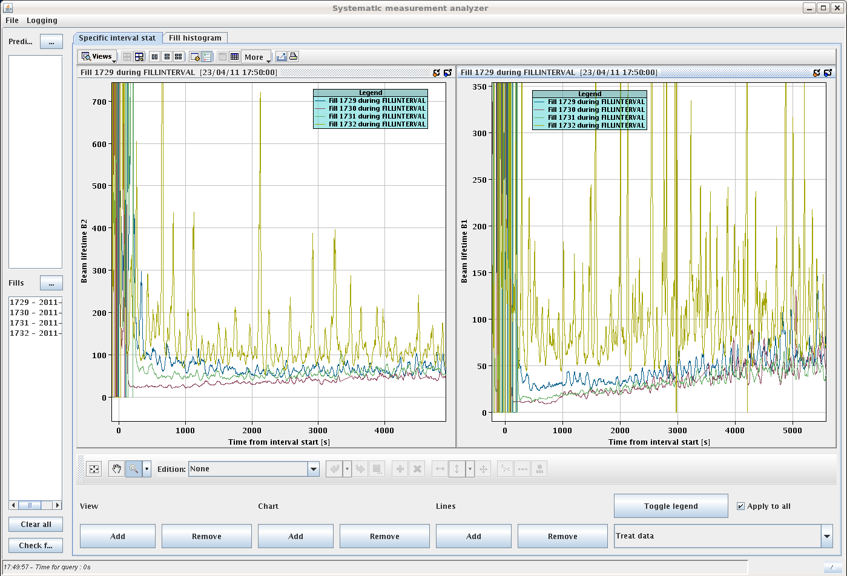
Beam lifetimes
Tested effect of the octupoles on the beam and luminosity lifetime. No clear sign observed.

Slide 11
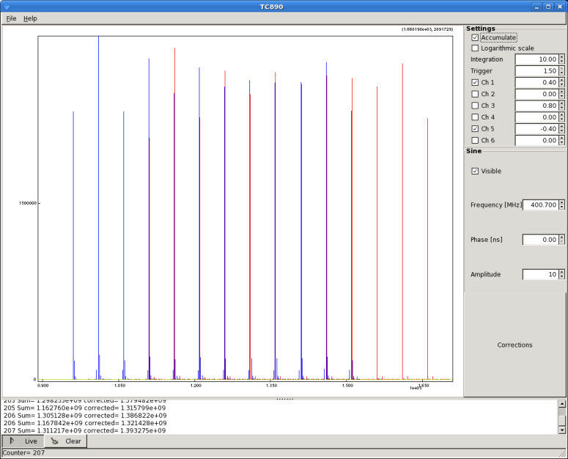
Satellites and intensity distribution
After adjustment of the extraction kickers in the PS yesterday no satellite visible after the 12/36 bunches train (should be the case for fill 1732). Some satellites close to main bunches (~10 ns?)
Still some work to be done in equalizing bunch intensities

Slide 12
Plan
Fill for physics with 480 bunches (trains of 72 bunches)

Slide 13
Issues
Logging of pre-pulse distribution for injection by RF
BSRT ➔ stability of the pattern (take the BQM?) and fixed display

