Slide 1
Tuesday 19/4
11:10 End of Stable beams #1722 (336 bunches – 36 bunches/train) – ~6 pb⁻¹ in 5h 40. Now at ~61 pb⁻¹ deleivered at 3.5 TeV.
11:00 Cryo problem in point 8. PLC problem: Cold compressor trip. Vacuum pressure rise in the triplets in point 8 and 1L due to the temperature increase of the magnets ➔ to be watched out with higher intensity
12:00-18:00 Access in the machine and experiments
Restart Compensator in point 2
Equalization of the emittance of the bunches along the trains (Ring 4 PSB + injection in PS)
23:30 Cryo OK
23:30-03:30 – Recover and pre-cycle (2 ventilation doors open)
03:20-07:00 Loss map in collision (off-momentum -500 Hz)

Slide 2
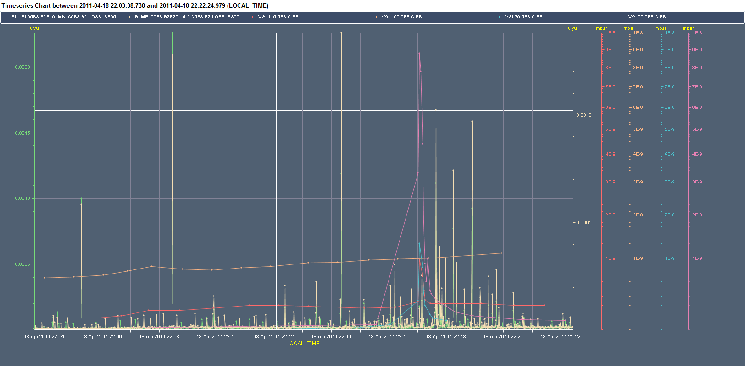
Vacuum and UFOs at MKI
No clear correlation

Slide 3
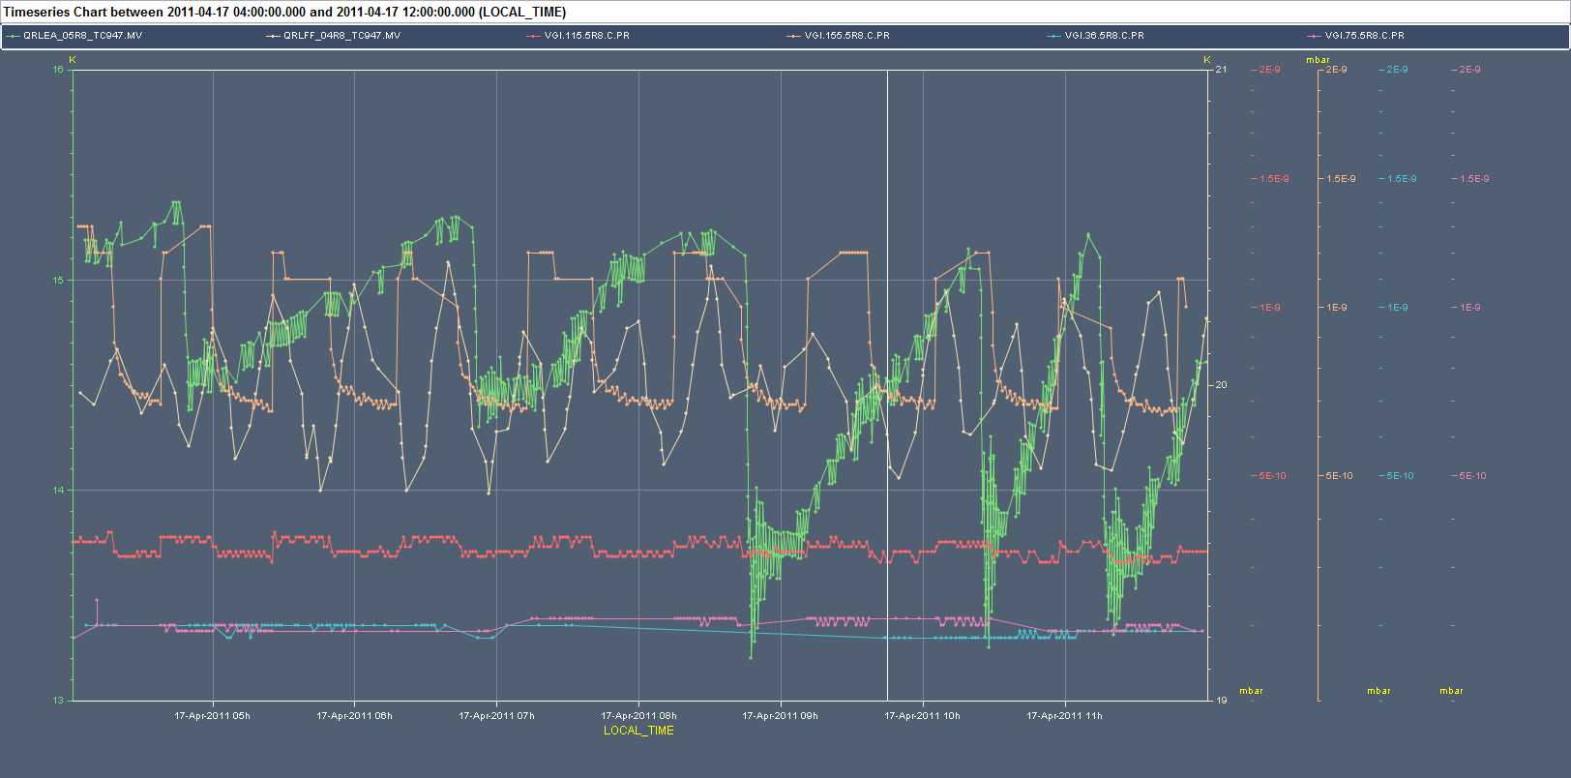
MKI vacuum and cryogenics
Oscillations in the BS temperature of Q4? Yes
BS_T_Q5
BS_T_Q4
VGI.155.5R8-MKI1
VGI.115.5R8-MKI2
VGI.75.5R8-MKI3
VGI.36.5R8-MKI4
BS_T_Q5

Slide 4
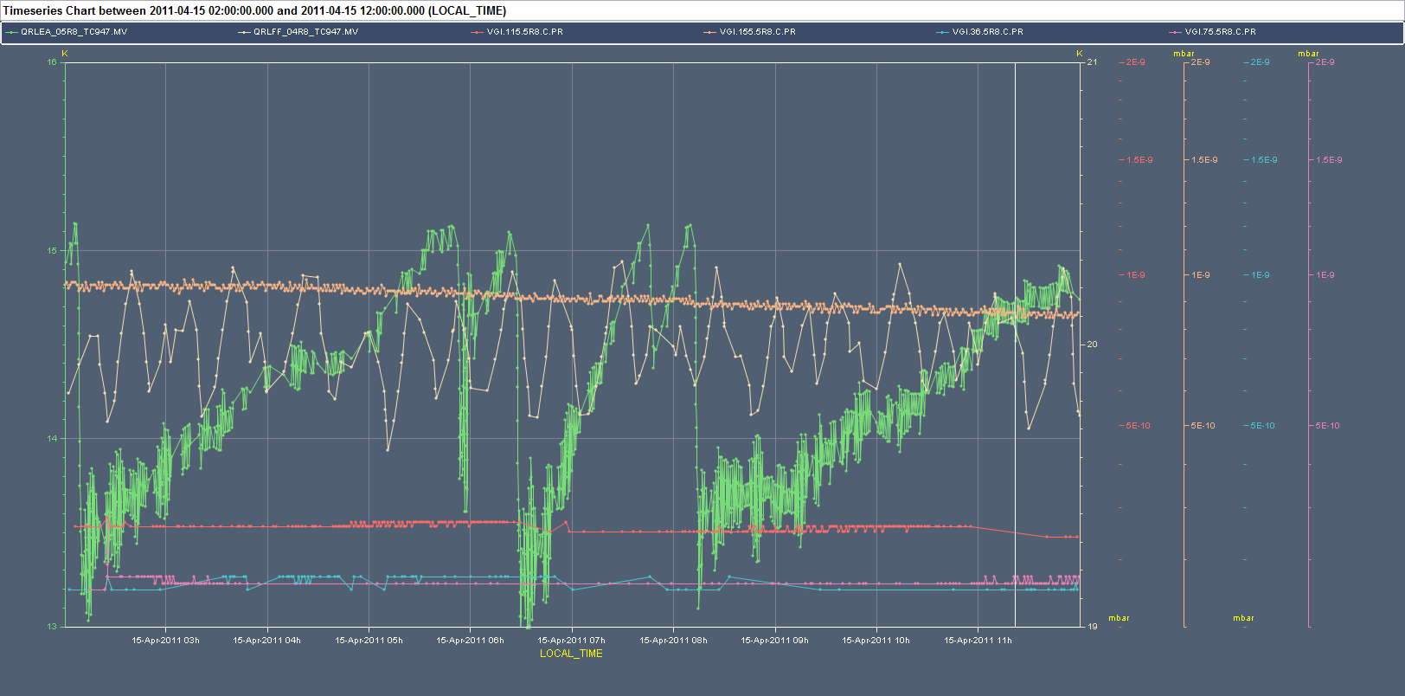
MKI vacuum and cryogenics
Oscillations in the BS temperature of Q4? May be
BS_T_Q5
BS_T_Q4
VGI.155.5R8-MKI1
VGI.115.5R8-MKI2
VGI.75.5R8-MKI3
VGI.36.5R8-MKI4

Slide 5
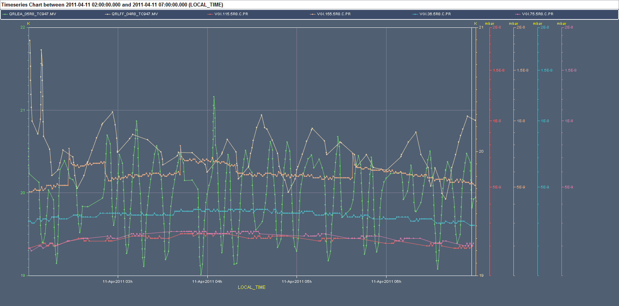
MKI vacuum and cryogenics
Oscillations in the BS temperature of Q4? No
BS_T_Q5
BS_T_Q4
VGI.155.5R8-MKI1
VGI.115.5R8-MKI2
VGI.75.5R8-MKI3
VGI.36.5R8-MKI4

Slide 6
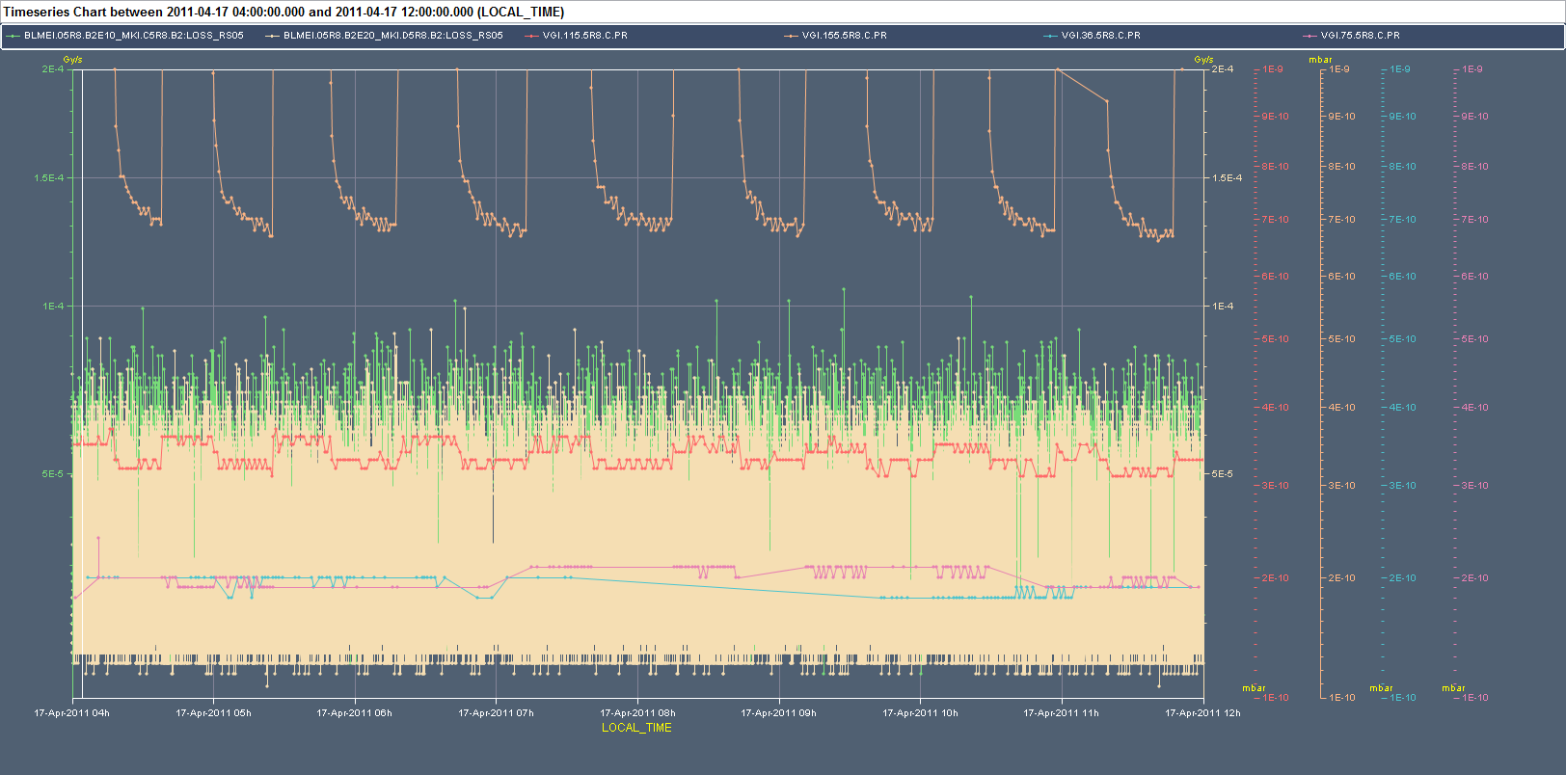
MKI vacuum and cryogenics
Correlation with losses. No
BLM_MKIC
BLM_MKID
VGI.155.5R8-MKI1
VGI.115.5R8-MKI2
VGI.75.5R8-MKI3
VGI.36.5R8-MKI4

Slide 7
UFOs and BLMs
Monitor factor of 4 MQY monitors in the injection regions from 0.3 to 0.5:
BLMQI.04L2.B2I20_MQY
BLMQI.04L2.B1E20_MQY
BLMQI.04R8.B1I20_MQY
BLMQI.04R8.B2E20_MQY
These monitors see the losses from the frequent UFO's in the MKI regions. (17.4.2011 at 03:58 one UFO was at 98% of dump threshold) The MQY BLMs do not yet have the new master thresholds, which allow for higher signals in the ms time range (for UFOs).
New master thresholds for MQY families will be applied at the latest during the next TS.
B. Holzer

Slide 8
Plan
07:00-10:00 TDI alignment and check of injection of 72 bunches (PS train spacing=225 ns)
10:00-16:00- Attempt to go in physics with 336 bunches and trains of 72 bunches
16:00 Ramp down magnets and prepare for VIP visit
VIP visit + access in Sector 34 for inspection on water leak in the tunnel vault
19:00 Patrol and recover
Night: Physics. Aiming for next step in intensity (480 bunches)

