Slide 1
Sunday morning
Recovering from 400 kV disturbance.
Access for QPS – QHPS on RB.23.
4 Collimators to be reset by piquet. As UPS was not lost, positions could be restored.
13:00-14:30: Loss map to check collimators.
A bit lengthy due to various little hick-ups.
Loss maps look OK.
15:00: Filling for physics with 72b per injection, intensity similar to previous fill.
800 MHz RF in SPS not locking. Very slow filling.
Signs of instability in first part of ramp, but losses OK.
16:30 Stable beams fill 1733.
Luminosity ~10% lower than previous fill.
Dumped by vacuum spikes in R8 after 10 minutes.

Slide 2
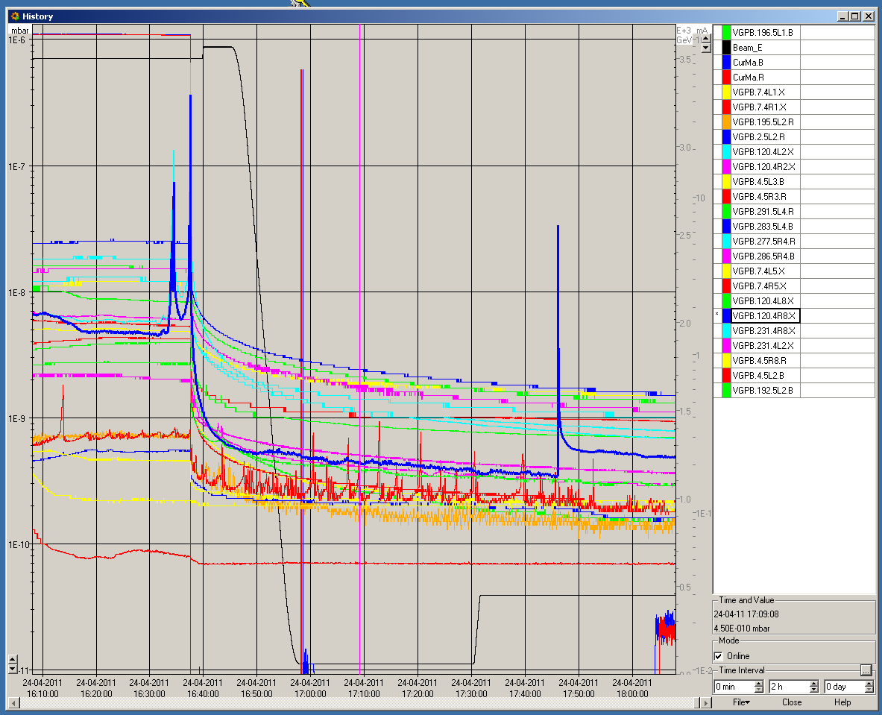
Fill 1733
‘Dumping’ spike
Spike during setup

Slide 3
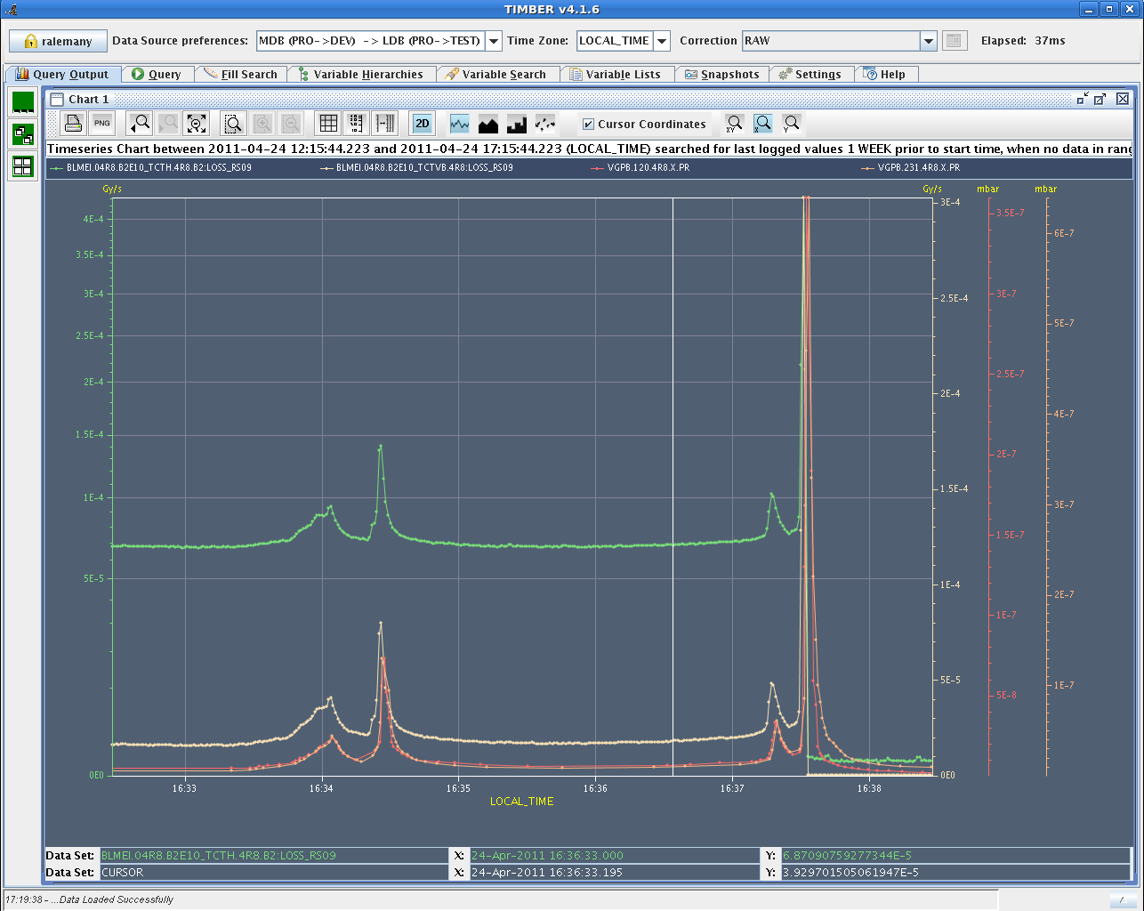
Correlation losses at TCTs and vacuum

Slide 4
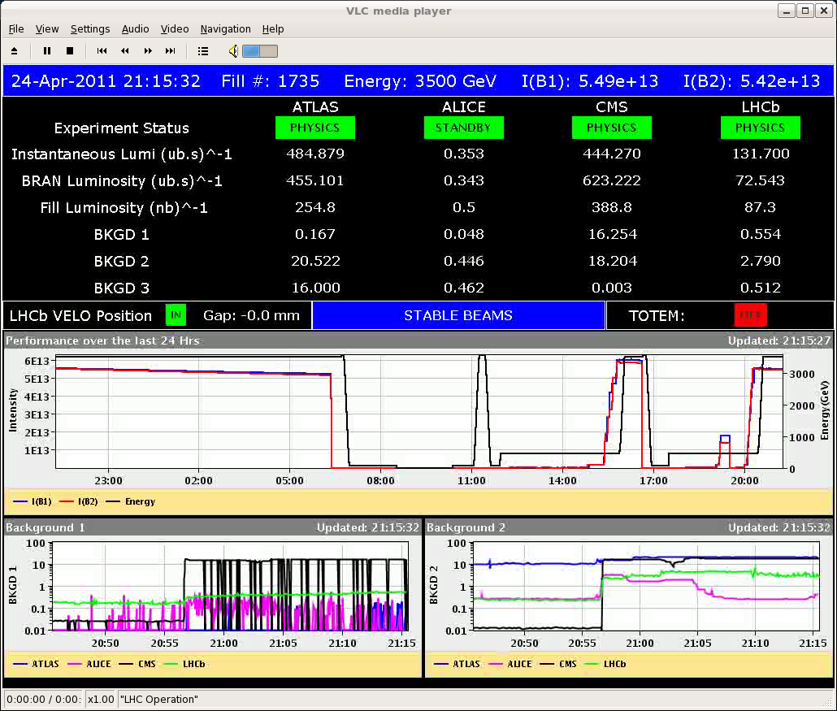
Sunday evening
19:30: Refill with 480 / 72 b per injection, drop intensity 10%.
Lower damper gain.
21:00 Stable beams fill 1735.
Despite lower current luminosity close to record.
Fast filling seems to have been beneficial for emittances.

Slide 5
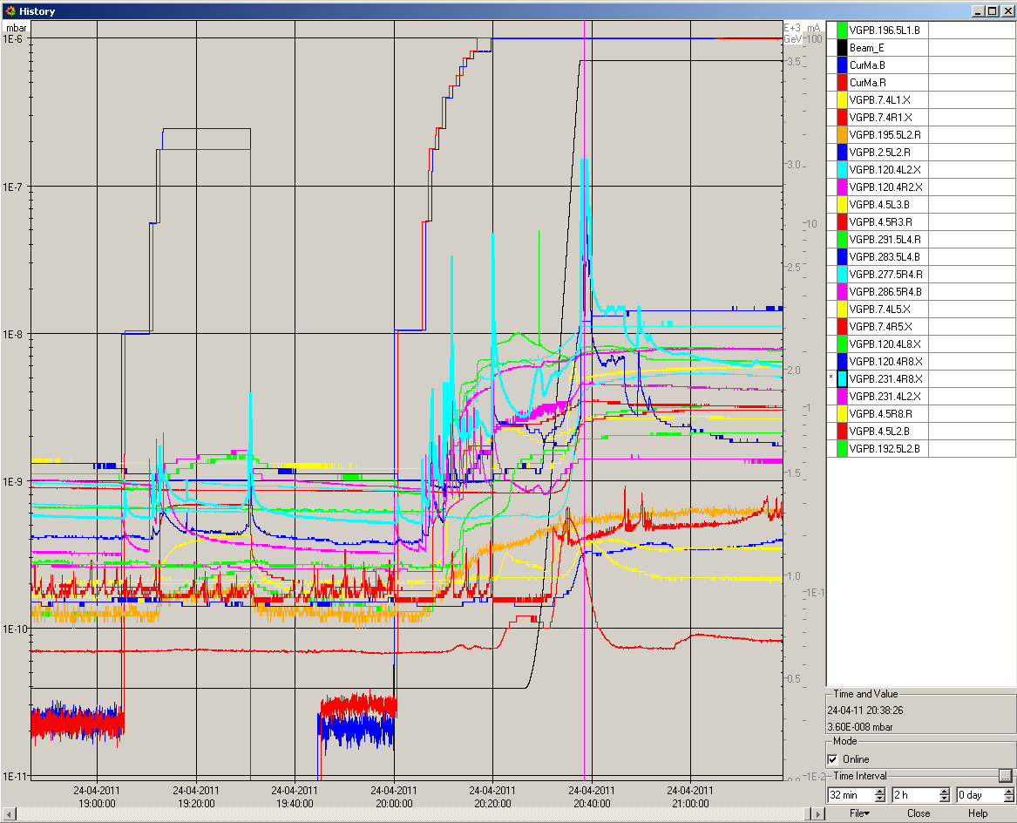
Vacuum fill 1735
Hypothesis of M. Jimenez : it is the gauges that out-gas (following the cryo problem in the previous week).
Interlock levels set temporarily to 4E-6.
Fill 1735

Slide 6
Today
Refill for Physics with 480b / 72b per injection.

