Slide 1
Monday – recovery from MKI flashover
Extensive re-conditioning of MKI8 in the morning.
Beam back midday.
Afternoon: IR8 TDI angular alignment (check).
Beam edge defined with TCP.
Move one of the TDI jaws into the beam with a given angle until beam is fully absorbed.
Repeat different angles.
Jaw aligned when the centre given by upper and lower jaw is minimum.
Results being analyzed...

Slide 2
Ramp, squeeze, loss map
Evening solenoids on around MKI2/8.
Little/no effect.
18:30: Ramp with 2 nominal bunches for loss map.
One injection (1 nom) dumped on TDI in IR2 – seems the injection timing event was not sent out, but the SPS extraction event was sent:
beam extracted and not injected. ALICE BCM trigger.
Ramp with feed-forward of RT trims (to reduce criticality of OFB).
¾ successful…see next slide.
Off-momentum loss map (dp/p < 0) – seems OK.

Slide 3
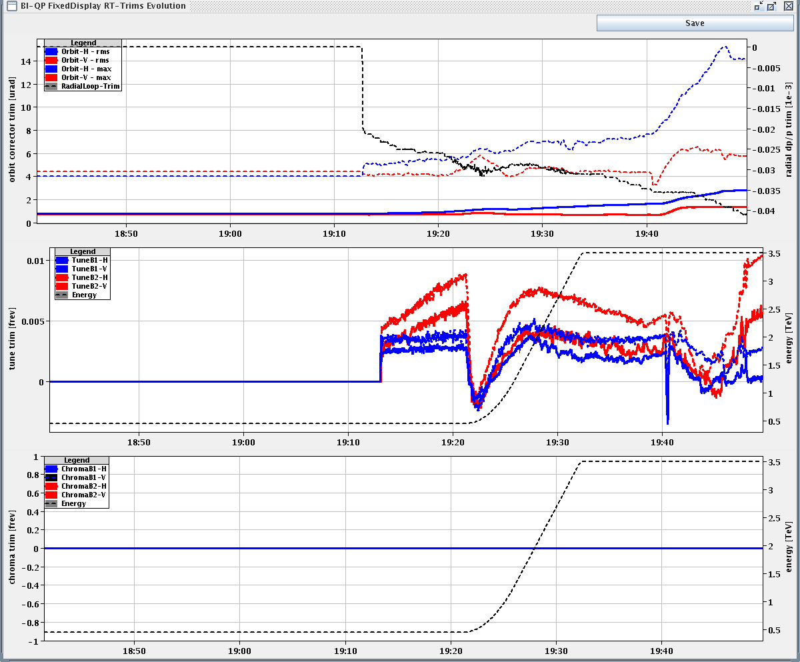
Ramp, squeeze, loss map
H plane not OK
in squeeze ??
V plane OK

Slide 4
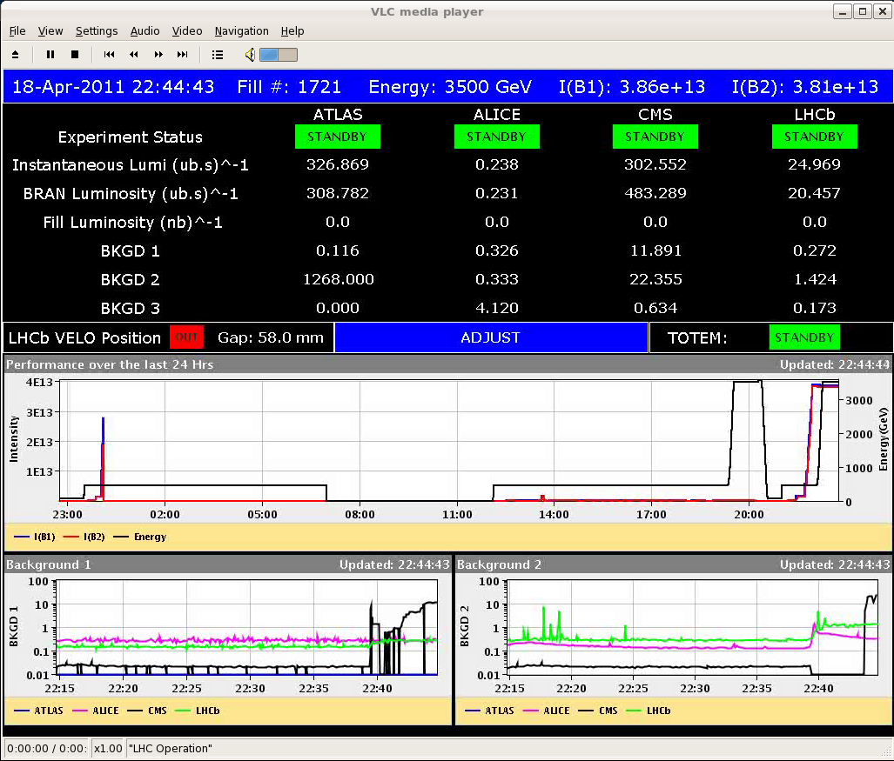
Filling for physics
Fill 1721, 336 bunches, 36 bunches/inj.
Bunch intensities ~ 1.15E11.
Dumped by SIS at 00:30. Interlock on HOM powers – lost communication.
1.7 pb-1.

Slide 5
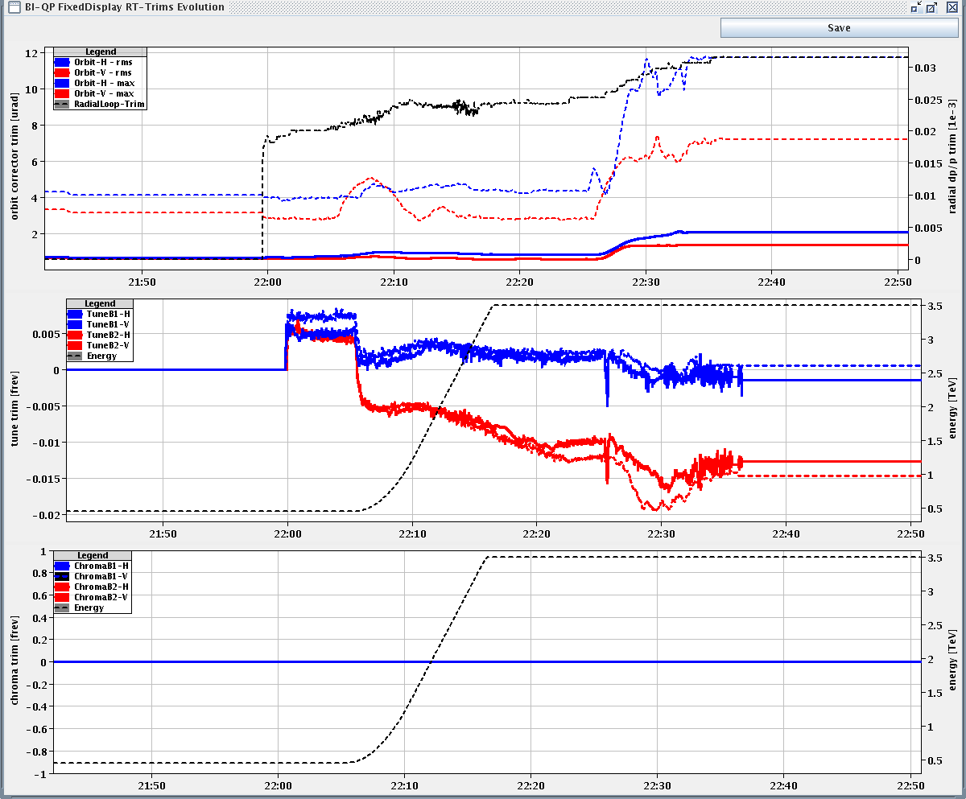
Ramp and squeeze fill 1721
Again large RT trims in the squeeze
Suspicion on parameters for correction (no. eigenvalues for SVD too large [from slowly increasing no. of bad BPMs]?).

Slide 6
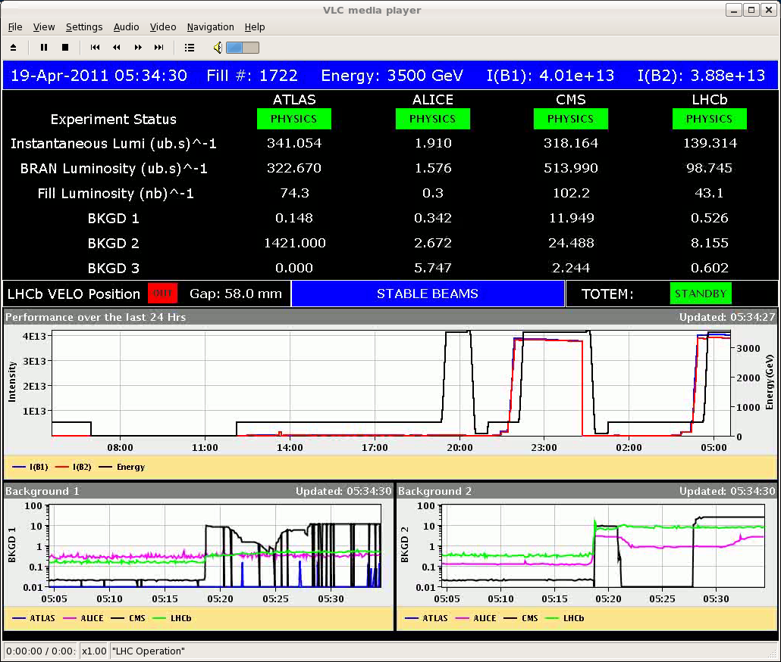
Filling for physics
01:30 TOTEM interlock, crate power off.
Fill 1722, 336 bunches, 36 bunches/inj.
Bunch intensities ~ 1.15E11.

Slide 7
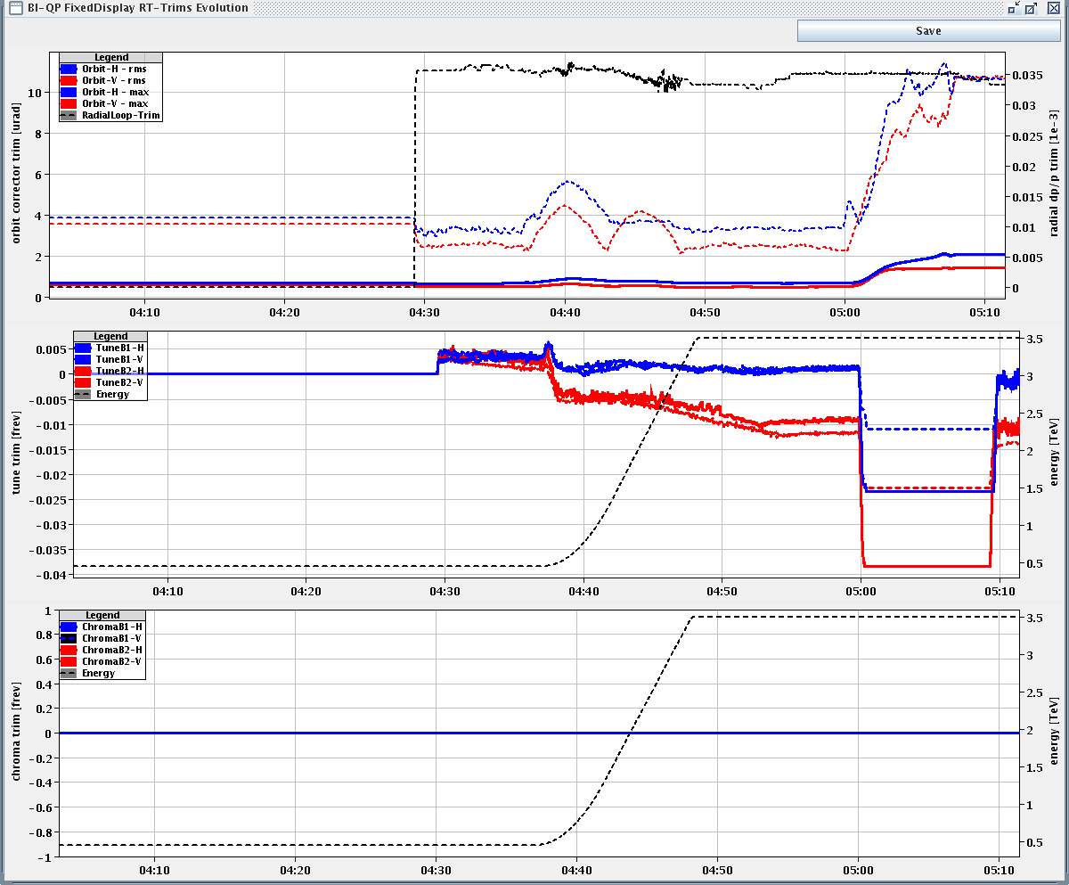
Ramp and squeeze fill 1722
Again large RT trims. In the squeeze.

Slide 8
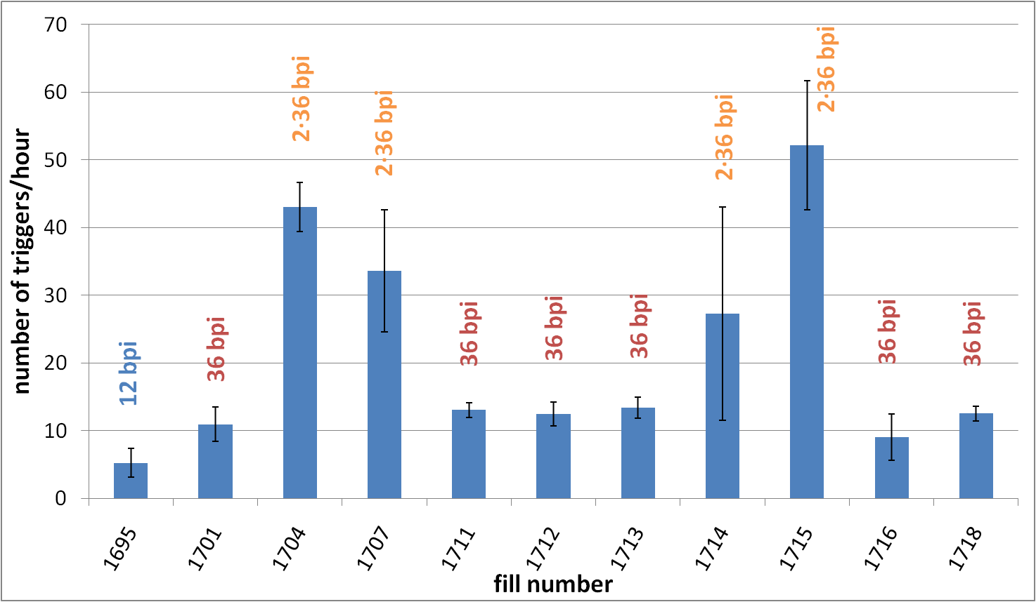
UFO rates in recent fills
T. Baer

Slide 9
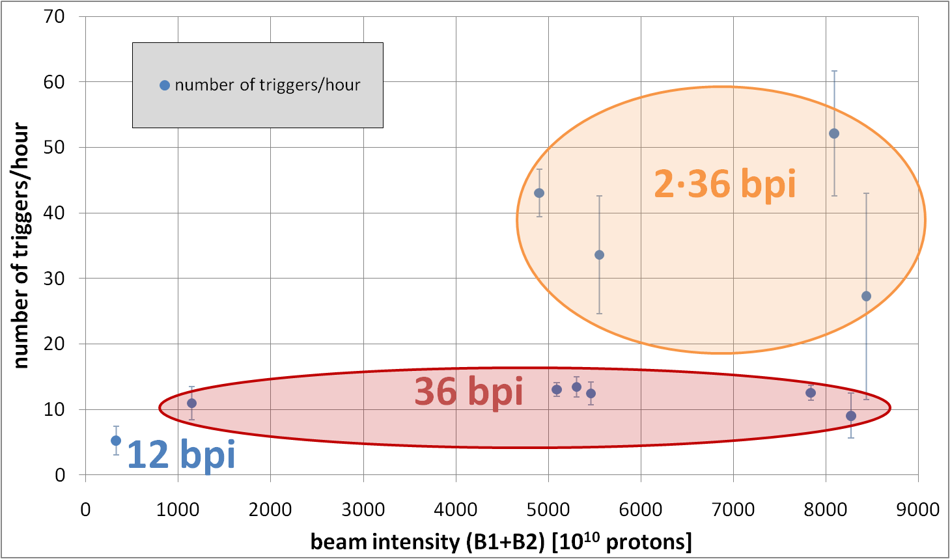
UFO rates versus intensity
T. Baer

Slide 10
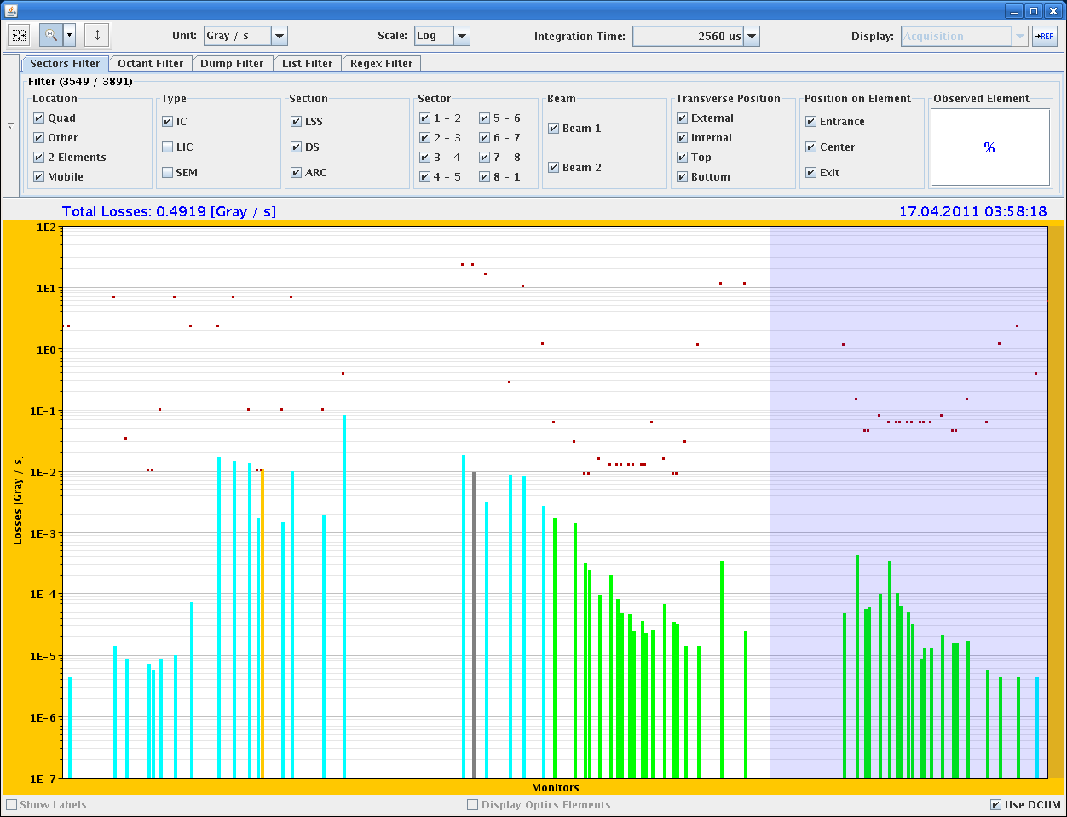
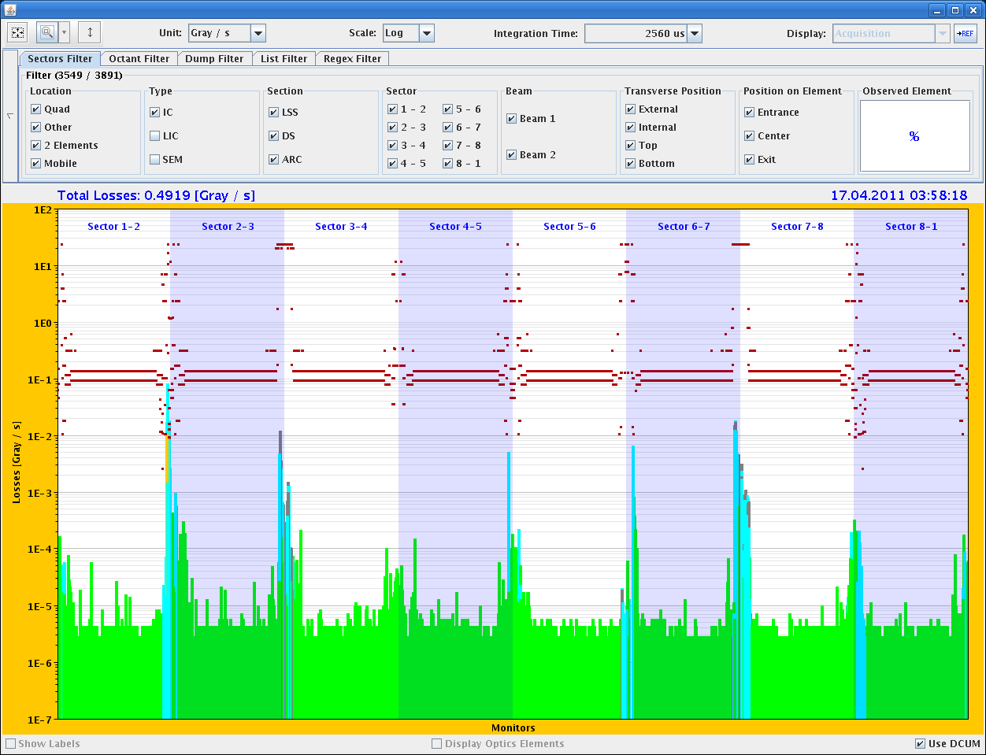
Example: Loss at MKI for B1
Loss starts at BLMEI.05L2.B1E20_MKI.C5L2.B1
BLMQI.04L2.B1E20_MQY at 98% of dump threshold (RS5)
At 3.5 TeV stable beams.

Slide 11
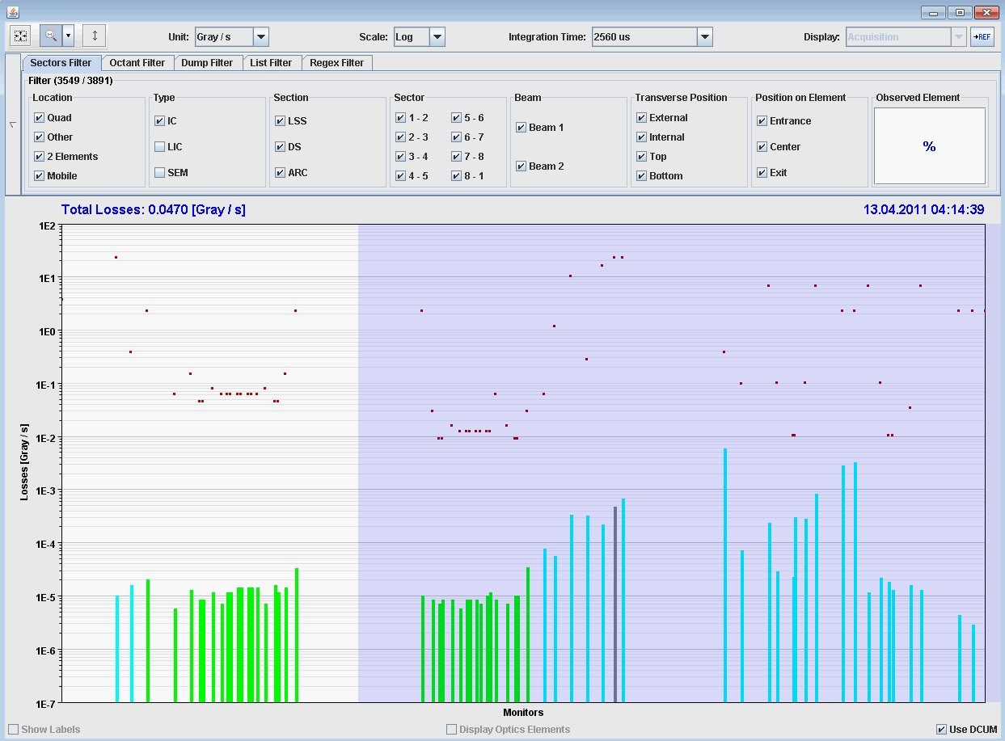
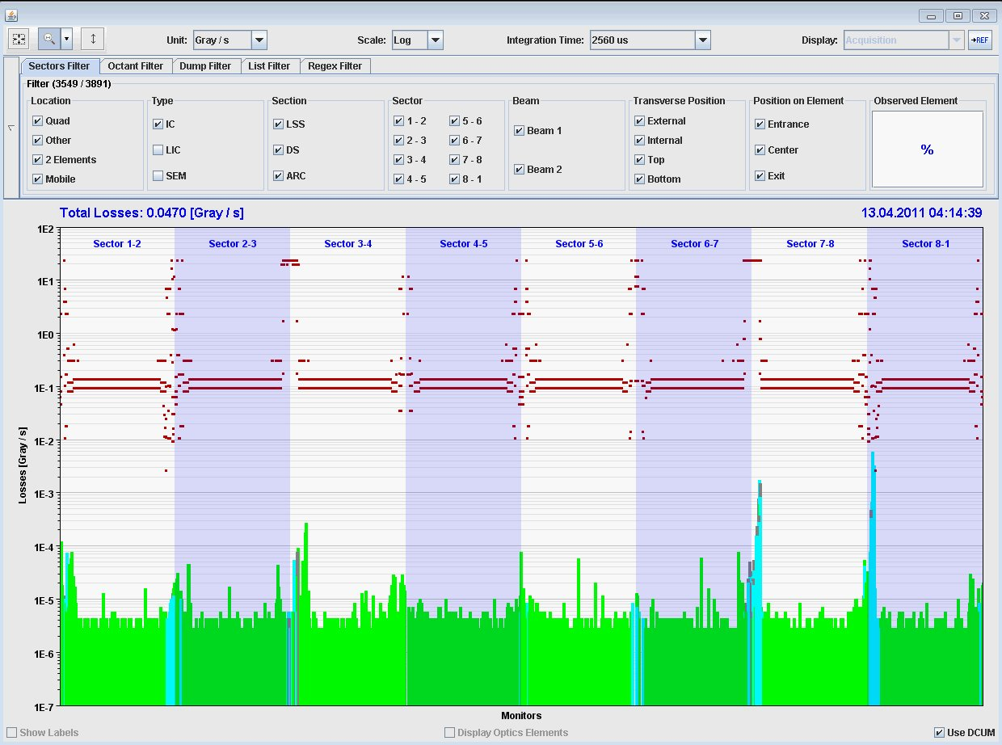
Example 2: Loss at MKI for B2
Loss starts at BLMEI.05R8.B2E10_MKI.C5R8.B2
During scrubbing (450GeV)

Slide 12
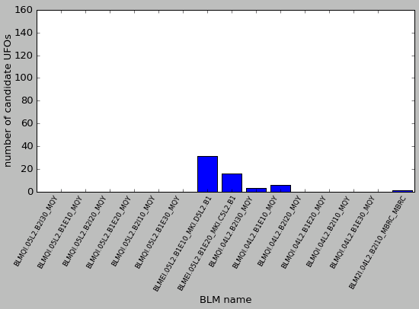
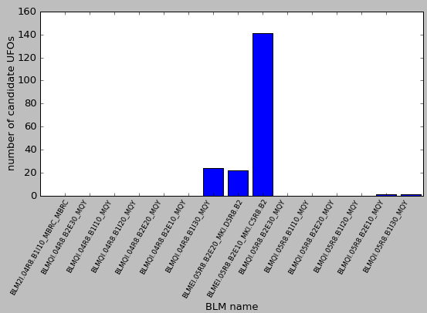
BLMs with highest loss
Between 08.04.2010 and 18.04.2010 in total 246 fast loss events around MKIs. (57 around MKI in IP2, 189 around MKI in IP8).
Distribution of BLM with highest loss in RS04 (start of losses varies as well):
Left of IP2
Right of IP8

Slide 13
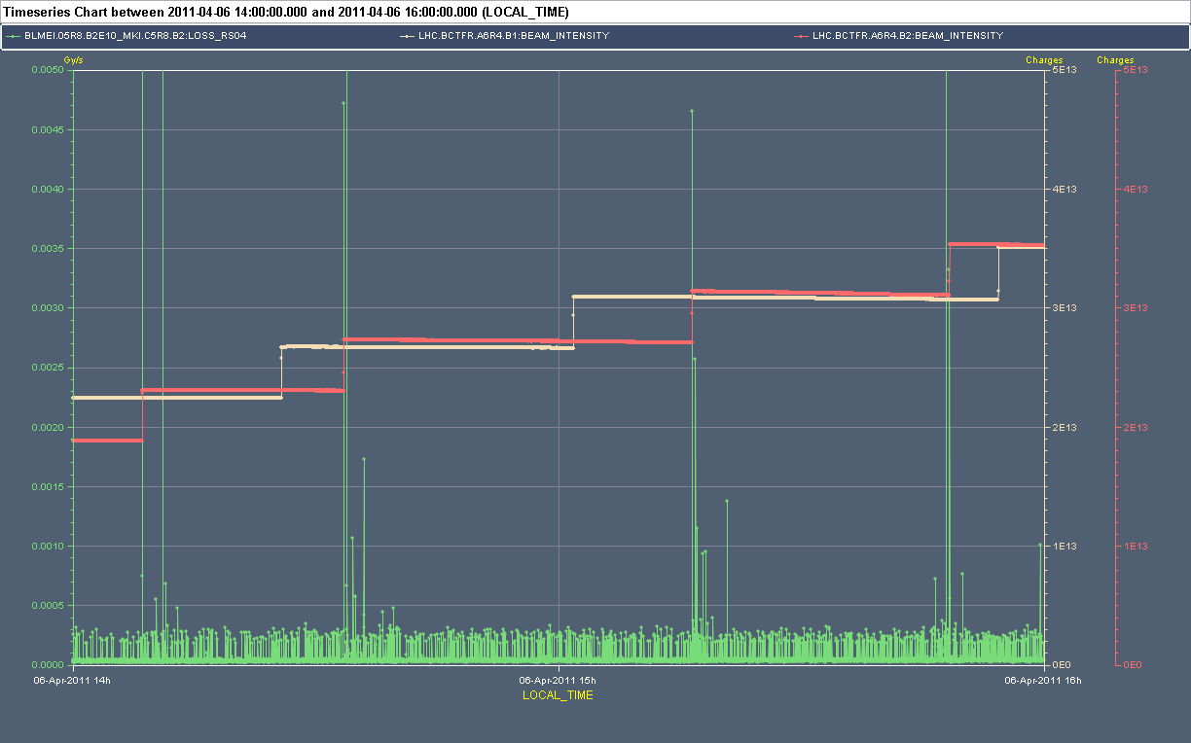
Fast losses during scrubbing
Typical scenario for fast losses at MKIs during scrubbing: Loss spikes occur in first few minutes after an injection and go away then. (correlation to e-cloud?)

Slide 14
Today
08:30-09:30: Access for PS.
New TDI settings, TDI protection check in IR8.
Injection of 72 bunches.
Physics with 336 b - 72 b/injection but moderate intensities (~ last 2 fills) ?
Tomorrow:
Ramp and squeeze, loss map dp/p > 0.
Switch to 480 bunches – tbc.
Wednesday: no beam from 16:00-19:00+ for VIP visit.

