Slide 1
Sunday 17.04
03:00 injection 336 bunches, ramp, squeeze luminosity.
03:19 Stable beams #1718. Duration: 9h08.
Peak lumi ATLAS/CMS: 3.8/3.6e32.
Int. lumi ATLAS/CMS/LHCb/ALICE: 10.1/9.6/4.3/0.06 pb-1.
11:27 Lost QPS OK on RQD and RQF sector 3-4. Will reset at the end of next rampdown.
12:28 Beam dump. No orbit data > 10 min, SIS interlock.
13:29 incorporating lumi scan:
IP1 is working and IP5 in H only. IP5-V: request is out of range.
13:39 Access started in CMS and US15 for ATLAS.
14:58 CMS access completed.
15:01 Electron stopper relay at Pt 4 not working
access to UJ43 not possible.
access piquet called.

Slide 2
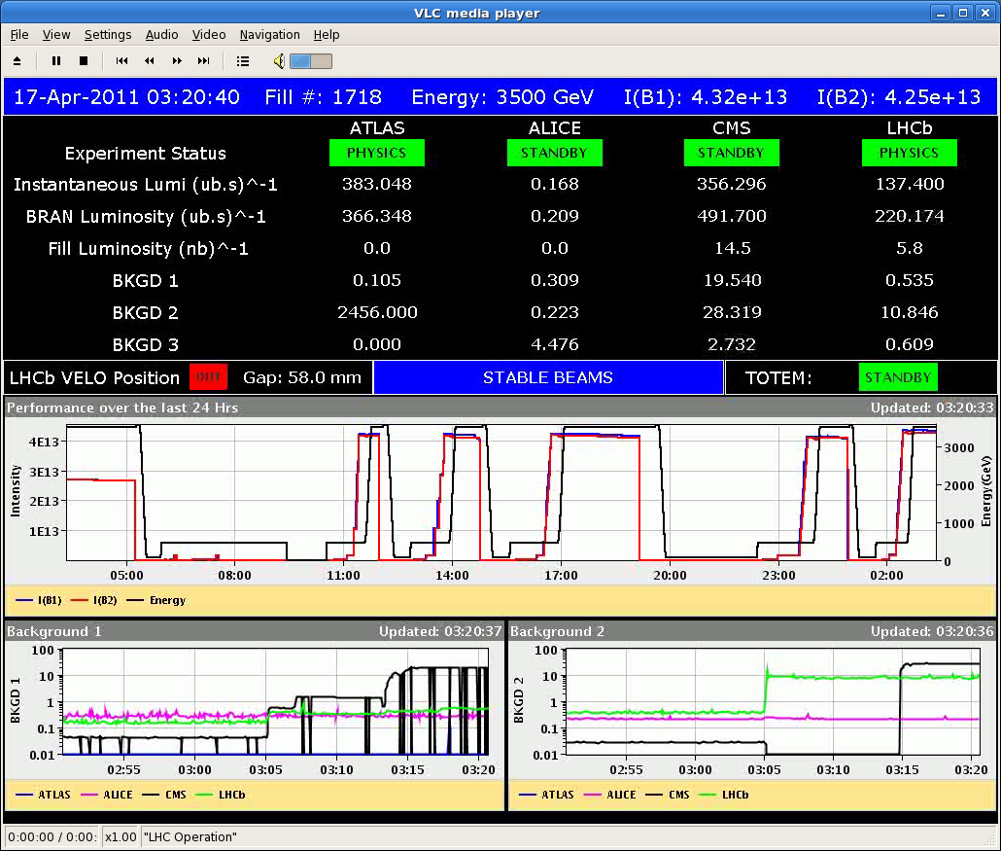
Start Stable Beams #1718

Slide 3
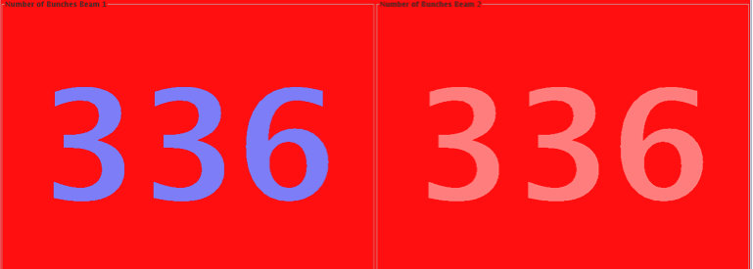
Peak Luminosity ~ 3.6 x 10³² cm⁻² s⁻¹

Slide 4
Sunday/Monday 17/18.04
20:19 Electron stopper problem fixed (micro switch).
Patrol lost. Pt 4 ( sectors 1,9,11), organize re-patrol within OP
21:19 RQD QPS: MQ.33R3 reset by the MPE piquet.
21:20 Vacuum valve fault on VVGSW.160.5L4.B fixed.
00:06 Beams dumped injecting third 72b batch for beam 2. Injection had ~1.2e11 p per bunch (was lowered).
Kicker had a spark after 1.5 micro-s, while injecting the 72b batch. First 36b part OK, wrong kick for second 36b part.
Many BLM’s interlocked, LHCb BCM triggered, ~20 magnets tripped (heaters fired), vacuum valves closed, cryo lost 78 & 81
Since then: Recovery without beam.
Cryo OK. Vacuum OK. Collimators OK.
Beam after kicker flash-over has been fully analyzed.
For the moment it seems that protection, collimation and MP reaction was OK (designed for this).

Slide 5
Intensity when kicker flashover
Was lowered by ~10% for filling scheme

Slide 6
Flashover on B2 MKI magnet D (1st magnet seen by beam) after passage of 1st 36b and before 2nd 36b
1st 36b injection oscillations OK on IQC
2nd 36b with +/-5.5 mm oscillations on IQC (TDI edge)
1st 36b correctly deflected on BTVDD
2nd 36b too high on BTVDD, with reduced intensity
88% of total intensity dumped
had already 2x72b plus 1x12b circulating, lost 1x36b on TDI/TCLIs
Losses extensive through P8 and arc 78
Quench heaters fired on 11 magnets
Vacuum valves closed
MKI D vacuum activity for preceding injections – did not recover fully before last injection (unlike other kickers) – precursor?
Vacuum recovering slowly
Experts needed to reset and recondition MKIs
Brennan Goddard

Slide 7
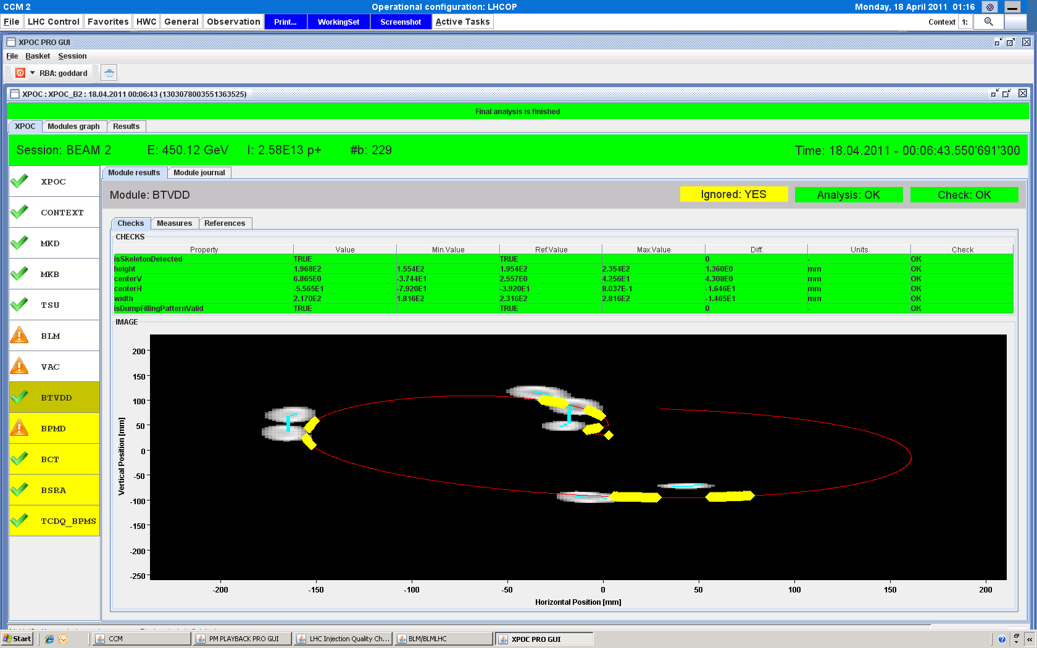
Brennan Goddard

Slide 8
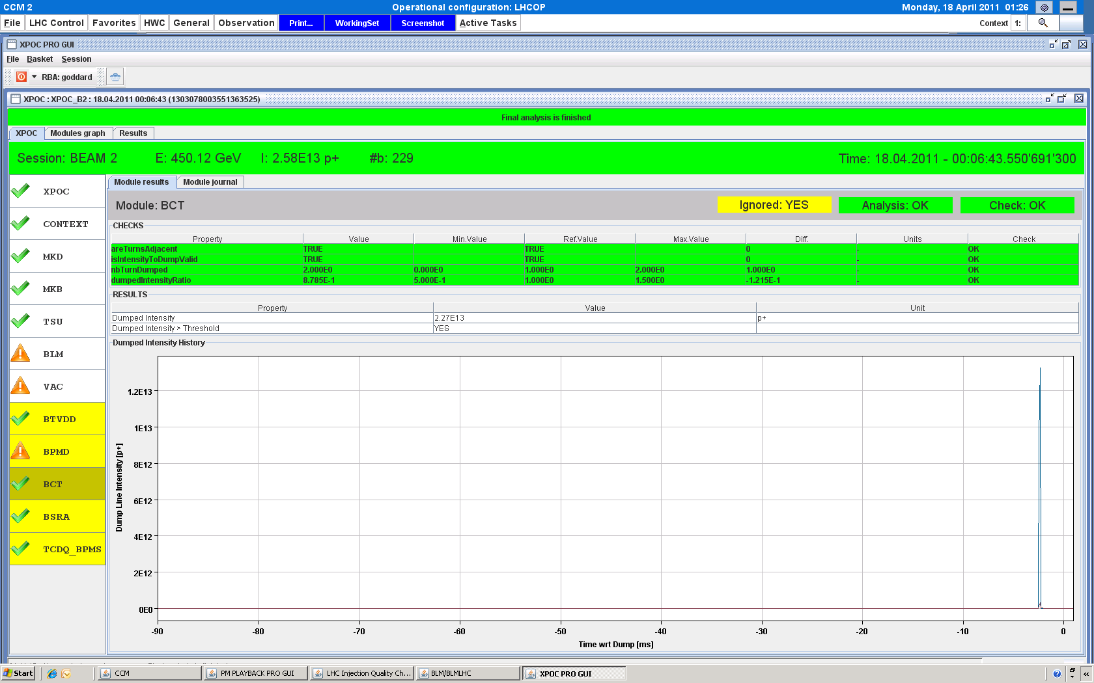
Brennan Goddard

Slide 9
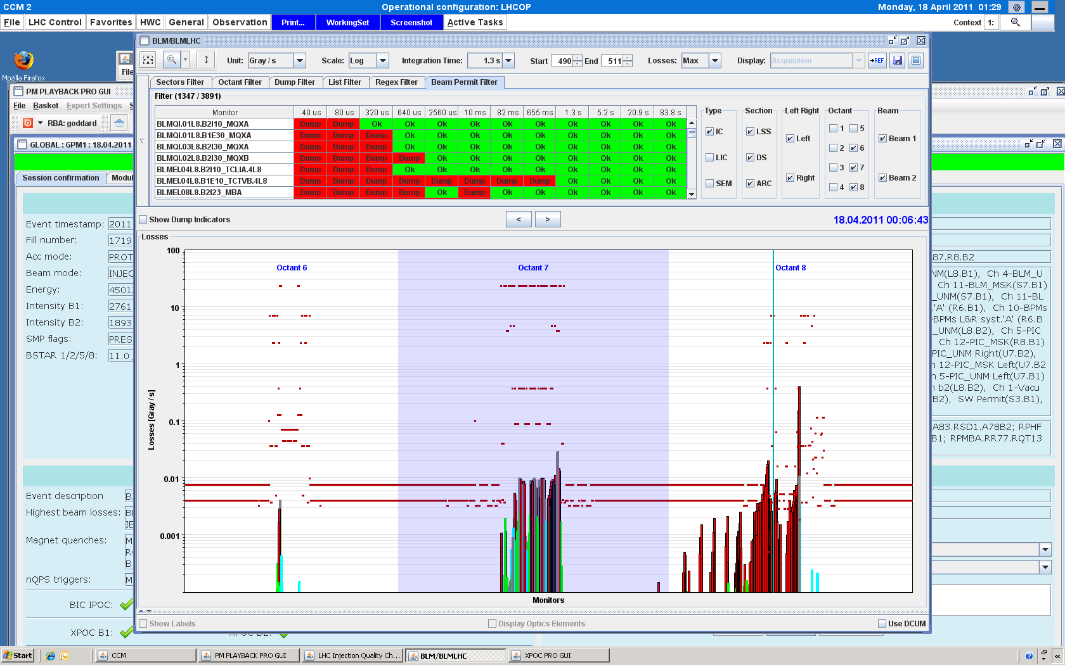
Brennan Goddard

Slide 10
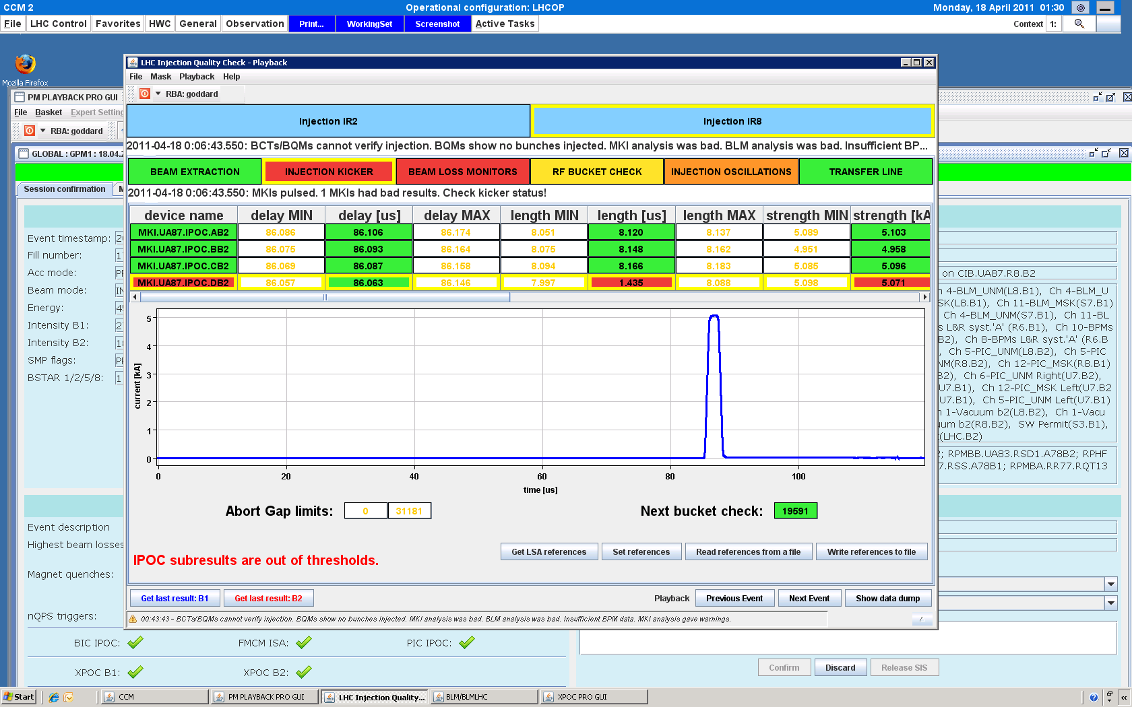
Brennan Goddard

Slide 11
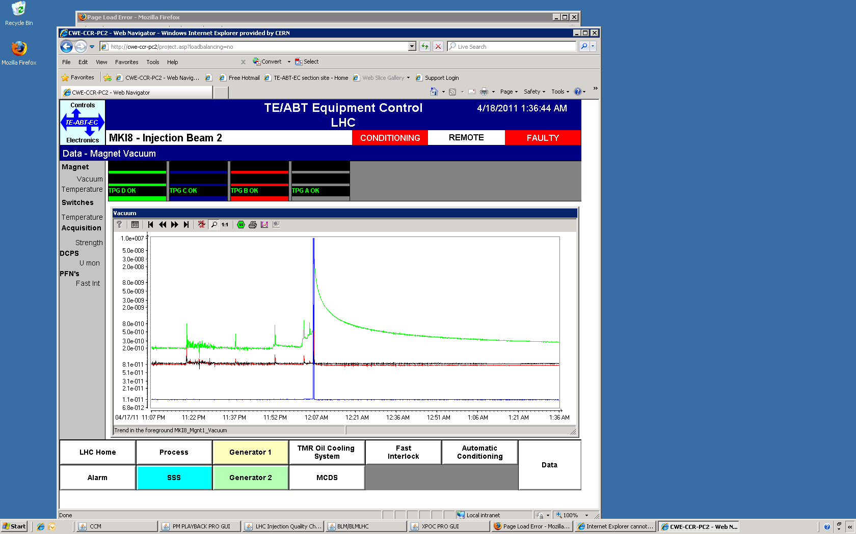
Brennan Goddard

Slide 12
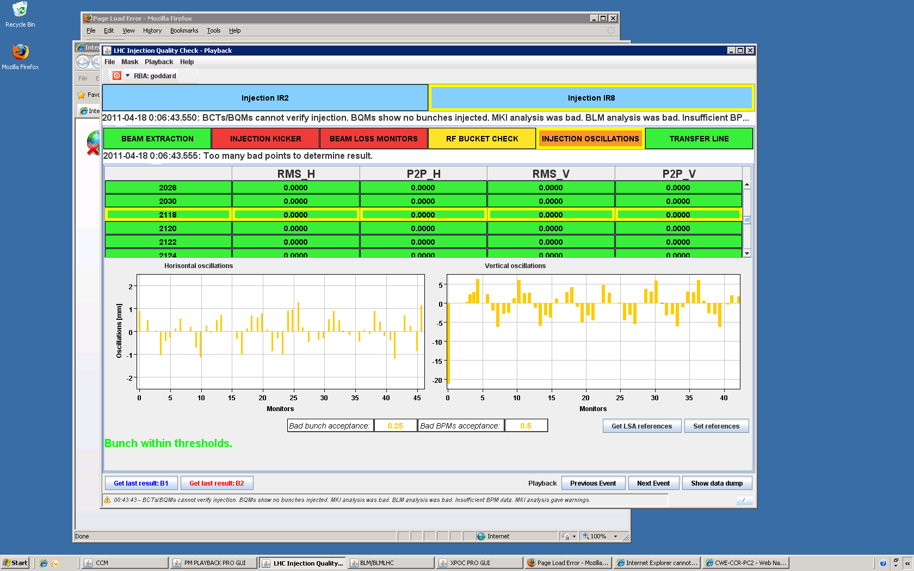
Brennan Goddard

Slide 13
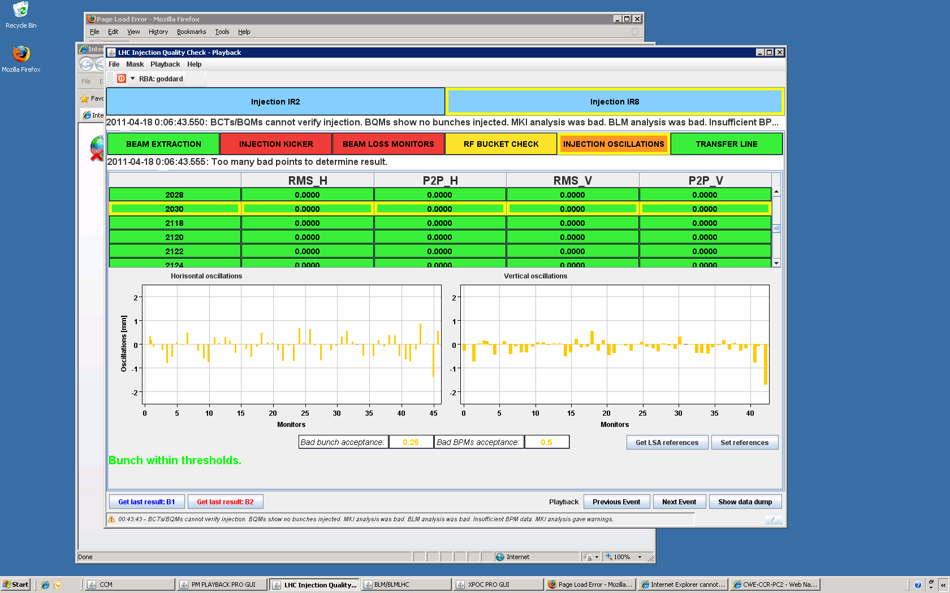
Brennan Goddard

Slide 14
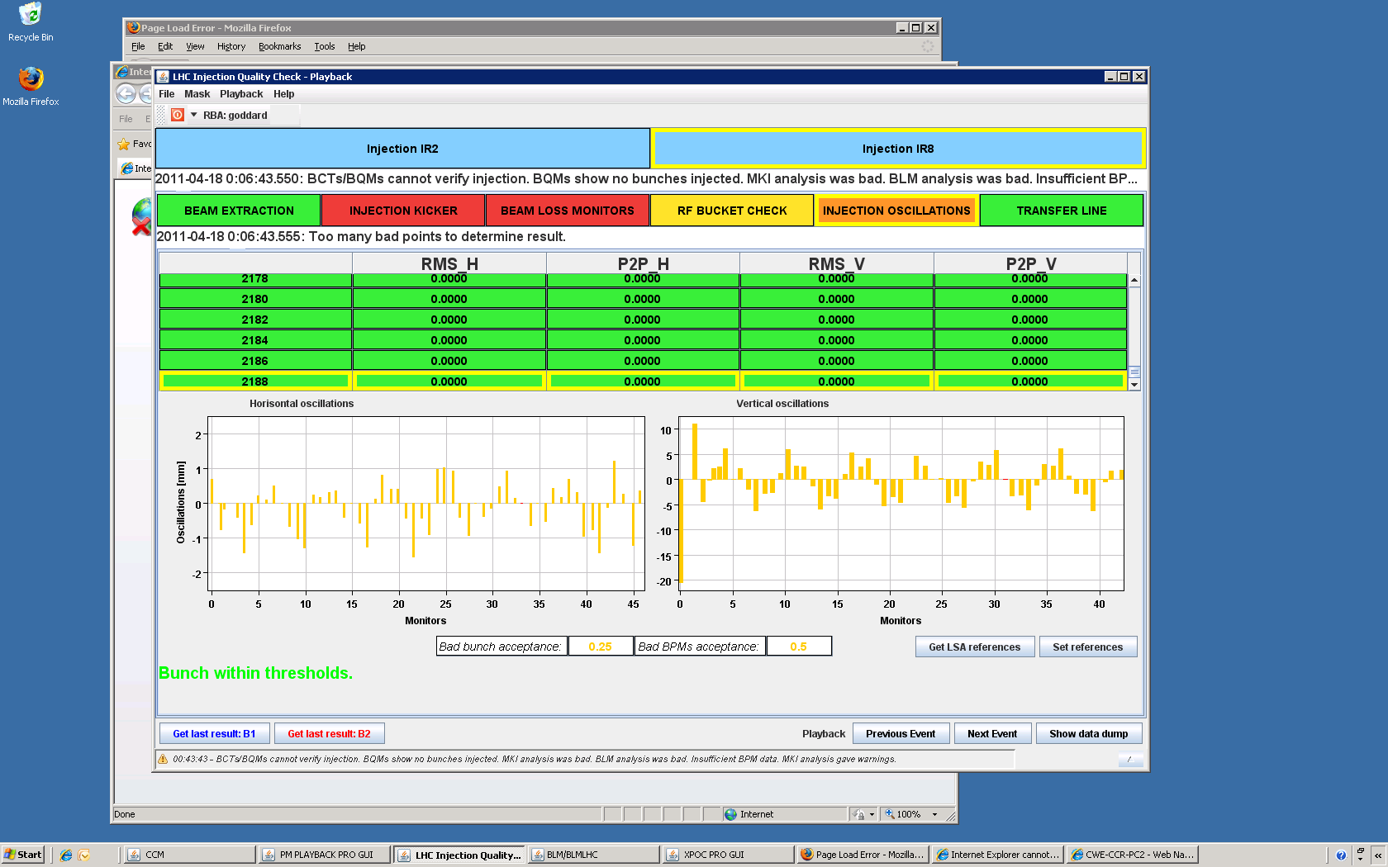
Brennan Goddard

Slide 15
Magnet quenches? (Markus Z.)
Quench heaters:
9 dipoles + 2 quads
Real quenches?
Looks mostly like real quenches.
1-2 doubtful cases
To be analyzed in detail
Cryo recovered in 10 minutes
Access required for QPS (global detector of the three main circuits)
More info in MPP logbook

Slide 16
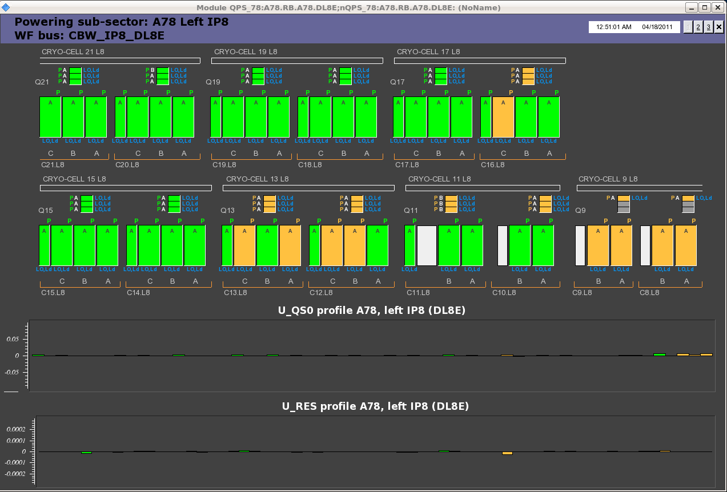
Magnet quenches? (Markus Z.)
See heater discharges + RQ6.L8 + RQX.R8

Slide 17
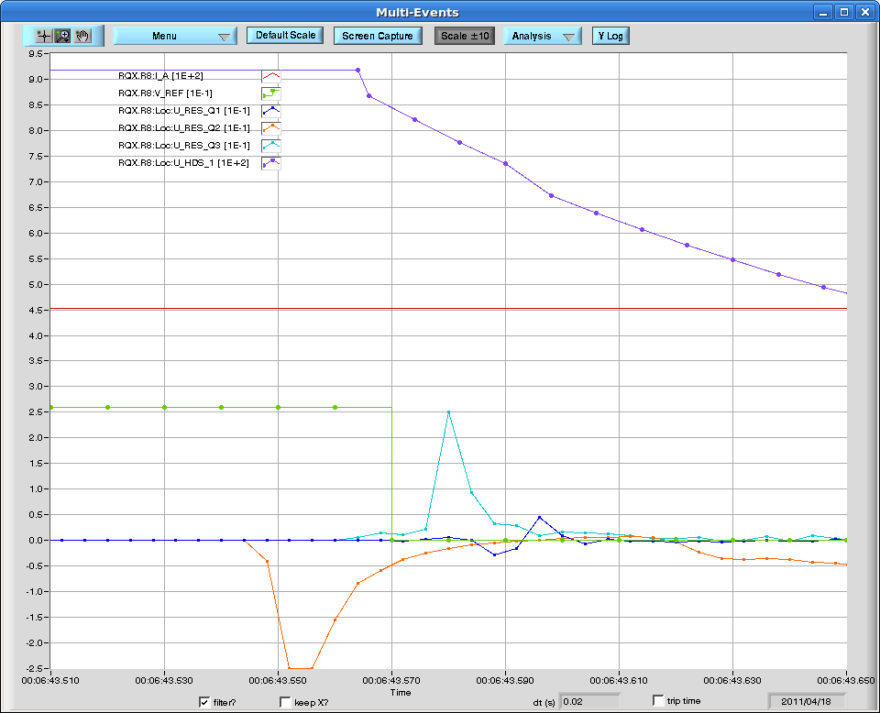
Magnet quenches? (Markus Z.)
Heater discharge
Q3 side effect
Q2 resistive voltage

Slide 18
The week #15: Part I
Monday - Wednesday:
e-cloud studies continuing
Systematic tests at injection energy, test ramp
Scrubbing shown to be very effective
50ns beam touchy → various strong beam losses (all safe)
BPM systematics solved. Different calibration modes to avoid offsets.
Uncaptured beam minimized.
Betatron loss maps at 3.5 TeV re-done (requalify every 4 weeks).

Slide 19
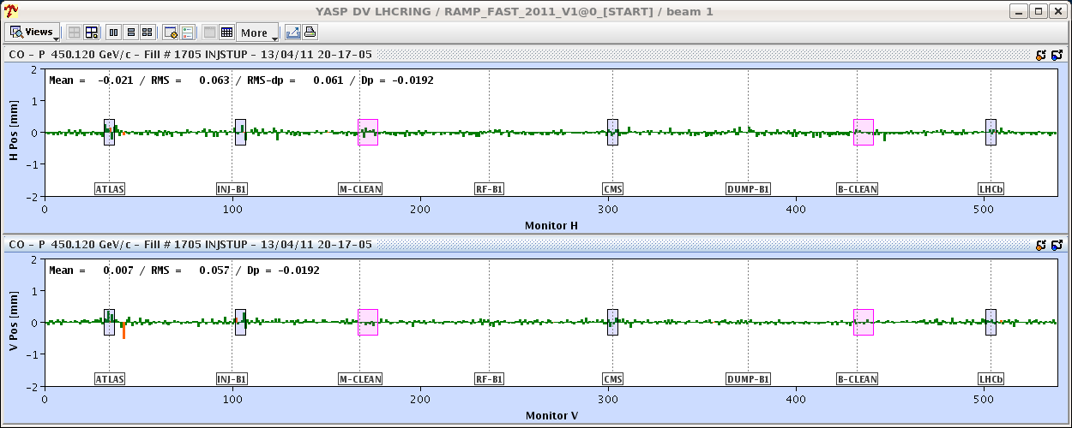
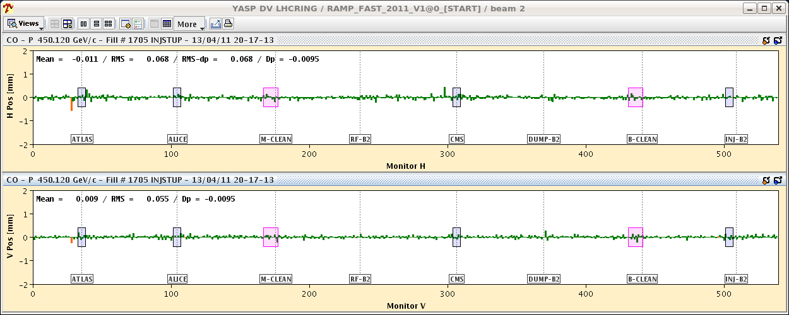
Orbits differences after 50 ns calibration

Slide 20
Summary of BPM test (BPM team, Joerg)
Injected an individual bunch with BPM calibration for individual bunches and corrected back to the normal 450 GeV reference,
Downloaded the calibration factors for 50 ns spacing: the measured orbit moved up by an amount consistent with the difference measured between trains and individual bunches (~ +0.14 mm).
Injected 12 bunches after the individual bunch (with 50 ns BPM calibration). The orbit offset disappeared and the orbit in both planes was again centered. After a light correction the rms difference came back to ~60 microns.
The conclusion is that if the orbit is calibrated in a mode that is consistent with the bunch filling (single bunch, 50 ns, etc) the orbits measured with the different filling scheme agree within ~60 microns rms, and the shift of the mean values are at the level of 10-20 microns maximum.
Until a sequencer task can be made operational (before the weekend - we hope), the shift crews have been instructed on how to calibrate the BPM system for 50 ns operation. For individual bunch operation, use the existing sequencer task!

Slide 21
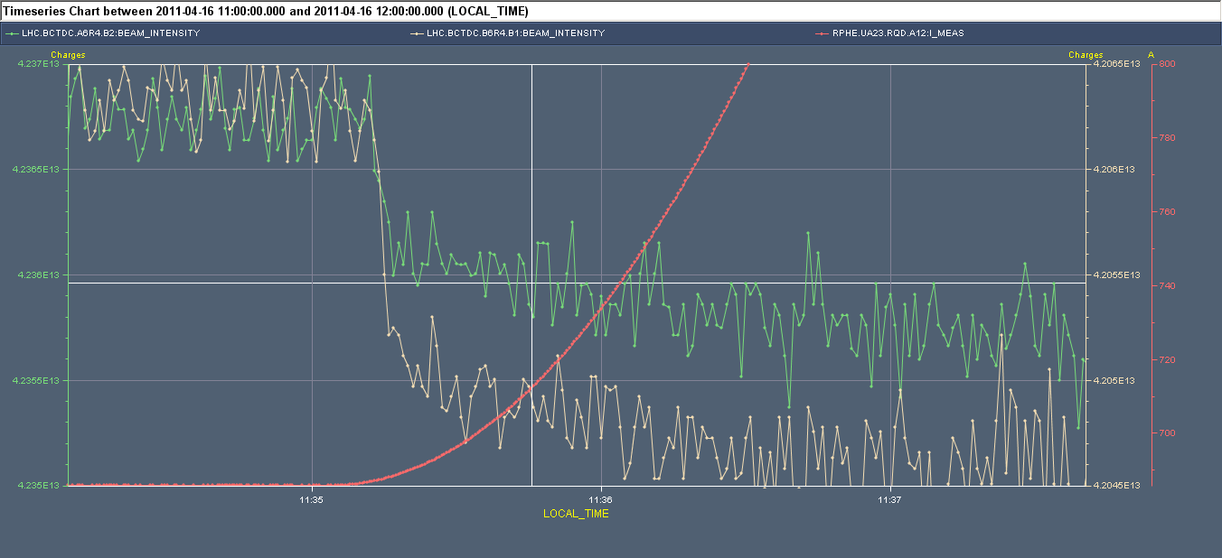
Capture losses
ΔI ≈5*10⁻⁴
current beam 2
current beam 1
improved capture & abort gap cleaning (Phillippe)

Slide 22
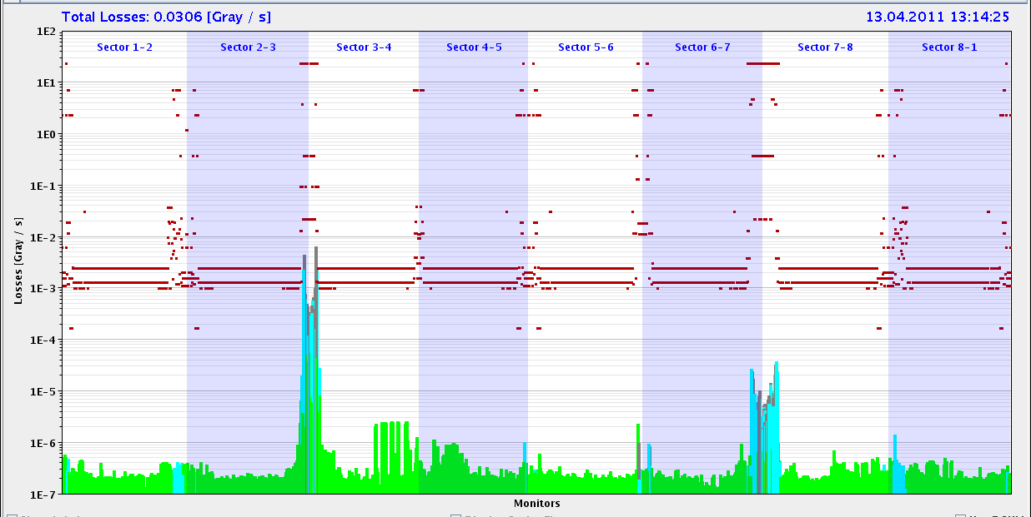
Losses Start of Ramp
Philippe: Capture losses B1:1.5E10 out of 2.8E13 (0.05%).
Capture losses B2: 2.0E10 out of 2.8E13 (0.07%).

Slide 23
Beam Loss with 1020b at 450 GeV
Analysis loss with 1020 bunches (50 ns). Fill 1694.
Beam lost during +10Hz frequency trim of RF frequency.
Dumped by BLM interlocks (loss limits violated).
Fast loss developed over ~70ms
Highest losses at TCP.B6R7.B2 (skew primary, probably due to losses on upstream H and V primary collimators), reaching 23 Gy/s in 40 us scale and 0.6 Gy/s in 1.3s.
Integrated losses in 1.3s bins went from 5e-4 Gy/s to 6e-1 Gy/s in one second.
Peak losses in 40us bin went from smaller 0.2 Gy/s to 23 Gy/s
Factor ~1000 increase in losses within 70 ms.
Interlocks from various BLM's, including TCP.B6R7.B2
Nice exponential take-off for losses initially. Then saturating.
Started from ~48.5h beam lifetime. Loss reduced lifetime to around 3 minutes.
Power loss went from 46 W to about 46 kW.

Slide 24
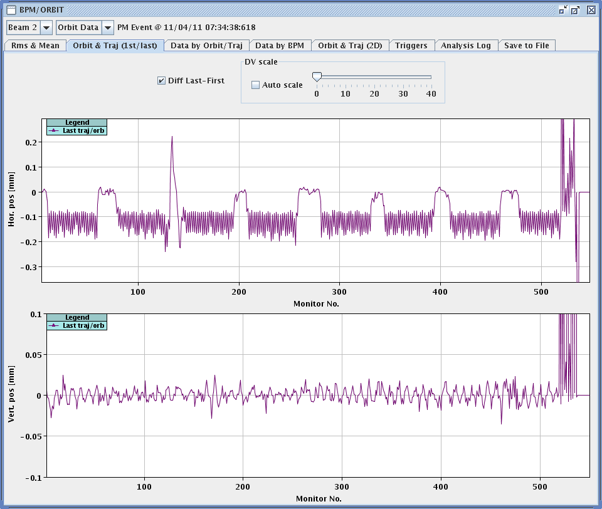
Δf_{RF} = 10 Hz → Radial orbit change

Slide 25
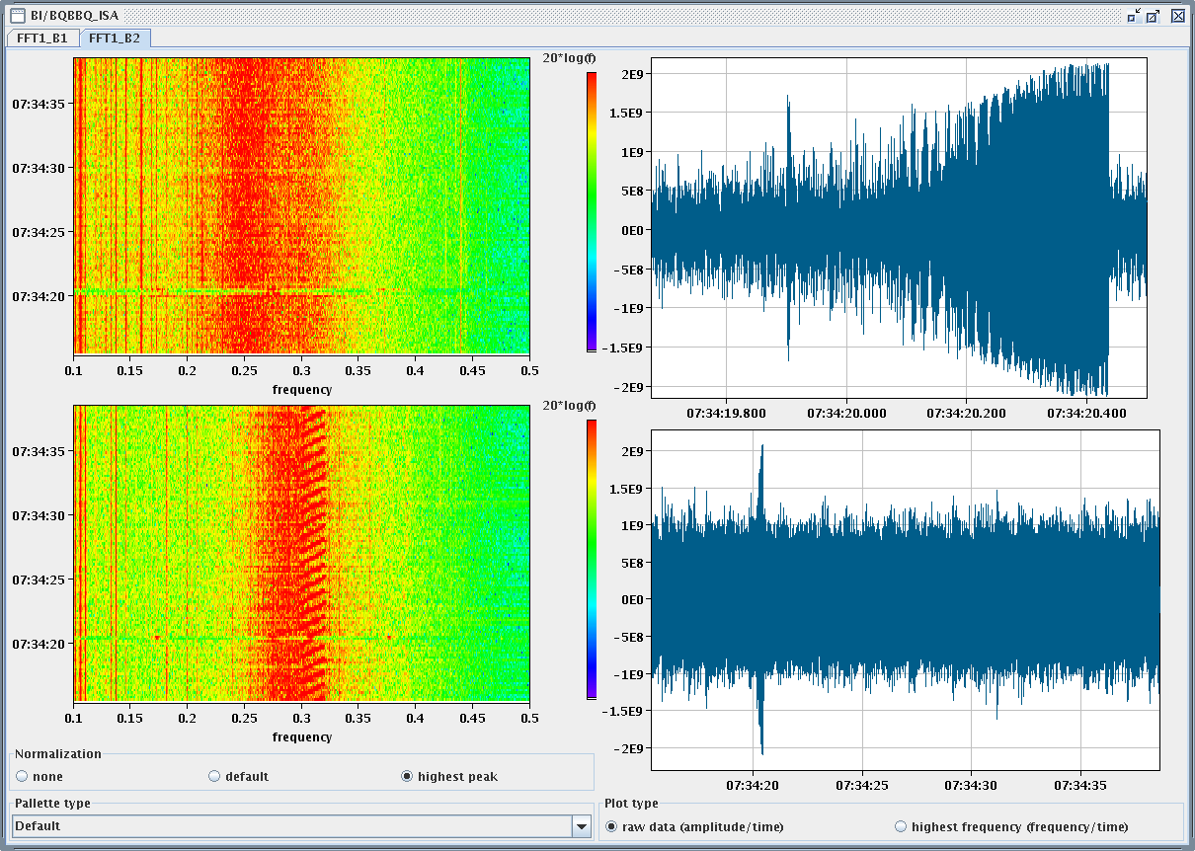
Δf_{RF} = 10 Hz → Beam instability
Losses
BBQ beam2

Slide 26
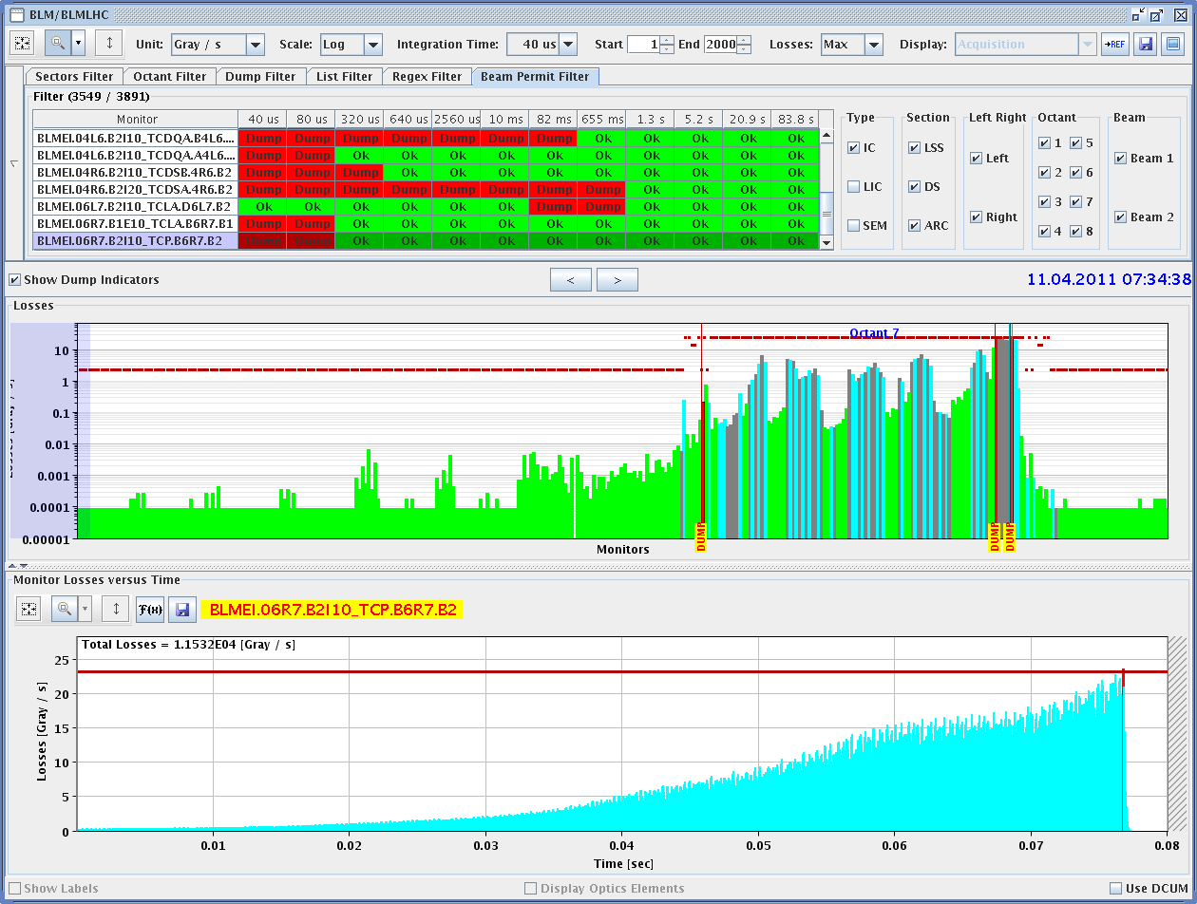
Losses in IR7: up to 23 Gy/s (saturation)

Slide 27
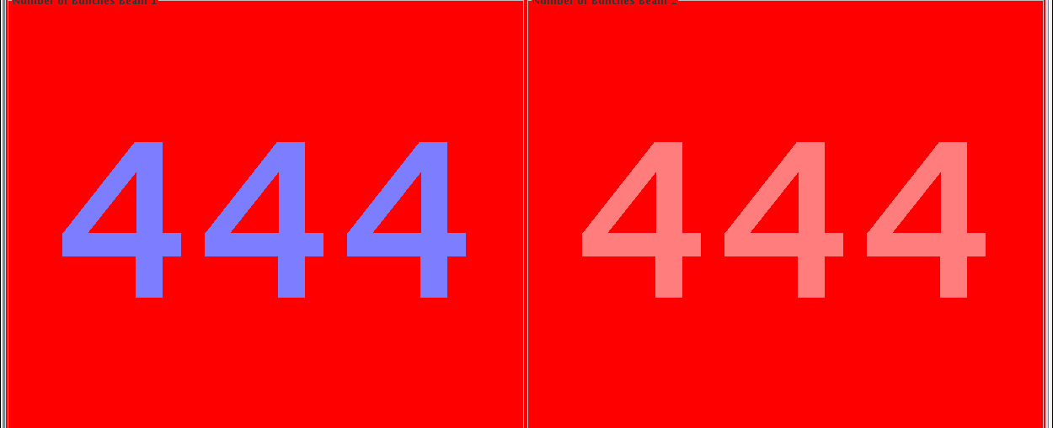
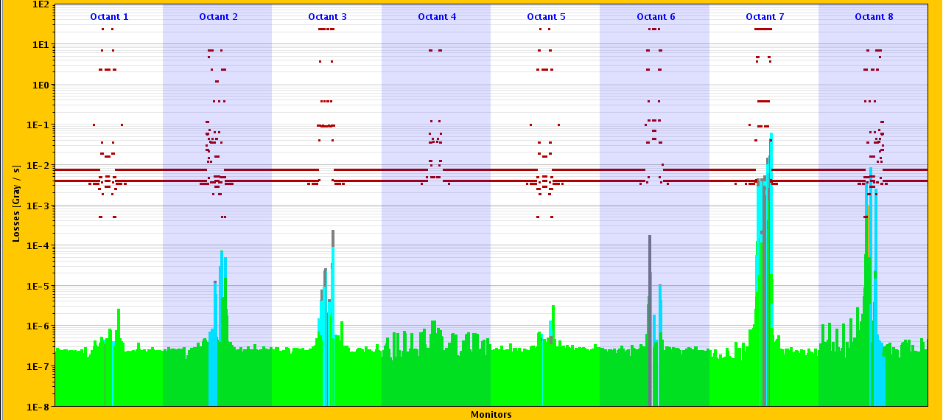
e-cloud checks continued with fewer bunches
RF frequency trimmed by +10Hz
+/- 10 Hz
but ...
beams dumped - high losses in IP7

Slide 28
Tue Morning: the 10 Hz problem revisited
b1
loss pattern:
b2
Loss occuring ~5 minutes after the frequency trim
The lossess affect initially B2 then B1 again and finally B2
The first loss is affecting all bunches while the second only some of the bunches of the tail of the trains
No sign of instability is observed either in the BBQ nor from the damper pick-ups Losses at TCPs are consistent with an increase in abort gap population

Slide 29
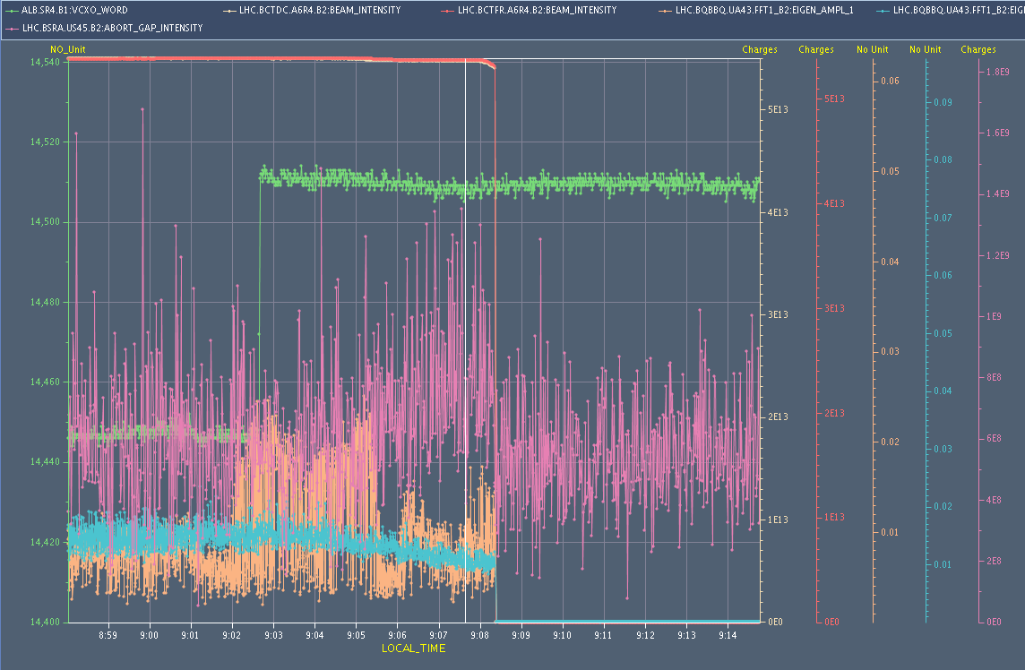
Tue Morning: the 10 Hz problem revisited
en detail: b2
beam current
frequency
abort gap intensity
bbq amplitude y
bbq amplitude y

Slide 30
The week #15: Part II
Wednesday – Saturday:
Ramp with 228b → strong beam losses (all safe)
Fixed by reduced chromaticity, increased damper gain, stronger octupoles in ramp.
Establishing physics with 228b, 50ns. 3 fills, 20h.
Losses at start of collision fixed by doubling transverse damper gain (200 turns damping time).
Saturday – Sunday:
Establishing physics with 336b, 50ns.
Trials with 72b injection given up: e-cloud activity, beam losses during going into collision.
Switched to 36b trains.
Doubling transverse damper gain (100 turns damping time).

Slide 31
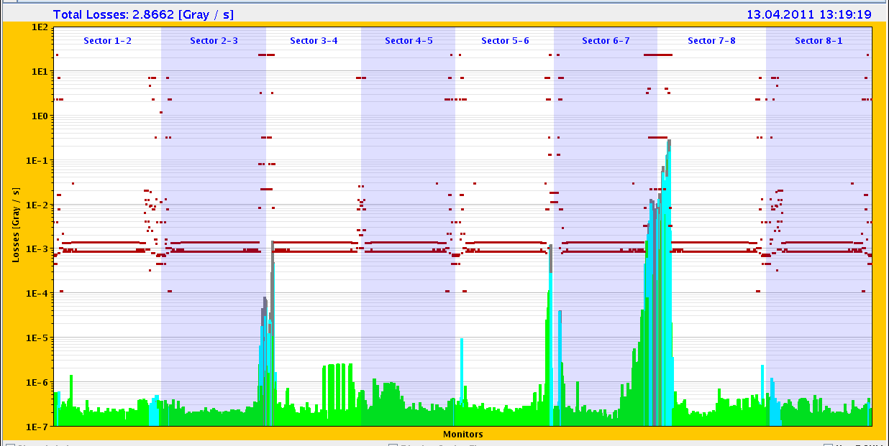
Ramp with 228b, 50ns: Losses at ~1.5 TeV
TCSG.A6R7.B2 close to dump value

Slide 32
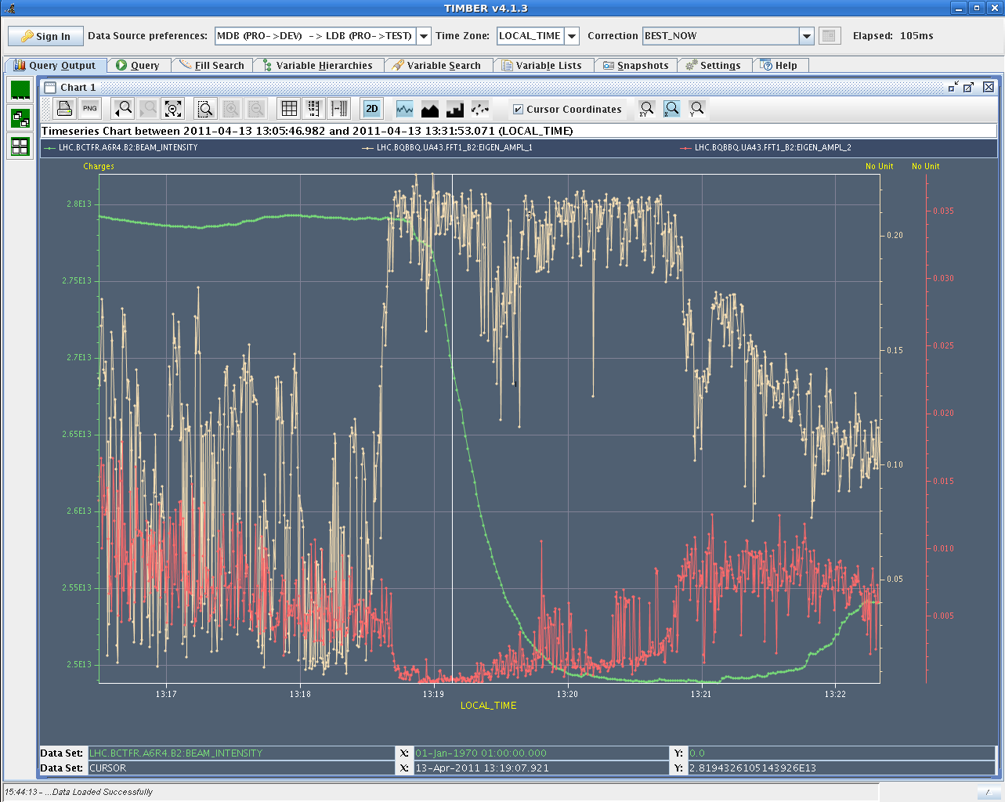
Loss: ~5e10 p/s → τ~9 min → ~12 kW

Slide 33
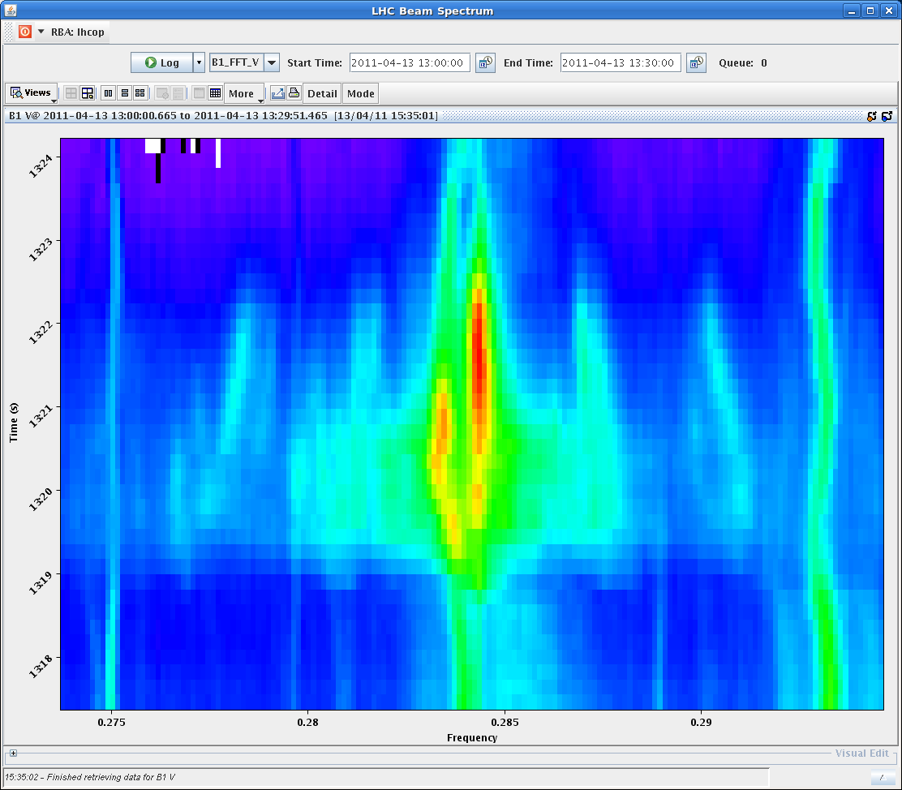
Tune excitation

Slide 34
Intensity around ring

Slide 35
Fixing losses in ramp with 50 ns (13/14.4.)
Changes in ramp functions…
Reduction of the chromaticity by 2 units for beam 1 and beam 2 - Horizontal plane in the middle of the ramp.
Increased octupoles.
Increased damper gain.

Slide 36
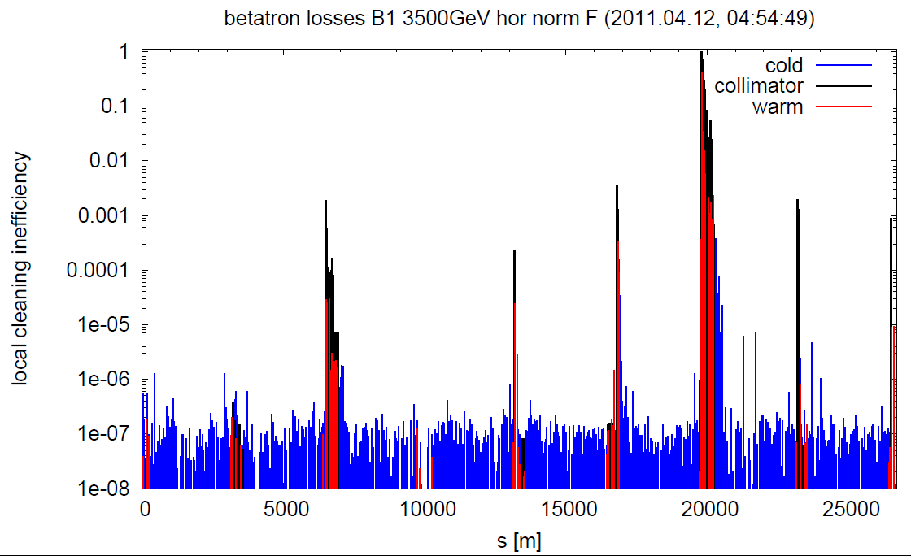
Betatron Collimation Checked (Loss Maps)

Slide 37
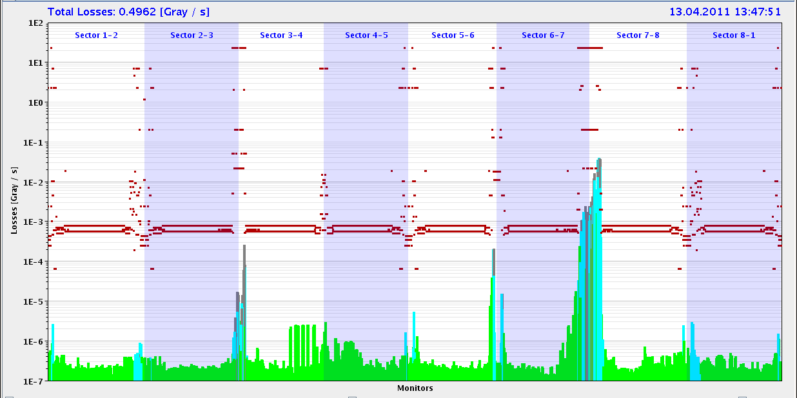
Losses in squeeze

Slide 38
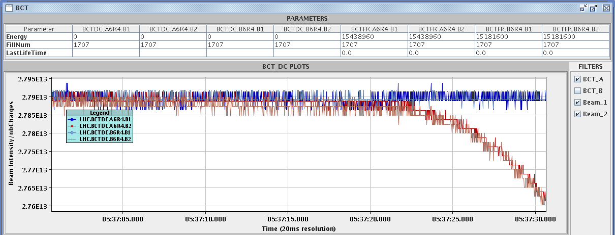
14.4.Beam 2 intensity in lumi opt. (IP1)
2e11 p lost in 5 s → 22.4 kW → τ = 12 min

Slide 39
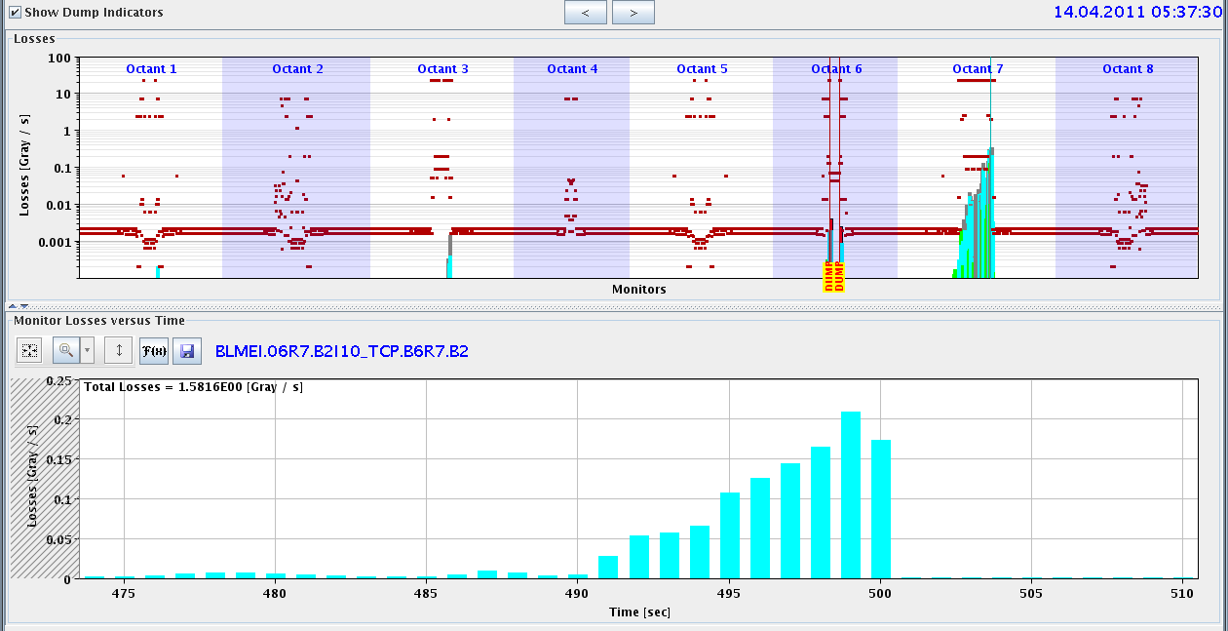
Beam losses in IR7
OK for cleaning at 22 kW but one bunch dropped below sensitivity range → IR6 BPM interlock. Logic must be adapted (see also 1.38 TeV experience).

Slide 40
Fixing losses with 50 ns, 228b, collisions
Thursday 14.4.
Increasing gain of transverse damper by factor 2.
Damping time ~200 turns.

Slide 41
Sa Morning: preparing for 336 bunch operation
tunes look strange
.... a bit like Christmas in hor.
... and no tune in vertical

Slide 42
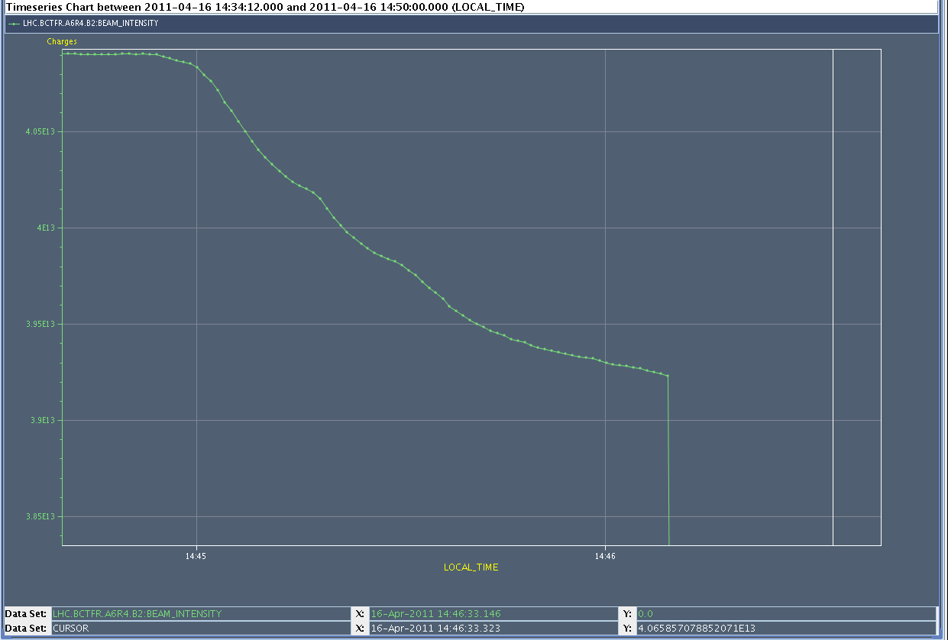
Peak loss: 3.3e10 p/s → τ~20 min → 19 kW
1 x 10¹¹ p
4 x 10¹³ p
30 s

Slide 43
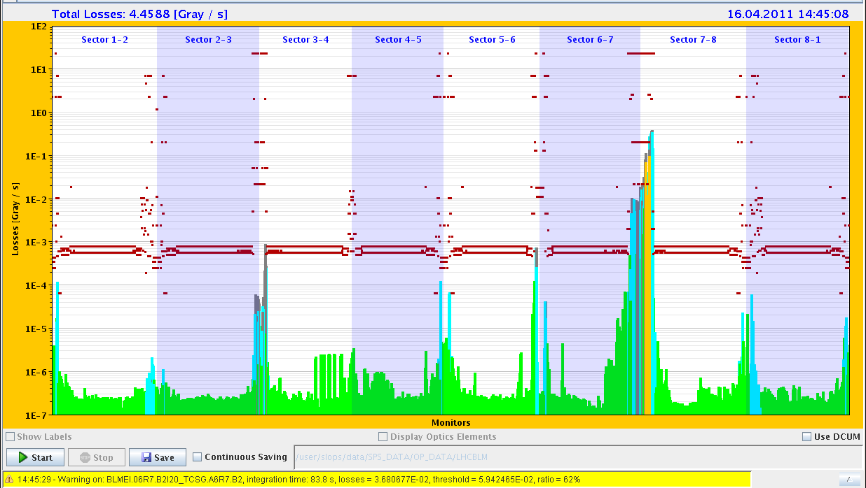
20 kW loss at 3.5 TeV…

Slide 44
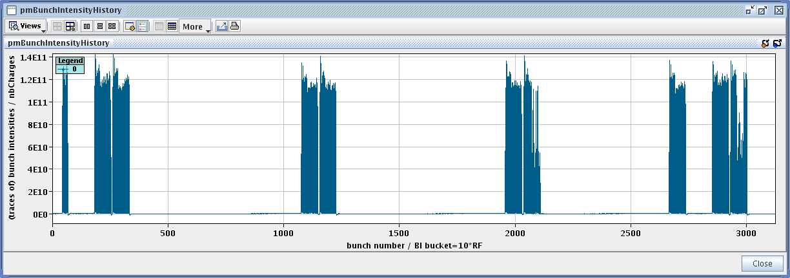
Bunch by bunch intensity
losses on many bunches of the 3rd and 4th train
always in the second PS injection
also specific lumi less (ATLAS)
before

Slide 45
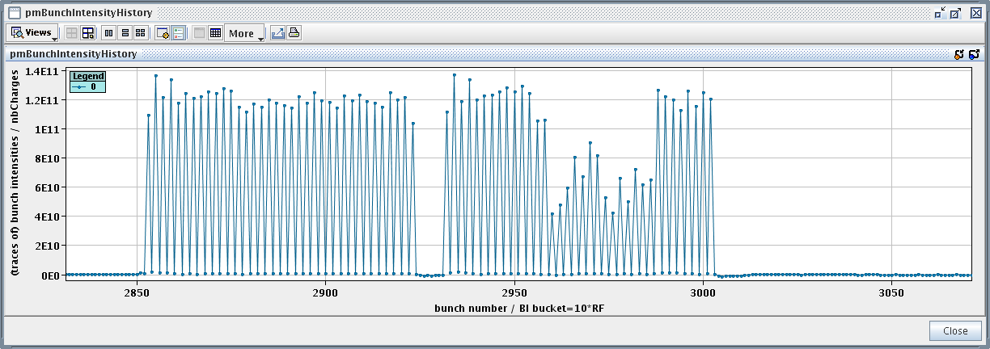
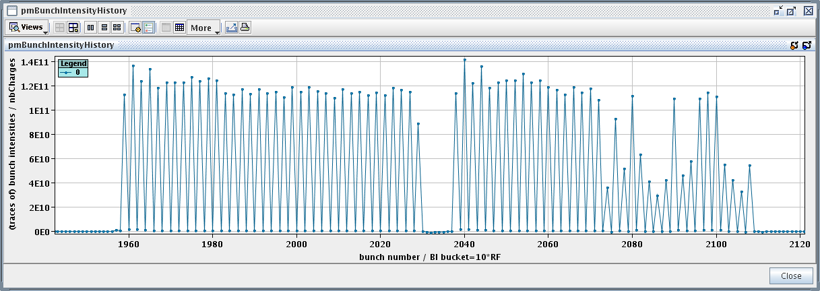
Bunch by bunch intensity (Joerg)

Slide 46
Fixing losses with 50 ns, 336b, collisions
Saturday 16.4.
Going back to 36b trains
Increasing gain of transverse damper by another factor 2.
Damping time ~100 turns.

Slide 47
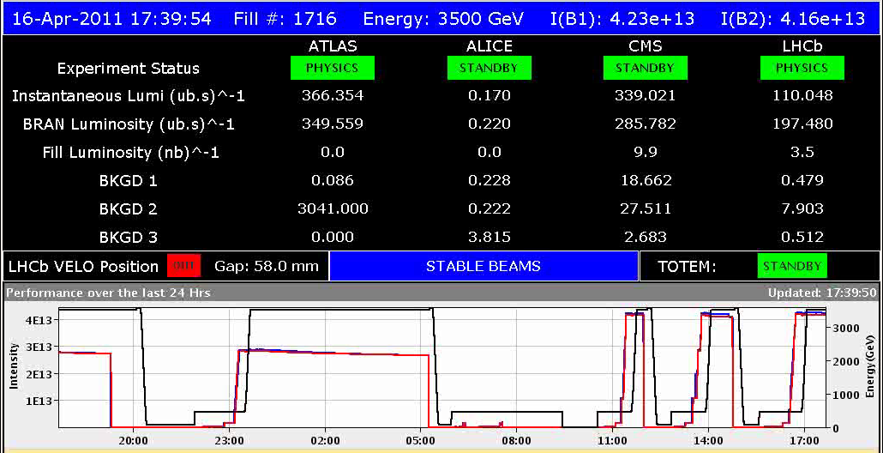
Sa Late: 336 bunch operation
switching to 36 bunch trains
16:55h injection / ramp
and nice intensity distribution
17:40h Luminosity

Slide 48
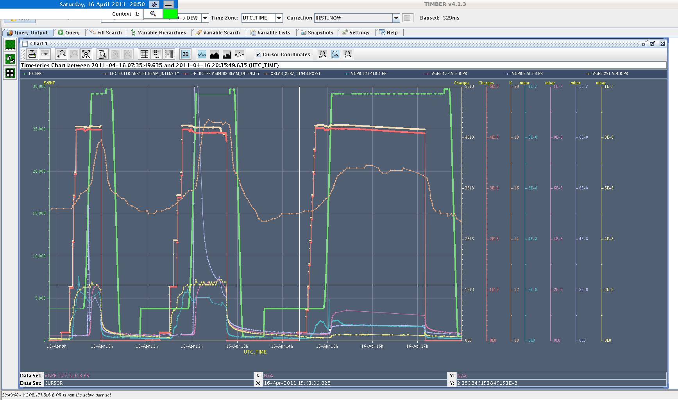
Sa Late: Vacuum
18:00h Vacuum during the three 336 attempts
beam screen

Slide 49
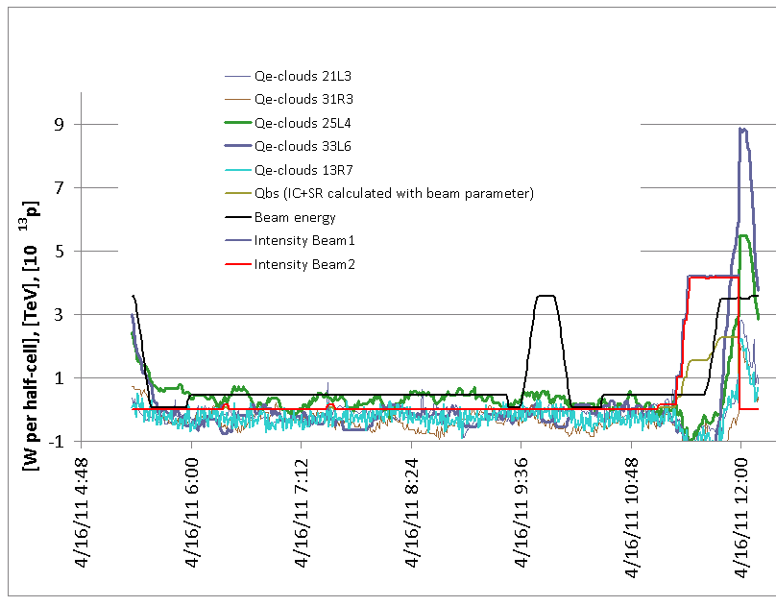
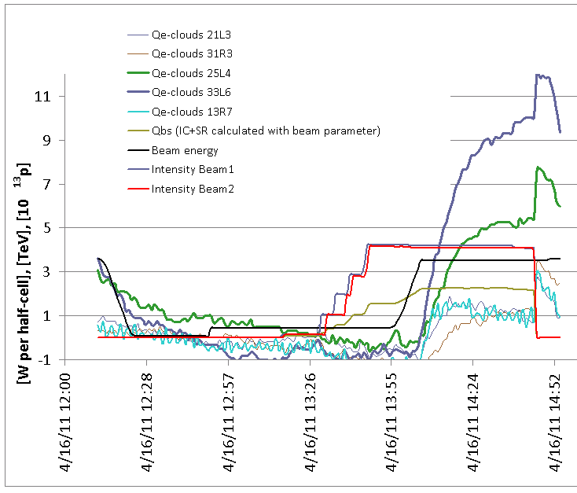
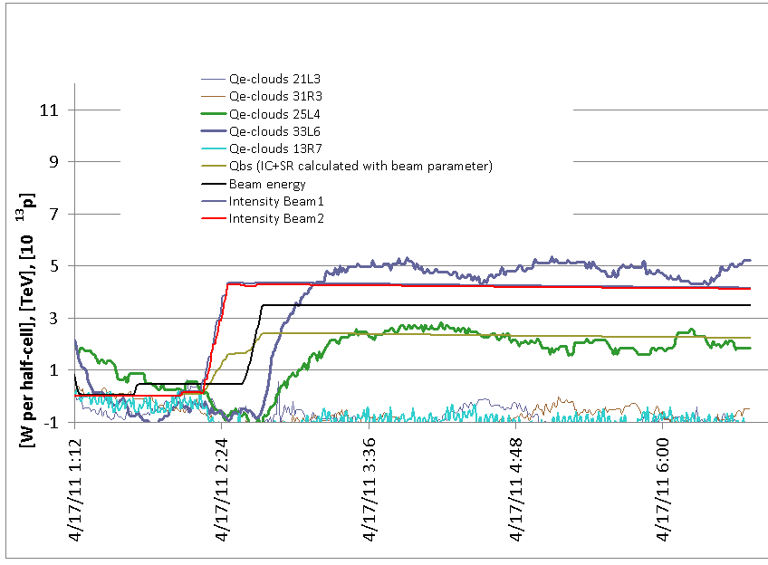
336 Bunches: Heat load ...preliminary
First experience with 336 buches:
The heat load with the filling scheme with 36 bunches at
injection is significantly less than with 72 bunches/injection.
72 bunch trains
36 bunch trains

Slide 50
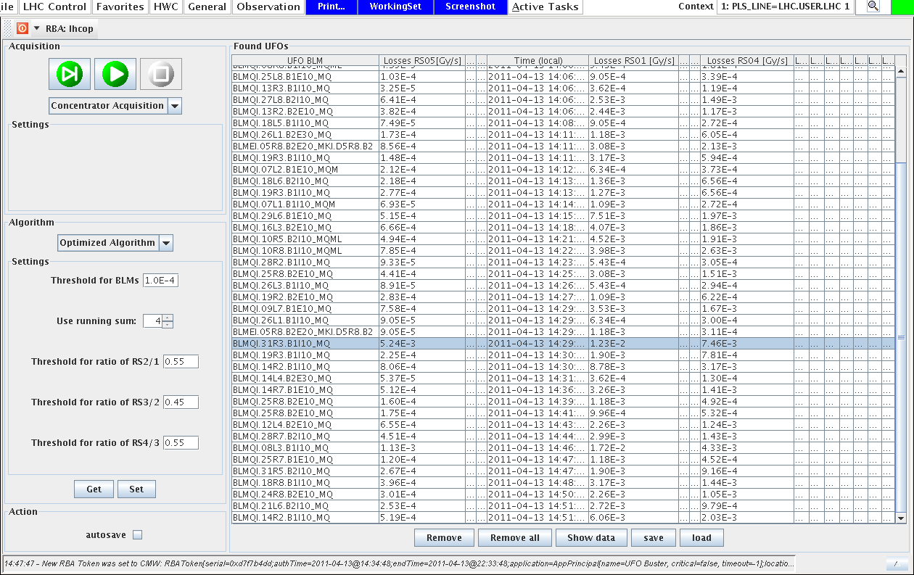
UFO’s: 90 in 90 minutes

Slide 51
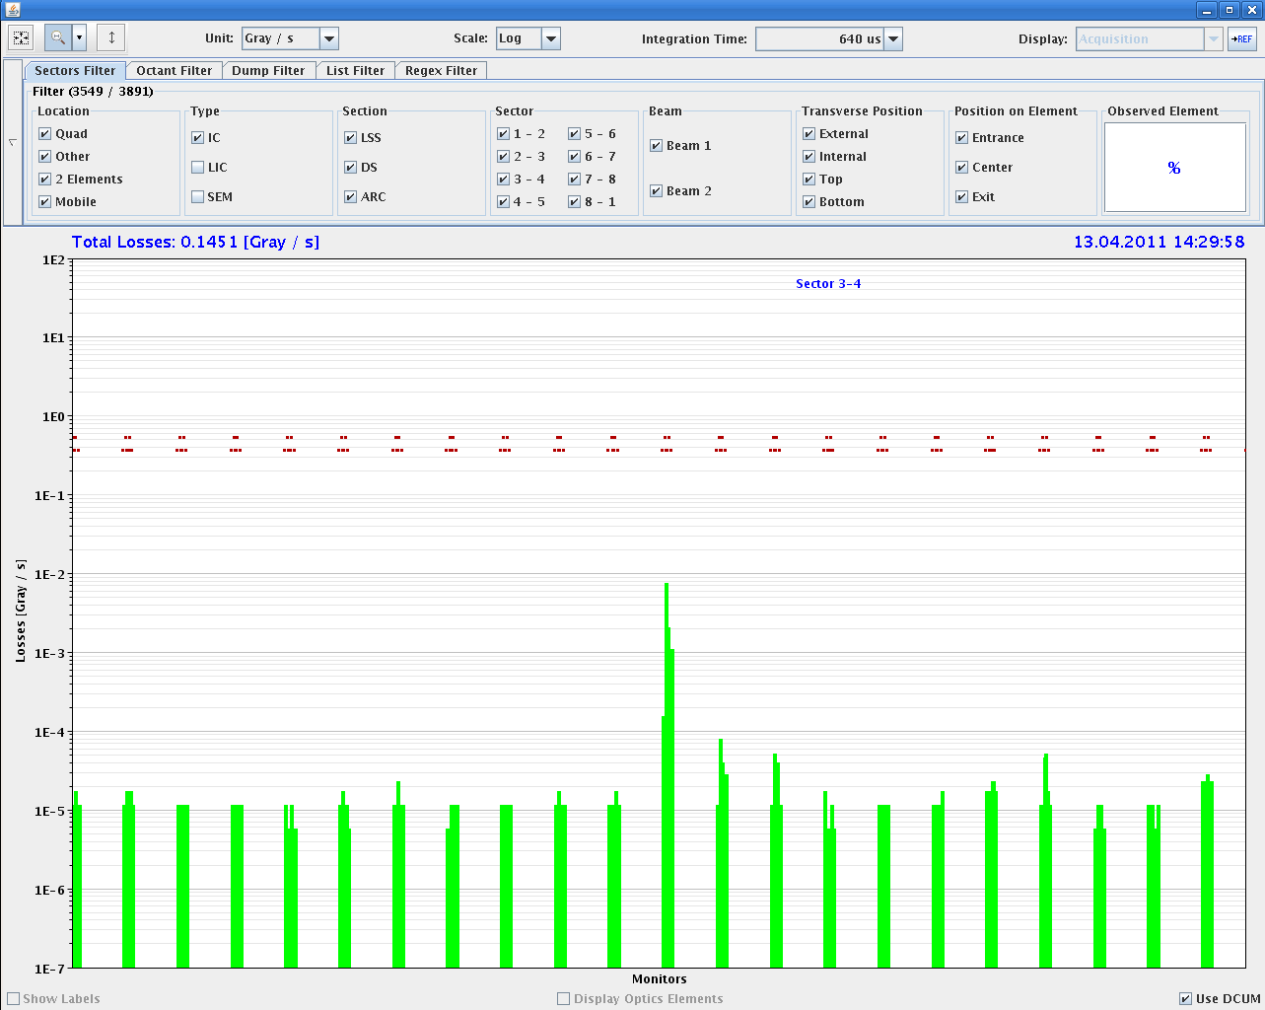
UFO example sector 34

Slide 52
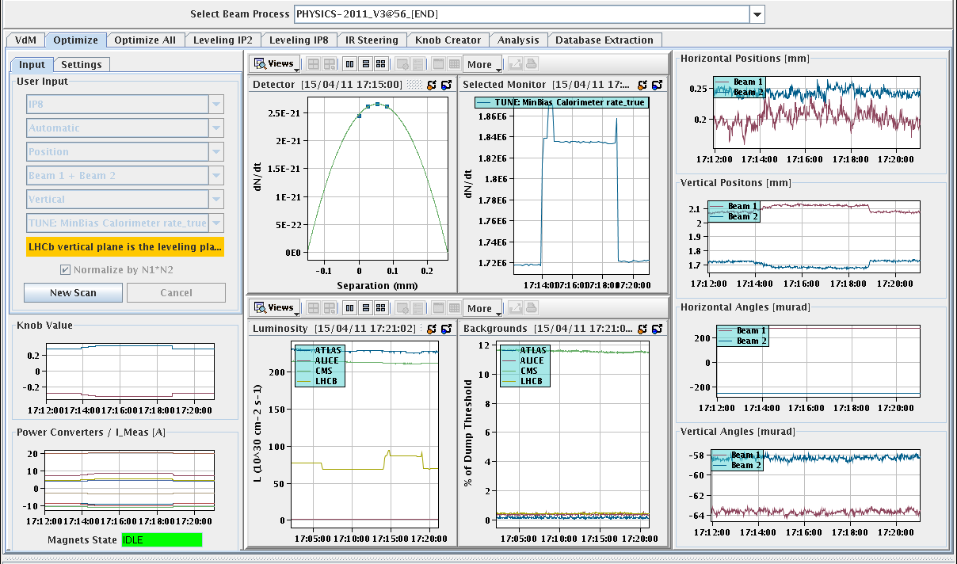
Lumi leveling test

Slide 53
Understanding I…
Beam loss due to small RF frequency trims:
All fully explained by abort gap population and losses?
Not clear to me: go through numbers…
Coupled-bunch instabilities kicking in at various instances:
Apparently driven by increase in beam intensity, filling pattern and probably emittance variation from PS.
Equalize bunch intensities and emittances from injectors.
Understand thresholds for coupled bunch instability.
How far can we increase transverse damper gain (20 turn limit → factor 5 still available?).
Look at optimal octupole settings.
Vacuum pressures and heat loads:
Stronger for 72b trains than for 36b train.
Understand if this is possible problem.
Define parameters for scrubbing in physics.

Slide 54
Understanding II…
Limitations in MP setup:
Single bunch logic for IR6 BPM interlock.
Increase IR7 BLM thresholds for more room in beam loss (20 kW to 500 kW).
No immediate action but needed to go towards design parameters.
Reaction to flaky BPM’s: set SIS interlock values tighter?
UFO’s:
Apparently higher rate with 72b trains from e-cloud filling scheme. Why this?
Kicker flash-over event:
All fully conform?
Provoked by injection of high intensities?

Slide 55
To be done…
Redo periodic loss maps (MP requirement every 4 weeks):
B1/B2 off-momentum +- 500 Hz, 3.5 TeV (last done 13.4.), 2 ramps
B1/B2 off-momentum +- 500 Hz, 450 GeV, ~1h
Software fix for transfer of feedback reference.
Incorporation of lumi scan values.
Lumi-leveling for IR8 to be made fully operational.
Next intensity step → > 4e32 cm-2 s-1 peak lumi
Operational setup of beta* interlock functions for collimation.
End of fill scraping → 50 ns halo population after lumi fill.
Increase coll. BLM thresholds for 500 kW design losses.
Handling flaky BPM’s (2.5 σ offset at TCP, caught by SIS).
Single bunch logic for IR6 BPM’s → several dumps.
Recurrent HW problems: electron stopper, IR2 compensator

Slide 56
Incoming
Monday | Recovery from kicker flash-over
 | Loss maps for collimation (2b, 3.5TeV, 450 GeV)
 | Analyze kicker flash-over event. If fully conform:
... | Physics 336b (another ~10h) and beyond

