Slide 1
LHC Status Wed Morning 13-April
R. Assmann, B. Holzer et al
✔
1.) BPM calibration study
2.) Ramp with 228b: present conditions and filling scheme as this afternoon. Call Andy Butterworth for RF before ramp. All the cycle into collision, no stable beams. End-of-fill: scraping (after 22h00)
3) Back towards physics: Switch on ALICE and LHCb (during rampdown)
Inject 2 nominal + 1 pilot schemeRamp with tune feedback off, RF modulation on for chromaticity, FIDEL. All the sequence into collision, no stable beams
4) ALPHA/TOTEM Roman Pots: After ramp down stay at injection energy without beamCall ALPHA and TOTEM 1 h in advance: interlock tests
5) ATLAS/CMS back on
Call ATLAS/CMS control rooms 1h in advance (~05h00) to switch on solenoids. Ramp up should start at 06h00CMS will stop at 2T until they have collected 2h of stable beams with this.
6) Towards next physics fill: Make sure all Roman Pots are out and no interlocks are active. Put back physics energy and physics beta*
Inject into new ~220b injection scheme for 50ns Stay with 36b injection. If needed, go into injection line optimization
7) During next days: Abort gap cleaning and gain optimization ... to be done
✔
✔
✔
✔
✔

Slide 2
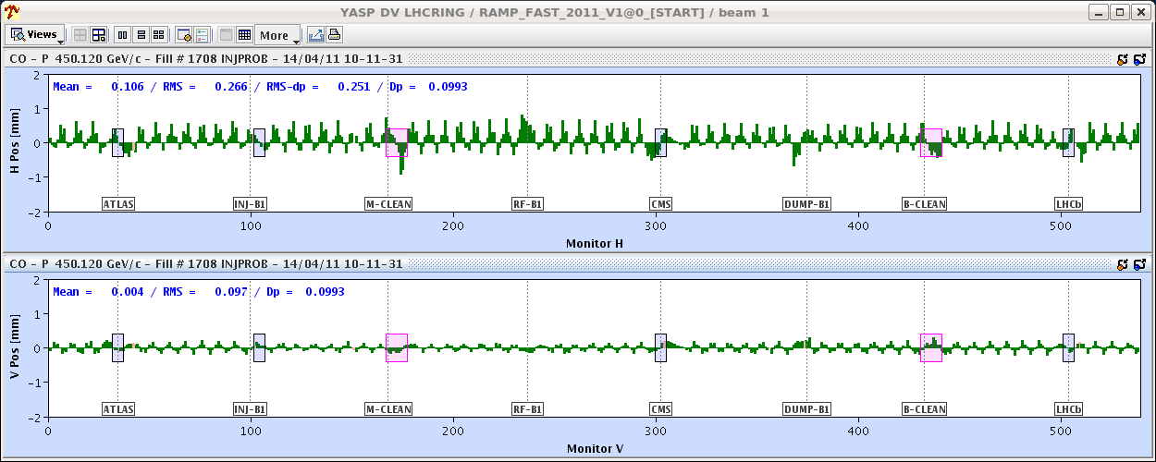
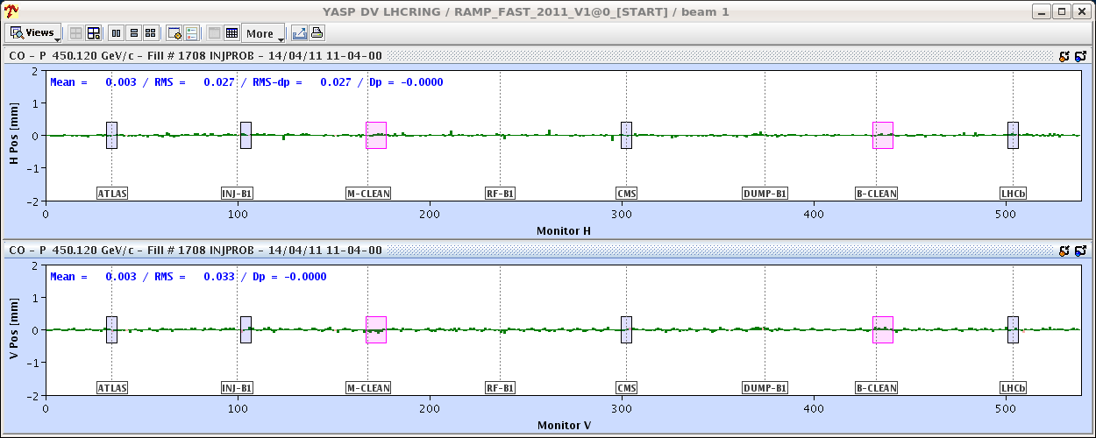
Thursday Morning:
Alice / LHC on
Difference orbit due to
“non-closure of compensators”: corrected

Slide 3
Thu Morning: preparing for 228 bunch operation
Test Injection / Ramp / Squeeze / Collisions: 2+1 bunches
nice, small chroma
variation
LHC RUN CTRL: BEAM MODE changed to FLAT TOP
Increasing strength of octopoles. going from knob strength =1 to 2 in steps of 0.5

Slide 4
Thu Late: set up collisions
✔
1.) Injection
2.) Ramp: ... Octupoles ?
3.) Dump: Alice ... ?

Slide 5
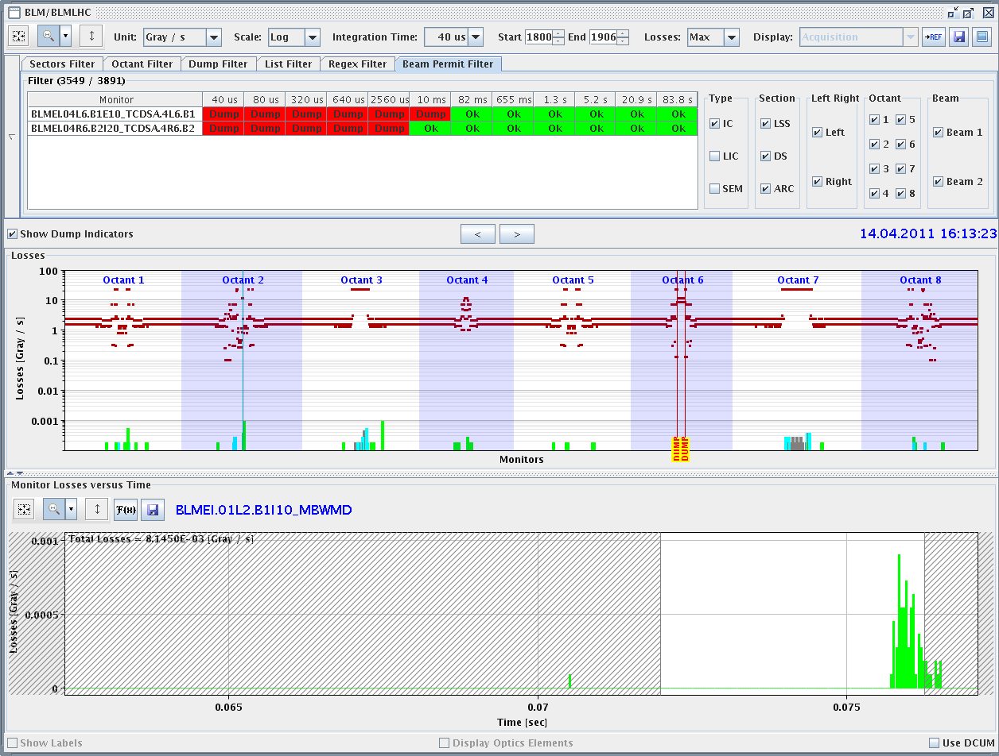
Thu Late: set up collisions
Dump: Alice ... ?
... or Ufo’s ?

Slide 6
Thu: Afternoon
16:13h Dump, precycle, inection ...
17:44h RQT13.L7B1 tripped:
cooling problems. In the end they changed the module.
22:35h Machine filled, beam at 3.5 TeV
✔

Slide 7
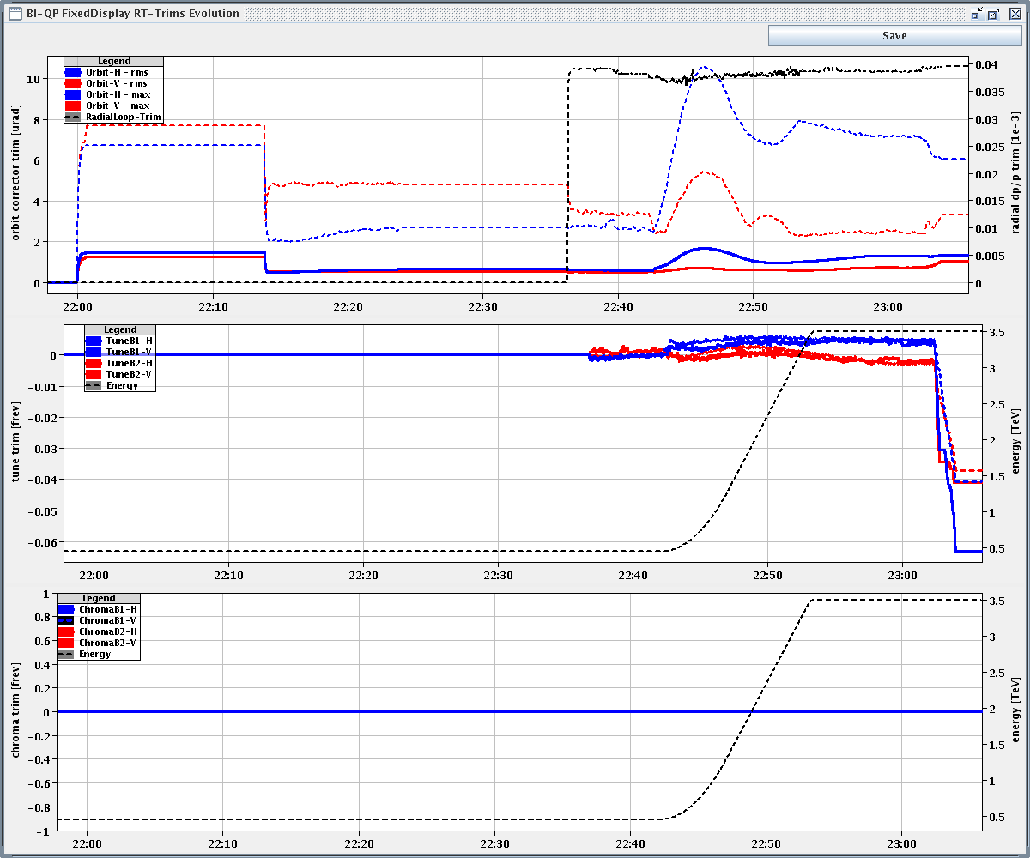
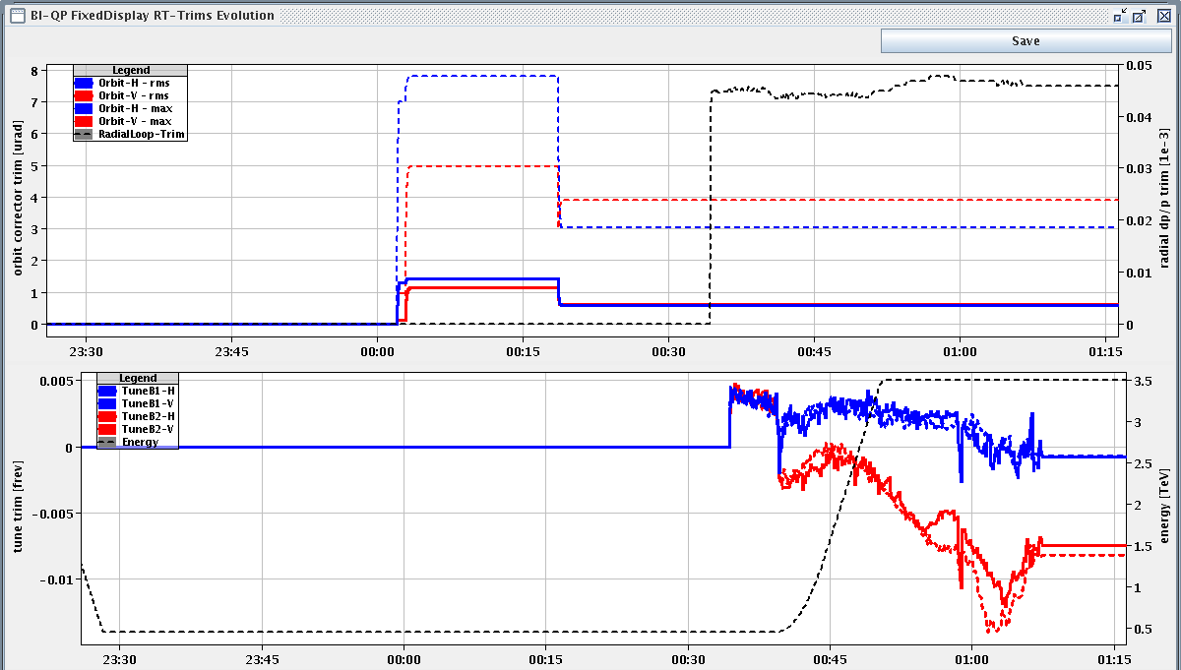
Thu Night:
23:05h beam loss, wrong tune peak
00:55h precycle, injection, ramp, squeeze
... and collisions
orbit corr trim
tune corr trim

Slide 8
Plan:
After all IR steering
... relative beam position was far off !!
stable lumi run CMS
τ ≈ 125 h

Slide 9
Plan:
1.) 200 bunch collisions:
three stable long lasting fills
2.) if successfull: increase to 300 bunches
3.) no access, no interruptions if not absolutely neccessary
4.) and hopefully no ufo dumps

