Slide 1
Wednesday 13.04
08h18: 228b fill lost just before start of ramp.
Transv. damper was switched off for chromaticity measurement.
09h02: Injecting again for 228b.
Beam dump due to losses at injection.
PSB checks. SPS had slight reduction in scraping. Last bunches in batch had very low intensity.
Still losses at 70% of dump threshold for 72b injection.
13h12: Ramp.
Capture losses B1:1.5E10 out of 2.8E13 (0.05%).
Capture losses B2: 2.0E10 out of 2.8E13 (0.07%).
Tune feedback switched off at 13:18:51 (due to a coupling that was larger than the tune split).
Losses associated with coupled bunch instability started at 13:19:00.
13h33: Squeeze.

Slide 2
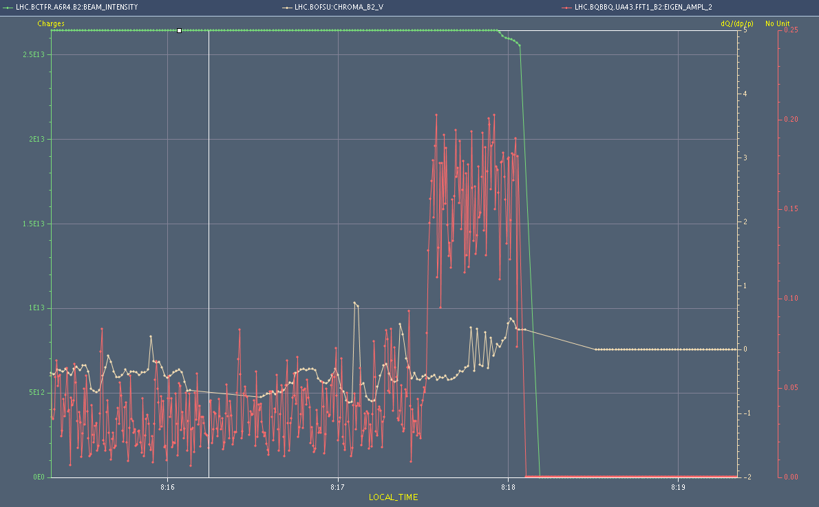
Fill lost at 8h18
Intensity - 7%
Tune amplitude
Chroma

Slide 3
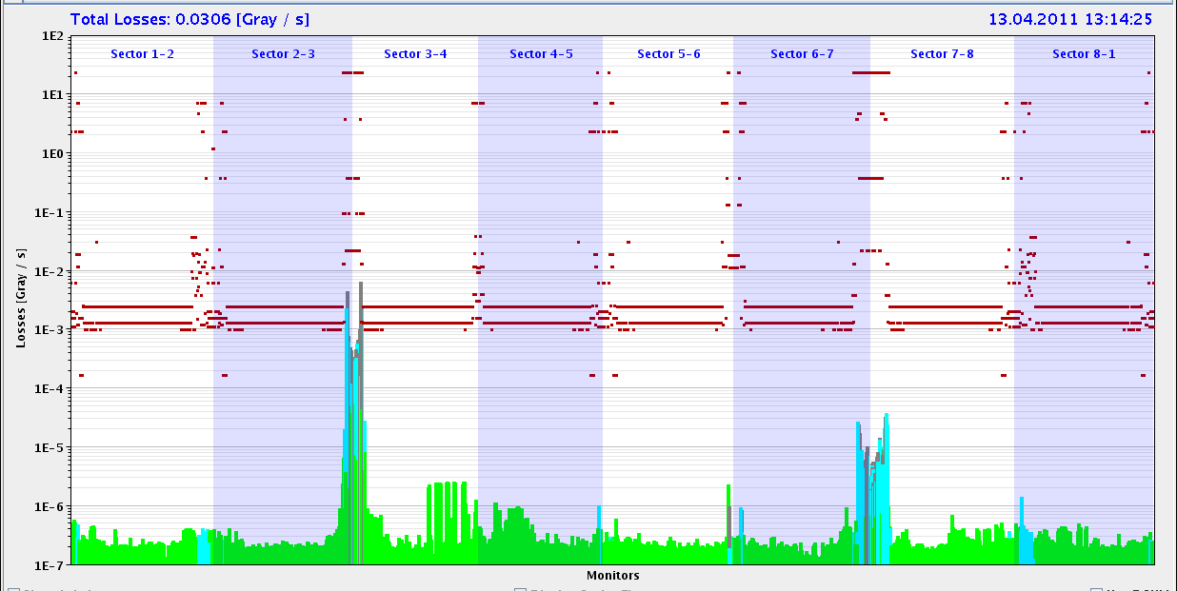
Ramp 13h12: Losses Start of Ramp
Philippe: Capture losses B1:1.5E10 out of 2.8E13 (0.05%).
Capture losses B2: 2.0E10 out of 2.8E13 (0.07%).

Slide 4
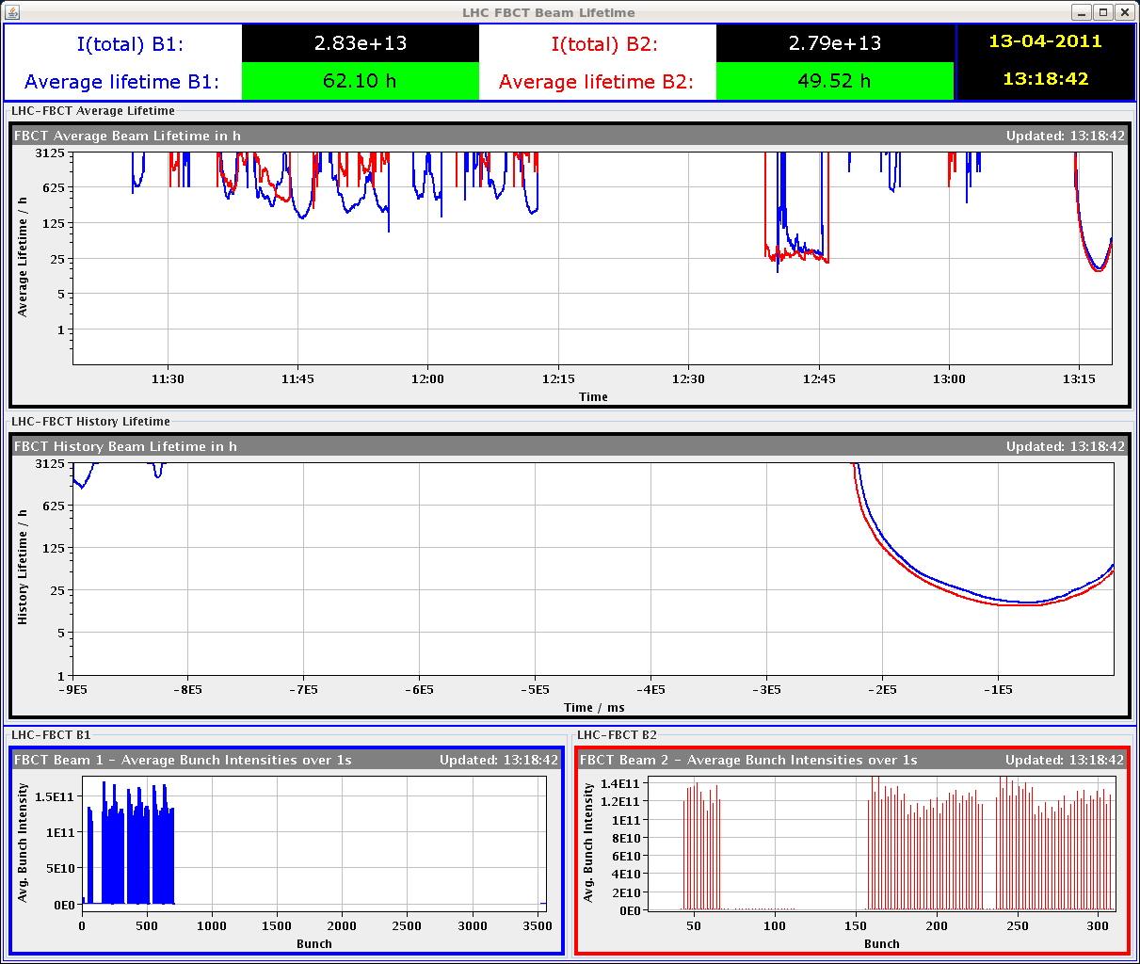
Lifetime start of ramp

Slide 5
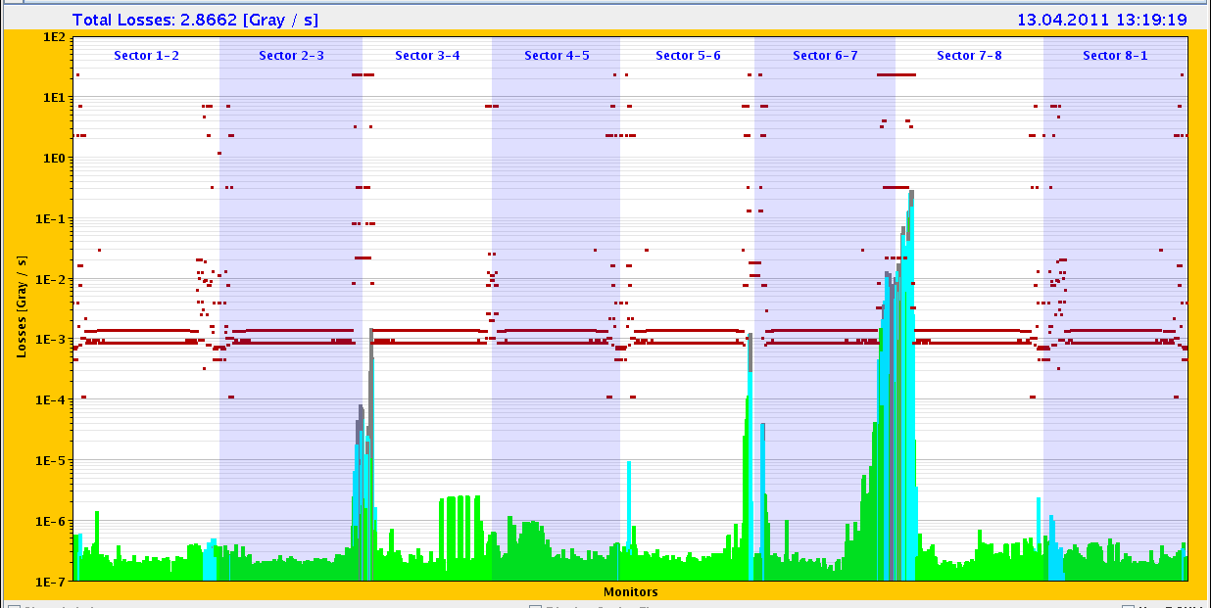
Ramp 13h12: Losses at ~1.5 TeV
TCSG.A6R7.B2 close to dump value

Slide 6
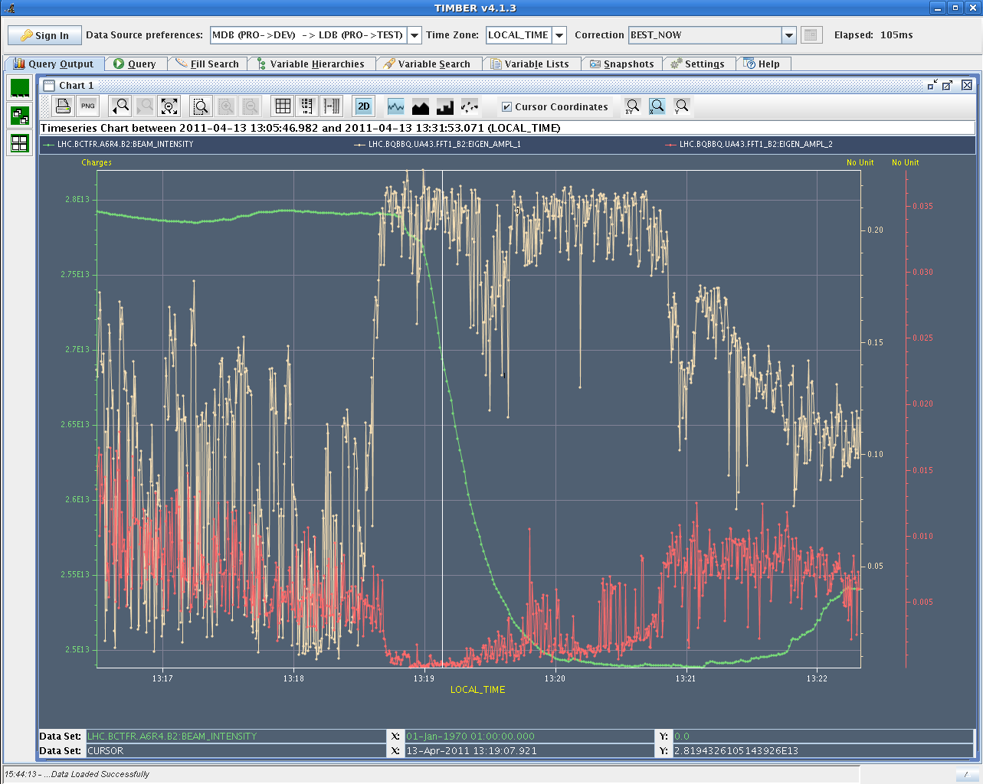
Loss: ~5e10 p/s → τ~9 min → ~12 kW

Slide 7
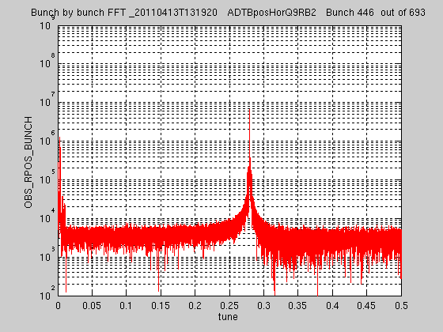
Strong coherent excitation (ADT)

Slide 8
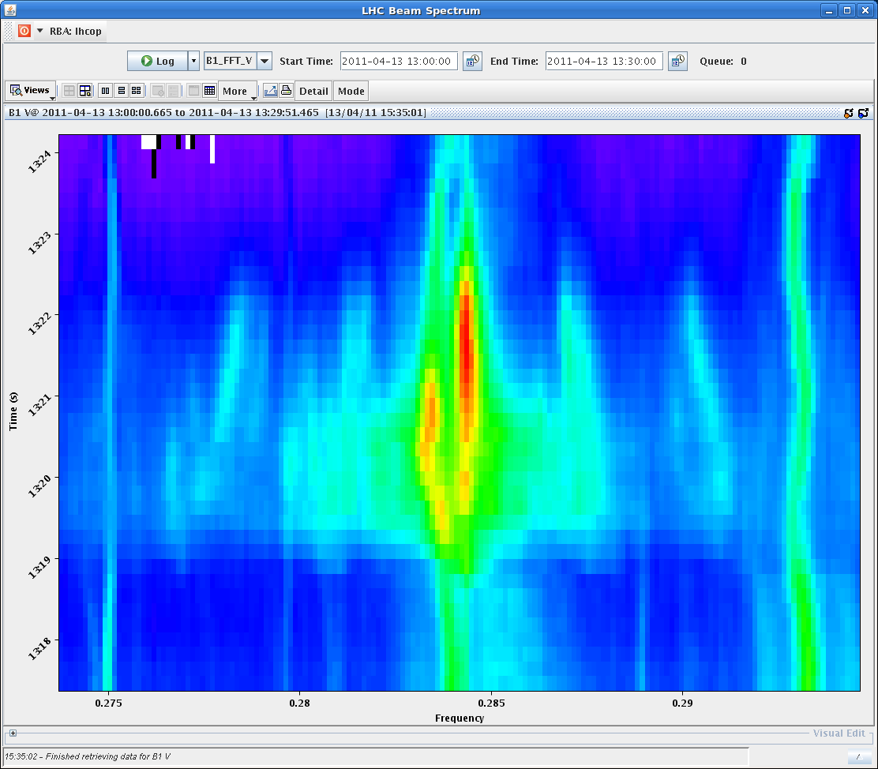
Tune excitation

Slide 9
Intensity around ring

Slide 10
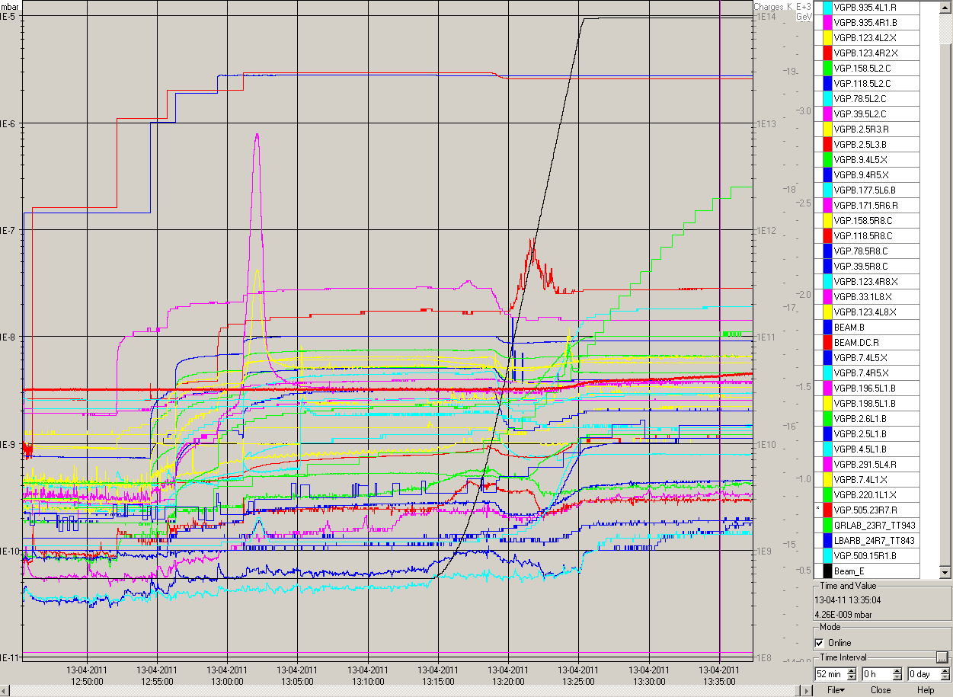
Pressure variation

Slide 11
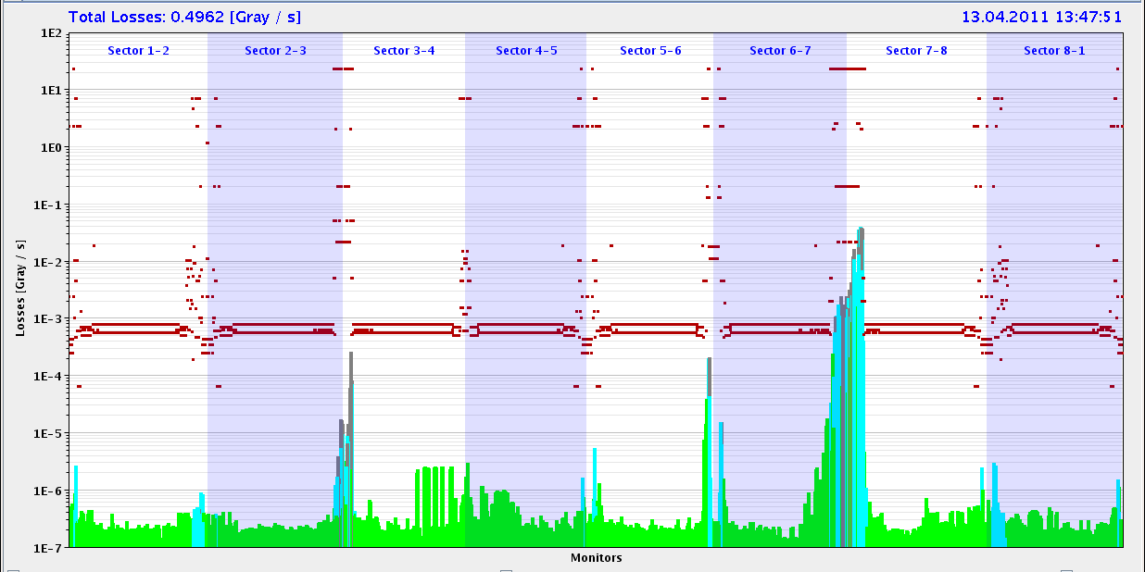
Losses in squeeze

Slide 12
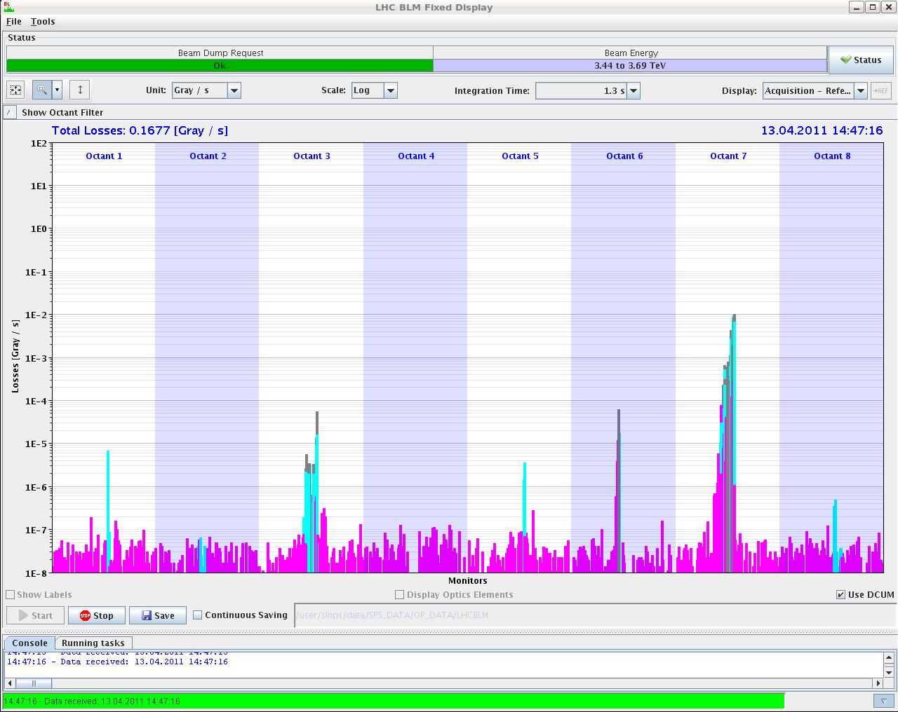
Effect of 0.003 Tune Trim

Slide 13
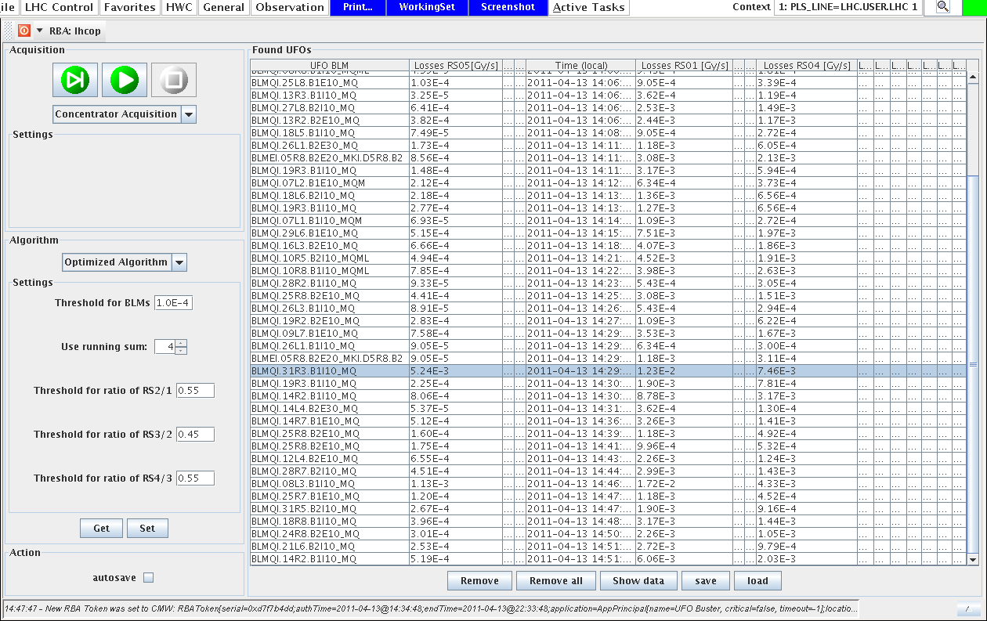
UFO’s: 90 in 90 minutes

Slide 14
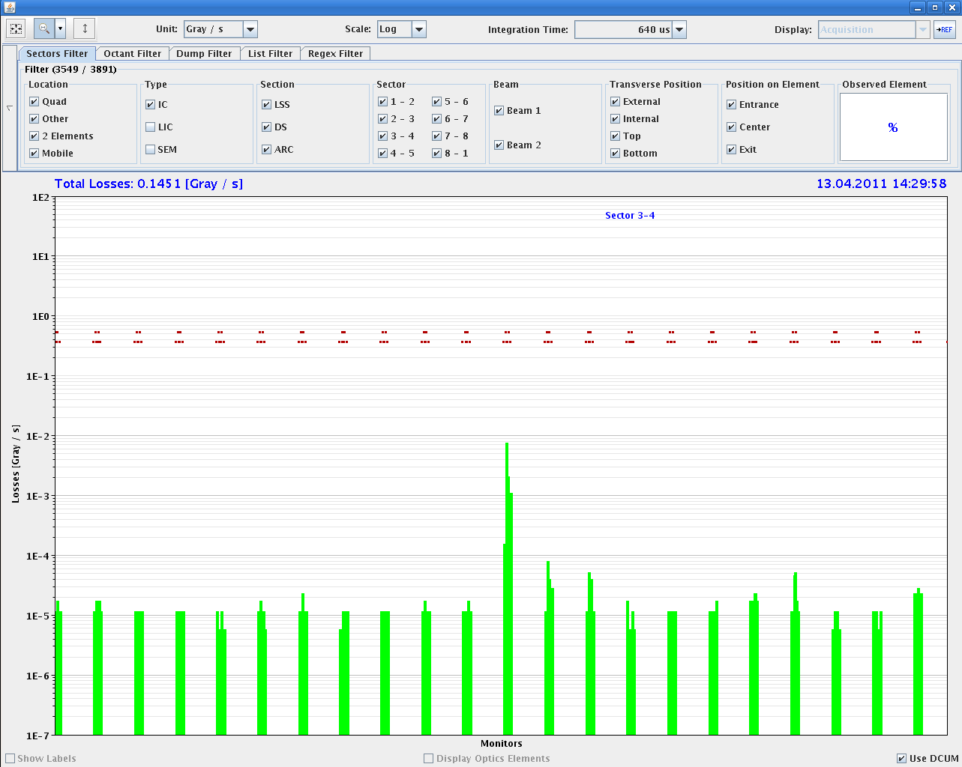
UFO example sector 34

Slide 15
Wednesday 13.04
13h33: Squeeze.
14h57: Stable beams. Lumi 2e32 in ATLAS and CMS.
16h37: Beams dumped by EIC. BPM studies start.
17h46: Post-mortem. LBDS-B1 was armed during BPM calibration which triggered IR6 BPM interlock (no beam).
18h17: SMP configuration changed to be able to obtain the STB and MDI flags at 450 GeV - for the TOTEM/ALFA tests tonight.
18h21: Injection for BPM checks with beam.
19h29: Changes for next ramp…
Reduction of the chromaticity by 2 units for beam 1 and beam 2 - Horizontal plane in the middle of the ramp.
Increased octupoles.
Increased damper gain.
20h19: BPM studies completed.
20h46: RF problems in SPS.

Slide 16
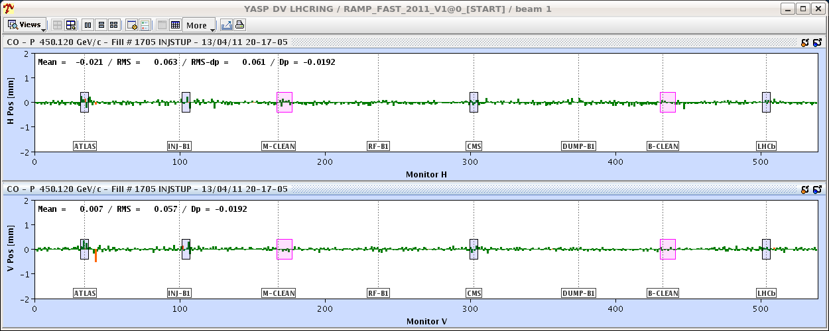
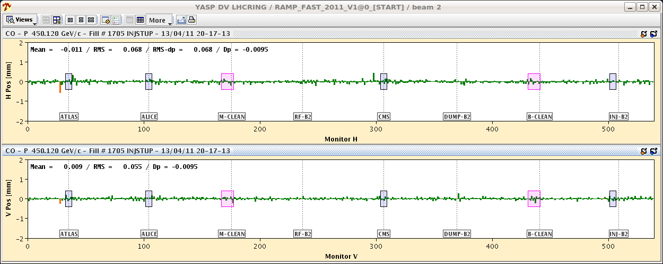
Orbits differences after 50 ns calibration

Slide 17
Summary of BPM test (BPM team, Joerg)
Injected an individual bunch with BPM calibration for individual bunches and corrected back to the normal 450 GeV reference,
Downloaded the calibration factors for 50 ns spacing: the measured orbit moved up by an amount consistent with the difference measured between trains and individual bunches (~ +0.14 mm).
Injected 12 bunches after the individual bunch (with 50 ns BPM calibration). The orbit offset disappeared and the orbit in both planes was again centered. After a light correction the rms difference came back to ~60 microns.
The conclusion is that if the orbit is calibrated in a mode that is consistent with the bunch filling (single bunch, 50 ns, etc) the orbits measured with the different filling scheme agree within ~60 microns rms, and the shift of the mean values are at the level of 10-20 microns maximum.
Until a sequencer task can be made operational (before the weekend - we hope), the shift crews have been instructed on how to calibrate the BPM system for 50 ns operation. For individual bunch operation, use the existing sequencer task!

Slide 18
Thursday 14.04
00h59: ALFA and TOTEM interlock tests (SPS still down).
01h33: SPS available again. Was a problem with radial steering function.
03h58: Injection.
04h55: Ramp.
05h16: All OK from RF.
05h26: Adjust.
05h37: Beam losses during lumi-scan. IR6 BPM interlock (one bunch below threshold).
06h12: ATLAS and CMS prepare ramp up. Delays in CMS.
06h28: Sector 67 tripped due to glitch on 18kV.

Slide 19
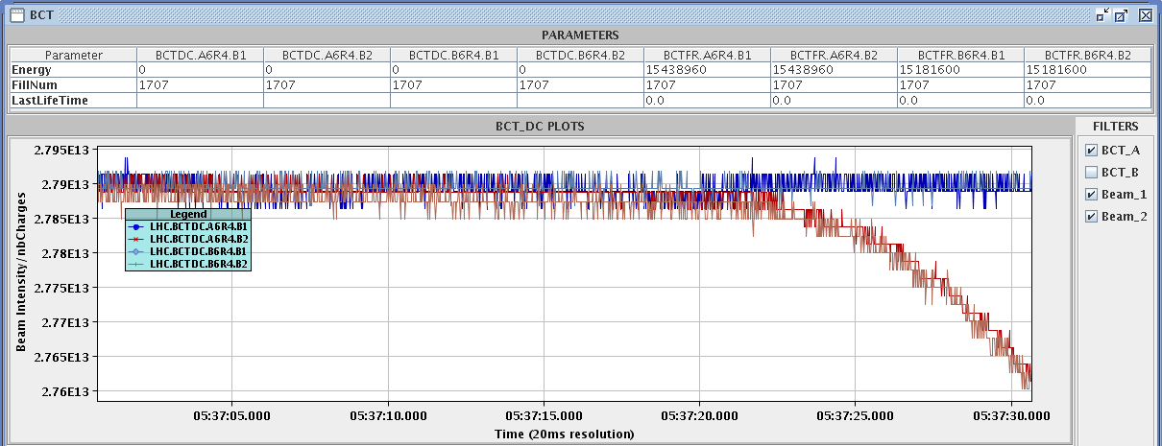
Beam 2 intensity in lumi optimization (IP1)
2e11 p lost in 5 s → 22.4 kW → τ = 12 min

Slide 20
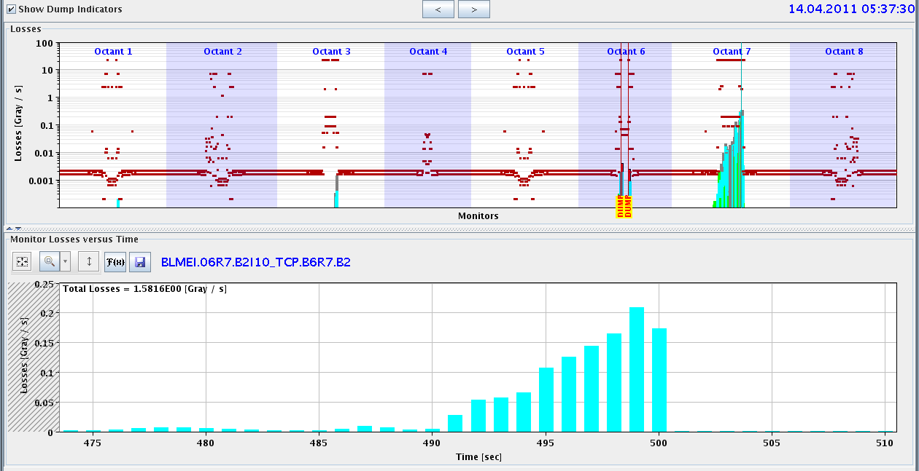
Beam losses in IR7
OK for cleaning at 22 kW but one bunch dropped below sensitivity range → IR6 BPM interlock. Logic must be adapted (see also 1.38 TeV experience).

Slide 21
Incoming
Thu AM | ALICE, LHCb on (negative polarity). Ramp 2+1b. Chromaticity. Fidel. ATLAS/CMS solenoids on.
Thu PM/night | Stable beams 200b, 50ns.
Fri/Sat/Sun | Stable beams 200b → 300b.
 | Transverse damper and gain gain optimization.
 | Injection line tuning, if required.
 | End of fill studies: scraping for 50ns halo.
Accesses:
Transverse damper (HOM checks – 2/32 channels dead). Before 300b. ~1 h
Beam dump? 2-3 h

