Slide 1
HTS lead protection cross-wiring
Friday 8 April 2011
M. Koratzinos, B. Panev, J-P. Tock, R. Denz, K. Dahlerup-Petersen, G. Dangelo

Slide 2
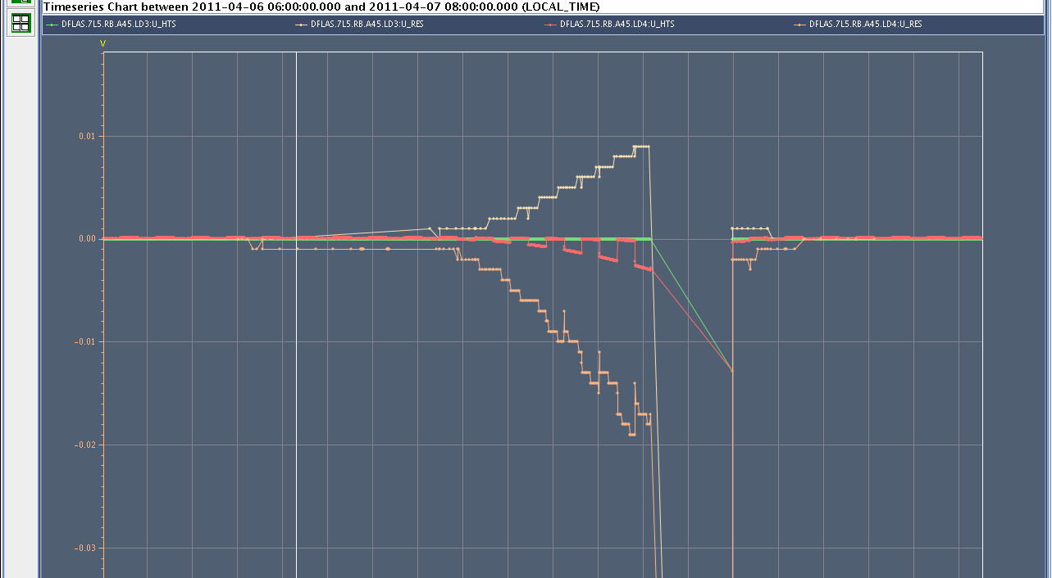
Trip of RB.45 on 7/04
QPS trip at 2349 A during ramping up (precycle)

Slide 3
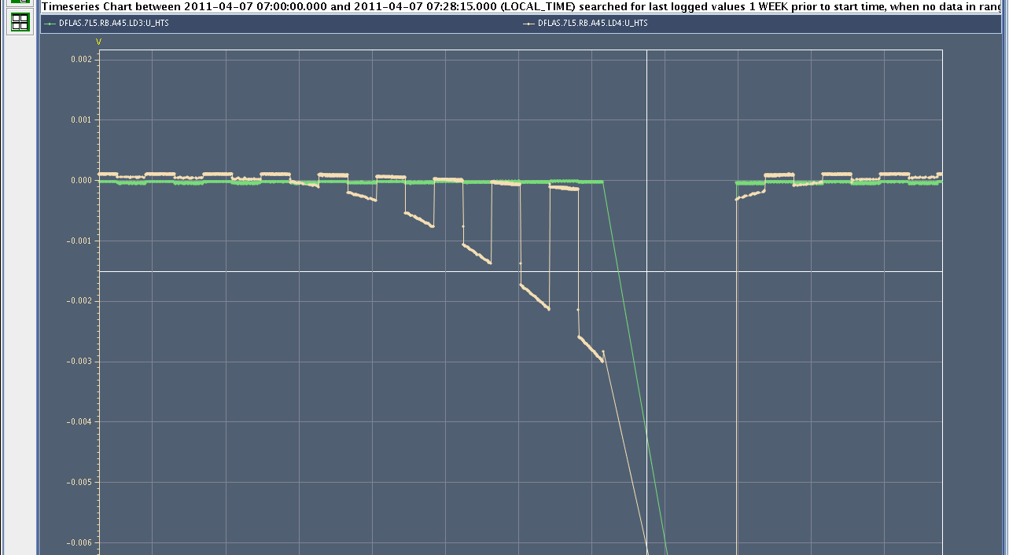
Trip of RB.45 on 7/04
Signals from CL3 CL4. CL 4 signals (board A vs B) are abnormal

Slide 4
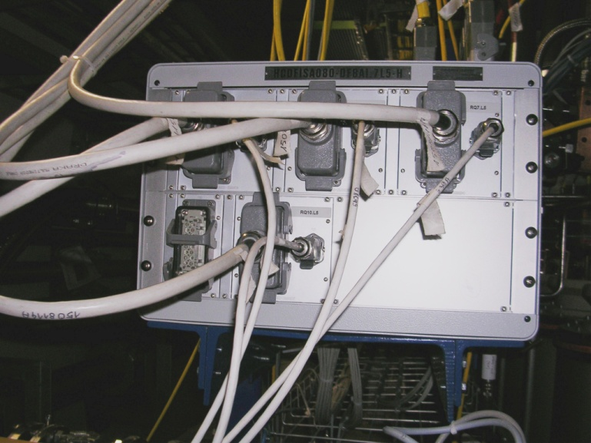
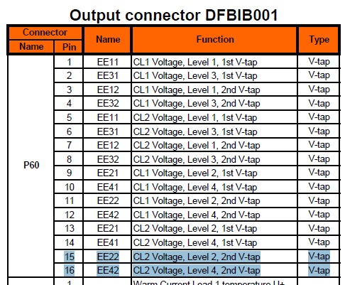
Simplified schematic…

Slide 5
What was swapped…?
What was found swapped in RB.A45, Lead#2 on DFBAI (L5)?
EE22 (pin 15) and EE42 (pin16)
of cable between PE and QPS controller

Slide 6
Signal meaning…

Slide 7
Could there be more U_HTS or U_RES signals with crossed wires?
A recent improvement for this year, makes the search possible by looking into TIMBER data
We can answer the question by looking at existing ramp data.

Slide 8
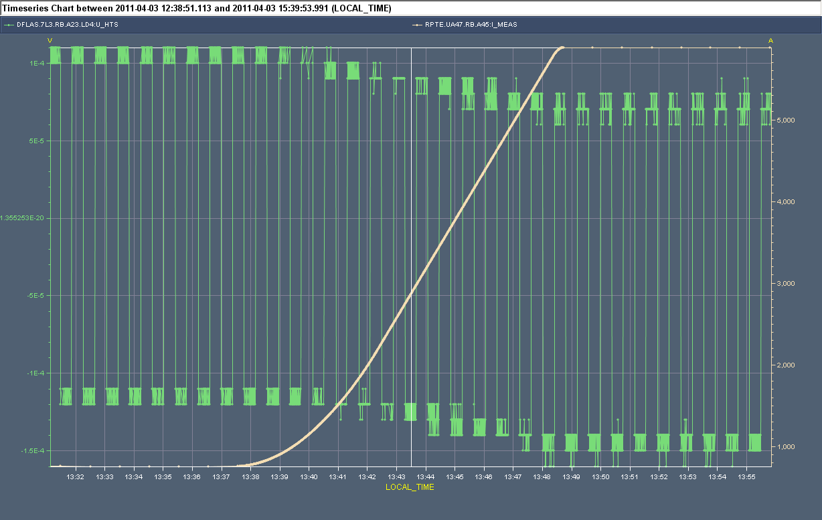
Fill 1670
Board A
Board B
Example of a healthy channel: both boards move in unison during a ramp

Slide 9
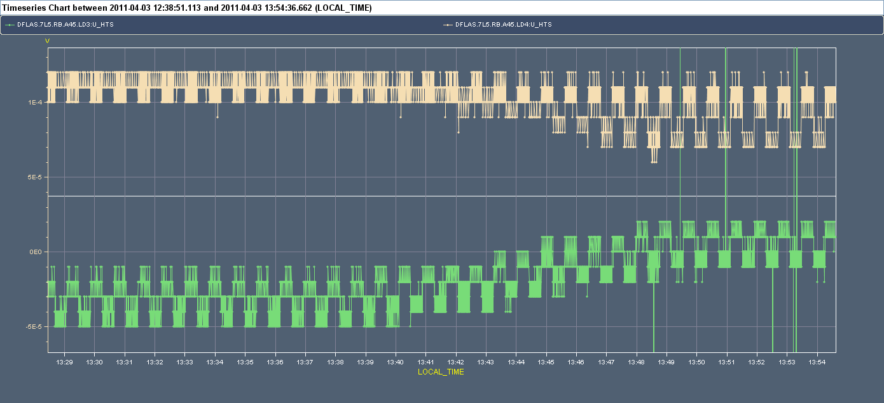
Fill 1670 – U_RES of DFLAS.7L5.LD3&4
LD3 is normal; however, LD4 board B is flat, indicating a problem

Slide 10
Analysis of all main circuit U_RES and U_HTS
Looking at all U_RES and U_HTS data it appears that the only abnormal signal is DFLAS.7L5.LD4, board B
We need to also check all IT and IPQs: unfortunately, we do not have the interleaved feature of board A / board B, so we can check only board A (the default) from old ramps and we need a dedicated ramp for board B
This (software) approach is arguably safer than disconnecting cables in the tunnel…

Slide 11
End

