Slide 1
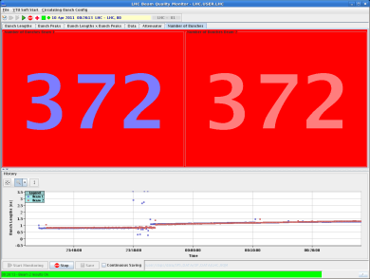
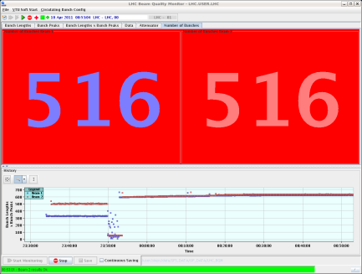
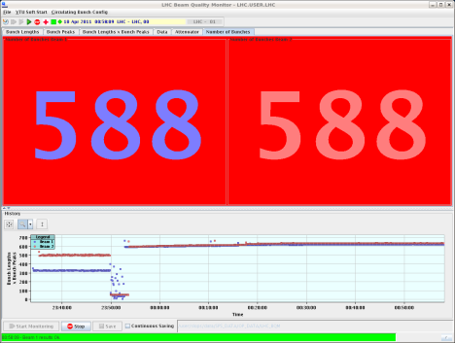
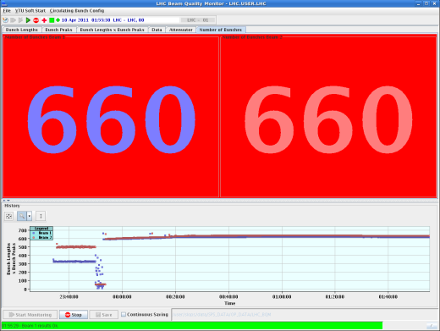
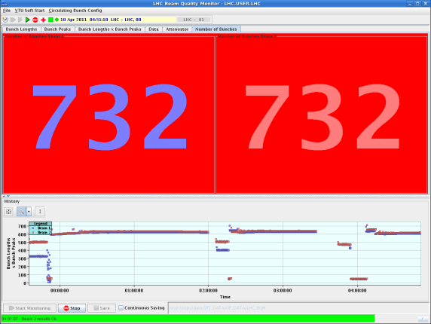
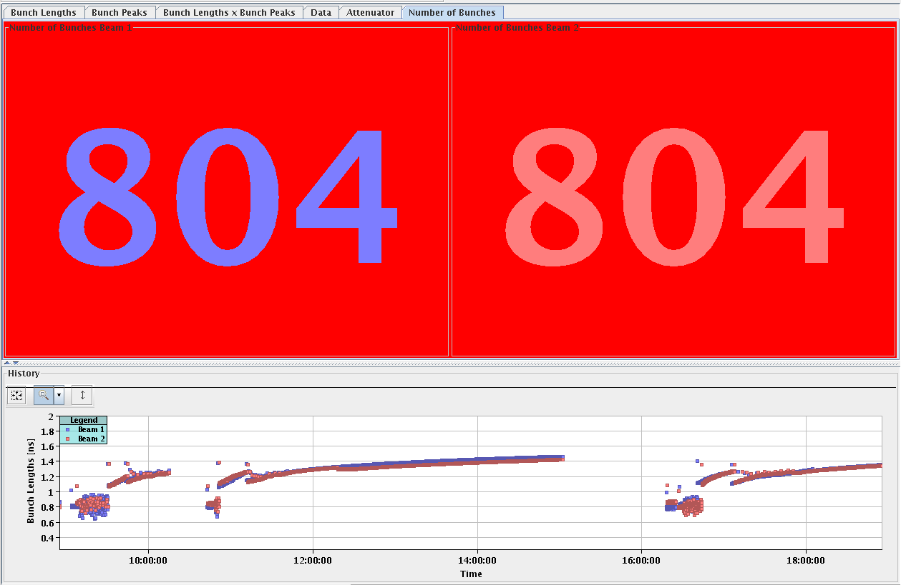
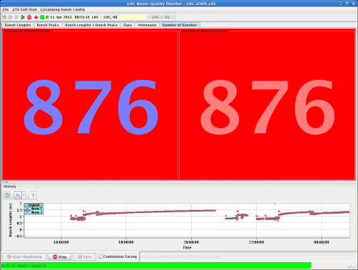
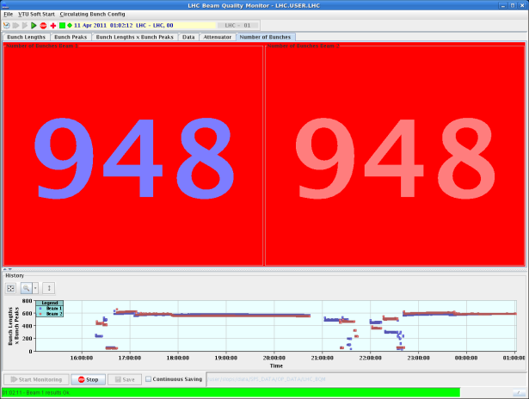
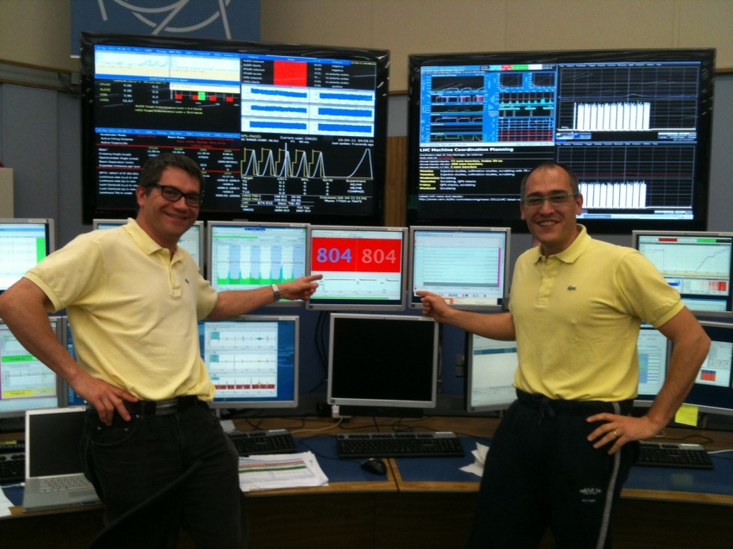
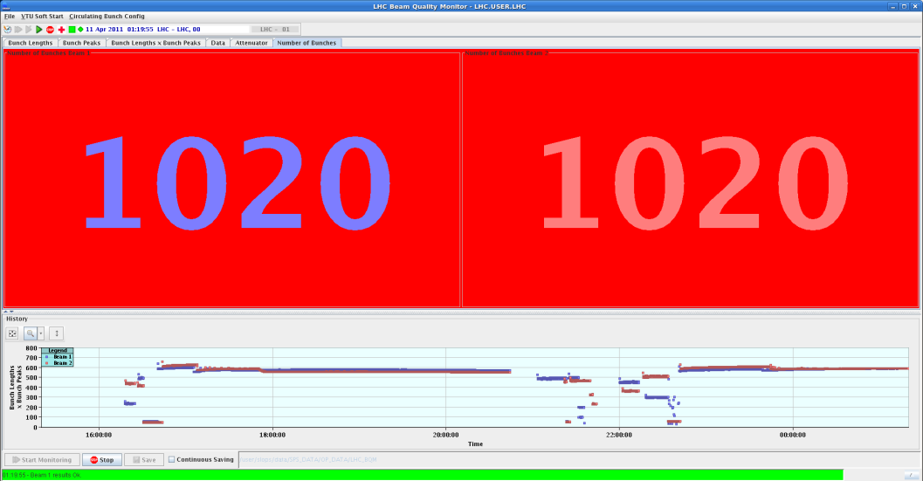
Summary of week 14
Scrubbing run
J. Uythoven, J. Wenninger,
G. Arduini

Slide 2
Event of the week
… that for some time pushed the scrubbing into the shadow.
Thursday afternoon all powering is stopped in the LHC following the discovery of a worrying cabling problem affecting the QPS system protecting the HTS current leads.
Followed by an extensive verification campaign.

Slide 3
QPS - what happened
QPS tripped the RB circuit in sector 45 on Thursday around 07:00.
First time ever quench of HTS current lead
The HTS quenched due to a lack of cooling in the DFB
  Faulty electronics board corrupted the temperature feedback loop, which closed the cooling valves of the current lead
Protection by the QPS monitoring the the current leads.
  Logging of the two HTS signals showed that only one of the two measurements was correct, the other measurement showing continuously low values for Ures, Uhts due to a wrong connection to the proximity box
An identical fault on the redundant signal would have left the system unprotected and could lead to beyond repair damage to the DFB.
  No spares
Decided to stop powering magnets
  Be sure no similar connection error to proximity boxes exist

Slide 4
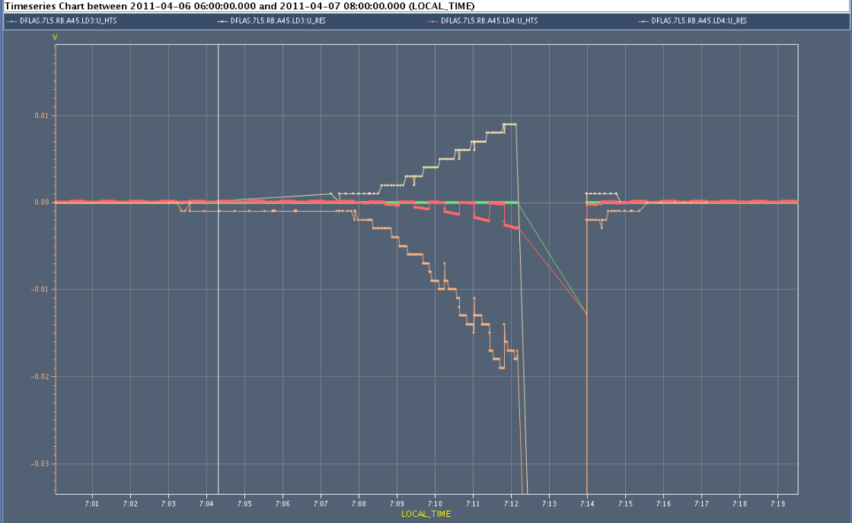
QPS signals monitoring the HTS
Ures Uhts redundant signals, logging swaps every 30 s from board A to board B
One of the signals is not correct !

Slide 5
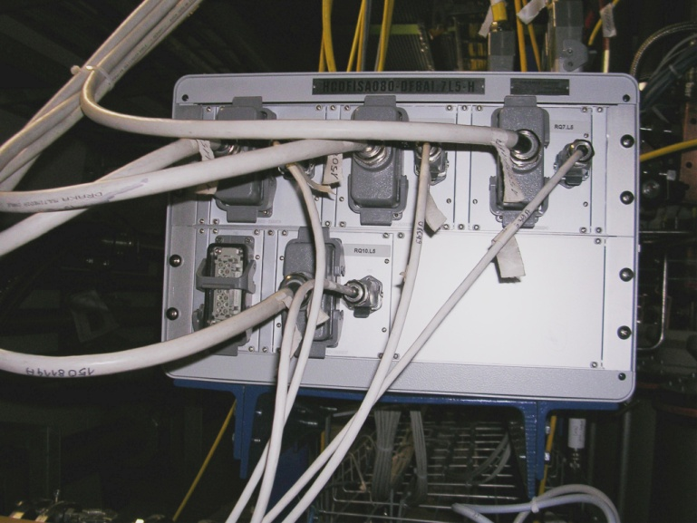
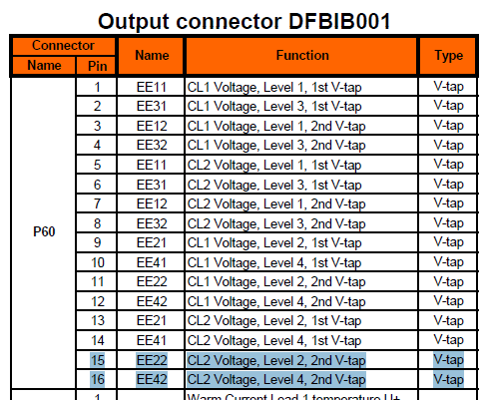
Simplified schematic…
A. Siemko

Slide 6
What was swapped…?
What was found swapped in RB.A45, Lead#2 on DFBAI (L5)?
  EE22 (pin 15) and EE42 (pin16)
  of cable between PE and QPS controller

Slide 7
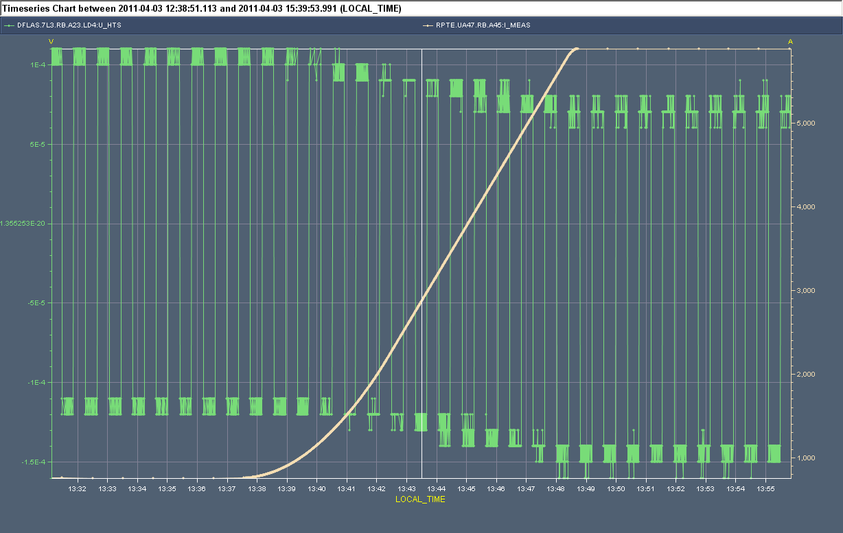
From the logging
Analysis of the logging data from old ramps allowed the QPS team to verify the correctness of the signals for other 13 kA circuits.
Board A
Example of a healthy channel: both boards move in unison during a ramp
Board B

Slide 8
Verification - Friday 8th April
Verification of U_RES & U_HTS on all IPQs, IPDs, ITs using dedicated powering cycles by the QPS team.
  Verification of boards A & B.
U_RES from resistive part of the three leads of RQ9.R2 during asymmetric powering of B1 and B2.
Example: U_HTS from s.c. part of the three leads of RQ9.R2.

Slide 9
Verification - Friday 8th April
In the late afternoon all high current circuits except the 600 A circuits had been checked.
  Acceptable risk for 600 A circuits.
All tests showed the presence of the expected signals.
Green light for powering from TE/MPE in the evening.
Among all the high current circuits we happen to quench exactly the one circuit with a cabling problem !!

Slide 10
Back to the beginning - injection
Goal of the week: injection of 144 bunches (4x36) with 50 ns spacing from the SPS.
Achieved: injection of 108 bunches (3x36) with 50 ns spacing.
Used operationally: injections of 72 bunches (2x36) with 50 ns spacing.

Slide 11
Injection – pre-conditions
Key conditions for good injections:
  Good splitting and low level of satellite bunches from to PS.
    Presence of satellites for intermediate but also for nominal PS batches has caused some headache (until it was clearly identified).
    Separation between injections in the LHC had to be increased to ~1.1 μs to avoid kicking satellites onto the TDIs and TCLIs.
  Good transverse scraping in the SPS.
    Both planes.
    Maximum energy for scrapping ~420 GeV.
  Well corrected and if possible stable trajectory in TI2/8.
    Significant drifts, but also sometimes shot-to-shot fluctuations.
  Abort gap and injection cleaning in the LHC.

Slide 12
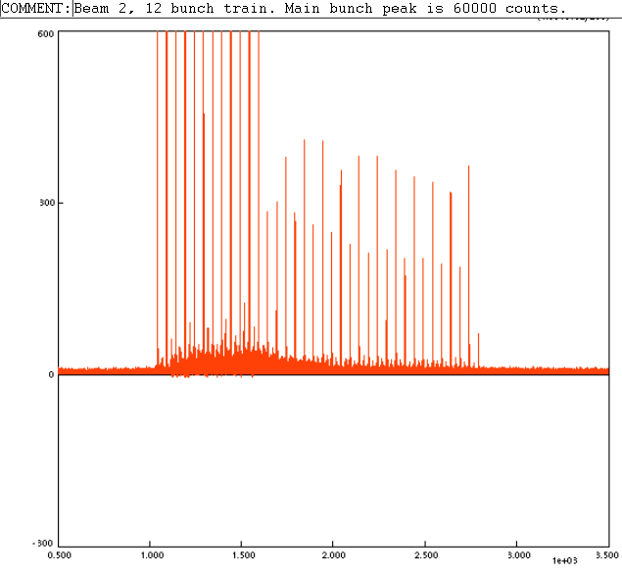
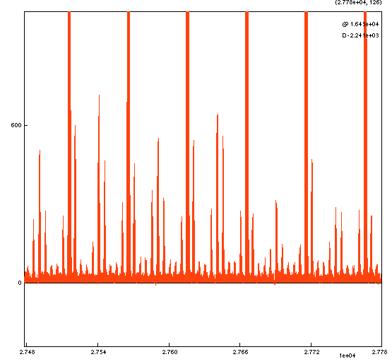
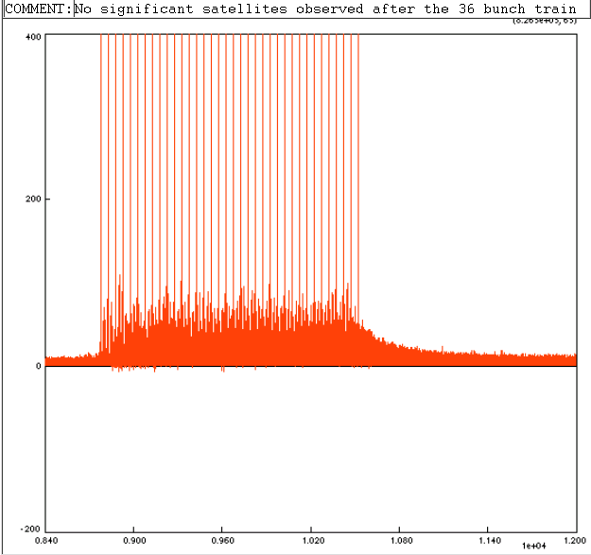
Satellites seen by LDM
5 ns ghosts
First 12 bunches
36 bunches
Adam Jeff
Satellite < 1% of peak bunch intensity but get swept into experiment by the LHC injection kicker

Slide 13
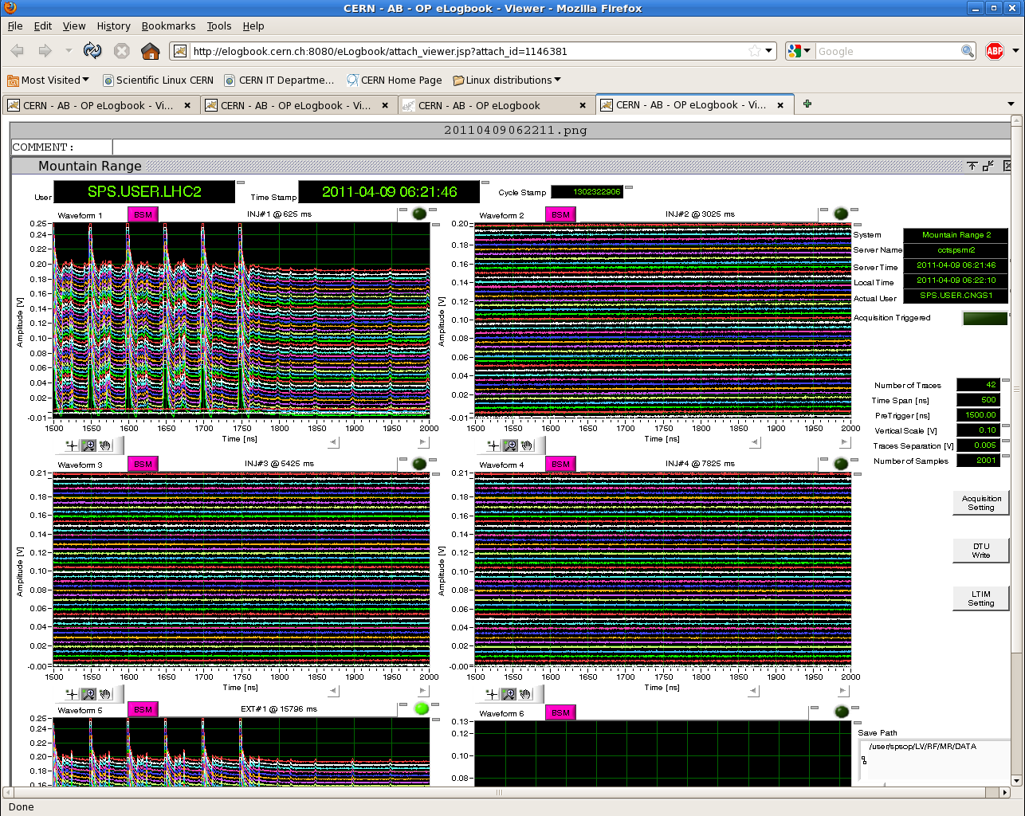
Satellites on the SPS mountain range

Slide 14
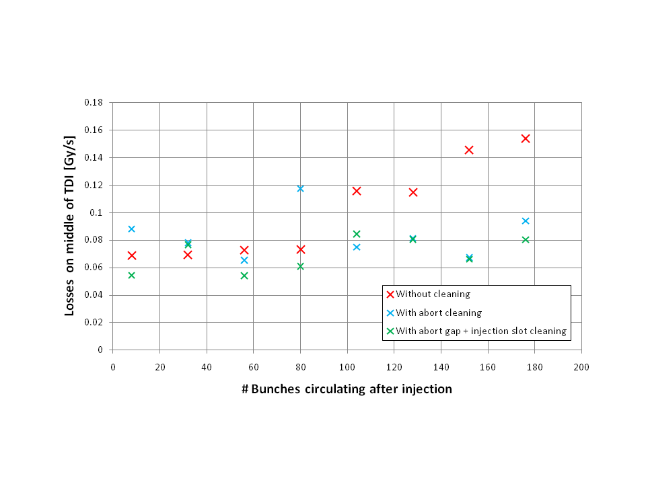
Injection cleaning
Influence of abort gap and injection cleaning.
  With higher RF capture voltage there is less un-captured beam, injection cleaning not as critical.

Slide 15
Injection setup so far…
Injection of 108 bunches (3 batches) with 50 ns done.
  Losses at the level ~40% of thresholds during setup.
Injection of 144 bunches pending…
Stability of beam parameters is a key ingredient to inject many bunches !
  Losses have been increasing again over the weekend.

Slide 16
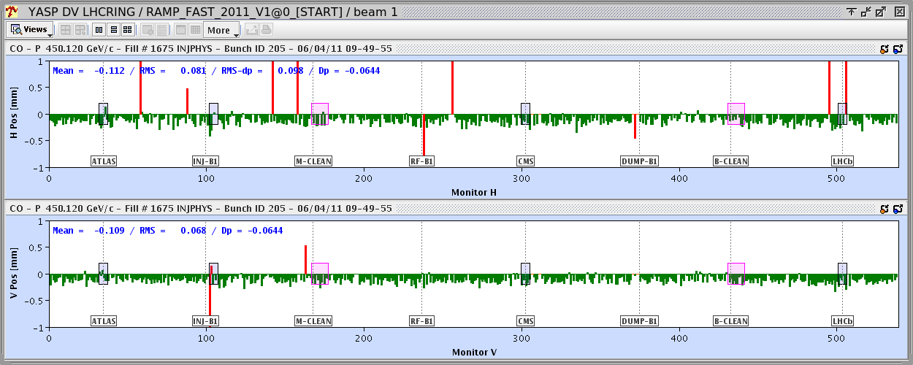
Systematic position shifts of BPMs
Recent observation of systematic BPM shifts was traced to a filling pattern dependent shift (ADC).
  Orbit is different for first bunch of train and bunches with large spacing (reset effect).
Orbit for second bunch in train wrt first :
~ -0.12 mm shift, rms of similar size

Slide 17
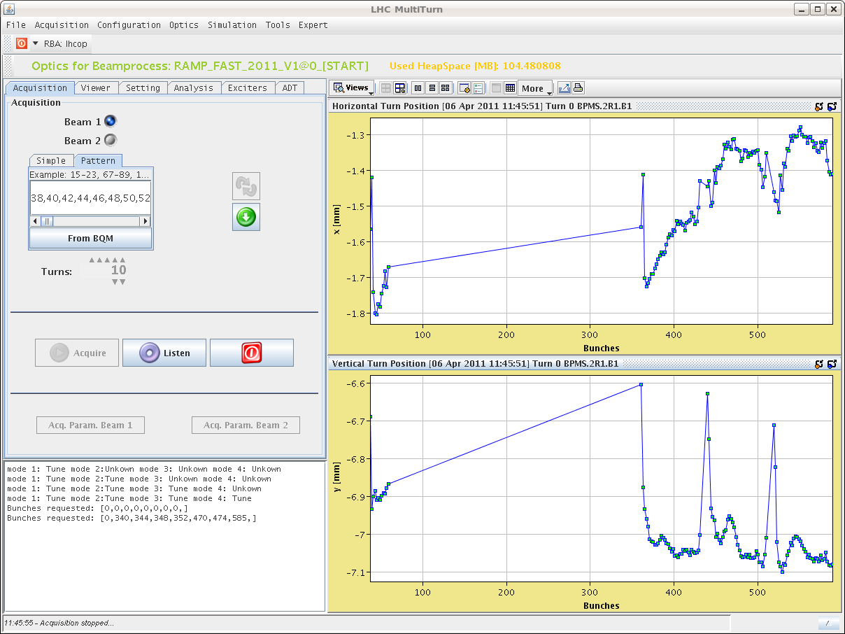
Position shift
Affects mostly first bunch, structure in train not clear, depends on the BPM.
  Shift versus bunch position in trains depends a lot on the BPM.
3 trains of 36

Slide 18
Consistency issues
To cope with this effect, OP is now working at 450 GeV with 3 distinct references (probe, indiv, train).
  Orbit reference for ramp with trains to be re-measured.
  Not ready for ramps with trains (or must accept 0.12 mm offsets).
Need calibration tasks adapted to the different schemes to avoid a multi-reference jungle.
  Calibration should be able to compensate for the effect.
  Quality of compensation to be measured.
  This probably also affecting the TLs.

Slide 19
Collimation
Setting up of the collimators that had been realigned (angle) during the TS has been completed at injection and at 3.5 TeV.
A collimator hierarchy violation in B1 horizontal has been observed 3 times over the time scale of a week (started in W13).
  No such effect for B2 and for B1 vertical.
  Hierarchy always breaks down ~ in the same location (not far from skew collimator).

Slide 20
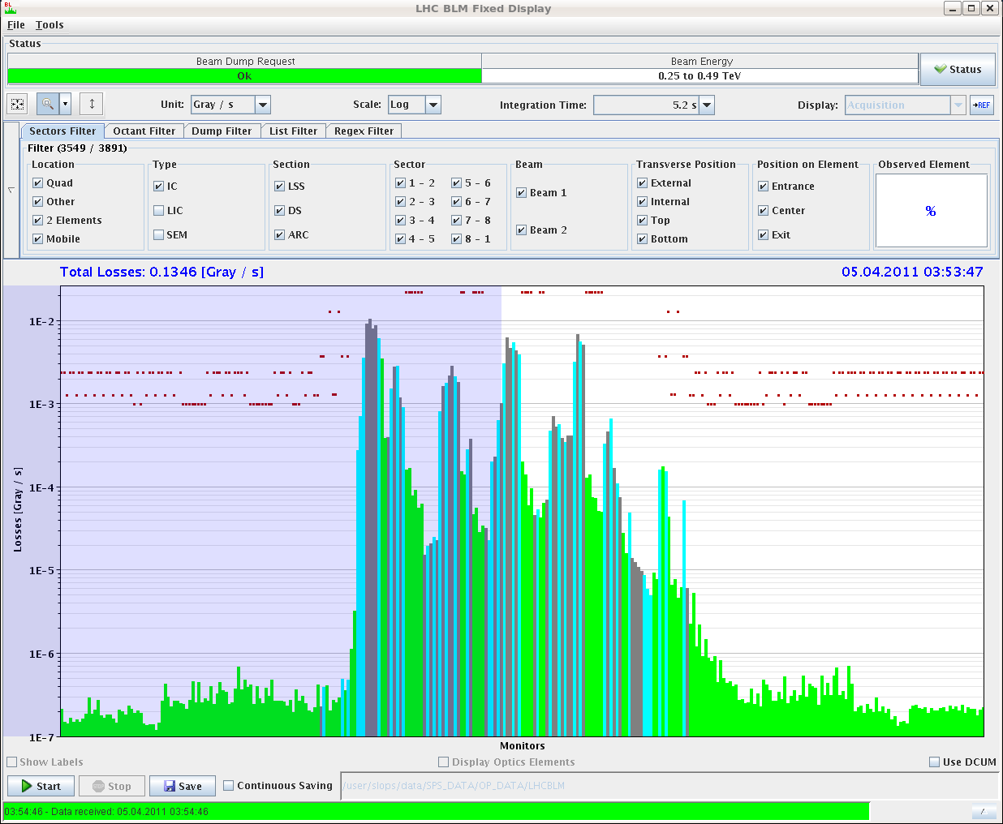
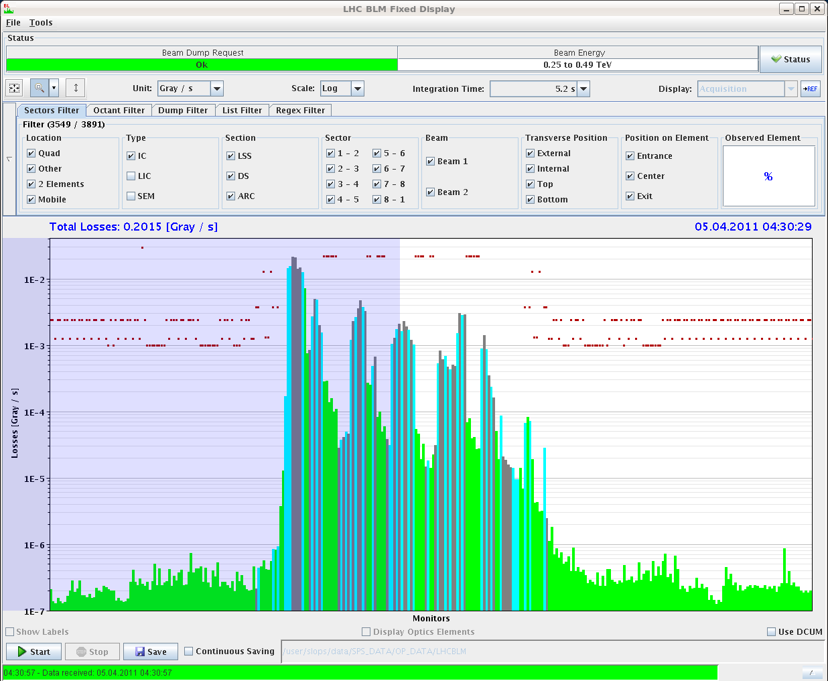
Loss maps B1H – April 5th
First loss map
Between the maps:
Very small orbit correction.
Small change in procedure: B1 H map done first.
Second loss map

Slide 21
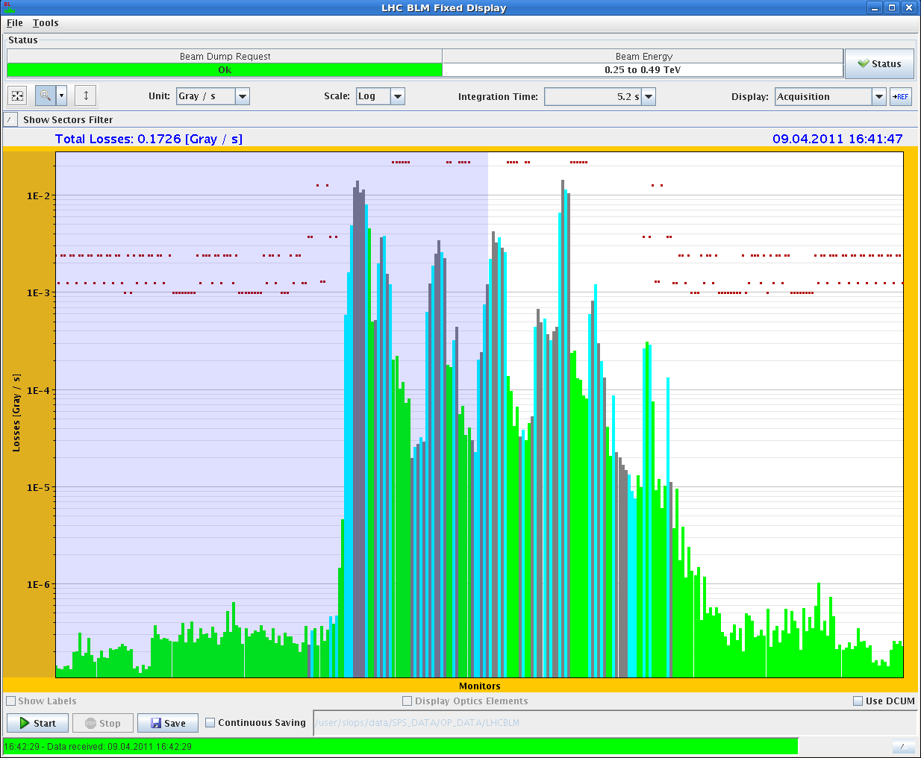
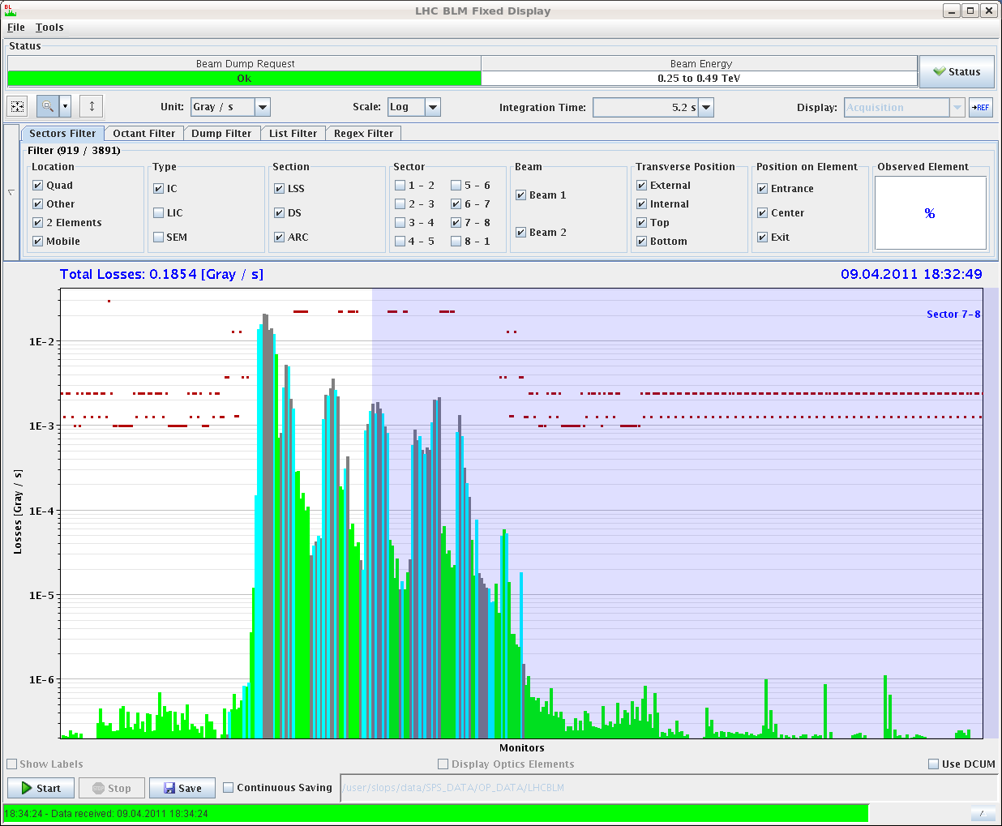
Loss maps B1H – April 9th
Between the maps:
BPM calibration.
Very small orbit correction.
Small change in procedure: B1 H map done first.
First loss map
Second loss map

Slide 22
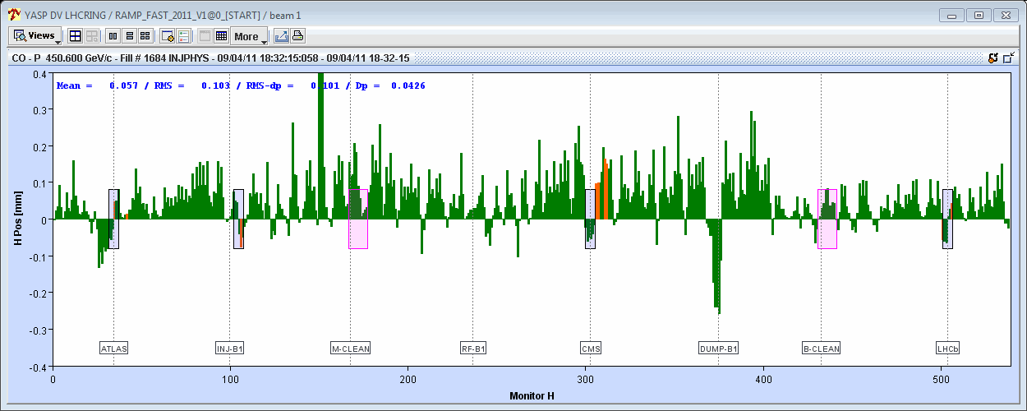
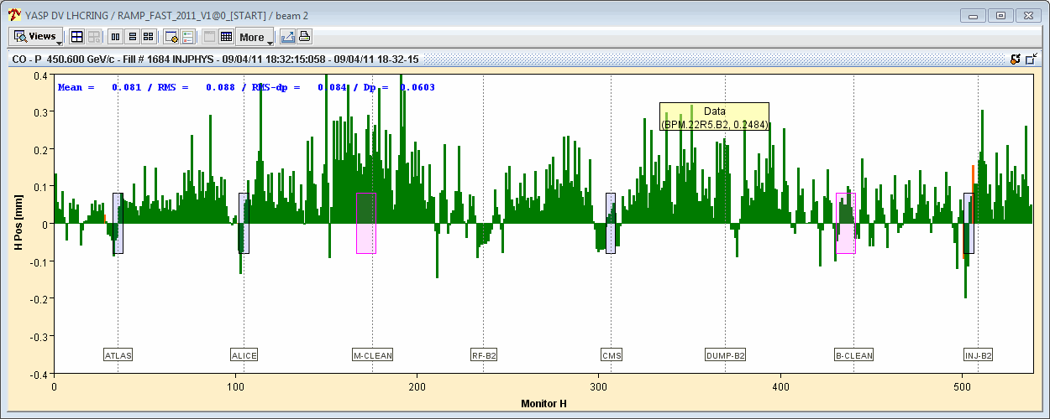
Orbit difference between the 2 loss maps - April 9th
Unfolded orbit difference in H:
  ~ 0.1 mm in IR7 H, similar for B1 and B2.
  ~0.1 sigma – abnormally small !
Beam1
±0.4 mm
Beam2

Slide 23
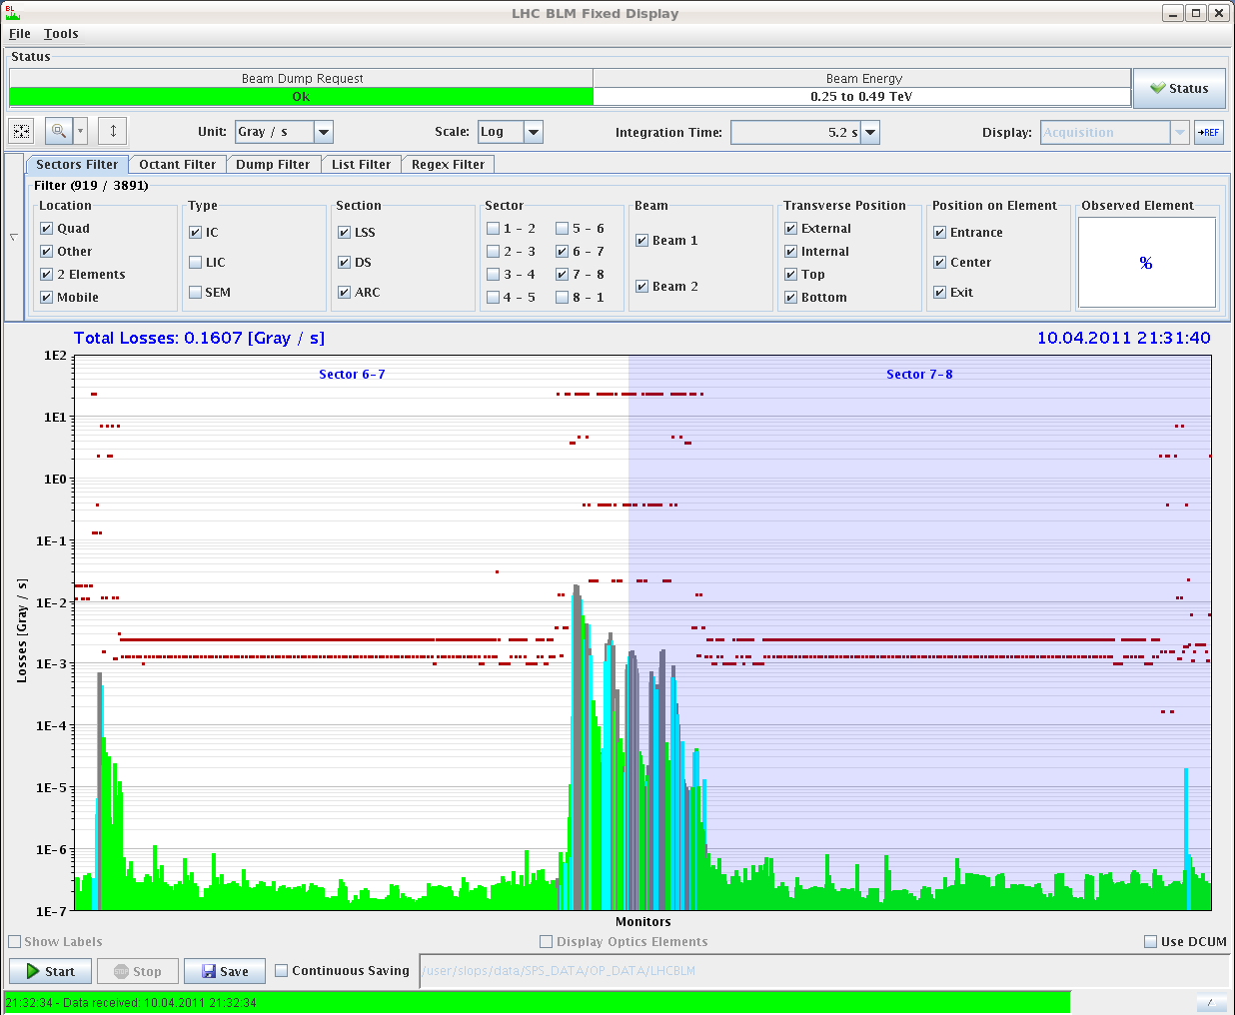
Loss maps B1H – April 10th
Correct orbit for 804 b.
Dump and refill asap – slowed down by MKI softstart.
Small MICADO correction (4 CODs / plane) for betatron oscillation – very small on B1 H (~0.05 mm rms).
Q1 H across 1/3 resonance FIRST.

Slide 24
Loss map issue
Loss map of B1H not ‘reproducible’.
  Abnormally sensitive to orbit changes?
….or artifact of the procedure?
  ‘Bad’ loss maps:
    Qv first moved across 1/3 resonance, then Qh moved across 1/3.
  Good loss maps:
    Qh moved across 1/3 first (or V not done).
  >> suspicion that moving Qv first leads to vertical beam blowup that could change conditions for Qh map and lead to issues in skew plane uncorrelated to orbit - To be confirmed / checked !

Slide 25
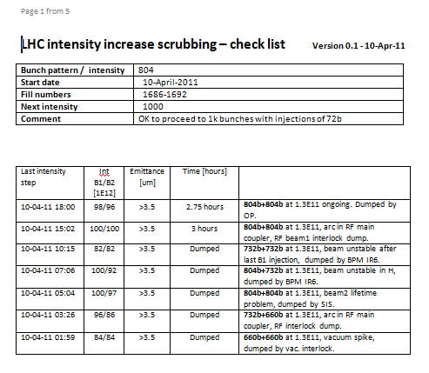
Scrubbing run – intensity increase
Agreed intensity progression for the scrubbing run.
  Steps of 200 bunches.
  rMPP members + RF group to check conditions and give green light for next intensity step. Filled checklist to EDMS.
Challenge of the week:
Get two checklists filled in during a superbly sunny weekend !

Slide 26
Scrubbing progression
Intensity progression – 50 ns
  Above 600 bunches beam stability became an issue an slowed down temporarily (many dumps) the progression.
    Tune shifts with intensity, RF tuning…
  All dumps well captured by MPS.
  No issues with HOM power for RF (so far).
Date | Bunches B1+B2
Tue 5th April | 300+300
Wed 6th April | 408+336
Sat 8th April | 588+588
Sun 9th April | 804+804
Mon 10th April | 1020+1020
1E14 p/ring

Slide 27
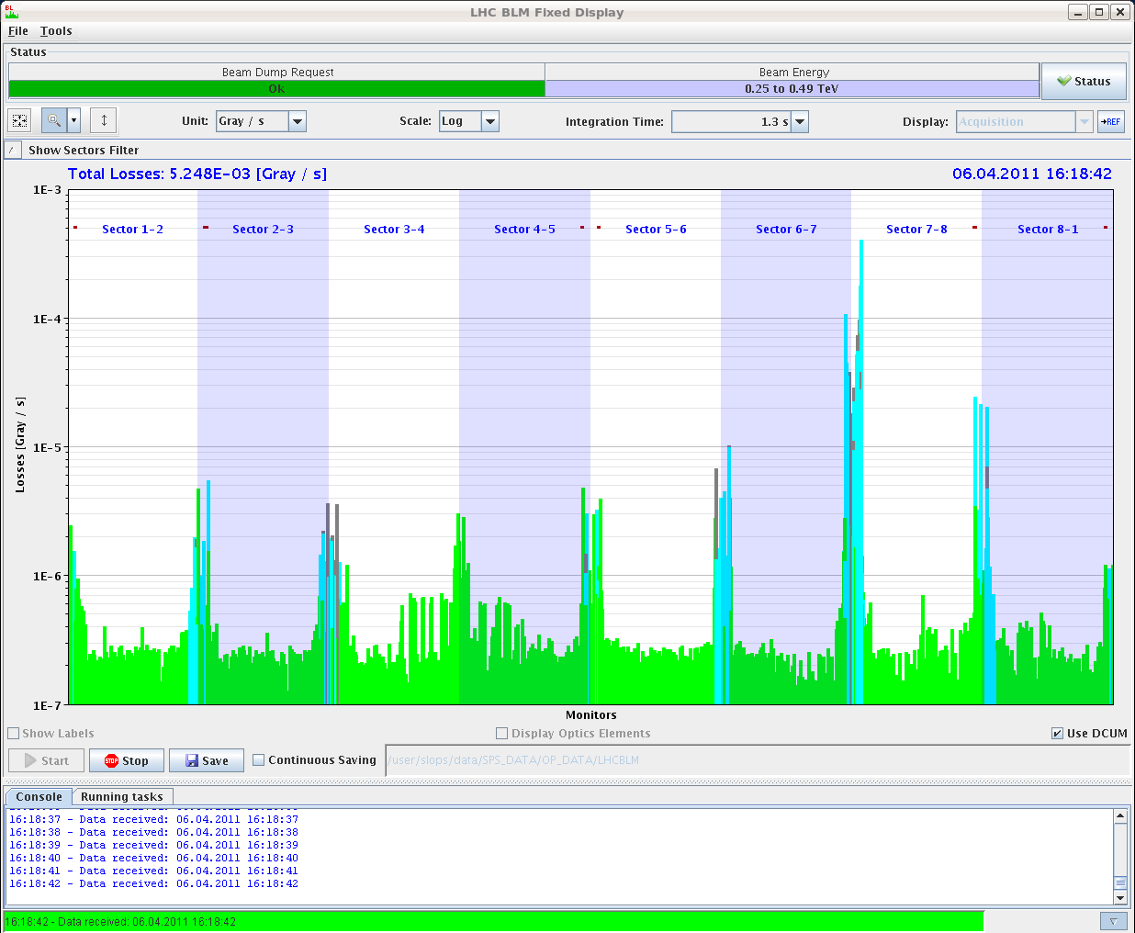
Losses with 300 bunches

Slide 28
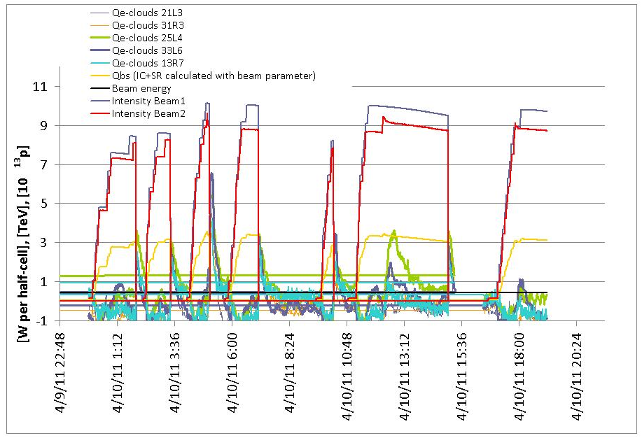
Heat loads on beam-screen
Up to 70 mW/m/aperture
due to e-cloud
W. Venturini

Slide 29
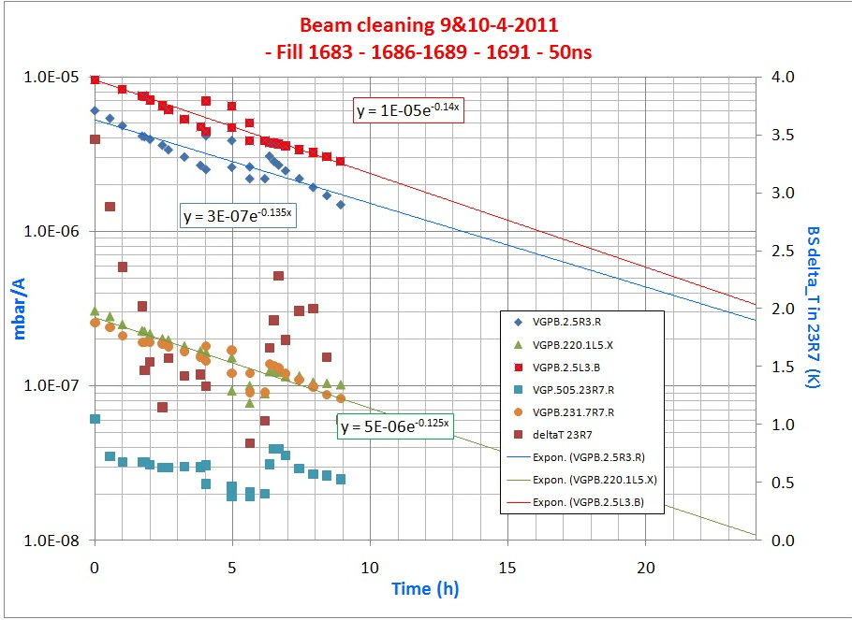
Vacuum improvements
Time constant of ~ 4 hours.
V. Baglin

Slide 30
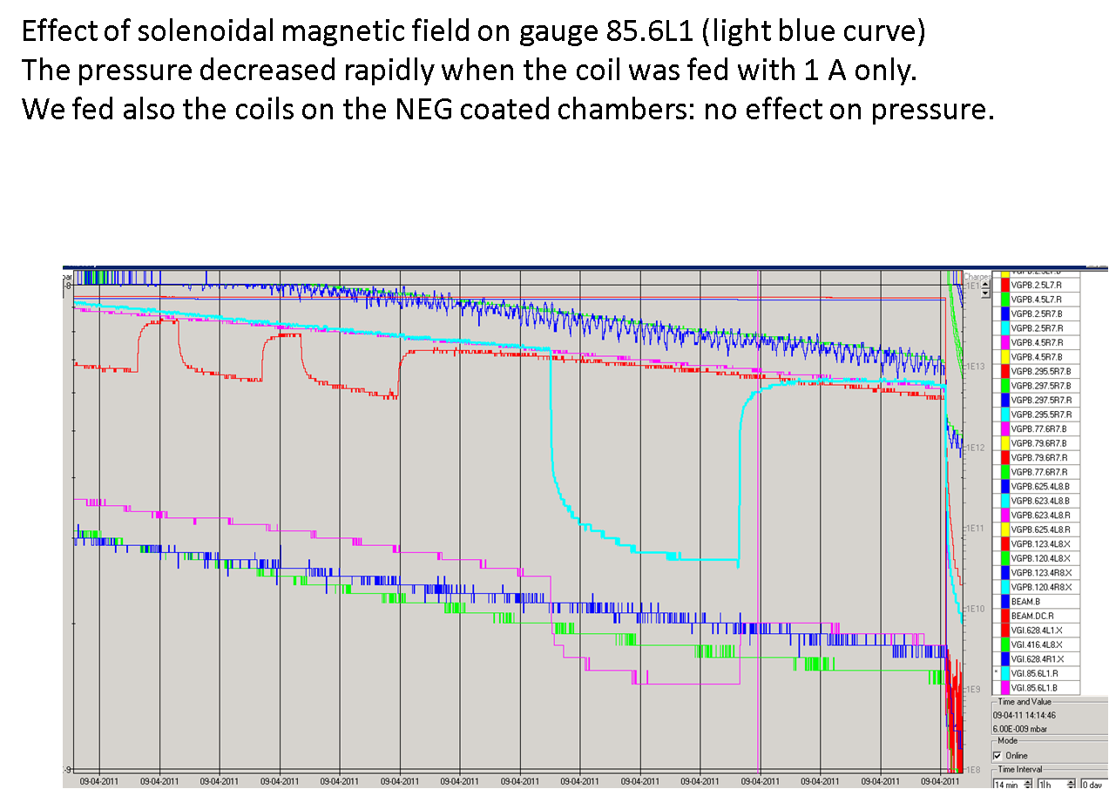
Solenoid with 1 A
P. Chiggiato

Slide 31
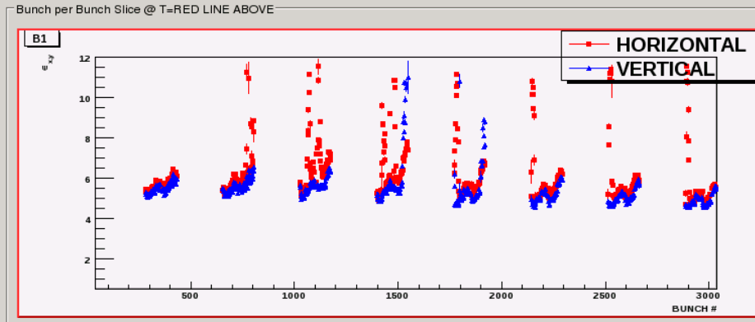
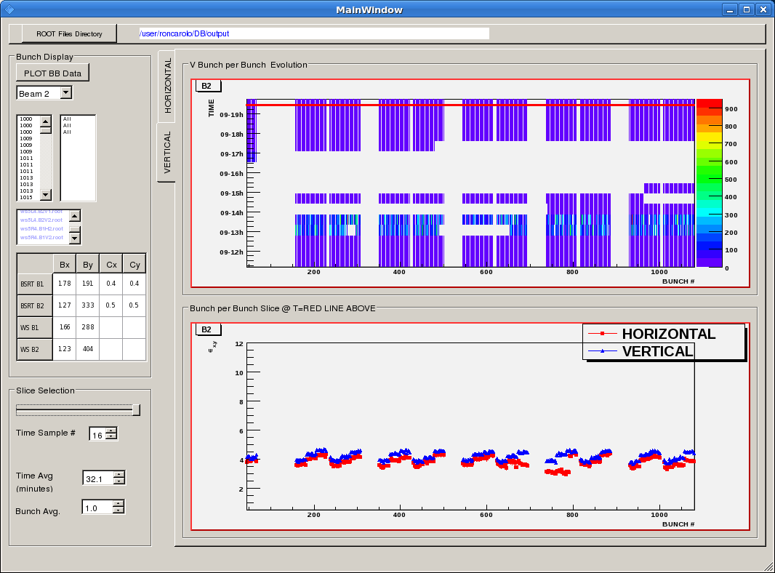
Beam emittance progression
Early 804 bunches
Improvement with lower Q’ ~ 4
Later 804 bunches (2 h)

Slide 32
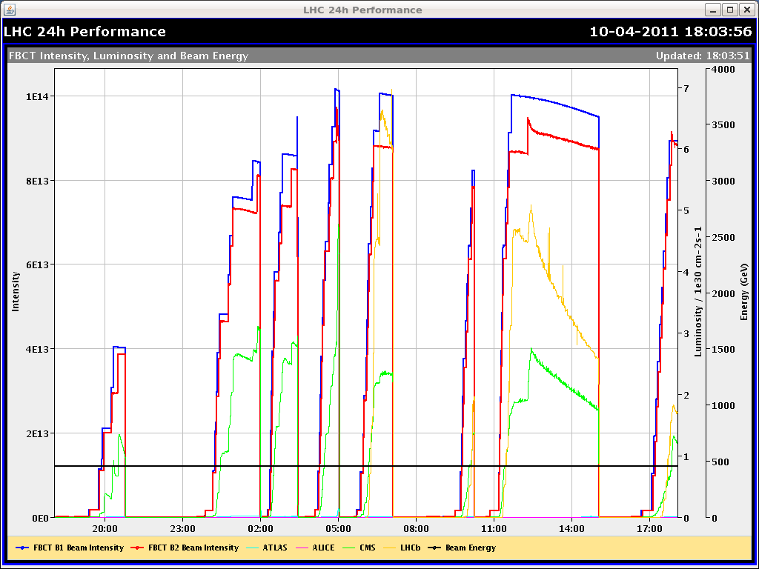
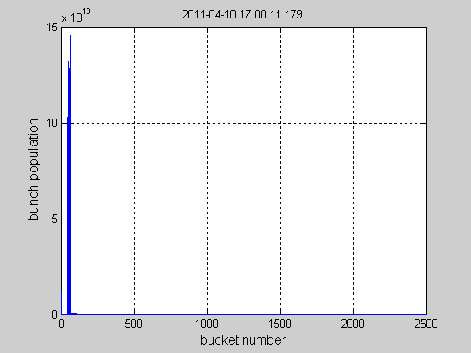
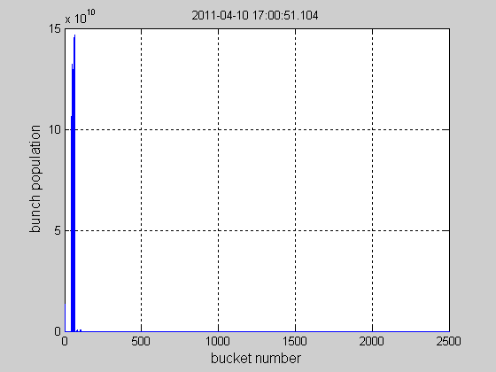
Slow losses observed on B2
Affecting B2 after after the 11th injection – all the bunches are affected ➔ no sign of instability
Sidebands observed in the tune spectrum likely due to persisting energy oscillations (no longitudinal damper yet)
Beam 2
N. Biancacci
Beam 1

Slide 33
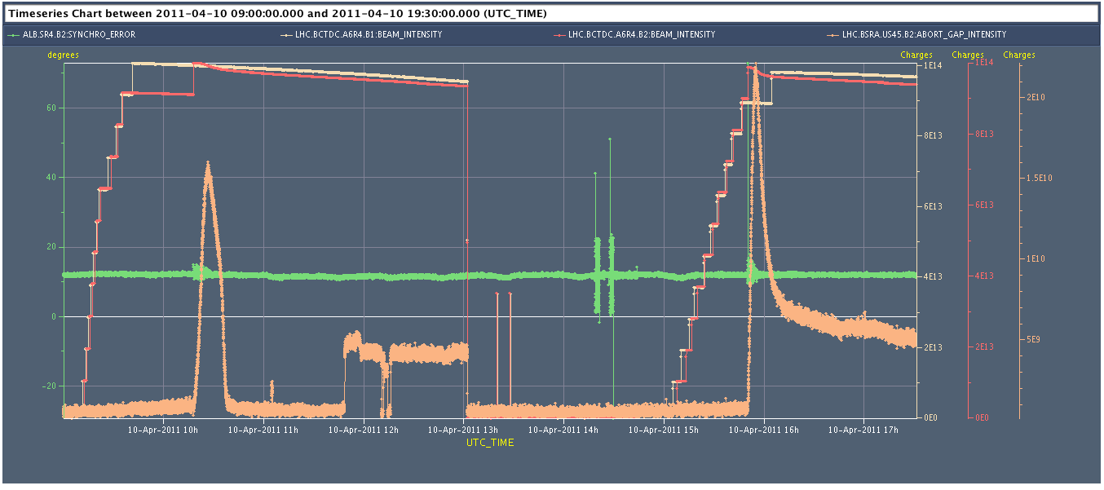
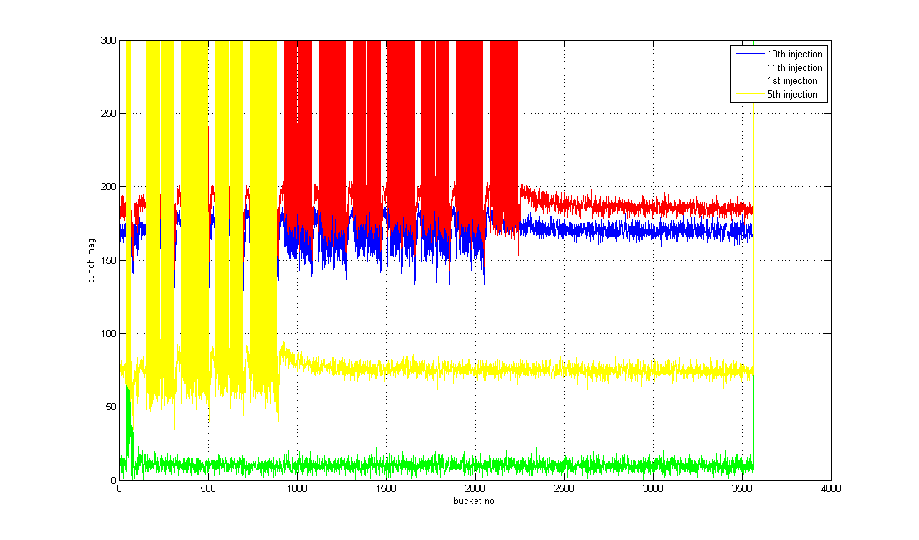
Slow losses observed on B2
Large phase error at the moment of the 11th injection leading to large phase oscillations of the train and debunched beam populating the abort gap and lost in the transverse plane (abort gap cleaner) ➔ fake phase error due to intensity dependent offset ➔ temporary fix found
D. Valuch

Slide 34
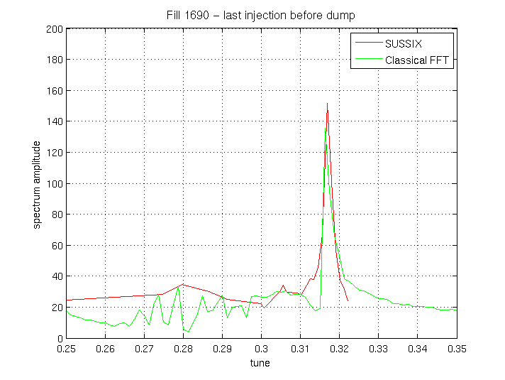
Beam dumps due to beam oscillations
Always affecting horizontal plane ONLY
Laslett tune shift ~+0.005 for total intensity corresponding to 800 bunches ➔ transverse feedback closer to limit of stability ➔ exciting coherent line at 0.32
Solved by trimming the horizontal tune by -0.005 and reducing the gain of the feedback. WE might need to do the same (+0.005 in V plane)
B. Salvant

Slide 35
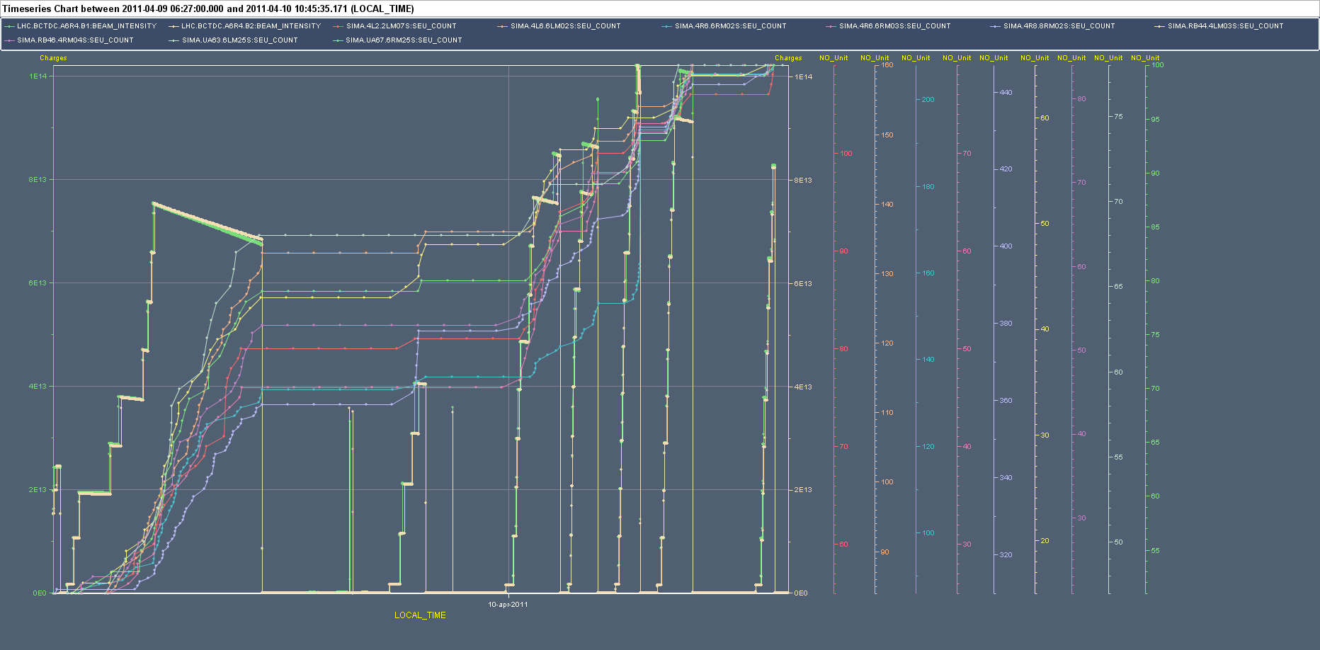
RadMon : Saturday – Sunday night (9/10-Apr)
Highest losses in the LSS: cell 4-5-6 of all points, in particular P6
Fluence of HEH up to ~10⁸ HEH/cm²
Concentrated losses (not found during physics run) in the RA43/47 and RB44/46 (HEH levels up to 1*10⁸/cm²)
First counts in the RRs (13/17-53/57-73/77) with radiation levels up to few 10⁶ HEH/cm² (confirmed also by FGC equipment (TE/EPC))
M. Calviani

Slide 36
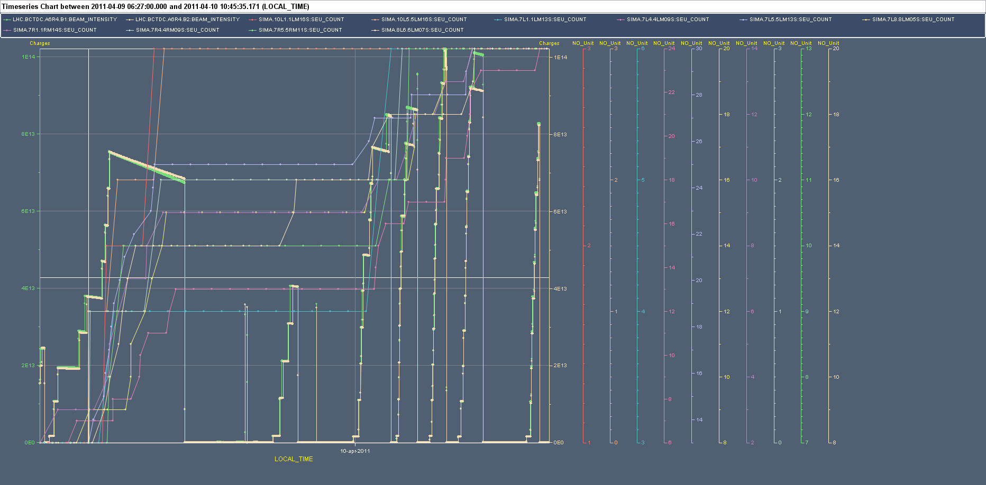
RadMon : Saturday – Sunday night (9/10-Apr) - DS
First cells 2 of the DS (7/8, closer to LSS) shows also some activity
HEH fluence few ~10⁷ /cm² → QPS firmware updated so it should be ok
from cell 9 on, the HEH levels are ~=10⁶ /cm²
M. Calviani

Slide 37
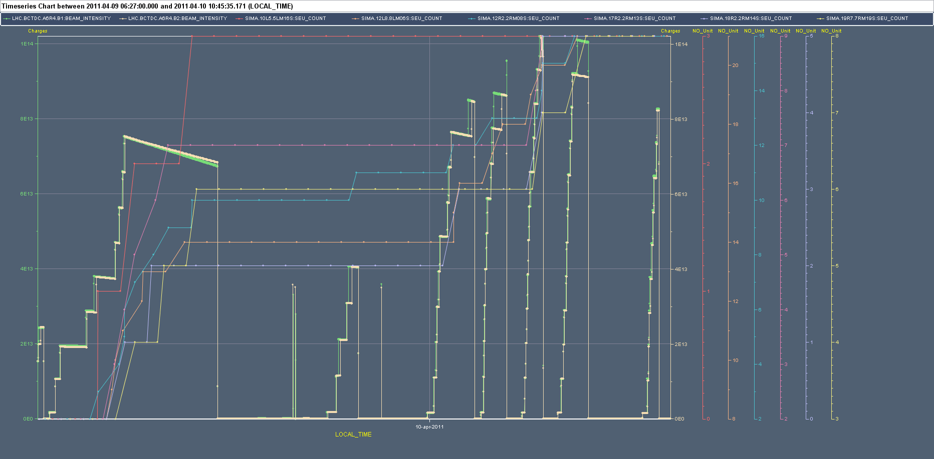
RadMon : Saturday – Sunday night (9/10-Apr) - ARC
The ARC is still relatively calm (continuous scrubbing – like Saturday during day is generating clearly more losses)
HEH levels up to few 10⁶ /cm² → if the pressure remains at these levels this should not pose huge problems for the QPS devices
Pressure spike in 31R7 confirmed by FGC crates in 30R7
M. Calviani

Slide 38
To do / next
Scrubbing:
  Orbit shift tests at injection (Xing and separation bumps).
  Ramp with ~ 200 bunches.
  More bunches…
Injection up to 144 bunches.
Orbit systematic trains-single bunches.
  BPM calibration.
  Updated reference for train ramp.
Orbit feed forward of RT trims for ramp and squeeze.
  One observation ramp (may use last week data), one test ramp.
Various fixes (XPOC issues etc).
2 QHPS discharging since last night (45+12).

