Slide 1
Thursday 7th April
06:30 408+336 bunches (trains of 36). Beam dumped due to cryo in AR45.
Problem on a temperature sensor.
07:15 RB S45 trip during pre-cycle.
Tripped around 2.3 kA
QPS
16:30: Decision to stop ALL powering.
The cryo temperature sensor problem this morning led to a quench of the HTS current lead
Machine idle overnight
Checks on QPS logging data
Checks on strategy
Get some sleep to avoid making the wrong decisions overnight

Slide 2
QPS - What happened
QPS tripped the RB circuit in sector 45
First time ever quench of HTS current lead
Analysis revealed that the HTS quenched due to a lack of cooling in the DFB
Faulty electronics board corrupted the temperature feedback loop, which closed the cooling valves of the current lead
The second protection in place is the QPS monitoring the LTS, HTS and Cu parts of the current lead.
Logging of the two HTS signals showed that only one of the two measurements was correct, the other measurement showing continuously low values for Ures, Uhts due to a wrong connection to the proximity box
An identical fault on the redundant Ures, Uhts signal would have left the system unprotected and could lead to beyond repair damage to the DFB
No spares
Decided to stop powering magnets
Be sure no similar connection error to proximity boxes exist

Slide 3
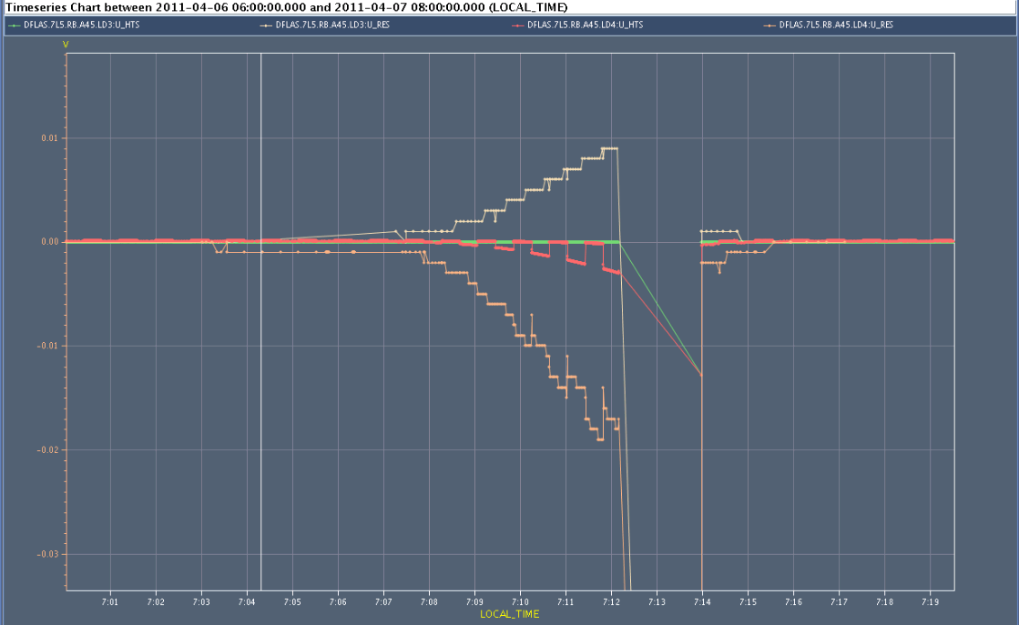
QPS signals
Ures Uhts redundant signals, logging swaps every 30 s.

Slide 4
Plan
Be sure QPS is connected correctly and no other similar faults exist
Special power cycles
Check logging
No tunnel access if no problems found
Continue scrubbing
Up to 600 bunches
Trains of 36 bunches, followed by trains of 72 bunches

