Slide 1
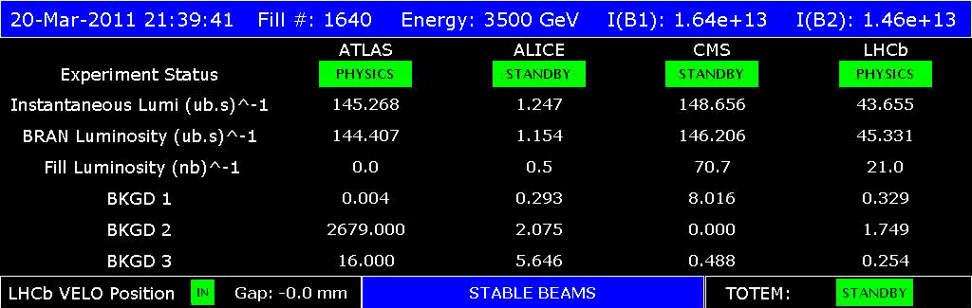
Summary of Week 11: 14 – 21 March
First week of intensity ramp up
Gianluigi Arduini and Jan Uythoven for the LHC teams
Aim of the week: Physics with 100 + bunches, Luminosity > 1e32
136 bunches !

Slide 2
Sunday 20/03
05:50 Dump fill #1639
Cryo lost S18 matching section. Temperature oscillation in QRL line C affecting DFB MB.
Second fill of 64 bunches after 7 hours in coast
09:22 Cryo recovered – access CMS
10:15 Injecting for physics
11:40 Stable beams 64 bunches – 3rd fill
18:00 Dump
21:30 Stable beams 136 bunches – 1st fill
06:00 Operator dump RB S12 and S23 tripped during ramp up, active filter
136 bunches: Lumi lifetimes: GOOD

Slide 3
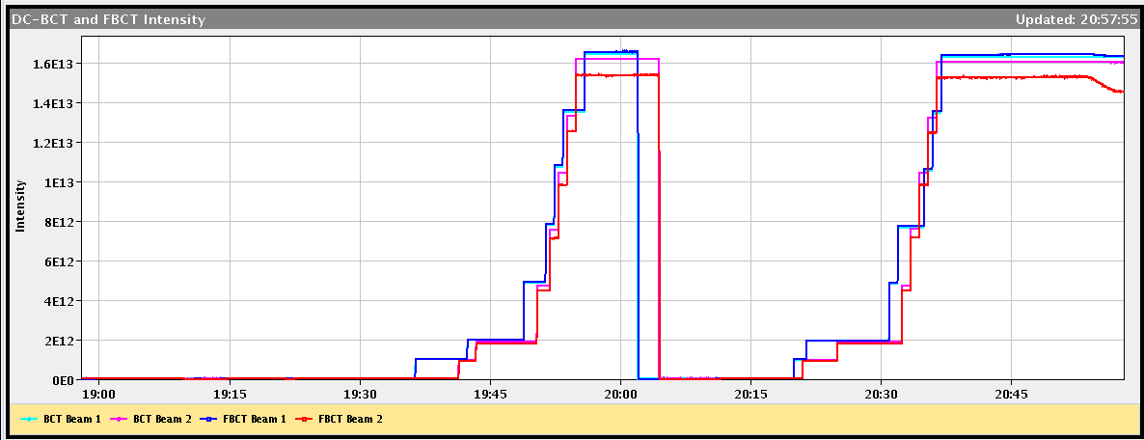
Injecting pilot + trains of 8 + trains of 24
Great job from the injector shift crews who changed settings from 8 to 24 bunches (75 ns) in 5 minutes!
But bunches could be a bit more equal…
BPMS IP6 Interlock test
24b
8b

Slide 4
Vacuum Experimental Areas 136 bunches
ATLAS had vacuum spikes at about 21:00... until 21:15 it went up by a couple of orders of magnitude, by now recovered 10%.
1e-6 mbar !!!
M.Jimenez

Slide 5
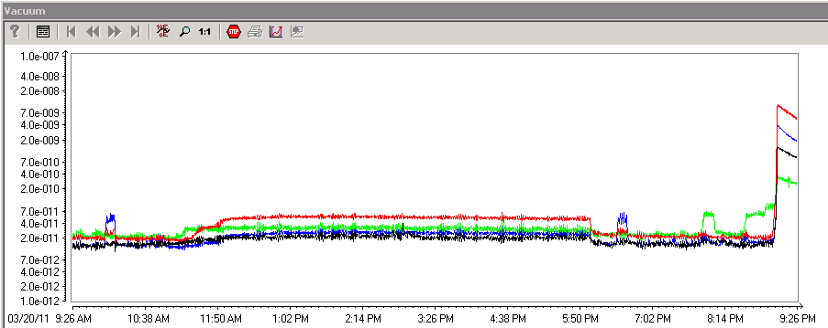
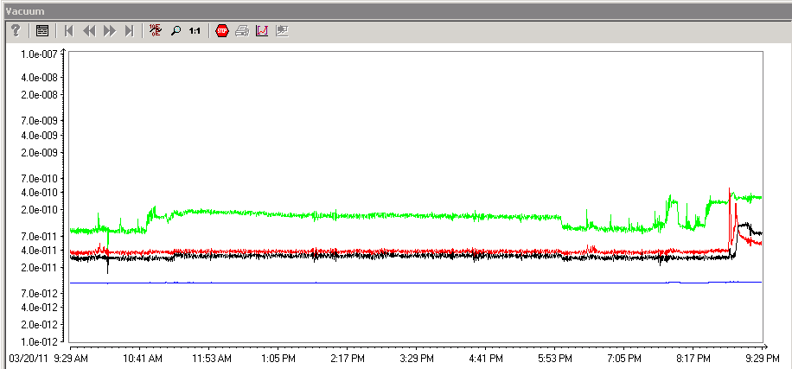
136 bunches - Vacuum activity starting
Vacuum around the injection kickers MKI IP2 and IP8
IP2 – Kicker tank changed
136 bunches
64 bunches
IP8 – not opened

Slide 6
Vacuum at the IPs during fill o-night
1E-8

Slide 7
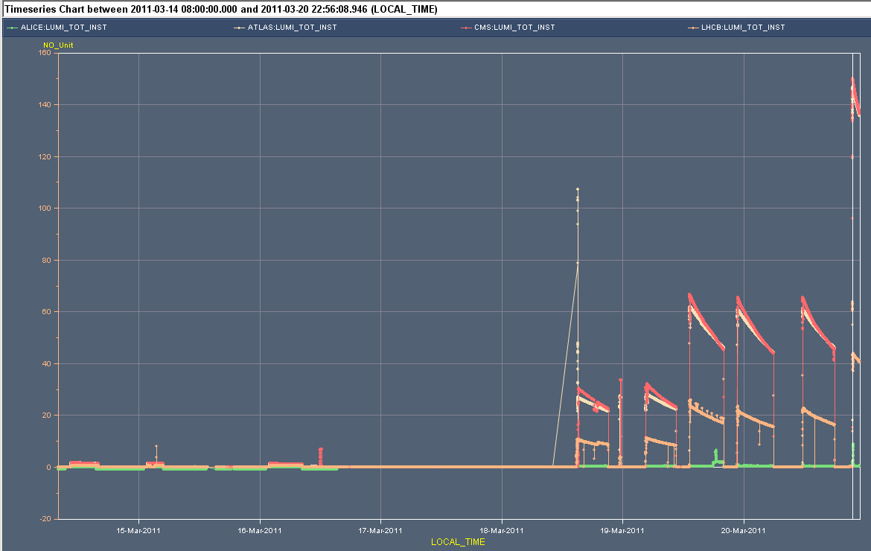
Overview of the week
160 x 10³⁰ cm⁻²s⁻¹
Lumi’s
2e13
DC BCTs
Inj. tests 48 b
Skip 8 b
32 b
64 b
136 b
Stable Beams: 3b
Timing Distribution problem
Tot. L = 8.7 pb-1
MPS tests

Slide 8
Fills of the week
Fill | # bun ches | Average bunch population@coll [10¹¹ p] | Initial luminosity [10³⁰ cm⁻²s⁻¹] | ε_{HV} _{@coll} (from init. Lumi) | Integrated luminosity [pb⁻¹] | Coast duration [hours] | Turn-around to next fill [hours]
1634 | 32 | 1.18/1.12 | 30 | 2.8 | 0.51 | 06:00 | 02:25
1635 | 32 | 1.18/1.17 | 33 | 2.7 | 0.009 | 00:06 | 05:00 (RF)
1636 | 32 | 1.16/1.15 | 32 | 2.7 | 0.56 | 06:00 | 02:41
1637 | 64 | 1.18/1.15 | 66 | 2.7 | 1.3 | 06:40 | 02:45 (Inj)
1638 | 64 | 1.14/1.14 | 66 | 2.6 | 1.34 | 07:05 | 05:50 (CRYO)
1639 | 64 | 1.14/1.14 | 65 | 2.7 | 1.21 | 06:20 | 02:30 (MPS)
1640 | 136 | 1.18/1.18 | 148 | 2.6 | 3.7 | 08:30
Tot. L = 8.7 pb-1

Slide 9
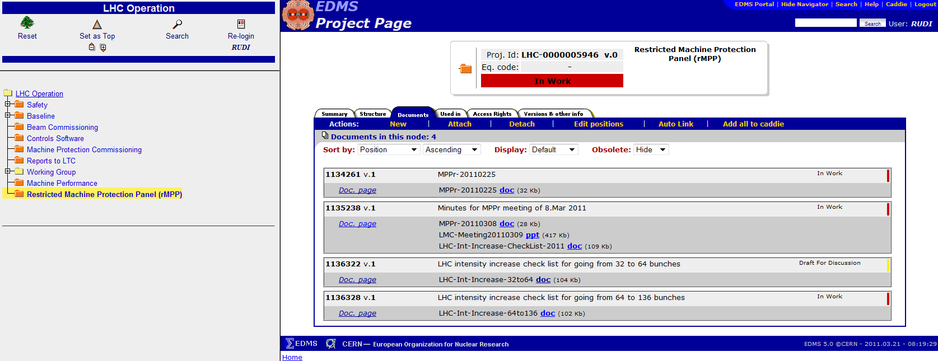
rMPP ok for every intensity step
Check list filled in for each step
On edms

Slide 10
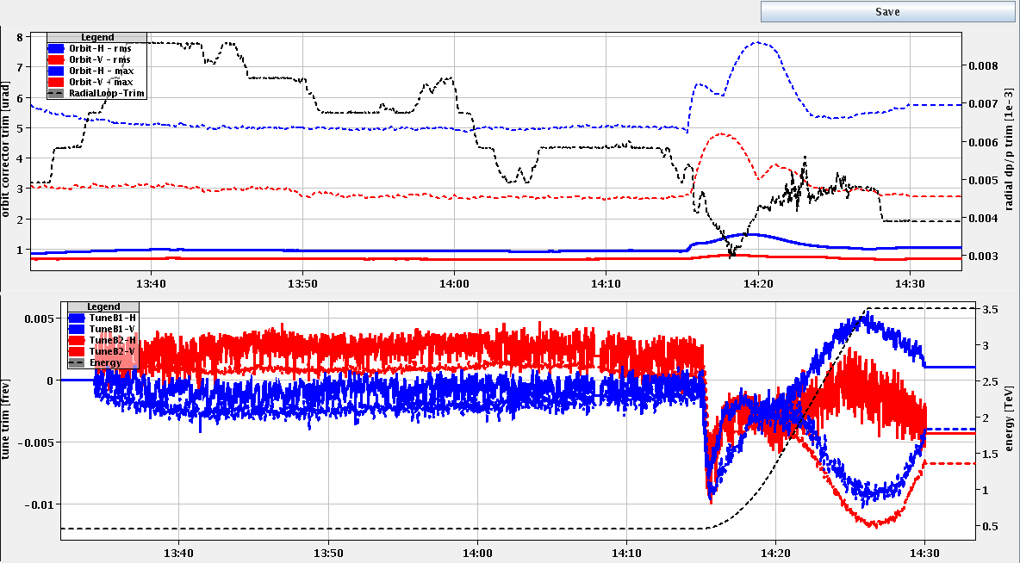
What kept us busy during the week
Test ramp with 8 bunches
Aim: validation ramp and squeeze with 75 ns beam and transverse feedback ON through the squeeze
Larger oscillations observed on B2 H tune corrections – tune feedback locking on mains harmonics leading to QPS trigger on RQTF.A23B2 and RQTF.A34B2
8 bunches

Slide 11
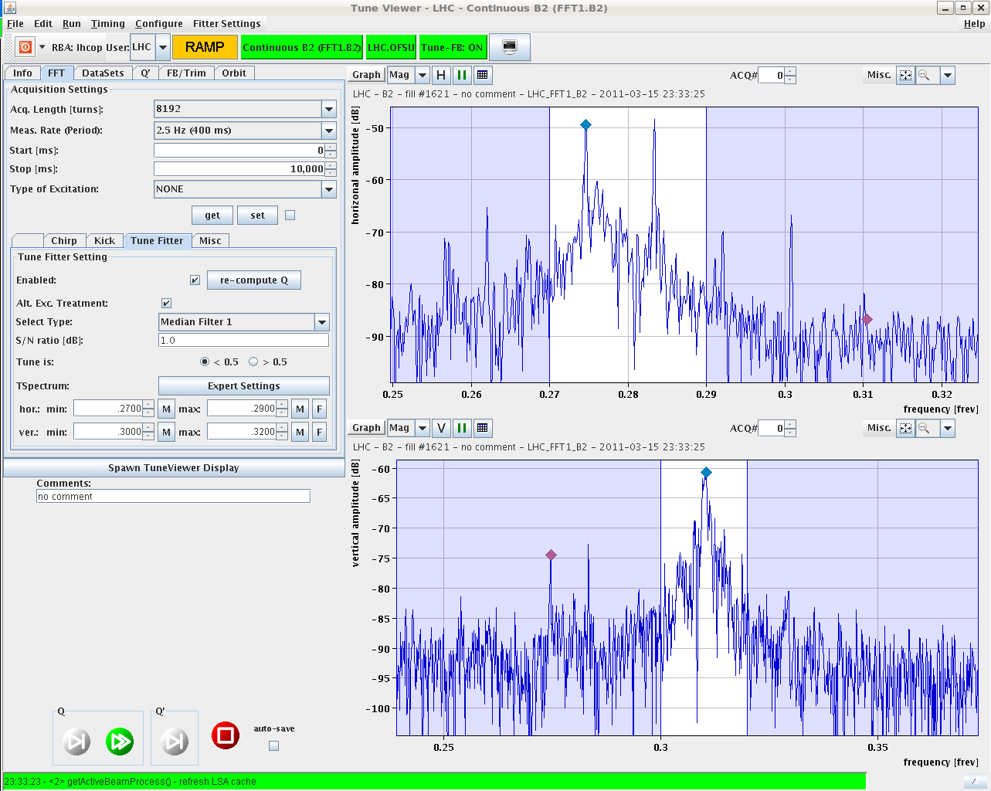
Test ramp with 8 bunches
Mains harmonics, not side bands
Reduced gain of the transverse feedback all through the ramp
Easier with 32+ bunches !
100 Hz

Slide 12
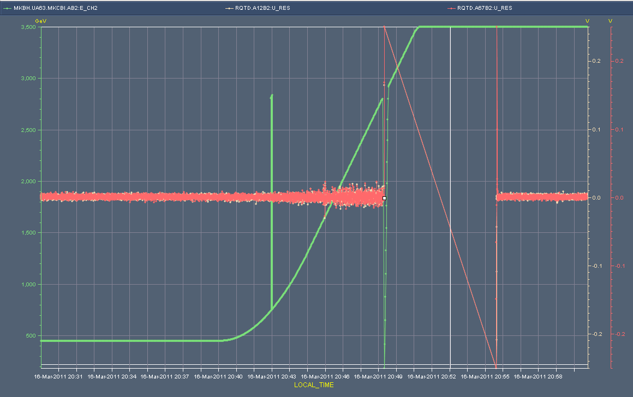
Wednesday Evening
Problem with the timing distribution
RQTD.A12B2 and RQTD.A67B2 tripped off due to large trim request – still not completely understood
Resulting dump was proper, but badly timestamped Post Mortem and XPOC data
New release of the MTG firmware failed
Took 36 h to convince that MPS is ok to continue 32 b
Mean time
1.38 TeV prep.
FIDEL, decay comp. at injection
Validation tests
Jump in Time

Slide 13
RF dump on Friday night
Following a modification introduced during the Xmas stop, the RF FGCs crash if they receive 3 or more simultaneous timing events (as in the case of the automatic optimization of all the IPs)
The bug has been identified and fixed by Q. King – new firmware version to be released at the next best occasion.
This explain why the problem occurred when using the application to optimize the separation simultaneously at all IPs
For the moment we do not to use the 'optimize all' option in the luminosity scan application!
Continue the intensity increase:
136 bunches = 8.5 MJ/beam

Slide 14
Plans
Coordinators this week R.Assmann, M.Lamont
Recover RB trip
Next: fill another 136 bunches
This week (possible program)
Increasing to 200 bunches
1.38 TeV run
Injection studies, prepare scrubbing

Slide 15
Outstanding
Injection of 96 bunches
Timing distribution
FGC firmware update
Collimation system controls fix
1.38 TeV setting-up
Crossing angle all zero: OK
TCTs to set up & loss maps
Interlock tests for the roman pot
RF voltage limit interlock
Longitudinal blow-up
Wire scanners
Abort gap cleaning
Injection gap cleaning

Slide 16
Overview of the week
160 x 10³⁰ cm⁻²s⁻¹
Lumi’s
2e13
DC BCTs
Inj. tests 48 b
Skip 8 b
32 b
64 b
136 b
Stable Beams: 3b
Timing Distribution problem
Tot. L = 8.7 pb-1
MPS tests

