Slide 1
Wednesday 16/3
08:30 – Dumped physics fill with 3 x 3 bunches
AM: Investigations on tune feedback Ramped 8 nominal bunches again, which stayed in this time, although perturbations still there. Collide 8 bunches. Dump.
PM: No beam
Problems with RF re-phasing: “there is a large static error on the synchro loop”
BST MASTER reboot
PS no beam
Evening: Continue investigations. Spectrum looks very different for 32 bunches compared to 8 bunches
20:40 Ramp 32 nominal bunches
Lost because of RQTD trips – but different signature
Problem with timing distribution
Night: Requalification of systems. Collimator problem.

Slide 2
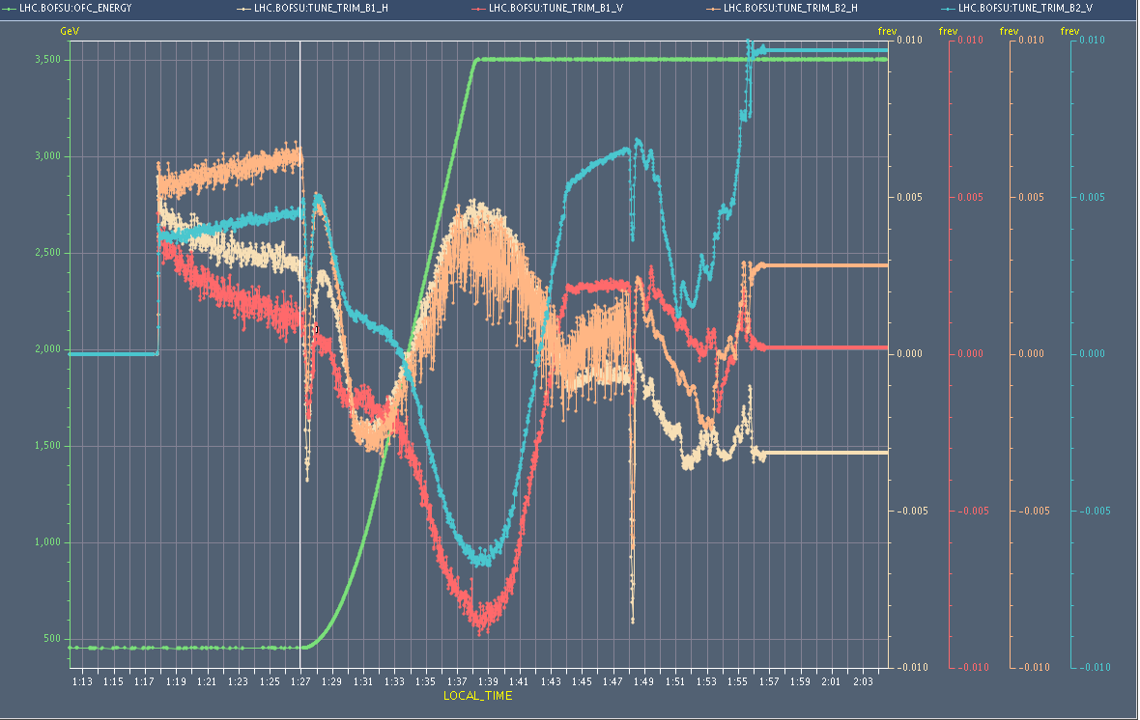
The 8 bunch ramp that stayed in - lucky
Tune-trim B2 H
OK when tunes moved for collisions

Slide 3
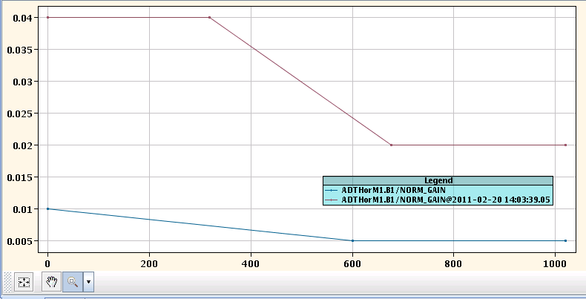
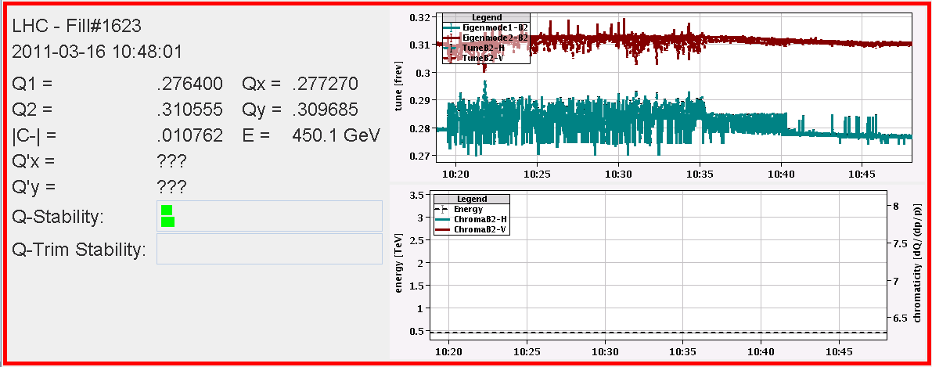
Tune feedback / spectrum issue
Problem: With 8 nominal bunches beams were lost at 3.5 TeV twice on Tuesday. “100 Hz” peaks in tune spectrum for B2 H makes tune feedback jump around, resulting in RQT trip.
At injection: Changing damper gains at injection -> makes tune measurement more stable
At 3.5 TeV switch off ADT -> perturbing lines still too large relative to tune lines.
Reduction of damper gain

Slide 4
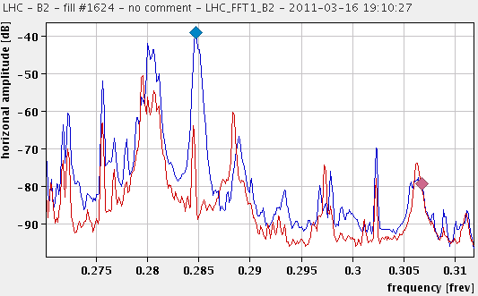
32 bunches at injection – spectra look different
32 bunches
8 bunches
ADT off

Slide 5
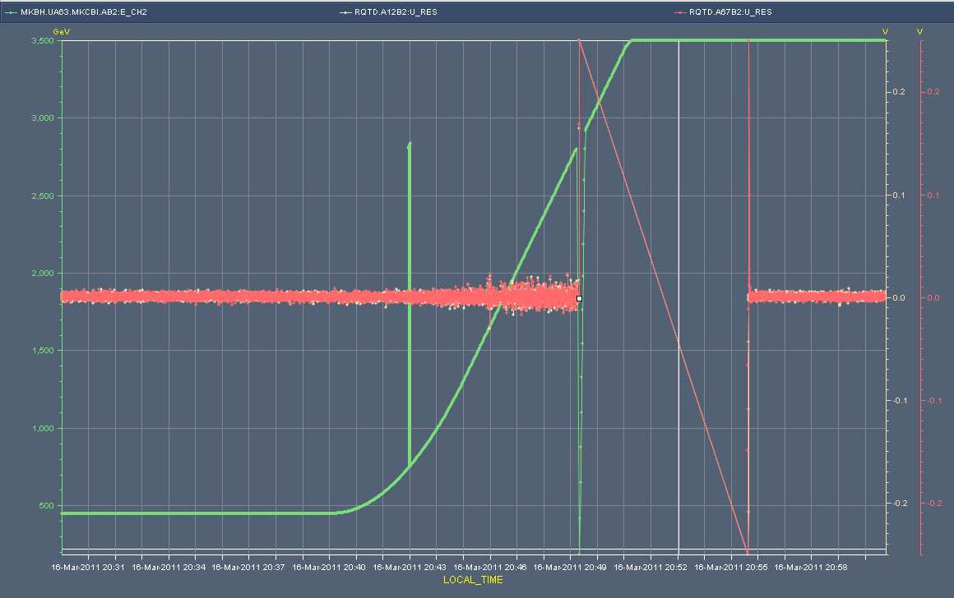
Ramp 32 bunches
Lost in ramp RQTD.A12B2 and RQTD.A67B2 tripped off
But tune signals were proper this time
Previous trips were RQTF and at flat top
RQTD U-res not noisy, but is sudden spike
PM, XPOC, logging thoroughly messed up
Switching the LHC Timing Gateway from A->B
Jump in Time

Slide 6
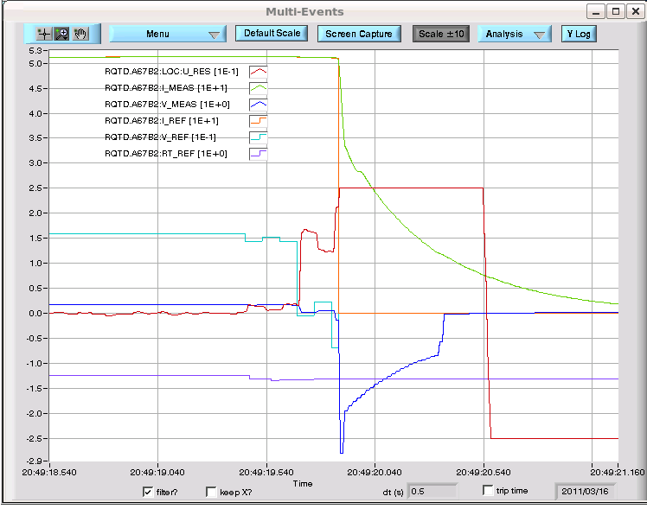
QPS of RQTD reacted correctly

Slide 7
Recover
As a result of this timing card switch, preformed a set of checks to confirm that the timing was OK and that the dump and PM was behaving as expected. Tests done:
Dry dump to check PM
Dump with pilot at injection to test PM etc
Ramp with pilots and then taken through the collisions BP
Tried to fill physics with 3 bunches – waiting for experts to report on “timing issue”
Collimation problem, TCTH.4L5.B1 position interlock at start of squeeze, expert working.
BPM calibration problem

Slide 8
The Plan
Confirmation from experts everything ok
Timing
Collimation
Ramp 32 bunches, aiming for stable beams
To do:
Collimation energy interlocks

