Slide 1
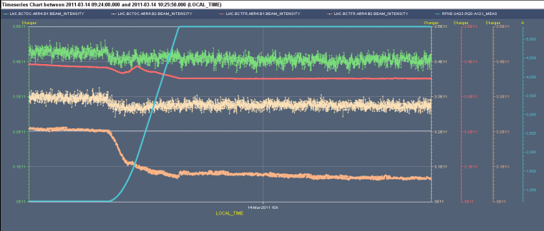
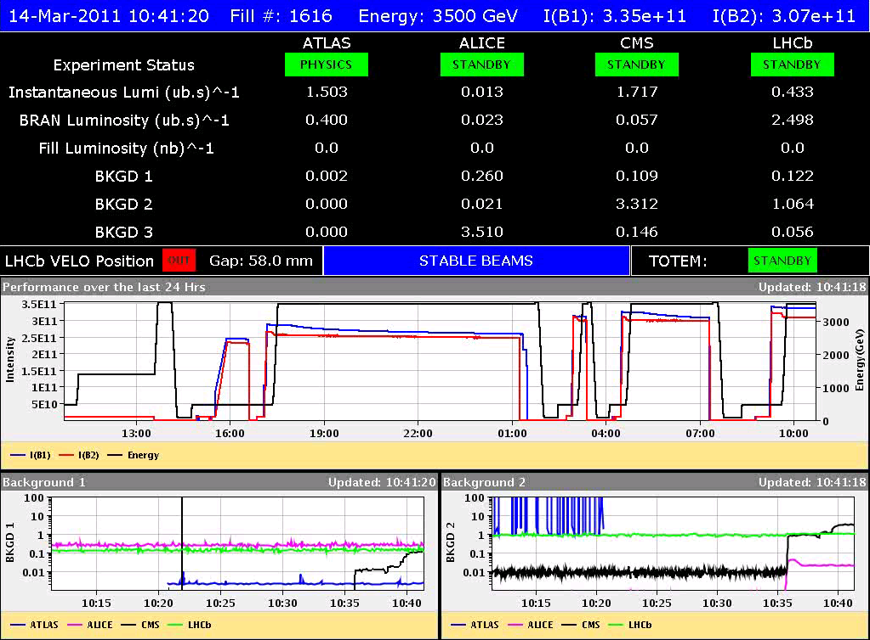
Monday 14th March
Second fill with pilot + 3 nominal bunches
Some debunched beam for beam 2? But losses on FBCT, would expect this on DC-BCT??
Stable beams 10:40 – 16:00

Slide 2
End of fill studies @ 3.5 TeV collisions
Betatron loss maps B2 H & V
First impression ok
“Asynch dump” test B2
The ratio of losses on the TCTs/cold elements to TCDQA was 3e-4 for B1, and 4e-4 for B2, assuming a filter factor of 60 on the TCDQA BLM. This is fine (BG).
FMCM tests by generating an FGC_STATE fault in the related power converters
Analysis off-line
Automatic BLM-BIS test
All tests passed ok

Slide 3
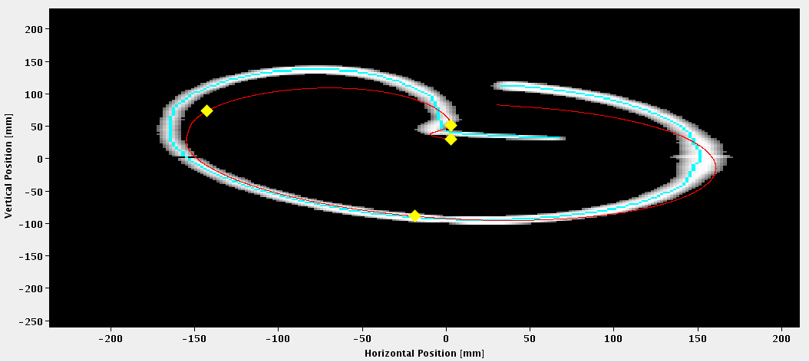
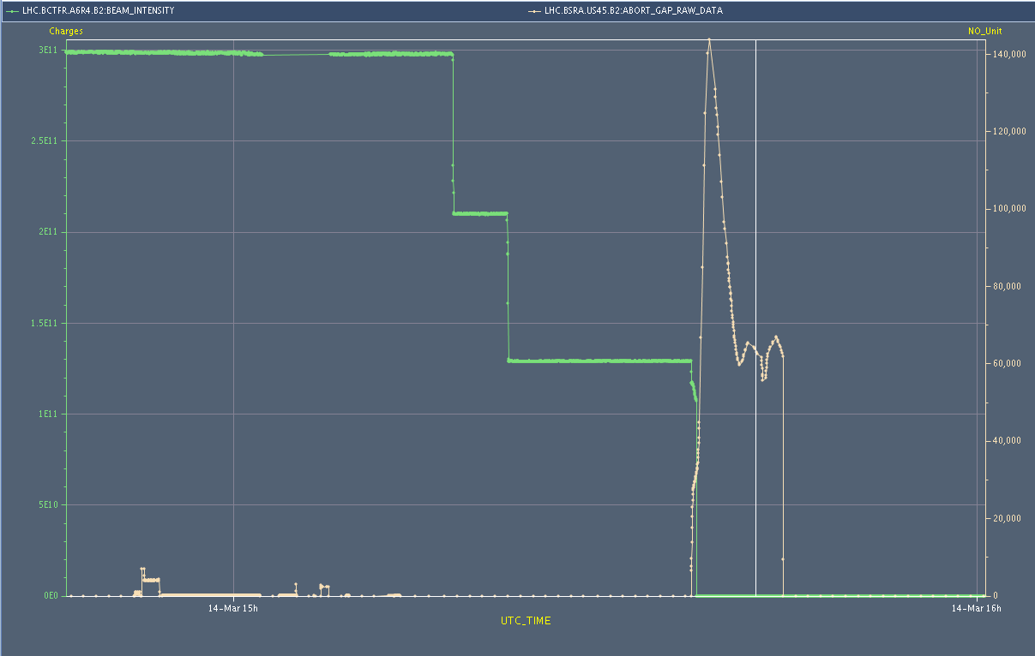
“Asynch Dump” test
Image at dump BTVDD
Abort gap monitoring BSRA
FBCT
BSRA
BLMs

Slide 4
Multi-bunch injection test – injected 48 bunches
Adjusted MKE delay for both beams (68 us Beam 1, 54 us Beam 2) with pilot bunch and settings copied to LHCFAST1-3 and LHC1-4 ==> ready for injecting trains of multi-bunches
Checked injection of the following sequences:
Probe + 8 b adding on to 32 bunches total per ring - Probe + 2 x 8 b adding on to 48 bunches total per ring - Probe + 1 x 8 b + 3 x 8 b adding on to 56 bunches total per ring - Probe + 1 x 8 b + 1 x 24 b adding on to 56 bunches total per ring - Probe + 1 x8 b + 2 x 24 b adding on to 56 bunches total per ring
Clean injection for beam 1 after correcting hor. and vert. trajectory on LHC3; no correction needed on Beam 2.
IQC latching for both beams when injecting 48 bunches for BLM and RF bucket (see attachment), and losses at MQ7 (fixed BLM display) at 30% from dump limit when injecting 48 b for B2. Extrapolation from 48 b: - B1: ratio to dump 20% - B2: ratio to dump 30% Next step will be more statistic with 48 b using the intensity increase check list and then moving on to the injection of 96 b (4 x 24 b).
M.Meddahi, C.Bracco

Slide 5
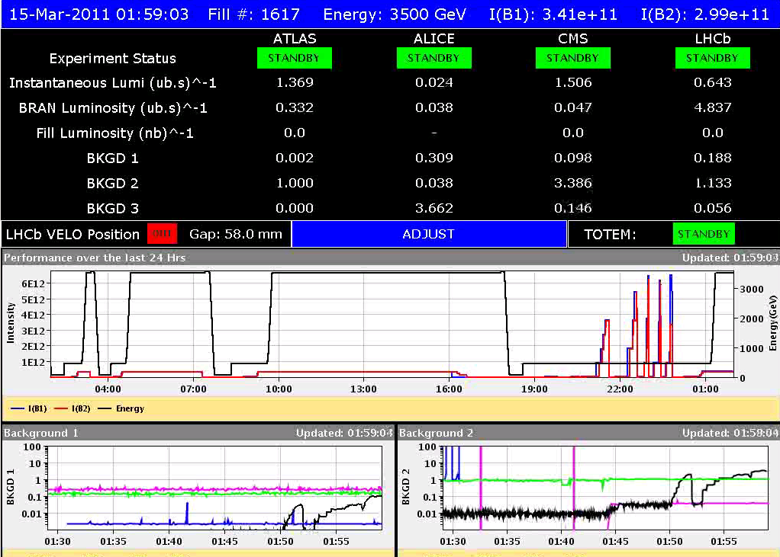
Third fill stable beams 3 bunches
02:00 Stable Beams fill #1617
RF-feedback during squeeze ‘monitoring’
If ok can be switched on on next fill
05:00 Self trigger Beam Dump on B2 MKD generator M
Seems to be problem at the level of slow control
To be checked in detail
During ramp down fault RB78, probably caused by active filter. Opened switches.
Seems ok, but also to be checked in detail

Slide 6
Plan
Tuesday morning
MPS tests: BIS, XPOC/IPOC
Another ramp and squeeze with 3 or 8 bunches with RF feedback and tune feedback on during the squeeze
Stable beams with 32 bunches
If all above goes well
If rMPP ok

