Slide 1
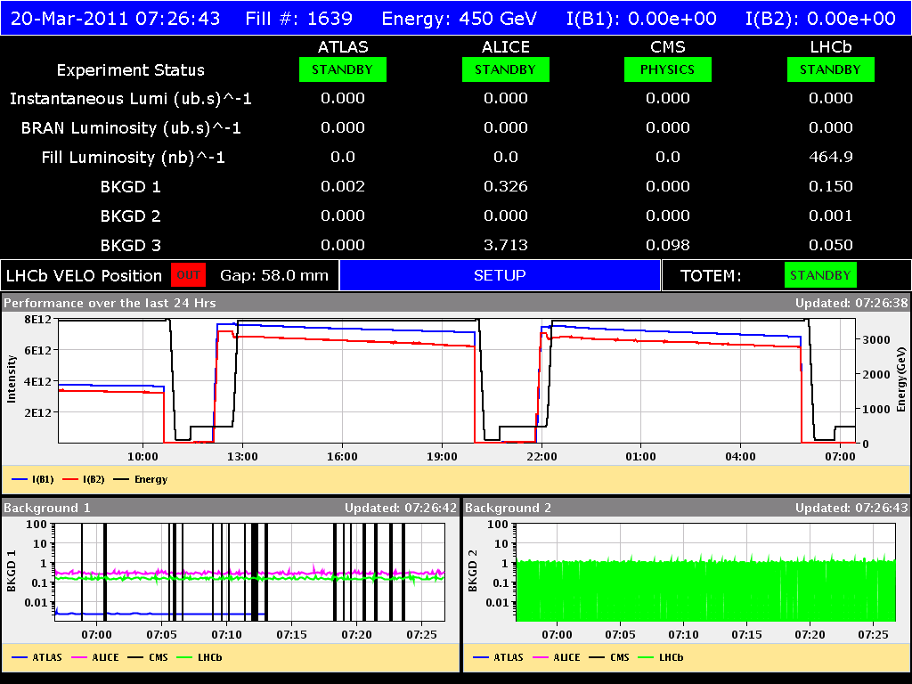
Saturday 19/3
10:30: End of fill #1636: ~0.6 pb⁻¹
OK from rMPP to go to 64 bunches
13:20 Stable beams #1637 64 bunches
20:00 End of fill #1637: 1.3 pb⁻¹
22:45 Stable beams #1638 64 bunches
06:00 Cryogenics lost in point 8. End of fill #1638

Slide 2
RF dump on Friday night
Explanation of the RF FGC problem of last night (Q. King):
Following a modification introduced during the Xmas stop, the RF FGCs crash if they receive 3 or more simultaneous timing events (as in the case of the automatic optimization of all the IPs)
The bug has been identified and fixed by Q. King – new firmware version to be released at the next best occasion.
This explain why the problem occurred when using the application to optimize the separation simultaneously at all IPs
For the moment we do not to use the 'optimize all' option in the luminosity scan application!

Slide 3
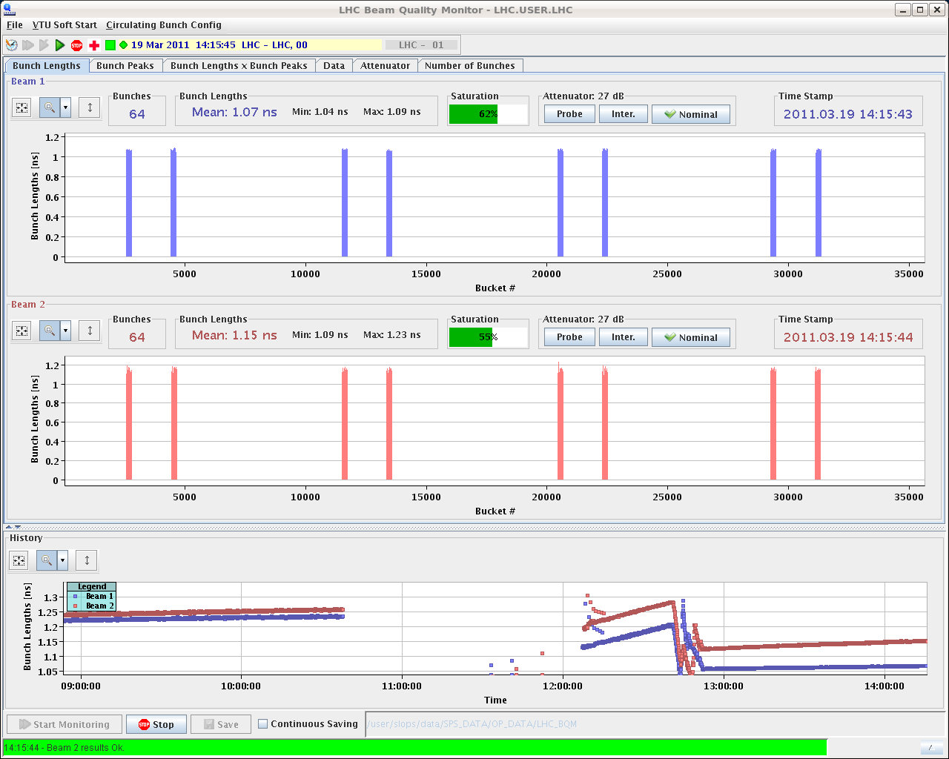
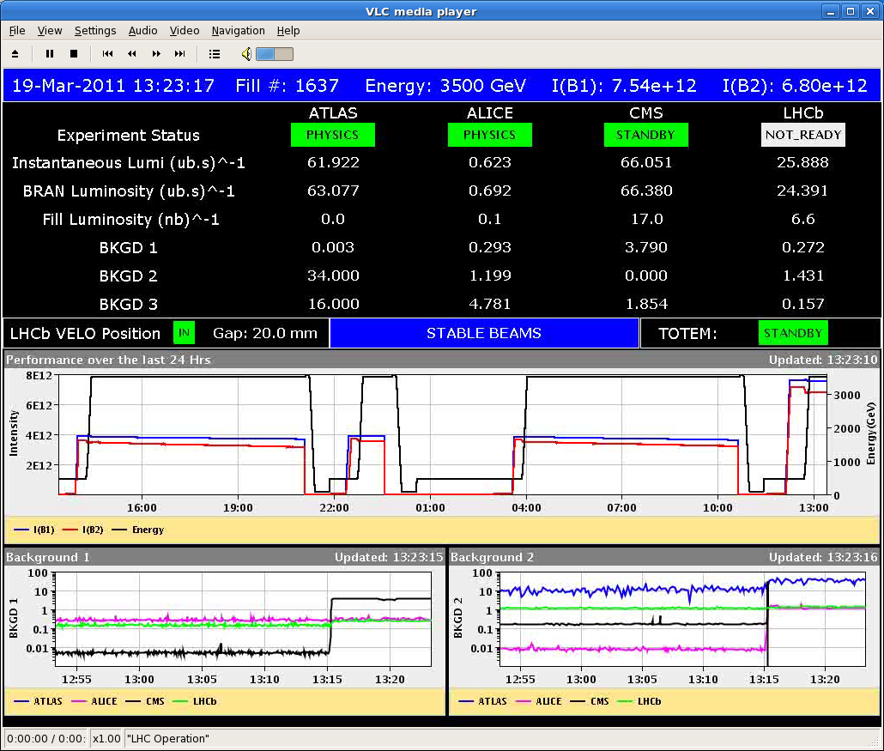
64 bunches

Slide 4
Summary
Fill | # bunches | Average bunch population@coll [10¹¹ p] | Initial luminosity [10³⁰ cm⁻²s⁻¹] | ε_{HV} _{@coll} (from init. Lumi) | Integrated luminosity [pb⁻¹] | Coast duration [hours] | Turn-around to next fill [hours]
1634 | 32 | 1.18/1.12 | 30 | 2.8 | 0.51 | 06:00 | 02:25
1635 | 32 | 1.18/1.17 | 33 | 2.7 | 0.009 | 00:06 | 05:00 (RF)
1636 | 32 | 1.16/1.15 | 32 | 2.7 | 0.56 | 06:00 | 02:41
1637 | 64 | 1.18/1.15 | 66 | 2.7 | 1.3 | 06:40 | 02:45 (Inj)
1638 | 64 | 1.14/1.14 | 66 | 2.6 | 1.34 | 07:05 | (CRYO)

Slide 5
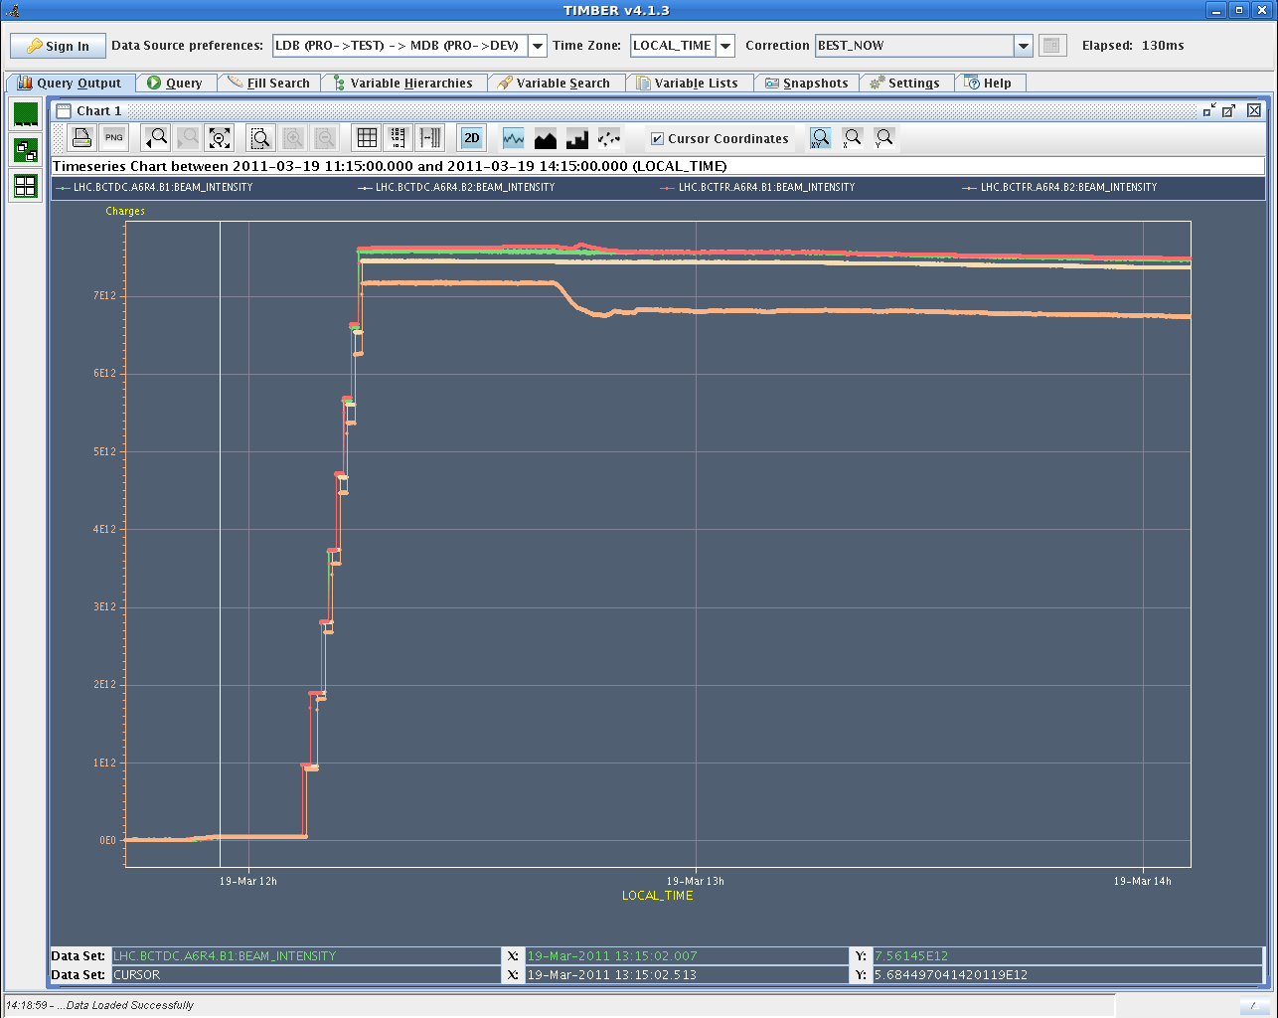
DCBCT vs Fast BCT

Slide 6
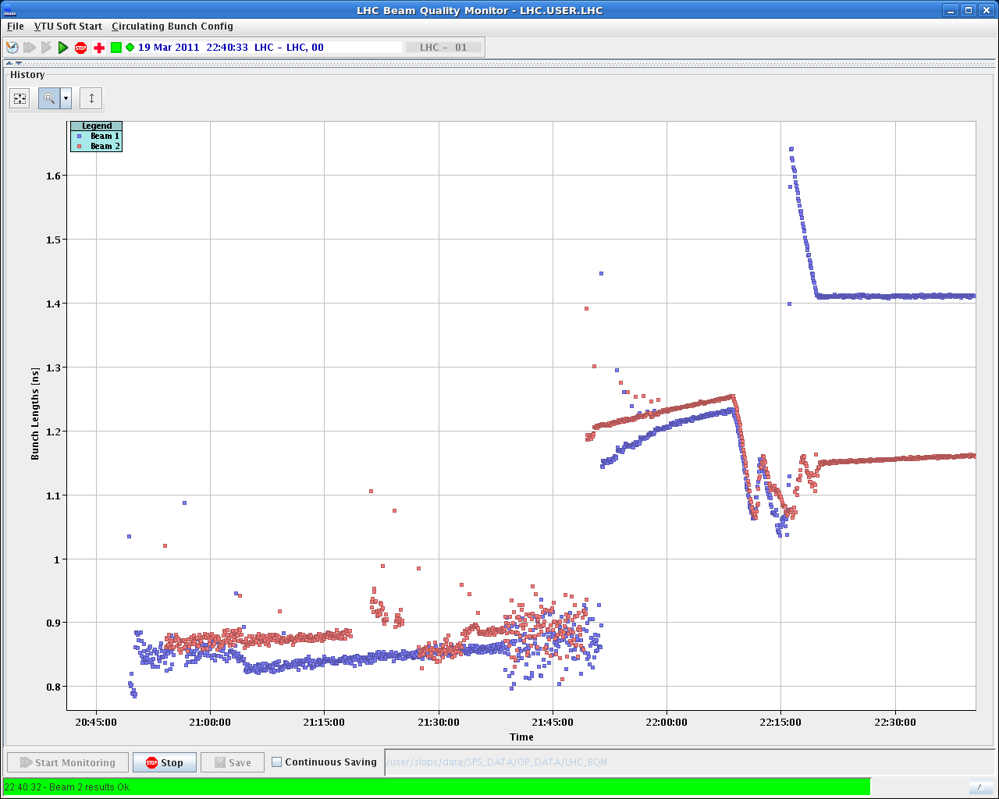
Long. Blow-up
Longitudinal blow-up still requiring some tuning. Too fast blow-up for beam 1

Slide 7
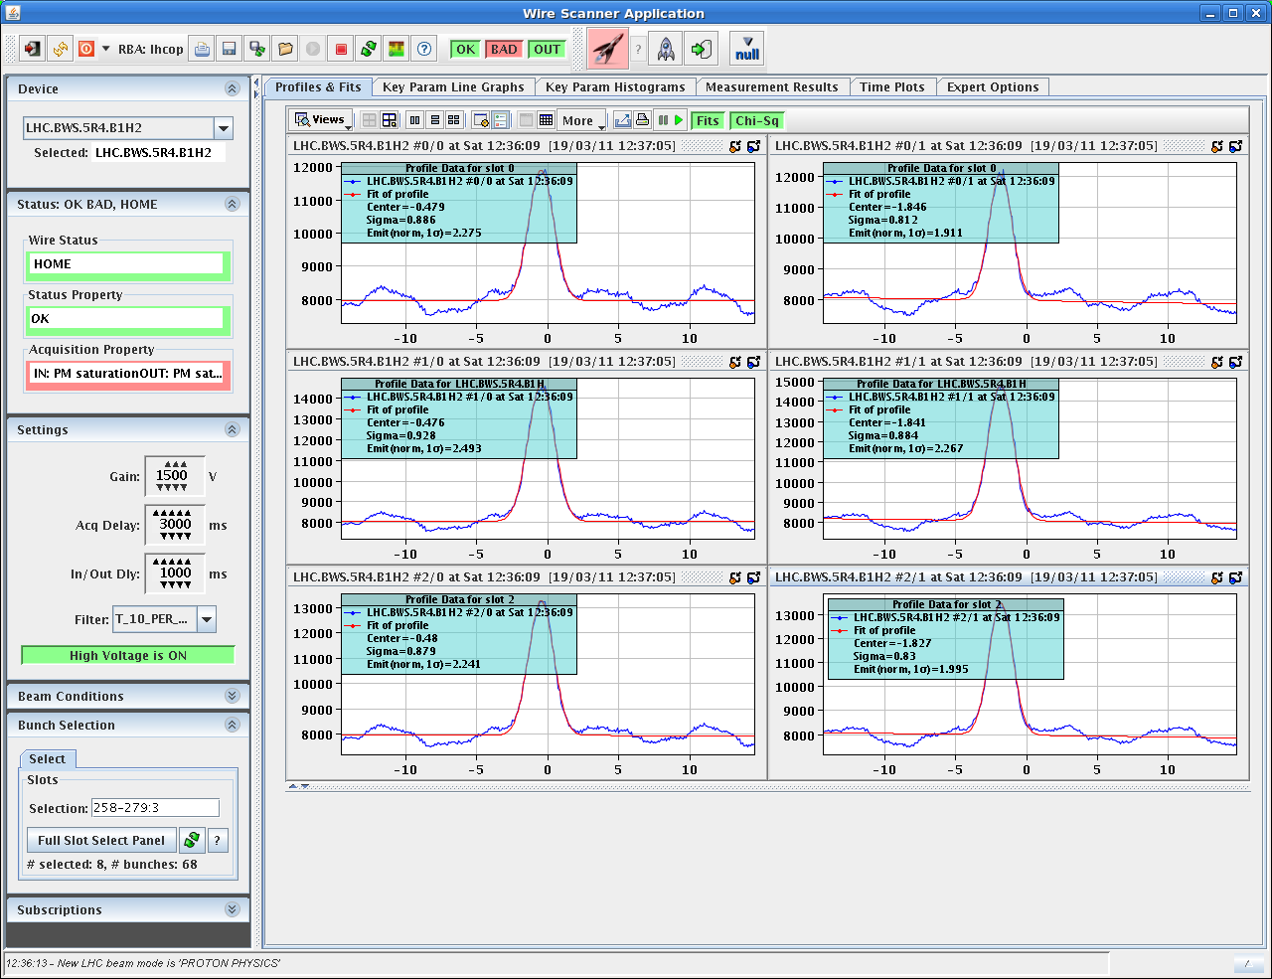
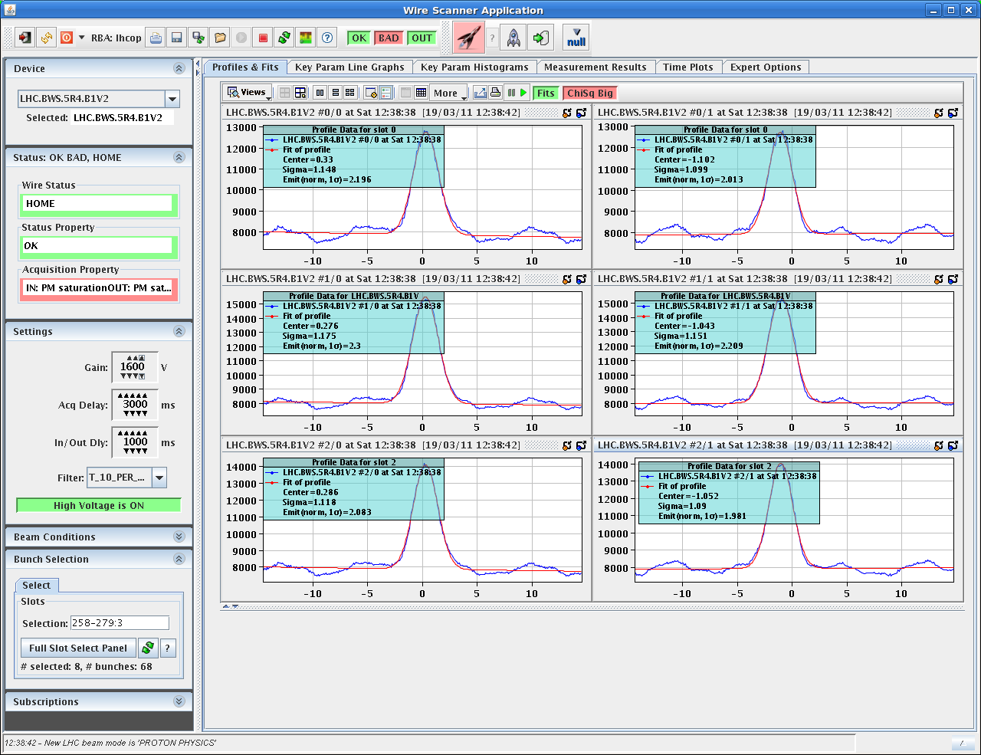
Wire scanners
Still quite some noise on wire scanner beam 1 (investigation is required in the tunnel)

Slide 8
Plan
AM: Fill for physics (64 bunches)
Afternoon: Dump and inject 136 bunches if OK from rMPP
Aim for physics with 136 bunches

Slide 9
1.38 TeV setting-up
Interlock tests for the roman pot
RF voltage limit interlock
Longitudinal blow-up
Wire scanners
FGC firmware update

