Slide 1
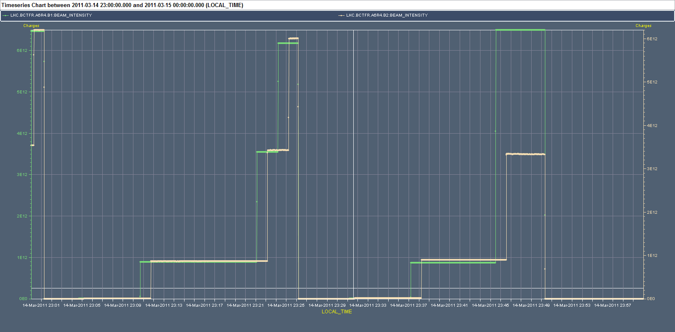
BCT
Clarified issue with reading of the BCT for injection of 48 bunches on B2. Due to injection in wrong bucket

Slide 2
Tuesday 15/3
08:00 – 12:00: Machine protection checks without beam: BLMs/XPOC/IPOC
12:00-16:30 Test ramp with 8 bunches (and 4 pilots) failed due to trip of trim quadrupole
16:30-21:30 - MPS checks:
BLM tests with beam
D1 trip and protection by BLM
Dump BTV interlock tests
LSS interlocked BPMs
OK from rMPP to go to 32 on 32 bunches
21:30 – 23:30 Test ramp with 8 bunches (75 ns spacing) failed due to trip of trim quadrupole at flat-top
23:30 – 02:00 Ramp and squeeze 3 on 3 with damper ON through all the squeeze and reduced gain – Validation of the behaviour of the damper during the squeeze.
02:00 – now stable beams

Slide 3
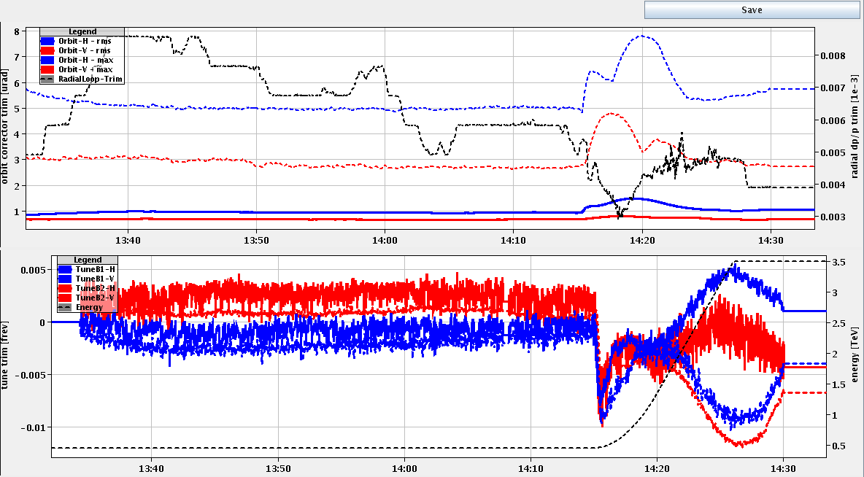
Test ramp with 8 bunches
Aim: validation ramp and squeeze with 75 ns beam and transverse feedback ON through the squeeze
Larger oscillations observed on B2 H tune corrections – tune feedback locking on mains harmonics leading to QPS trigger on RQTF.A23B2 and RQTF.A34B2
8 bunches

Slide 4
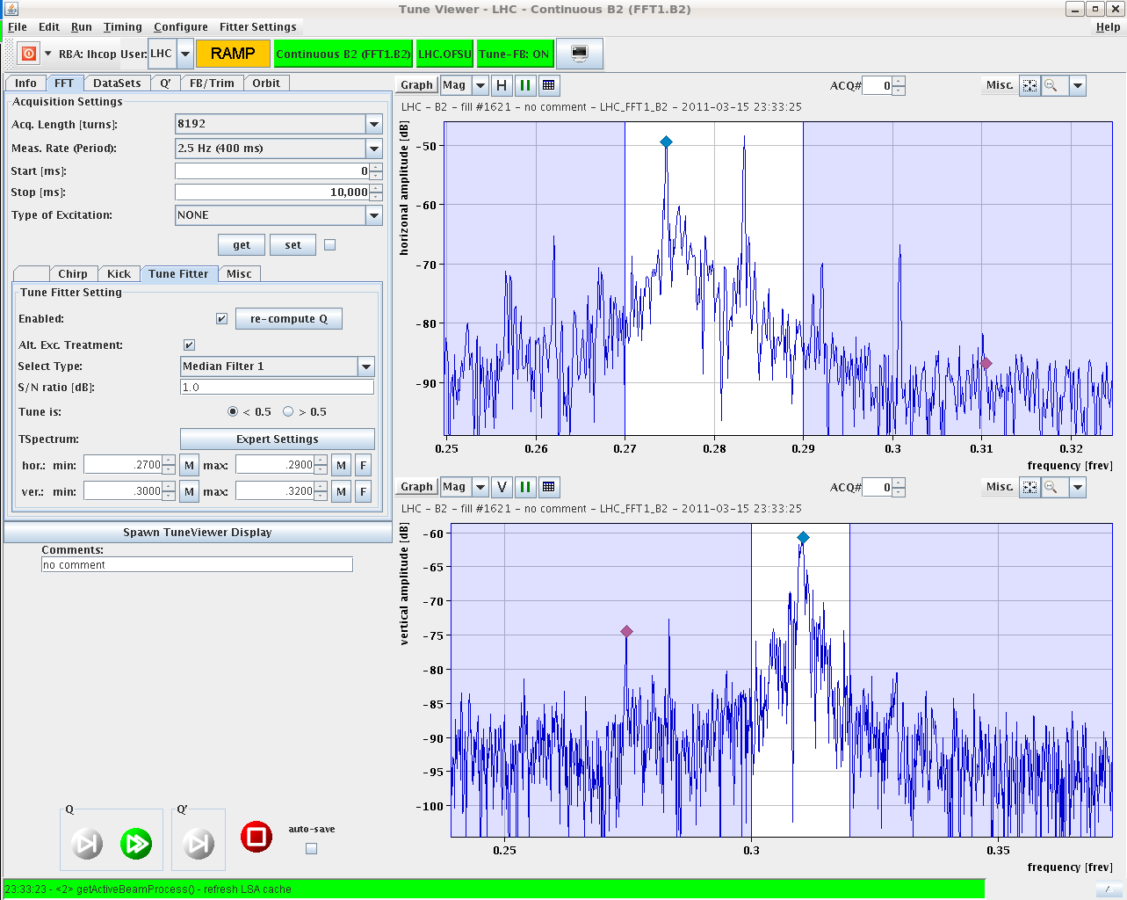
Test ramp with 8 bunches
Mains harmonics
100 Hz
8 bunches

Slide 5
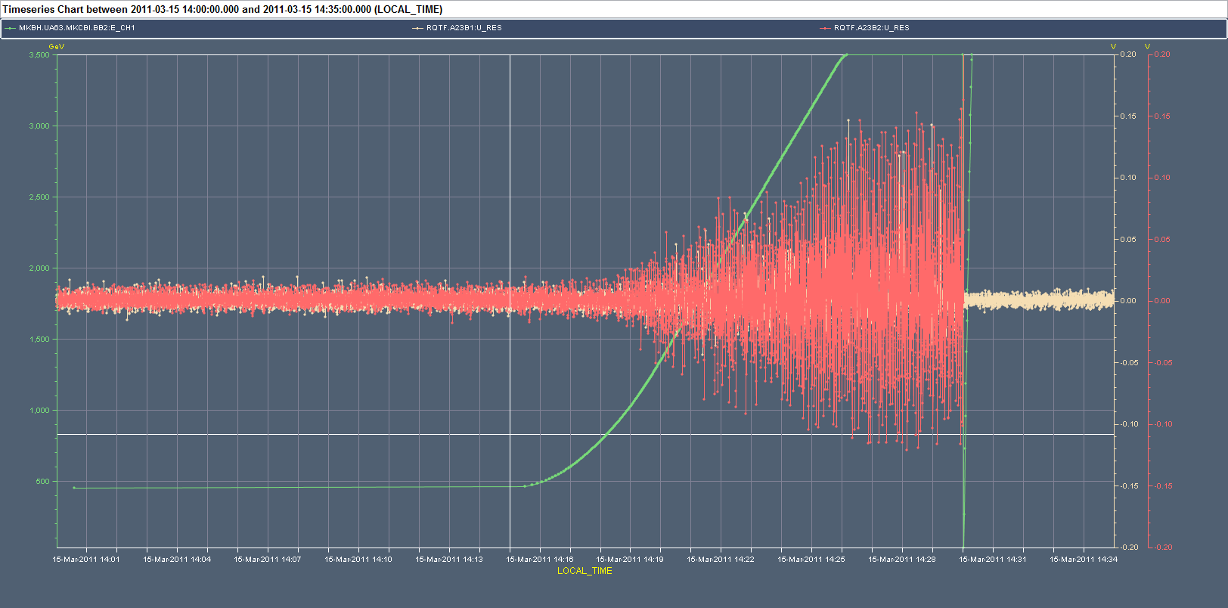
RQTF trip
U_res
Reduced gain of the transverse feedback all through the ramp

Slide 6
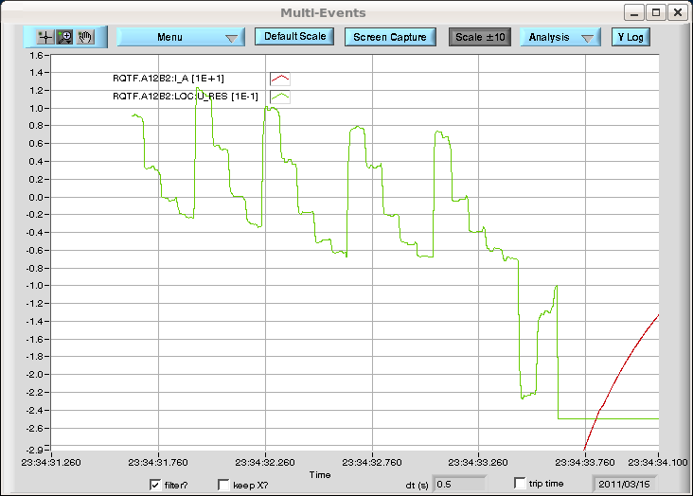
RQTF trip
U_res
Do we need all that bandwidth?

Slide 7
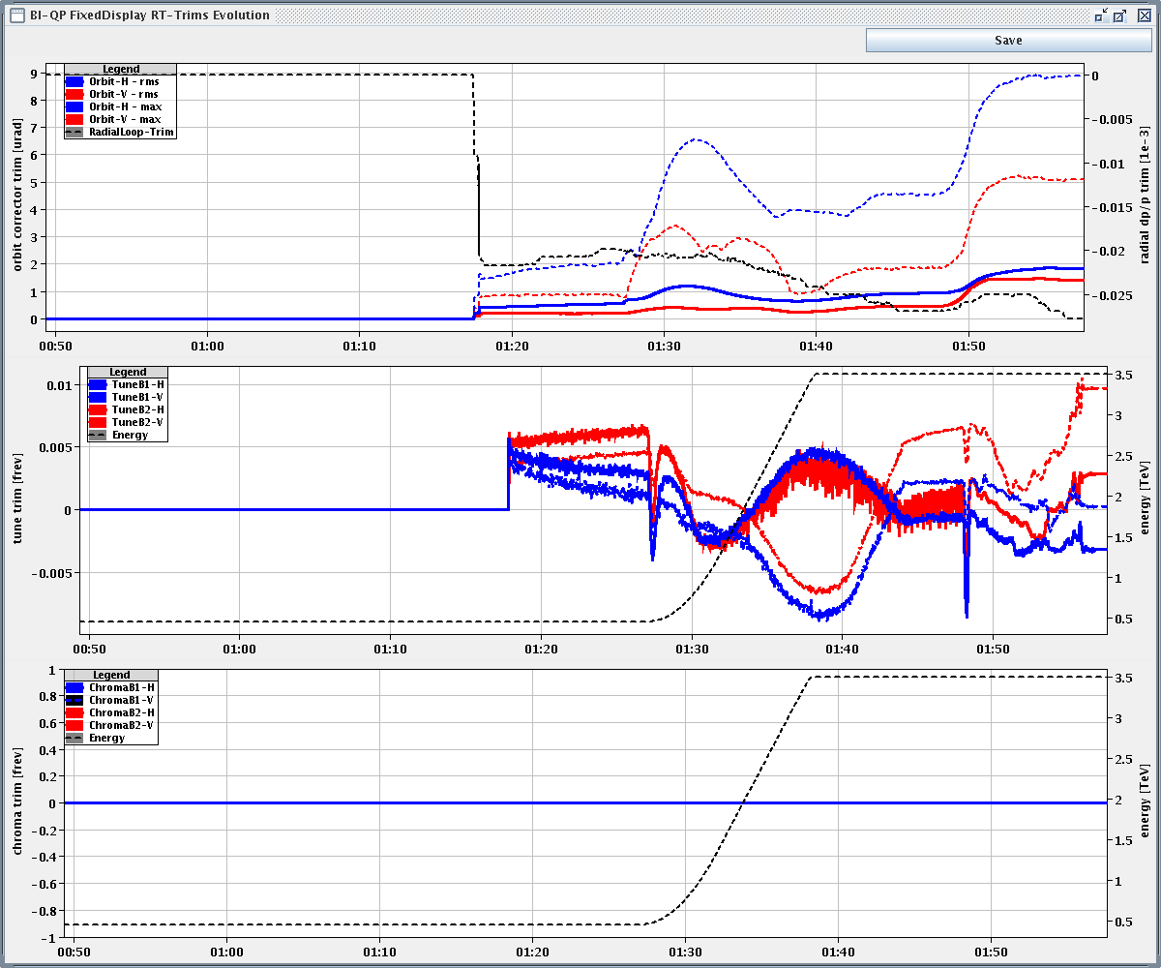
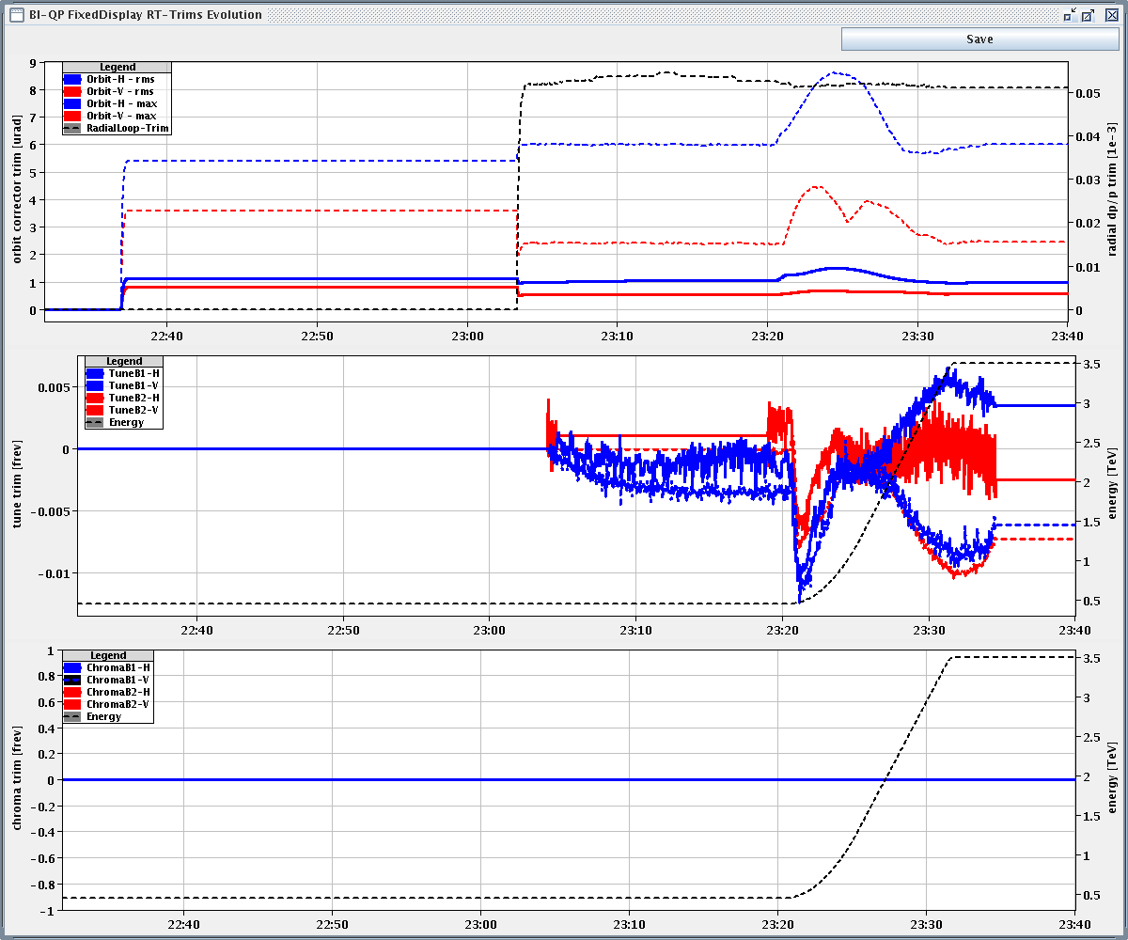
Test ramp with 8 bunches
Oscillations observed with 3 and 8 bunches but larger with 8 bunches (approximately factor 2). Poorer signal to noise ratio?
3 bunches
8 bunches

Slide 8
Plan
Test ramp(s) with more drastic reduction of the damper gain during the ramp (H-B2) to find possible operation with acceptable signal for the tune feedback
Data collection for understanding the origin of the noise (why on B2 H, visible in all BBQ systems?, cross-check with damper pick-ups)
If satisfactory solution found go to 32 bunches: comparison signal to noise ratio for BBQ signal at injection
Longer term:
need work to avoid trips of trim quads induced by the feedback
Bandwidth reduction?

