Slide 1
Thursday 25/11/10 & Night
7:00 Stable beams fill #1518
The delivered Lumi in (mb)^-1 ALICE: 30.534 ATLAS 34.022 CMS: 32.001
8:06 Beams dumped sector 23 tripped. Q9R2.
Work on:
Beam Gas Ionisation monitor calibration (BGI)
Injector chain beam intensity
Modification RF trim at
16:15 Inject fill #1520
Recovered intensities of 3e10 per injection
18:00 Stable beam (record turn around ☹ )
Good lumi’s back again ☺
24:00 Lost Sector 8.1
03:30 Start refill fill #1521
04:44 Stable beams
Good beam current, but beams slightly larger

Slide 2
Q9R2 trip & Operations Vistar Page
8:06 Beams dumped sector 23 tripped. Q9R2
Different to the case from last Monday. This time the quench detector signal shows clearly a slow rising voltage on beam 1 - with nothing on beam 2 until firing of the heaters. The heaters were fired when the Ures signal of Beam 1 coil reached the threshold 100 mV. Knud
No access required
LHC Operations fixed display problem with BCT plots now fixed
It was a problem with the difference between average and whole beam intensity ... Fixed display updated and released

Slide 3
Beam Gas Ionisation Monitor
BGI position calibration with bumps up to 5 mm finished, unfortunately only for Beam 1 due to HV problems. The maximum injected pressure was 7.8E-9 mbar. Data will be analysed in order to resolve the discrepancy between emittance measured by BGI and BSTR. Some wire scans has also been done and peak position moves with the bump.
Mariusz Sapinski

Slide 4
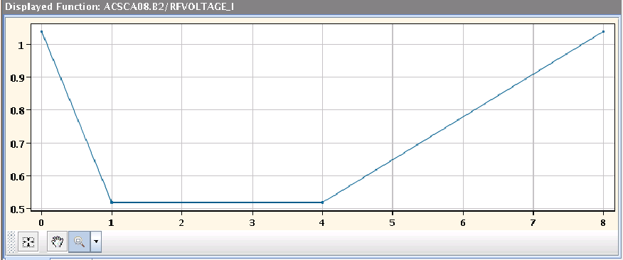
RF Voltage trim at injection – Ghost bunches
With the beams dumped, the RF voltage functions for injection were lengthened by 4.4 s to prevent the generation of ghost bunches. Unfortunately, this showed up an error in the injection sequencer logic with sent an abort to the RF FGCs while they were still running. This was eventually debugged.

Slide 5
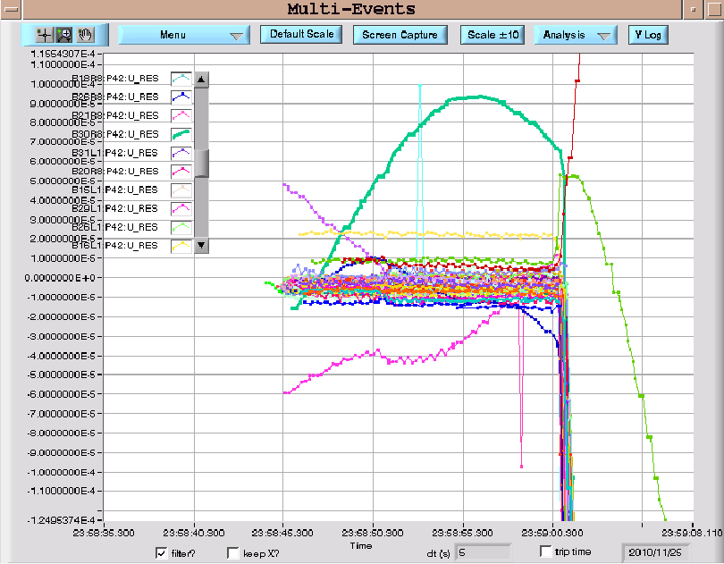
Midnight
Lost Sector 81
Some nQPS signals are clearly moving before the event, which was initiated by the opening of the quench loop for the RB.A81 circuit. However it is safe to repower sector 81, once the dump resistor has cooled down

Slide 6
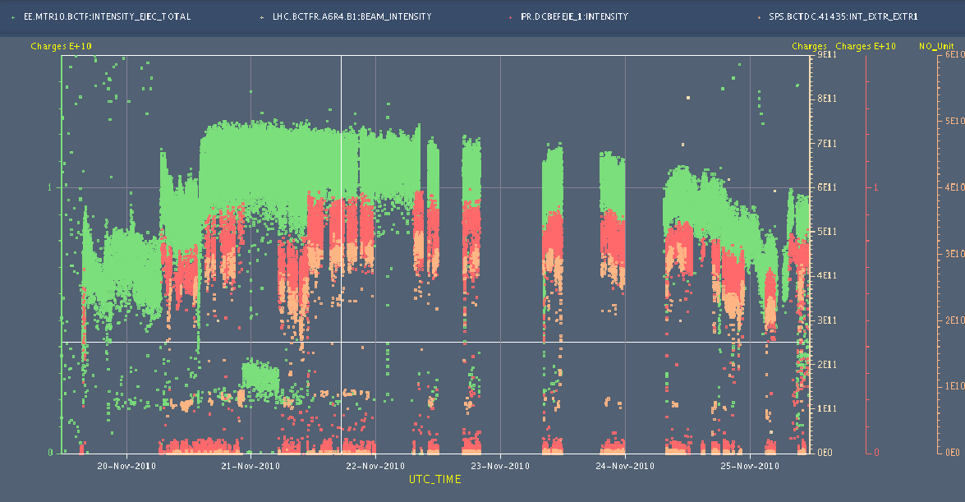
Injector Chain – Intensities back
SPS extracted beam intensities degraded over the last days
Spent the required time to reduce losses at LEIR and SPS
Performance from the weekend almost back
Injected intensities from SPS back to 3e10 for 4 bunches
Even distribution across bunches
Not a record but a lot better
Thanks to Django, Christian and the injector teams !

Slide 7
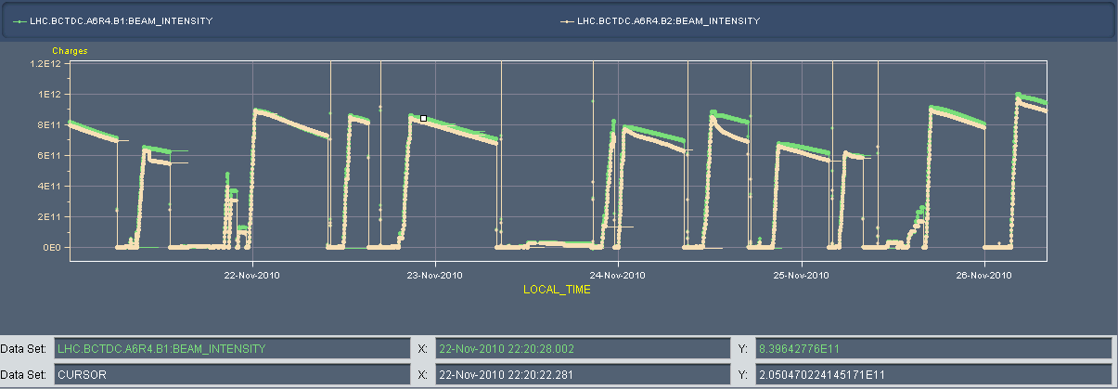
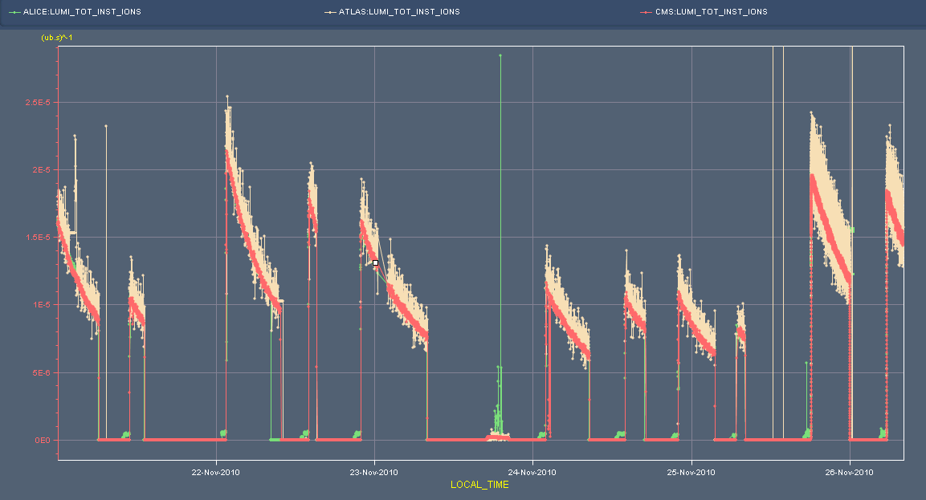
Intensities and Luminosities
Sunday 00:00
Friday 08:00
Intensity 1e12
Lumi 2e-5

Slide 8
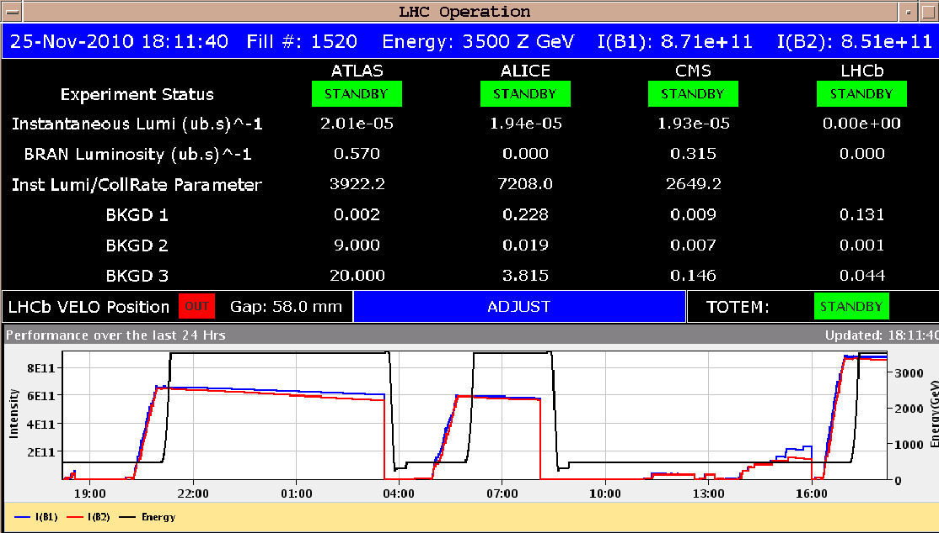
Fill #1520: max lumi’s again above 2e-5
‘Proton emittances’ at start injection
B1 H/V, B2 H/4: 2.1/1.8, 2.0/2.3
At end of injection:
B1 H/V, B2 H/4: 2.7/2.5, 2.9/4.7
Good lifetimes at collisions: 25 h +
Fill #1521
B1H = 3.0 B1V = 3.4
B2H = 3.2 B2V = 5.5

Slide 9
Plan
More physics 121 x 121
Atlas solenoid ramp down in between two fills
This morning?
Van der Meer Scans
Next week?
Injection with 8 bunches, reduce injection time in SPS
Next week

