Slide 1
Wednesday
06:00 - 10:30 Injection checks/SPS beam quality verification/Abort gap cleaning checks.
10:30 Start filling with an eye on vacuum and cryogenics
15:45 680 bunches/beam at 450 GeV with 75 ns spacing (8+14*48)
Kept this beam for 2 hours for UFO investigations
18:00 Beam dumped by OP
18:30-21:30 Damper setting-up
21:30-ongoing: filling with max. bunch intensity (~1.2x10¹¹ p/bunch) and two different filling patterns. Issues with the capture of beam 2 ➔ limit to B1

Slide 2
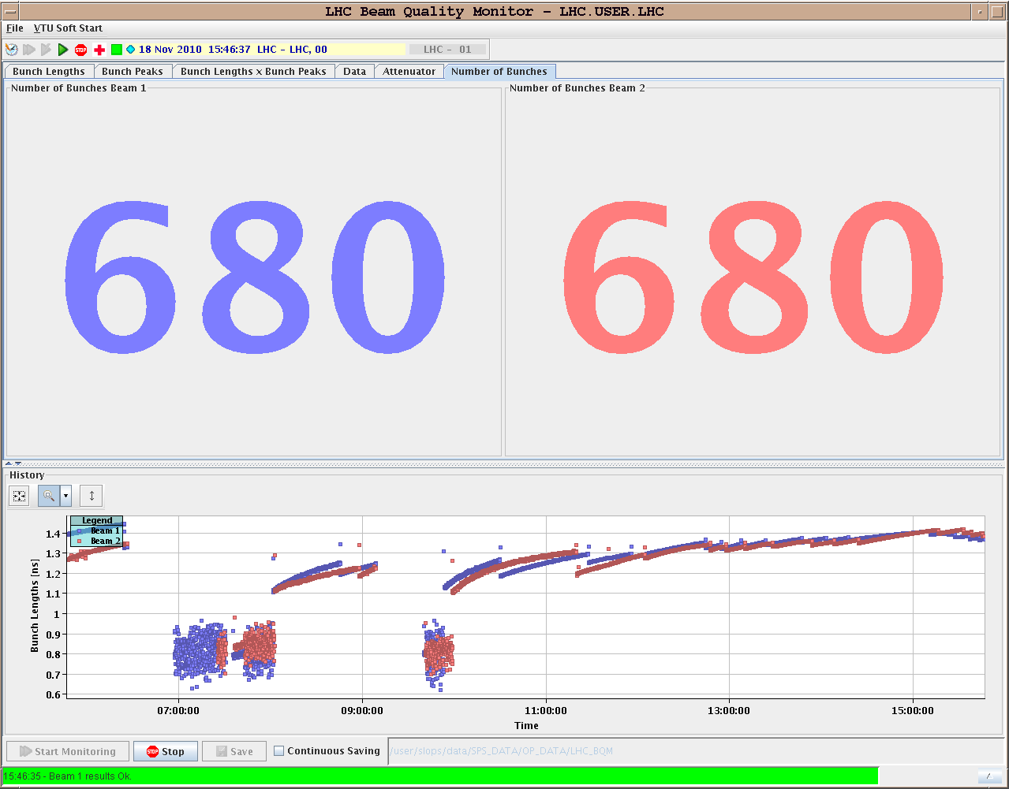
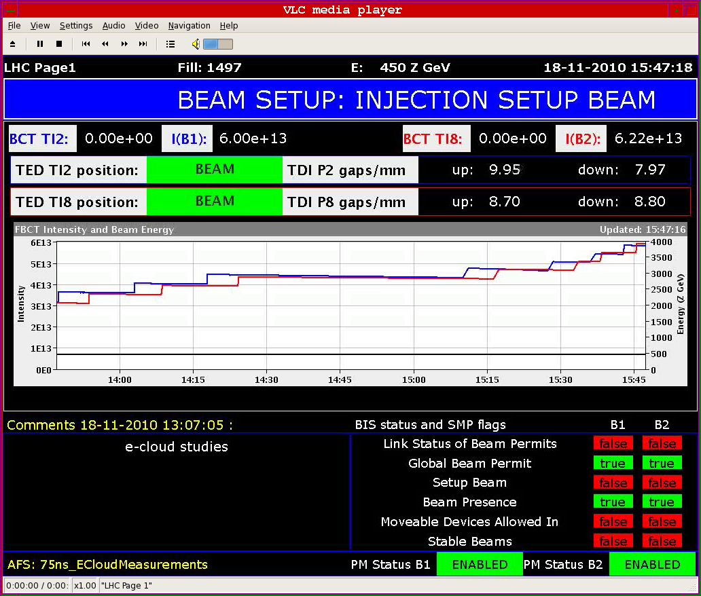
75 ns
Finally got there....intensity slightly lower than nominal (~0.9x10¹¹ p/bunch)

Slide 3
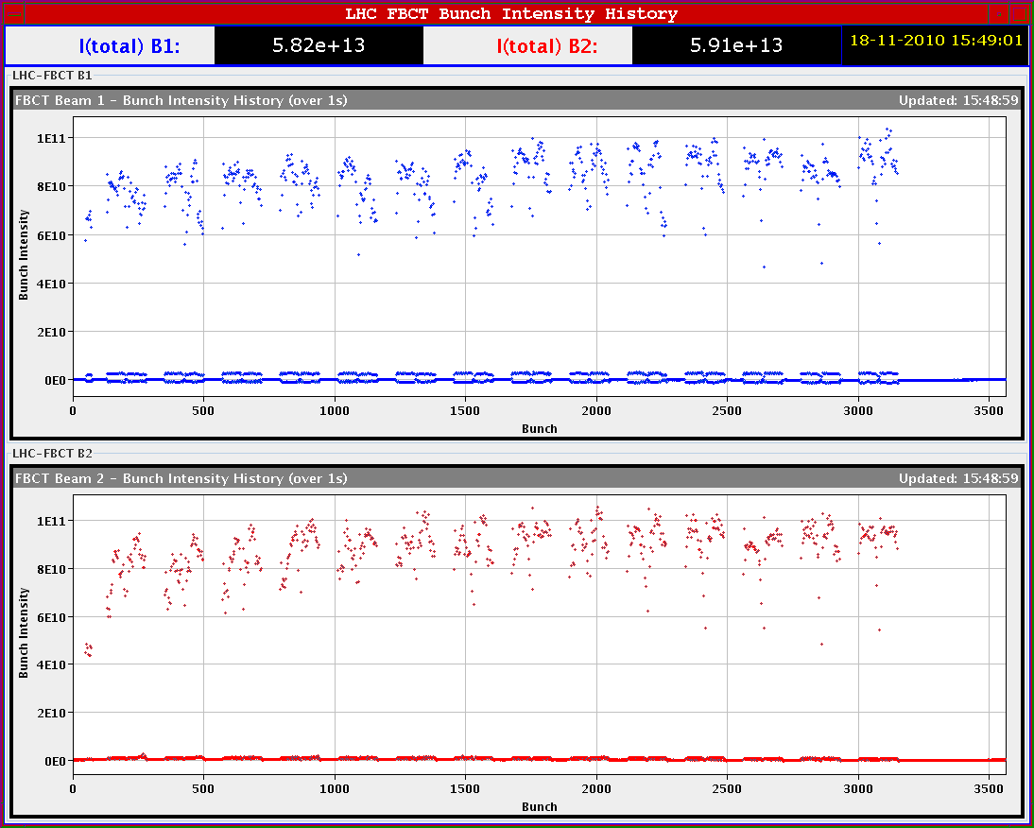
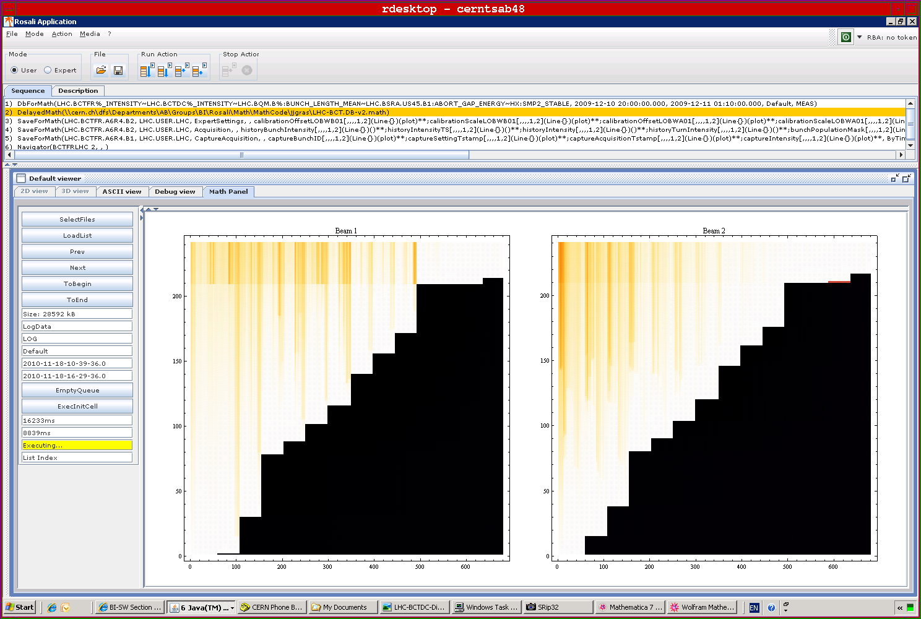
75 ns
Finally got there....intensity slightly lower than nominal (~0.9x10¹¹ p/bunch). During the ramp in intensity measurements for vacuum and cryogenics

Slide 4
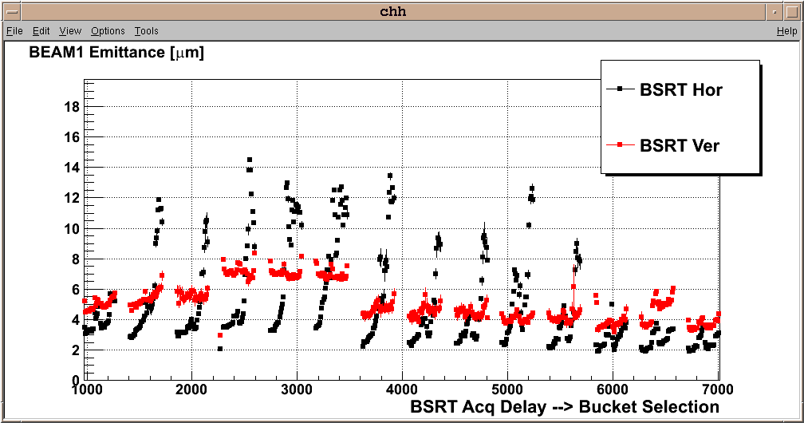
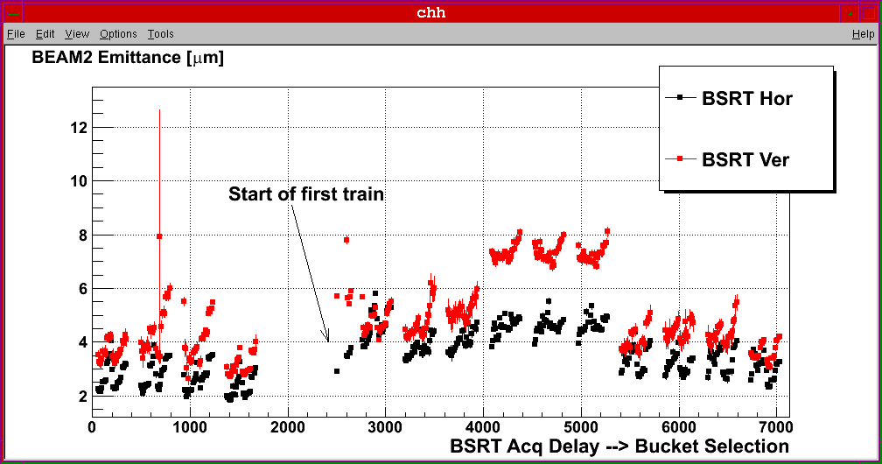
75 ns
Still blow-up observed in particular for B1 horizontal ➔ investigations on feedback side ➔ hoorizontal oscillations observed ➔ can be damped by higher chromaticity

Slide 5
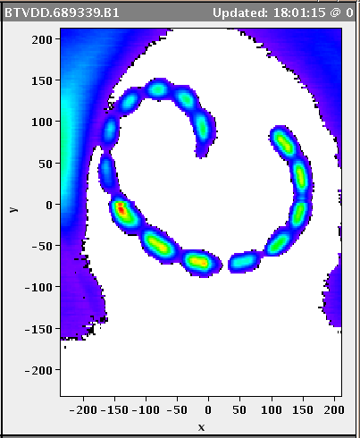
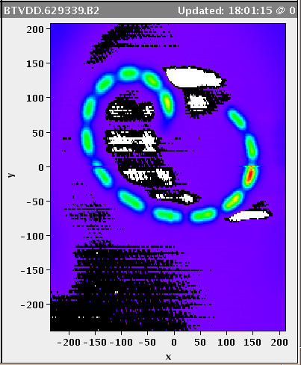
75 ns
Beam dump (OP)

Slide 6
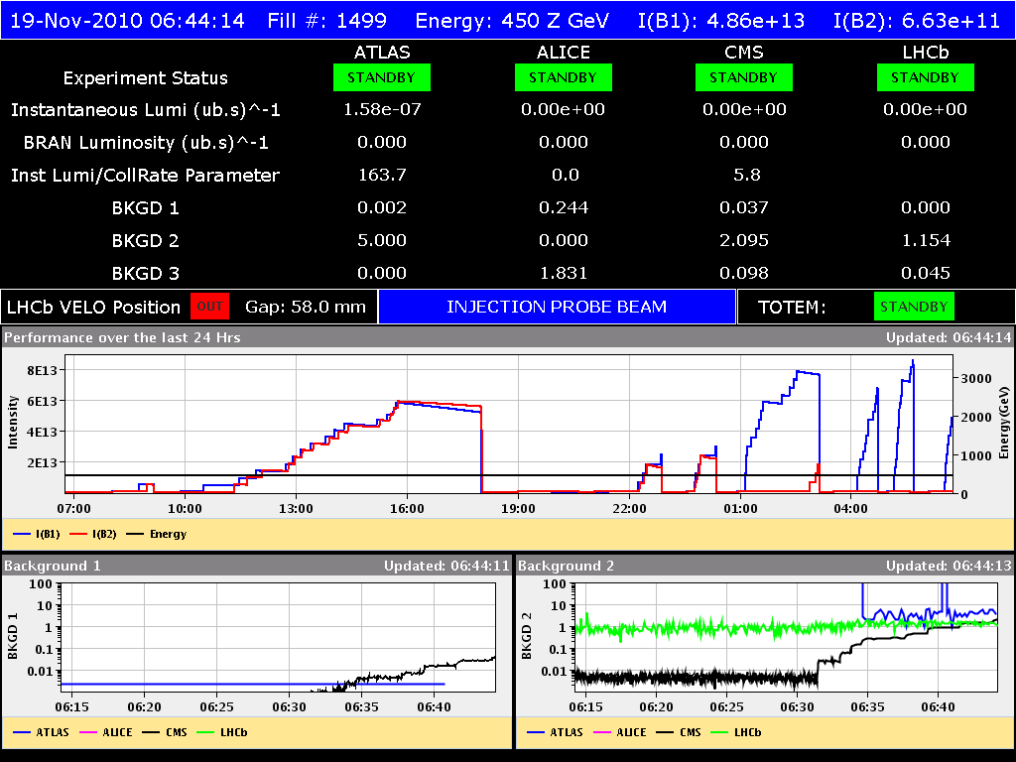
75 ns

Slide 7
Proposed Proton MD program
 | Start time | Duration [h]
 | 22:00 | 6 | Injection of 680 bunches max. bunch intensity
 | 04:00 | 8 | Injection of ~800 bunches max. bunch intensity
Fri 19 | ongoing | 8 | Switch to 50ns (up to 24+24 bunches), injection and damper checks
 | 17:00 | 4 | Test ramp with pilots
 | 22:00 | 10 | Ramp 9x12 50ns bunches
Sat | 08:00 | 4 | Switch to ions and interlock checks
 | 12:00 |  | Back to ion physics
Total MD time |  | 78

