Slide 1
Friday 12.11.
00h53: Stable beams. 68 on 69.
06h41: trip of RQD.A23
06h49: trip of sector 67 when loading the ramp-down start BP (SEU?).
09h49: Access for QPS problems.
19h04: QPS accesses finished. Starting recovery.
20h52: Injection. RF voltage modulation setup.
22h42: Start ramp. 69b x 69b.
01h04: Stable beams. Fill #1489.

Slide 2
QPS Interventions (Summary Knud)
Three QPS non-conformities occurred during the night to Friday 12/11, affecting the main powering circuits in sectors 23 and 67, requiring access to the tunnel.
Detailed report from Knud received
See next slides…

Slide 3
Event no. 1. Sector 67:
The ’QPS OK’ status was lost early in the night, however, first discovered by the QPS team in the morning of Friday. It affected the quench detector (iQPS) of dipole A9.L7 to which communication was interrupted as the unit did not return to logging. A fake Post-Mortem event had been triggered and the controller was left in a stalled state, preventing any new ramp. The quench protection feature, however, remained intact.
The controller was restarted by a locally applied power cycle (1st tunnel intervention).
Most likely the incident is the result of an SEU, such as it has been experienced with identical Local Protection Units in case of protons in the injection regions and at the occasion of bump applied for quench studies. This ties up with the observations made during this run by EN/STI of local single events, with 30 counts at detector adjacent to the QPS rack !
The undertaking by QPS of software upgrades to provide automatic return to logging after a SEU event has started and will be completed during the Xmas Stop for the exposed areas (P7, P3, DS next to experiments).
Knud Dahlerup-Petersen

Slide 4
Event no. 2. Sector 23 :
The RB/QF/QD Global Busbar Detector, located in UA27, was the origin of the beam dump and trip of the main circuits on Friday morning 06H39. Access was required. The detector (based on an industrial PC) was found with its power supply broken. Restarted after replacement of the power source.
This is the fifth event of this kind (out of 8 installed units) since the beginning of LHC commissioning. There is a proposal for a partial dismantling of these units during the Xmas Stop.
Knud Dahlerup-Petersen

Slide 5
Event no. 3. Sector 67: (a)
A first trip of the RQD circuit occurred at 06H48 on Friday morning, at the beginning of the ramp from 5800A. Heaters were fired on main quad Q15.R6 by the nQPS crate under dipole B16.R6, indicating that the SymQ (DS) system had observed a voltage rise (large U_{res} signal). Only board-B of the DS system appeared suspicious. The asymmetric quench detector (iQPS) reacted only as a result of the heater firing.
A similar event occurred at the beginning of the ramp to I_{min} of the following restart of the main circuits in S67 –intended for further analysis of the problem (at 12H56). Same fault signals and event sequence were observed as during the first trip.
It was decided to replace board B of the SymQ system of the nQPS crate B16.R6. Finally both MQ boards were replaced, however without any improvement, as demonstrated during the subsequent re-powering (again trip at the beginning of first ramp).
Knud Dahlerup-Petersen

Slide 6
Event no. 3. Sector 67: (b)
As the U_{diode} signal from board B appeared abnormally high further investigations concentrated on the voltage divider of the board B (mounted on the Motherboard of the nQPS crate). A broken or detached resistor (the parallel resistor 360Ω) of the divider would effectively cause a surge voltage as observed. It was decided to endeavor a replacement of the complete crate by a spare.
With the spare crate in place a new powering was successful.
Due to lack of RP approval for removal of the crate no immediate examination could be undertaken. However, intervention team reported about ‘loose’ objects inside!
Knud Dahlerup-Petersen

Slide 7
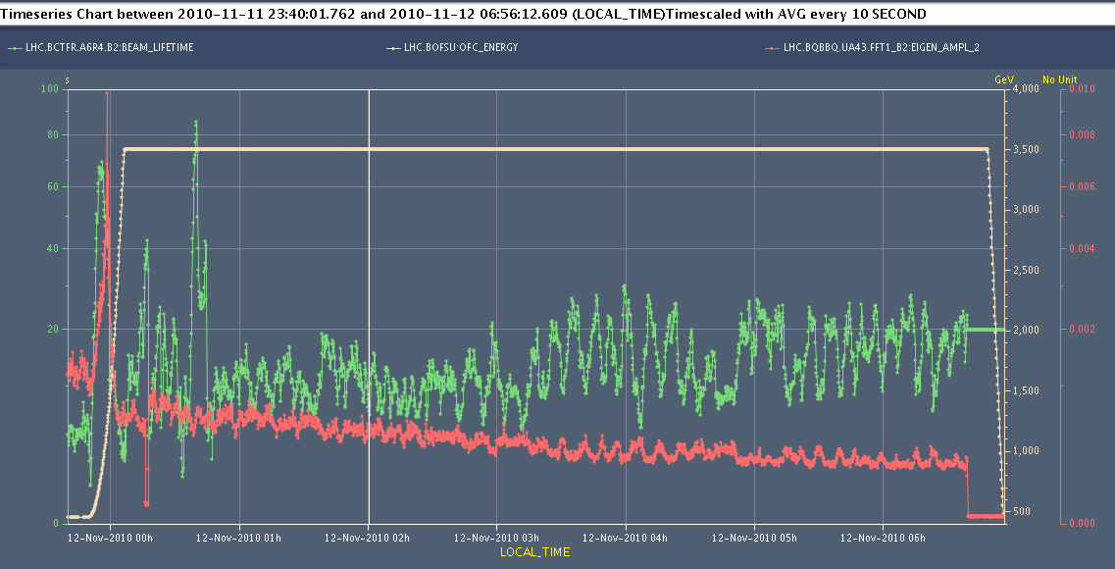
Look into A9.L7 Trip: SEU?
Lost QPS OK on 2am Friday morning → prevents injection but allowed keeping fill.
High losses in IR7 dispersion suppressor: worse leakage for ion collimation (fragmentation, dissociation) plus low b2 lifetime.
Lifetime
Beam2

Slide 8
Loss Maps: Physics Conditions B2 V

Slide 9
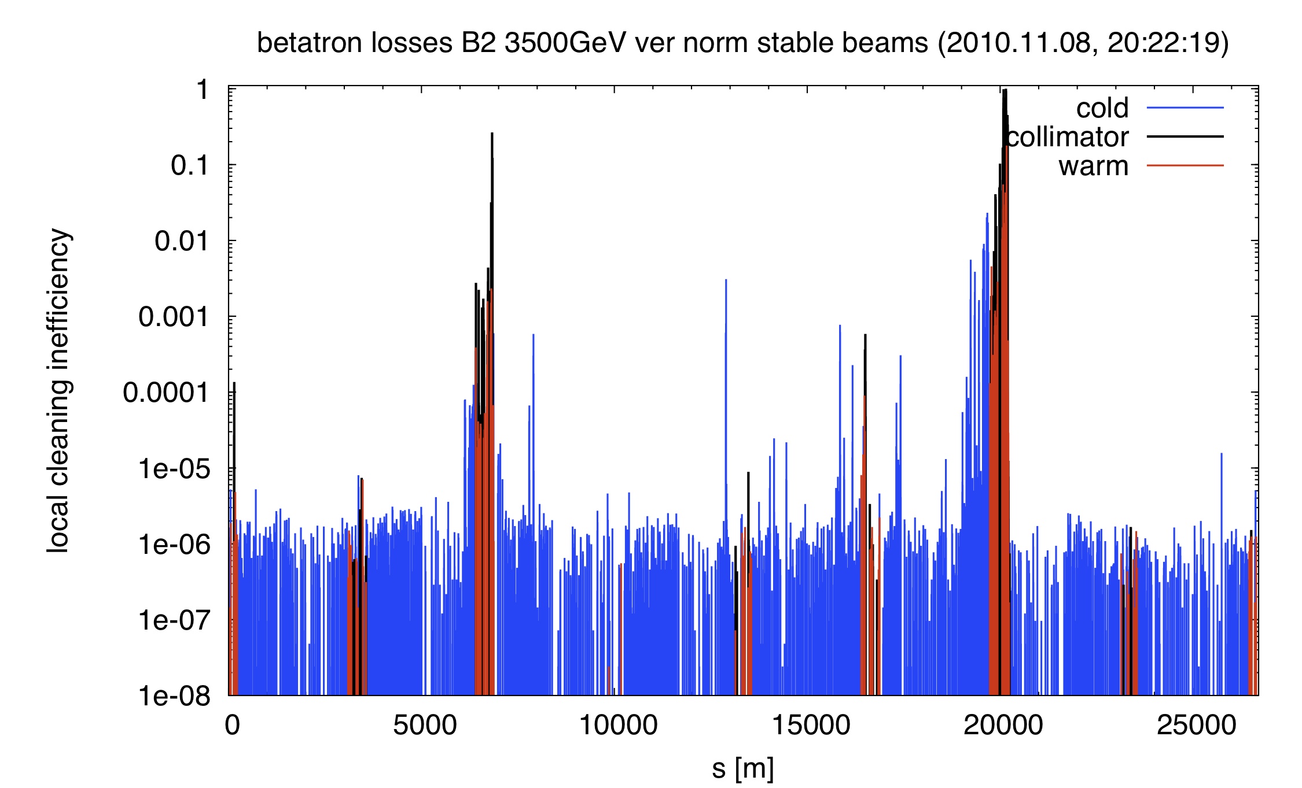
Loss Maps: Physics Conditions B2 V

Slide 10
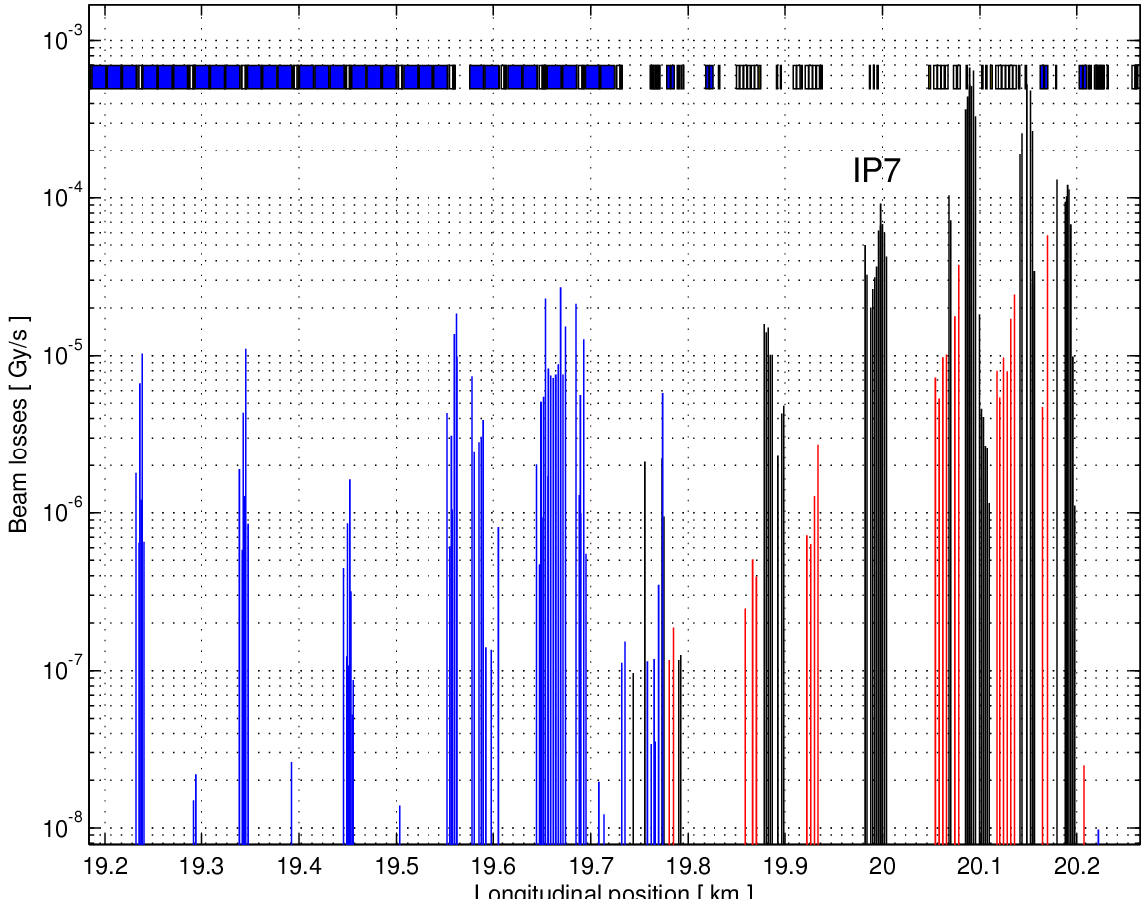
Zoom IR7 Losses, B2: Fill Early Friday
S. Redaelli

Slide 11
SEU Analysis
See slides M. Brugger for a first look at this fill…

Slide 12
a few slides about ‘Very’ ;-) VERY Quick look on IR7 – RadLevels (Ion versus Proton Run) [good and bad refers to losses in the machine]
M. Brugger
PLEASE NOTE THREE IMPORTANT THINGS: - very quick extraction and preliminary analysis
very limited statistics for the proton run (counts/fill) - mentioned scalings are very preliminary
[just to get a ‘feeling ;-) ]

Slide 13
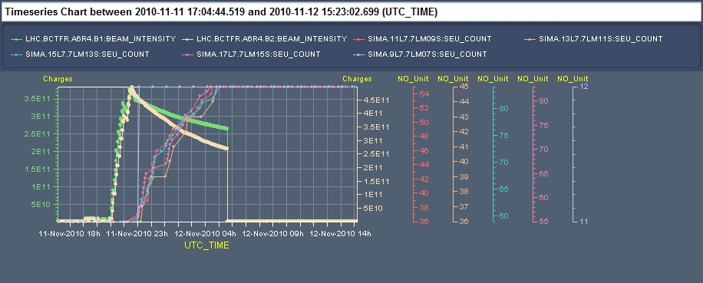
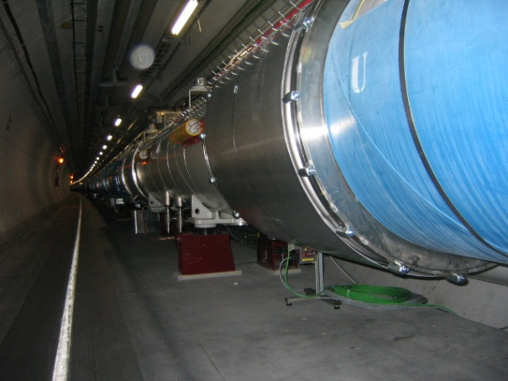
Left of IR7 “Bad Ion Fill (1488)”
M. Brugger
- Beam intensity for ions -> ‘equivalent’ of Ions/Protons to be scaled (208/82) -> ~9x10¹¹ - At the same time, this corresponds to 68bunches, thus about 10% of nominal.
- RadMons nicely ‘counting’ at uneven MQs (9-17), below Interconnects
- this dataset: RM9-11 set to 5V, RM13-17 set to 3V
this fill: with th. neut. ratio of 1: ~1E6cm⁻² (@Q9), ~1E7cm⁻² (@Q17) >20MeV
VERY simplified scaling to nominal (7TeV) and 1 month of Ions: ~1E10cm⁻²

Slide 14
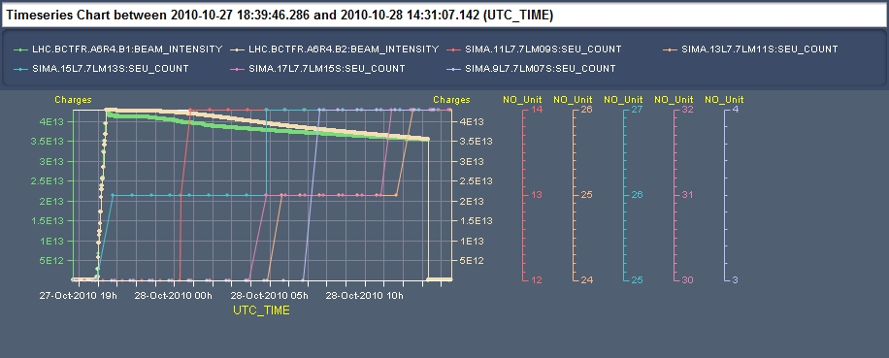
Left of IR7 “Good Proton Fill (1450)”
M. Brugger
To be compared with ~9x10¹¹ as equivalent number of protons of previous ion fill
Again running at about 10% of nominal
- RadMons have low statistics (2 counts in critical locations)
- Voltage settings are the same as before RM9-11 @5V, RM13-17@3V
VERY simplified scaling to nominal (7TeV) and 1 LHC year: ~5E9cm⁻² >20MeV
(nicely agreeing with the simulation estimates: 1E9-1E10cm⁻²/year)

Slide 15
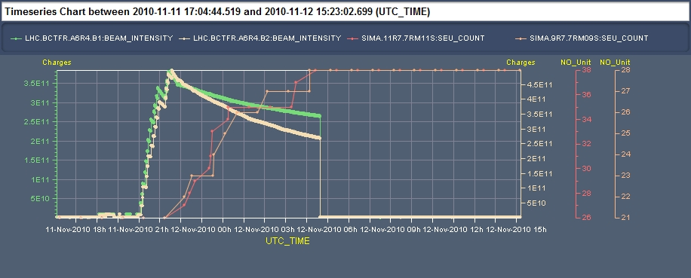
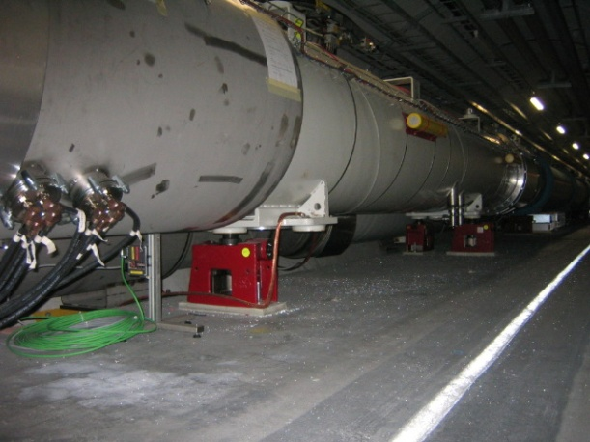
Right of IR7 “Bad Ion Fill (1488)”
M. Brugger
- Beam intensity for ions -> ‘‘equivalent’ of Ions/protons to be scaled (207/82) -> ~9x10¹¹ - At the same time, this corresponds to 68bunches, thus about 10% of nominal.
- RadMons nicely ‘counting’ at different locations (mainly Q9 and Q11)
- this dataset: RM9-11 set to 5V, RM13-17 set to 3V
this fill: with th. neut. ratio of 1: ~7E6cm⁻² (@Q9) , ~1E7cm⁻² (@Q11) >20MeV
VERY simplified scaling to nominal (7TeV) and 1 month of Ions: ~1E10cm⁻²

Slide 16
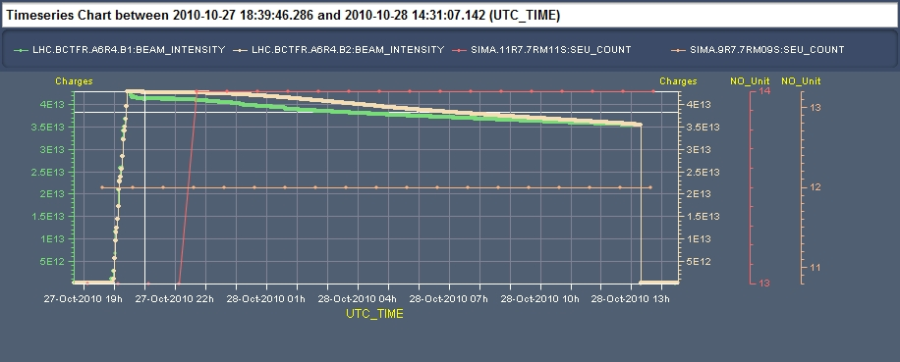
Right of IR7 “Good Proton Fill (1450)”
M. Brugger
To be compared with ~9x10¹¹ as equivalent number of protons of previous ion fill
Again running at about 10% of nominal
- RadMons have VERY low statistics (only one has 1 count)
- Voltage settings are the same as before RM9-11 @5V, RM13-17@3V
VERY simplified scaling to nominal (7TeV) and 1 LHC year: ~4E9cm⁻² >20MeV
(still nicely agreeing with the simulation estimates: 1E9-1E10 cm⁻²/year)

Slide 17
Very Preliminary ‘Conclusion’
M. Brugger
Ions (at least during ‘bad fills’) lead to high losses in the DS/ARC -> ratio Ion/Proton based on Radmon signal and normalized to proton equivalent is in the order of 600
Scaling for nominal
Protons: coherent with simulation estimates (bad statistics, can be improved by looking at more fills, ongoing) -> levels might reach up to 1E10cm⁻² per year
Ions: similar levels can be ‘achieved’ within one month of ions in case ‘bad fills’ would become ‘nominal’
QPS crates affected from Q9-Q17, firmware upgrade possibly needed soon (under investigation - R. Denz)
Quickly checked for P3, and DSs adjacent to experiments -> only little counts so far, levels significantly lower but more statistic/time needed to give some estimates

Slide 18
Friday/Saturday 12/13.11.
19h04: QPS accesses finished. Starting recovery.
20h52: Injection. RF voltage modulation setup.
Instability in LEIR identified as transverse damper problem. Under control for the moment. Working to further improve.
Much better quality of injected ion bunches.
RF modulation setup might allow lower transverse emittance from injectors.
22h42: Start ramp. 69b x 69b.
23h10: Flat top. Incorporation problems:
We had changed length of collision process from 108 s to 180 s.
Incorporation still done with 108 s → screwed up functions.
Mike in to fix it.
01h04: Stable beams. Fill #1489.

Slide 19
RF Modulation Setup
At each injection we have reduced the capture voltage to 3.5 MV for 3 seconds. Voltage at 7 MV between injections. Very good behaviour during filling: very little bunch lengthening and flat Fast BCT (no debunching). Some injection loss on the BLM (see plots).
At start ramp we raise voltage from 7 to 12 MV. OK for B1 and no capture loss. For B2 the voltage was accidentally reduced at start ramp.
Temporary conclusions: looks very good in long plane: no debunching/loss. To be confirmed in transverse plane during physics. If long emittance too small at flat top, we could try long blow-up in next ramp.
Delphine, Andy, Philippe

Slide 20
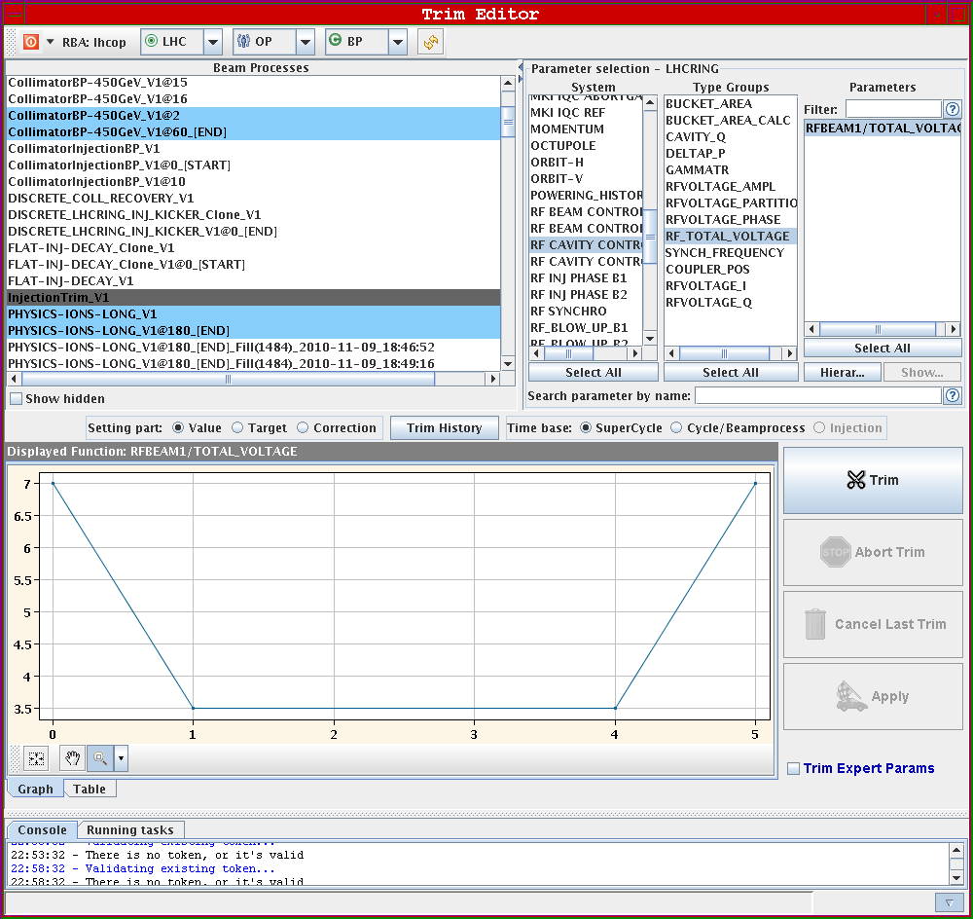
RF Modulation Setup

Slide 21
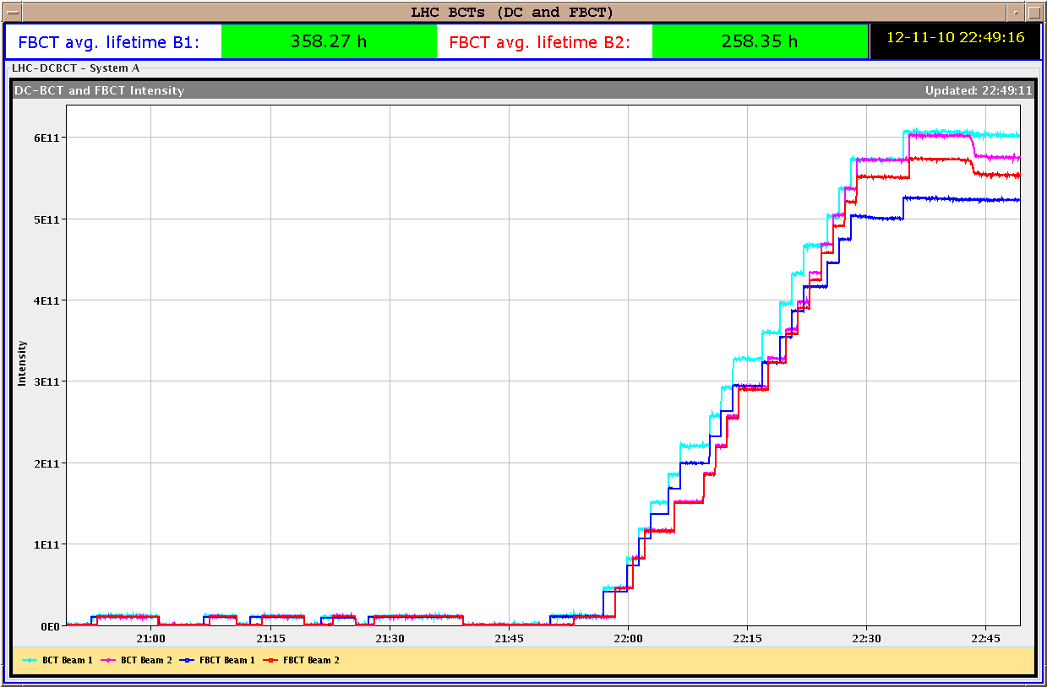
RF Modulation Setup
Nice filling…

Slide 22
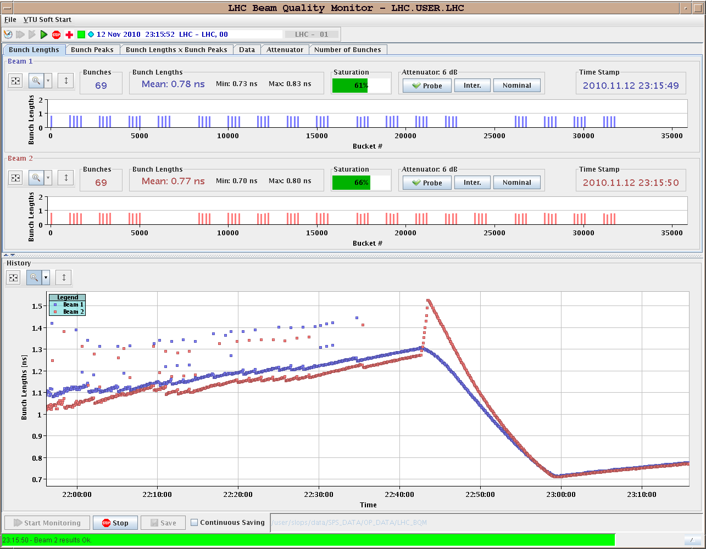
RF Modulation Setup

Slide 23
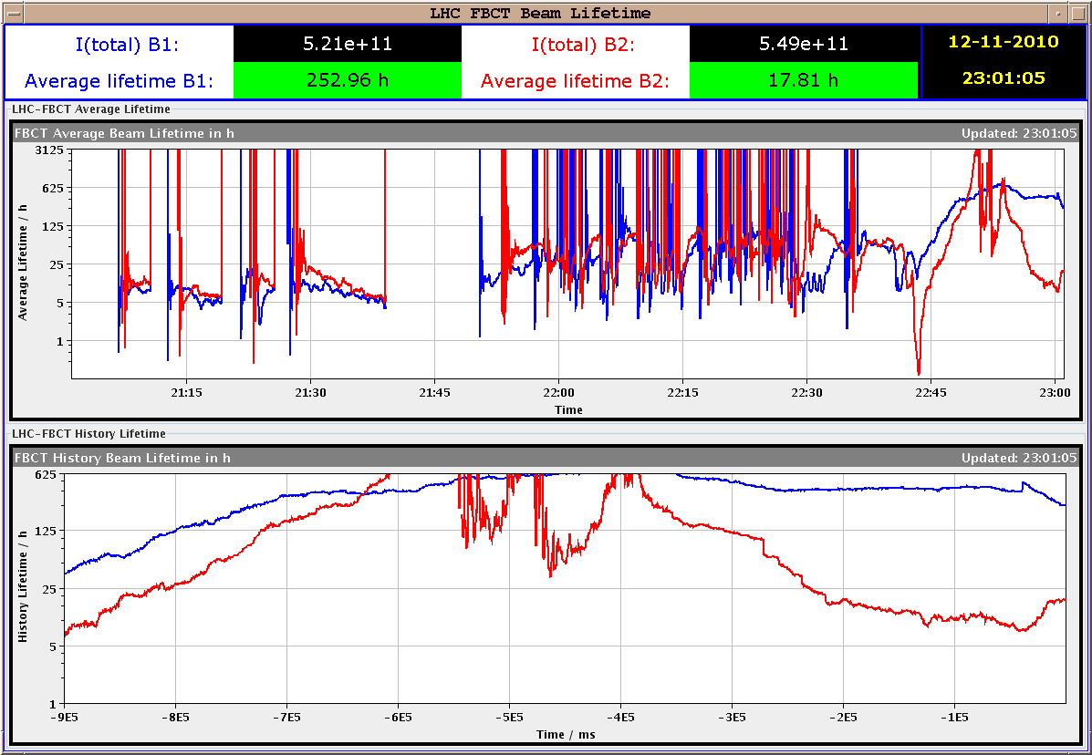
RF Modulation Setup

Slide 24
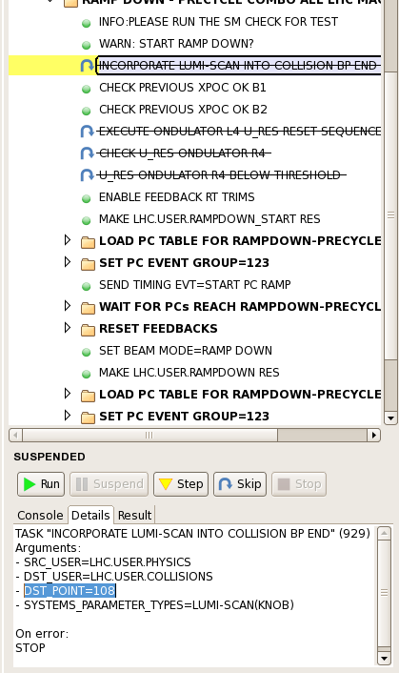
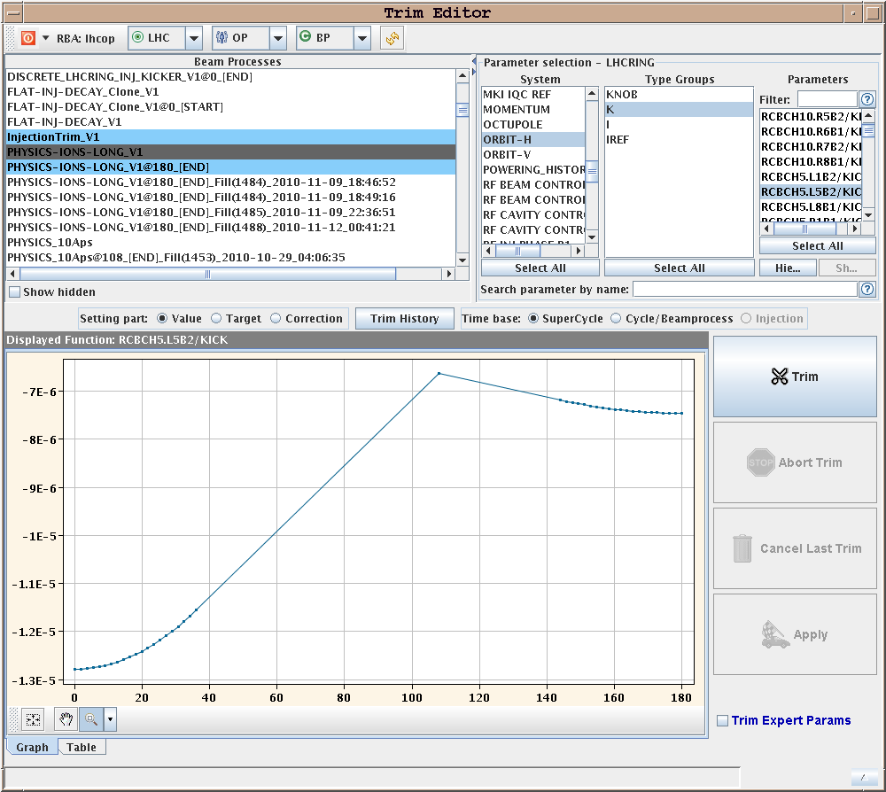
Incorporation Problem

Slide 25
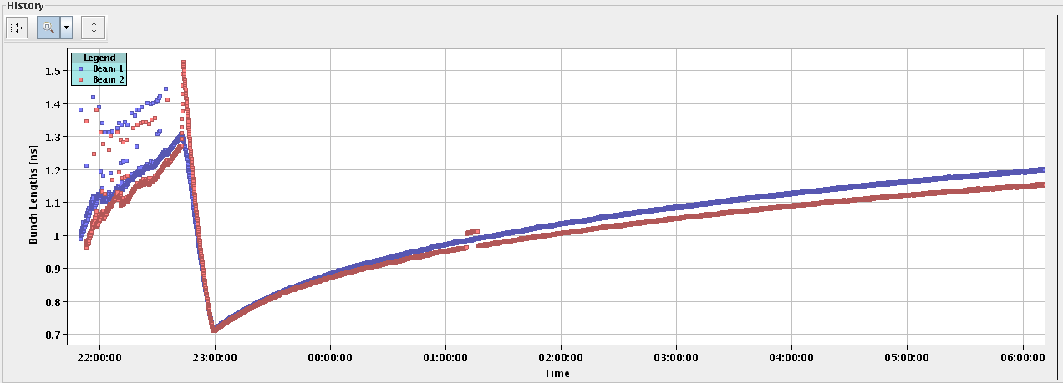
New Record Lumi for Ions

Slide 26
Beam Lifetime in this Stable Beams
Beams arrive in better shape and behave better (lower transverse emittance + diffusion → better lifetime).
Beam 2: from ~10 h (previous stable beams) → 20 h (in first hours).
As beam blows up (larger emittance) more losses at collimators.

Slide 27
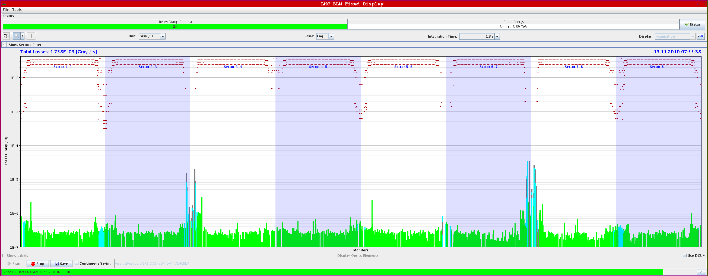
Losses
Losses mainly in betatron cleaning → confirms hypothesis of transverse blow-up.

Slide 28
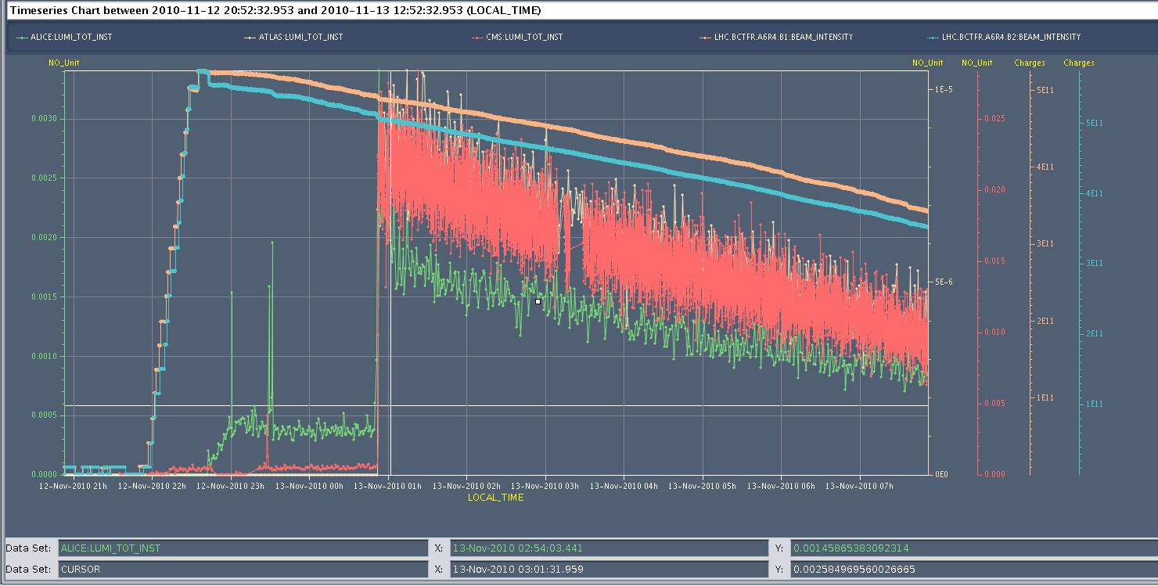
This Fill Intensity + Luminosity
Dump after the meeting…
Lumi down by factor ~2.5

Slide 29
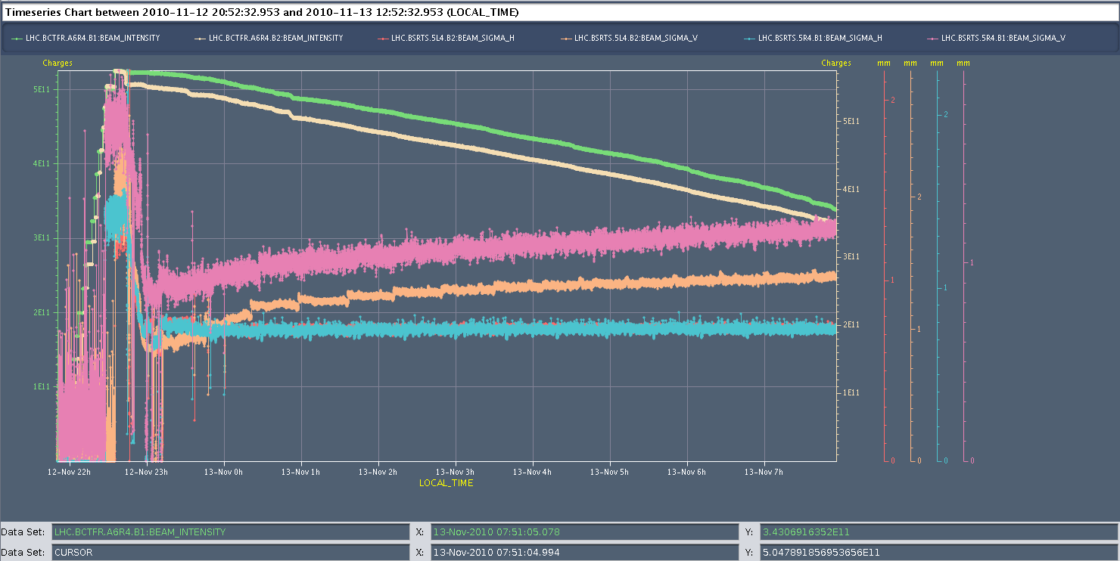
Transverse Beam Size

Slide 30
Ahead
End-of-fill study (switch on transverse damper, …).
Dump around 10h00.
Short injection optimization (1h).
Fill for 121 on 121 bunches. Stable beams.

