Slide 1
OP summary of week 40
Goal of the week:
Stable beams with trains of 200 & 248 bunches
R. Bailey, J. Uythoven & J. Wenninger

Slide 2
Physics
Monday evening: switching to 200 bunches
3 fills:1393, 1394 and 1397. Approx. 22 hours of stable beams
Peak L = 6.8x10³¹ cm⁻² s⁻¹
Small emittances in collisions, 2.6 to 3 um.
Bunch intensities ~ nominal 10¹¹ p. Limited due to vacuum and tune measurements issues (see later).
Thursday evening: switching to 248 bunches
1 fill:1400,
Peak L = 8.8x10³¹ cm⁻² s⁻¹
Small emittances in collisions, 2.6 to 3 um.
Bunch intensities ~ nominal 10¹¹ p.
After this first fill – unlucky all weekend….
Emittances at injection between 2 and 2.6 um.

Slide 3
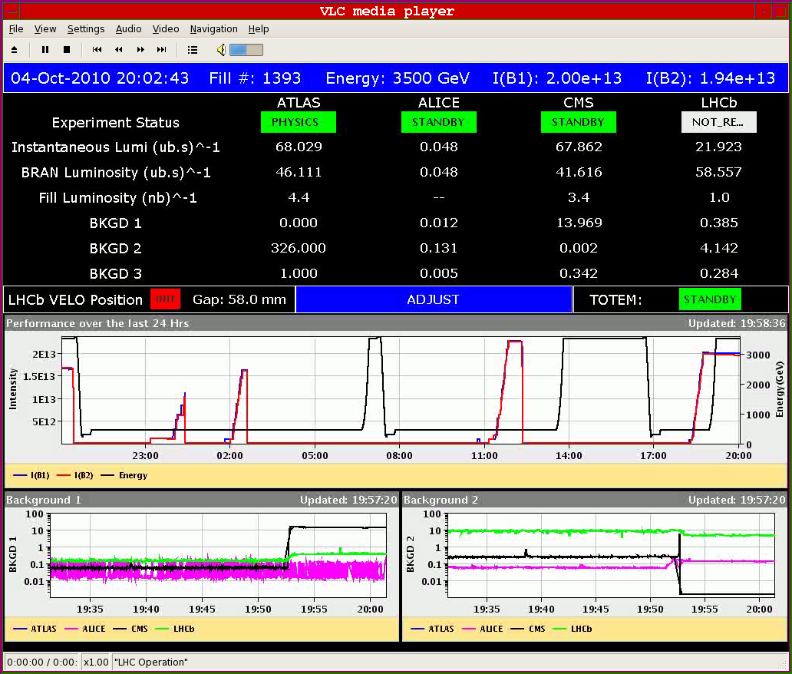
First fill with 200 bunches
Corresponding emittance around 2.6 µm

Slide 4
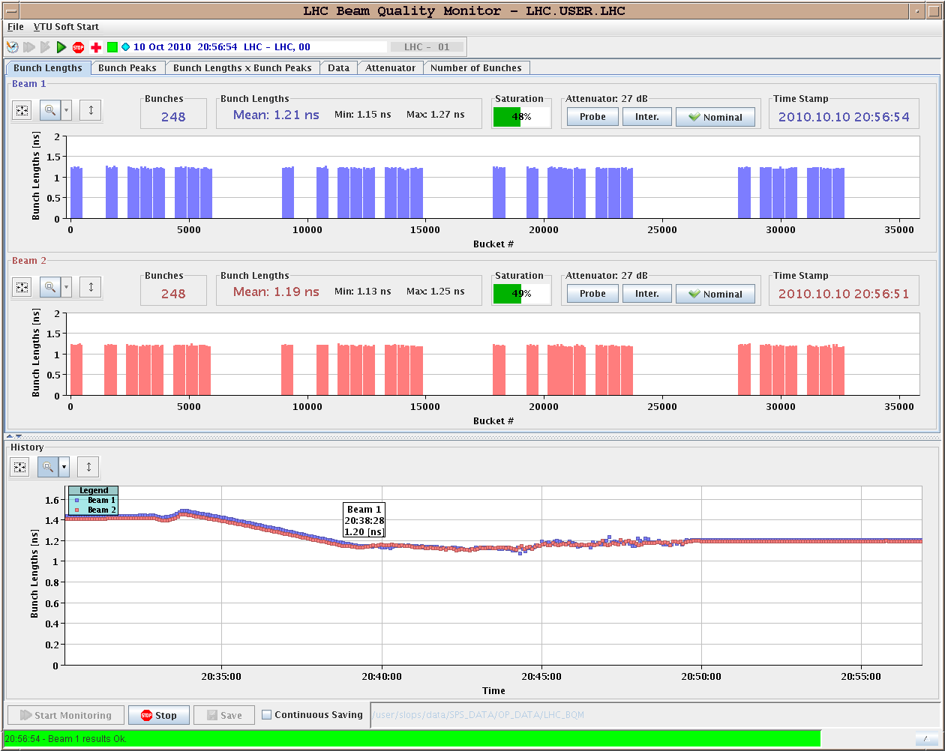
Filling pattern and bunch length

Slide 5
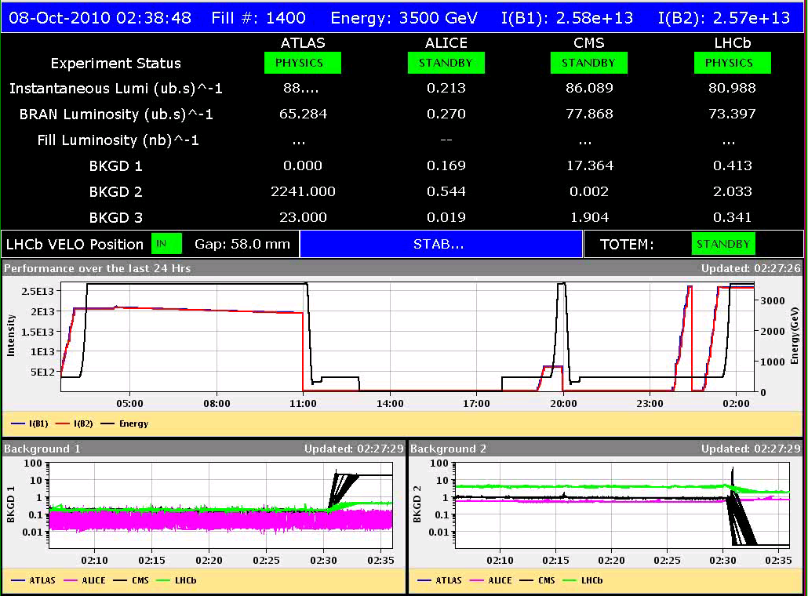
First fill with 248 bunches

Slide 6
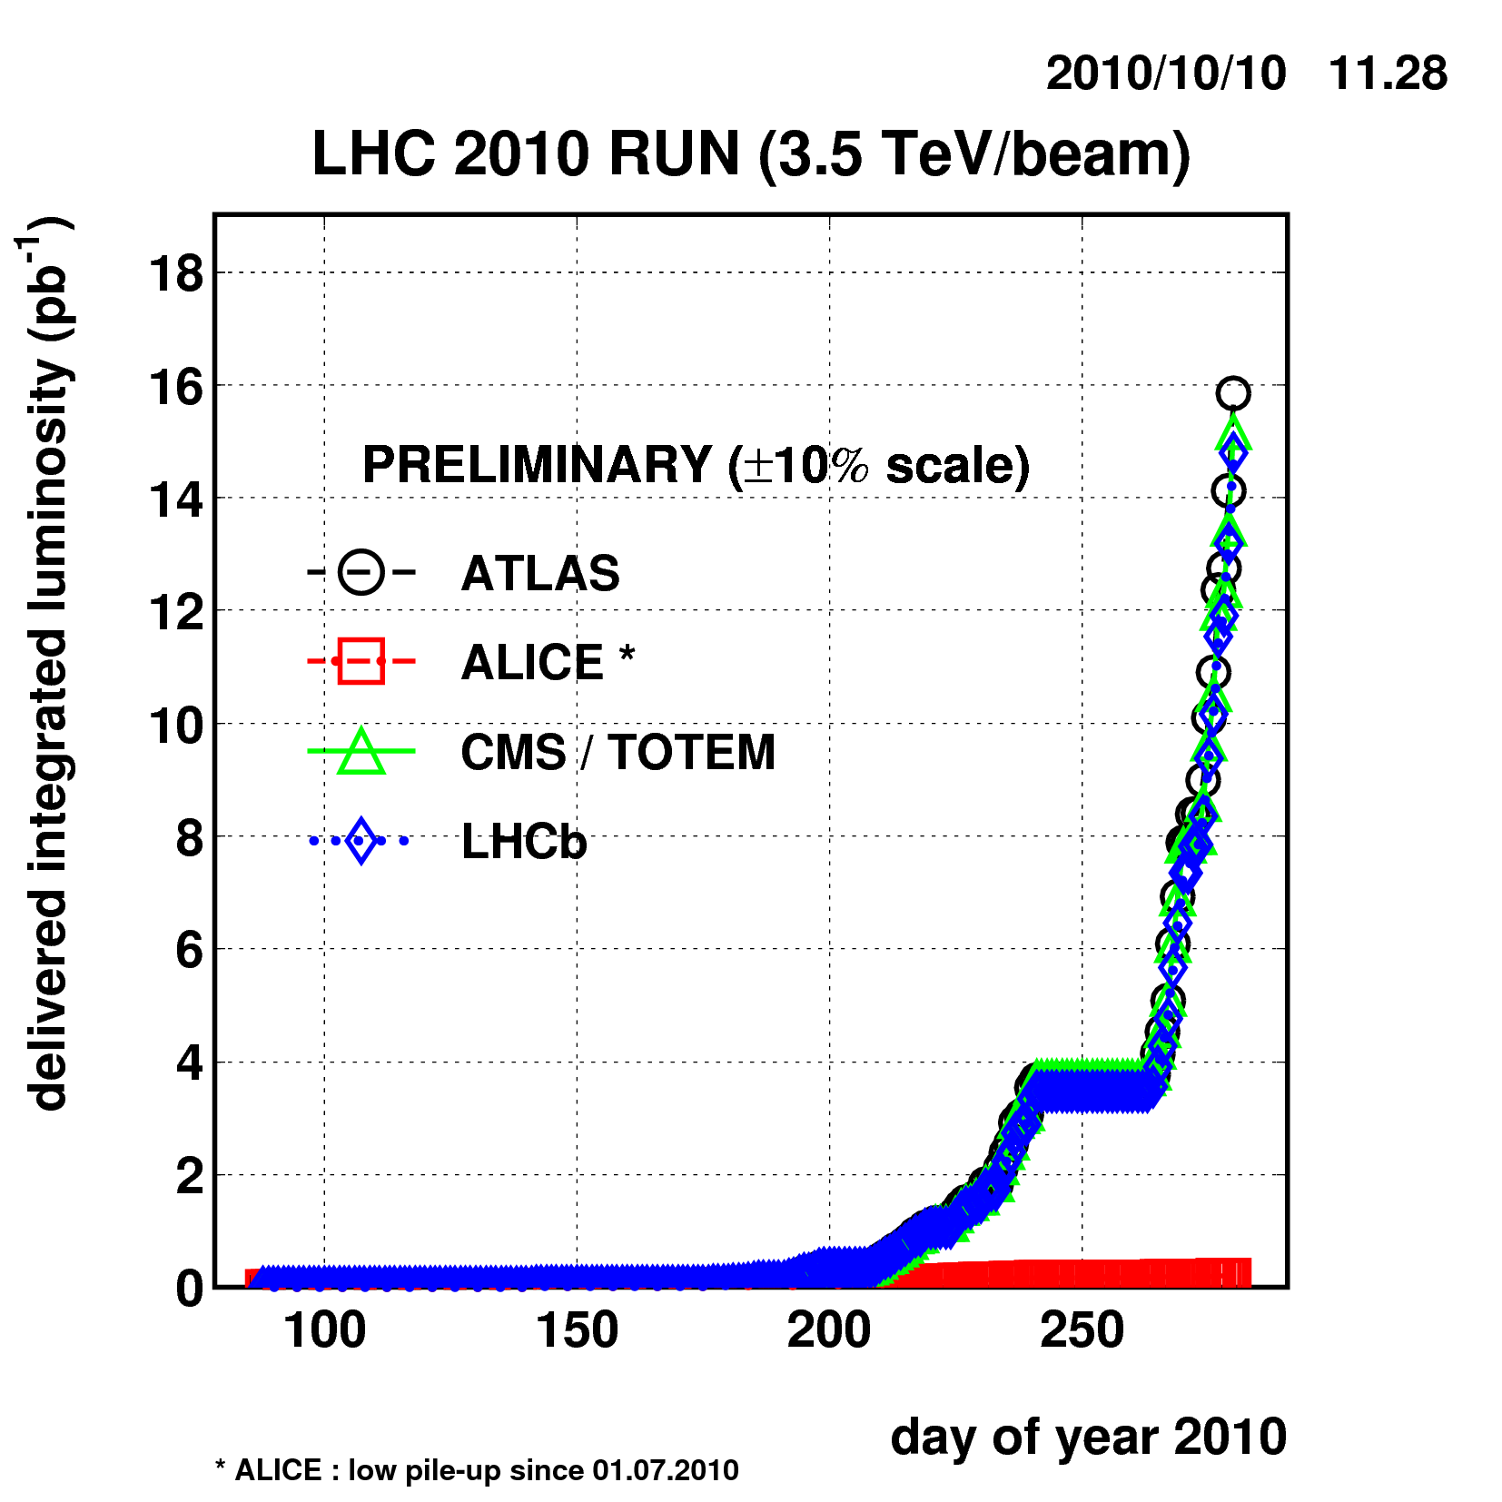
Integrated luminosity

Slide 7
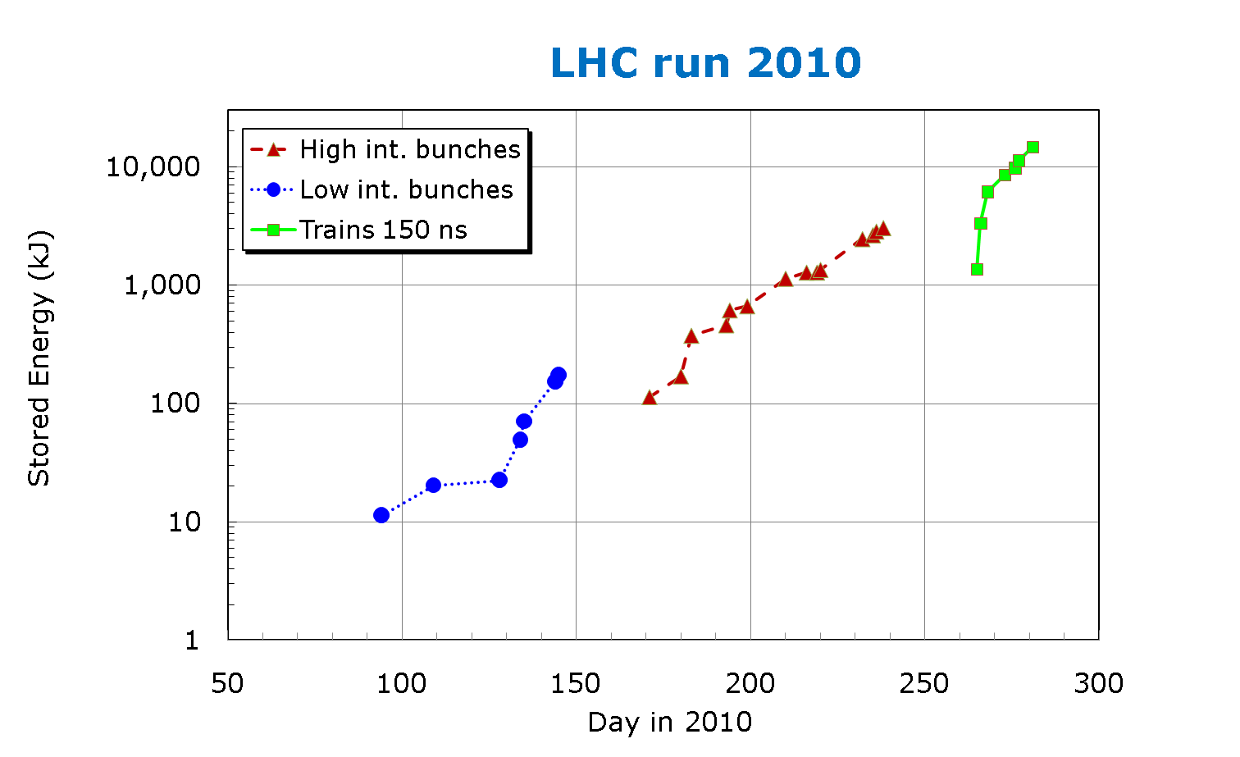
Stored energy
Stored energy now ~ 14 MJ

Slide 8
UFO and BLM news
No UFOs (dumping the beam) have been observed since the thresholds on SC elements were increased by a factor 3.
Wire scanner with 200 bunches leads to a beam dump by BLMs in IR4 ~ half way through the scan.
With BLM thresholds at 3 x estimated quench level.

Slide 9
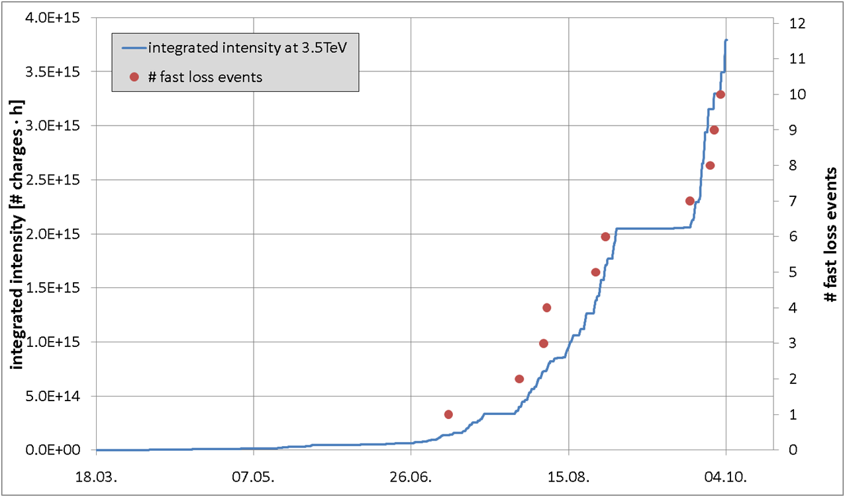
UFOs versus time

Slide 10
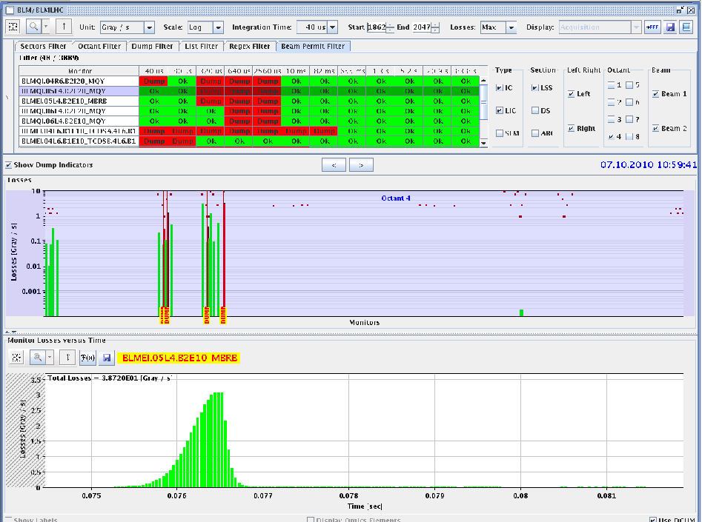
Wire scan with 200 b

Slide 11
Quench test
Wednesday morning: Quench test at 450 GeV
Vertical bump (upward) on MQ.14R2.B2, horizontal bump (inside) on MQ.14R2.B1. Probing loss scale of ~ 1 second.
Beam2:
Triggered busbar protection of nQPS on MQ with 1.6E11 and 2.4E11 (not with 1E11). EE opened, but heaters not fired. Beginning of the quenching of MQ observed.
Beam1:
Triggered old QPS on MB C14.R2 in front of MQ with 1.7E11. Quench heaters were fired.
Beam loss before PM trigger ~1E11.
Detailed analysis to be done.

Slide 12
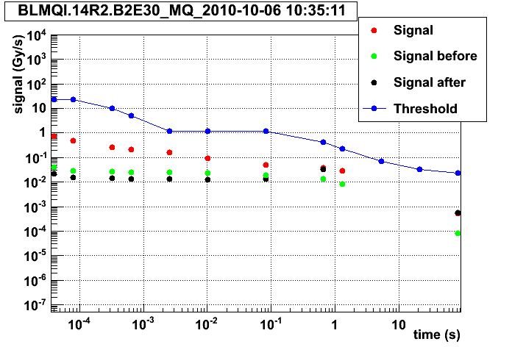
Quench test: signal versus threshold
BLM signal with 2.4E11 p – note the threshold was increased by a factor 3 to correspond to 3 times estimated quench level.

Slide 13
Vacuum
Vacuum activity in the common vacuum chamber, some 60 m from the IPs.
Depends in bunch current.
Cleaning after 2-3 fills with similar bunch intensity and count.
Tests with a solenoid installed last Saturday seem to indicate that it is driven by e-clouds.

Slide 14
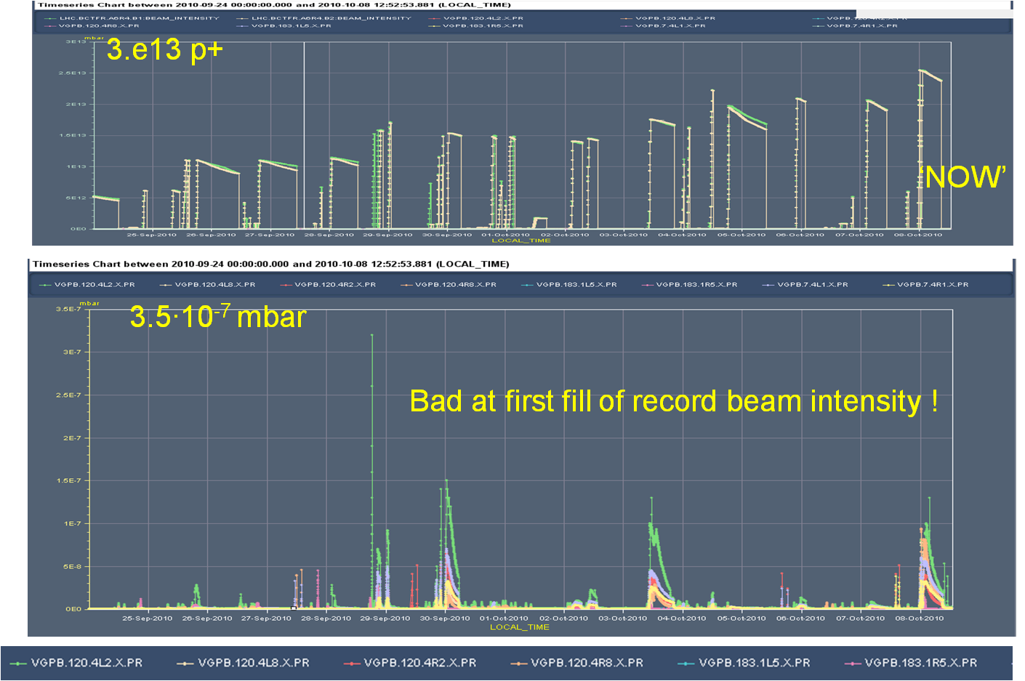
Vacuum activity

Slide 15
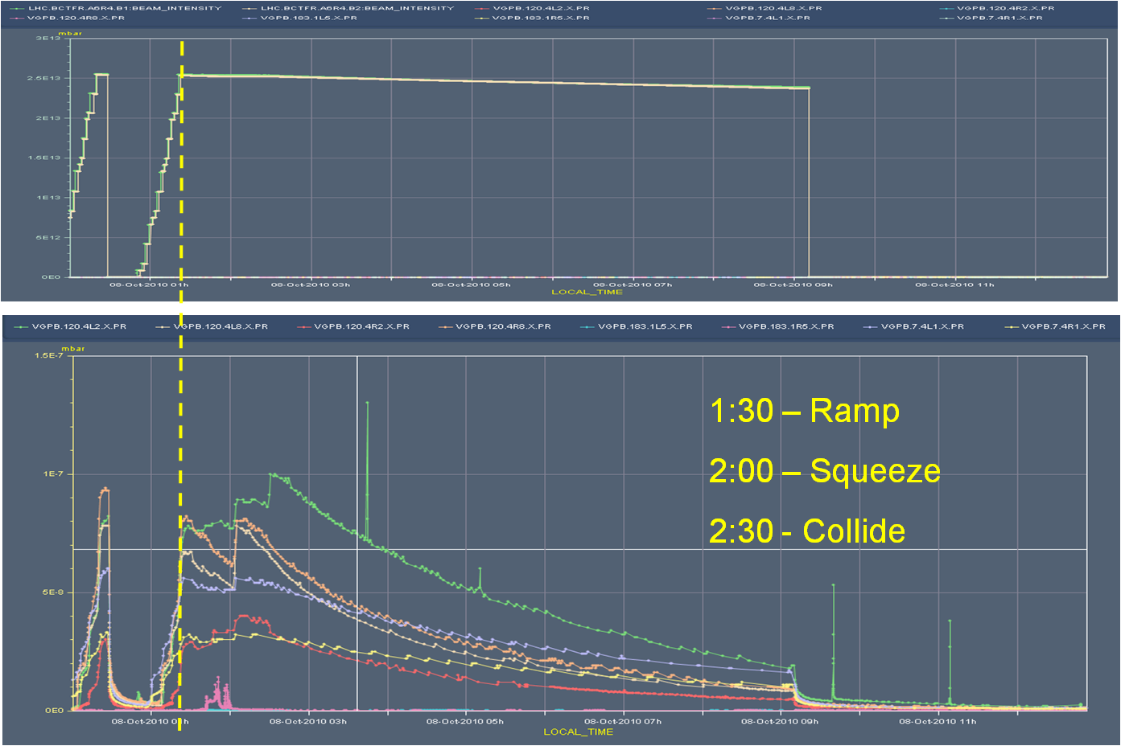
Fill 1400, 248 b

Slide 16
Tune
With 200 b frequent loss of tune signal (noise too high), in particular on beam 1 (and mostly H plane).
Signal filter was exchanged Thursday (before 248 b).
Rebuild with components rated for higher voltages.
>> no problems anymore with 248 bunches.

Slide 17
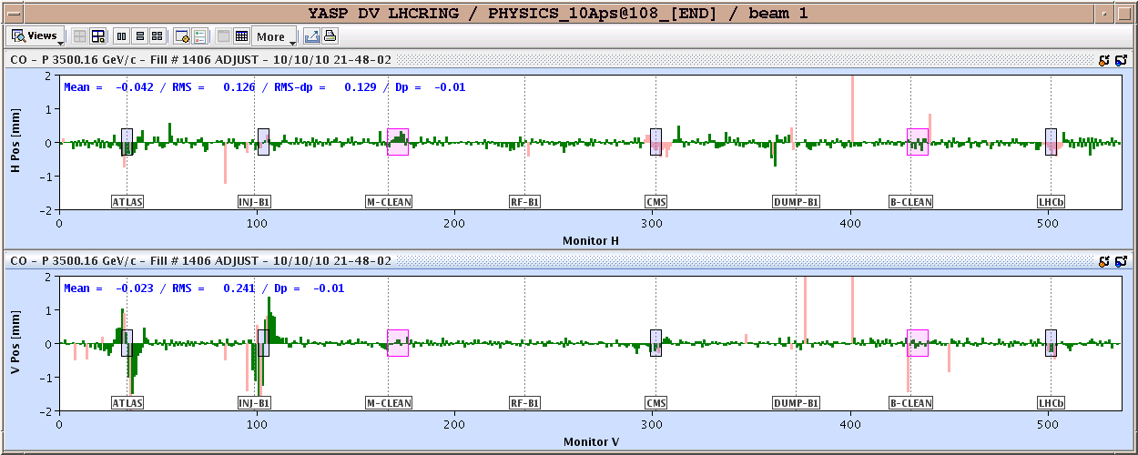
Orbit fill 1406
Problem with Xing angles in IR1 and IR2 (V plane) in first step of squeeze.
OFB kept the Xing at 170 urad, counteracting the bump reduction to 100/110 urad. Most likely problem with BPM mask sending.
This problem was only discovered in ADJUST with beams in collisions.
Send physics reference to OFB and let it correct out what it had put in – did not work, orbit drifted off and dump on slow loss in IR7 (TCSG), orbit off by ~0.3 mm.

Slide 18
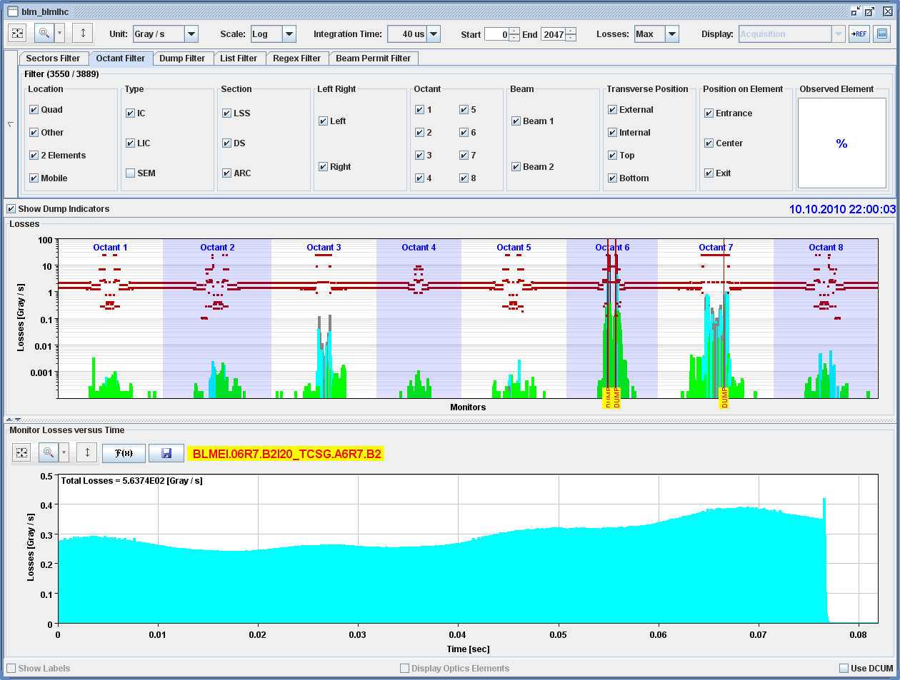
Slow loss on TCSG due to orbit deviation

Slide 19
Injection problem B1
Injection problems for B1 starting Friday night. Thursday was still good.
Large losses despite very good trajectory.
Losses ~100 larger than previously.
Loss location localized near end of injection septum MSI.
Steering the beam down by 2 mm or so helps.
BTV screens checked – not the cause.
TCDI collimators checked – not the cause.
Present situation:
Beam steered down a bit, losses acceptable to inject for physics on Sunday.
Alignment to be checked asap.
Tonight it seems to have degraded further – also TI8.

Slide 20
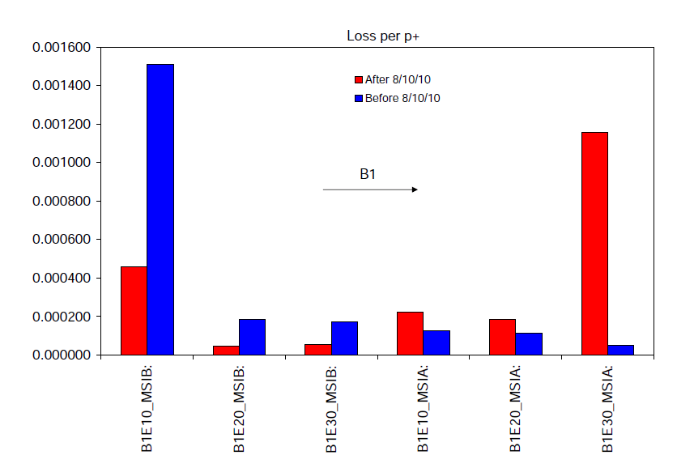
Injection problem B1
The problem: loss pattern change at the MSI

Slide 21
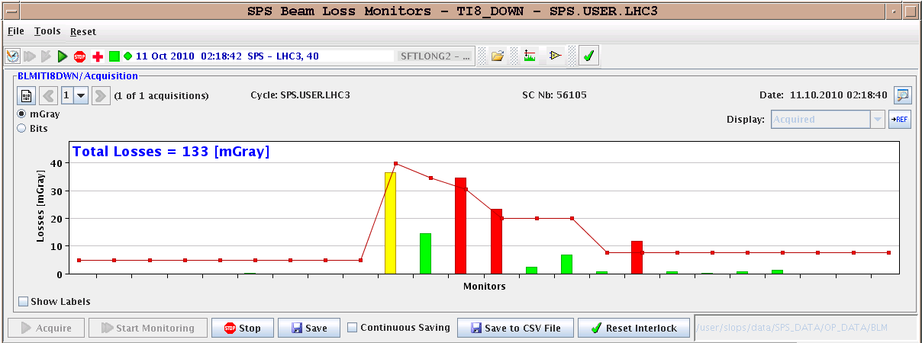
TI8/B2
Losses in TI8 last night (at the TCDI collimators)
Probably poor trajectory…

Slide 22
Timing system +
Synchronization problems on the central timing system occurred twice (disconnect from GPS).
Detected by IPOC of BIS system (PM data).
First occurrence Wednesday morning ~ 08:00.
Second occurrence Sunday afternoon ~ 16:00.
Each time a restart/resynch of the BIC crates was required
It also seems to coincide with injection kickers not firing. Happened 3 x since yesterday
No error reported by the MKI.
ALICE hit tonight, LHCb over the WE.
Vacuum valves closed in ALICE (24 b)
Last fill injected, ramped ok, trip of RB81 at flat top

Slide 23
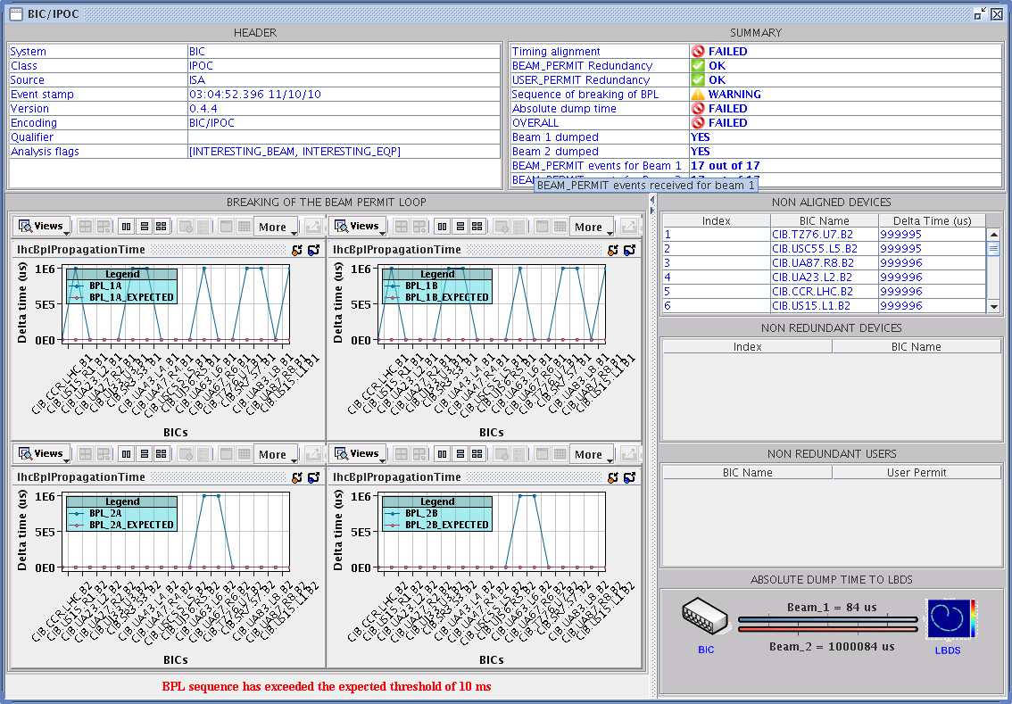
BIC crates with 1 second offsets

Slide 24
Valves closed in ALICE

Slide 25
Stops
Various accesses through the week.
Access on Tuesday revealed important water ‘leak’ in S34
The evacuation hose was blocked, water accumulating on the floor close to electronics racks.
Cryo stop Pt6 around 04:00 AM on Saturday due to loss of communication. Recovered Sunday morning at 09:00 AM.
De-icing of S34 in the shadow.

Slide 26
Pre-planning for the week
Missing injection kicker pulses B1 and B2. Timing?
Injection issue B1: access Pt2
Continue physics with 248 b, then switch to 300 b if OK.
V/d Meer Scans next Tuesday.
Change LHCb polarity after scan.

Slide 27
Outstanding requests for studies
Periodic loss maps (not really MD)
Betatron loss map done week 40.
Orbit shift versus TCT check: collide 1 bunch and check the TCT center change as compared to predicted orbit change.
BI
PLL studies during ramp
Commission BGI in preparation to ions – switch on at injection
Other BI studies – list to be updated
Test of 'dynamic' references for the OFB (varying Xing.separation bump): injection, then test of ramp + first part of squeeze.
BT
Abort Gap Cleaning – on at injection for physics
Injection Studies 32 Bunches when required (344 bunches)

Slide 28
Access Requests
Cryo : access to cavern in Pt8 (PM85) to exchange a 24 V power supply
not urgent ~ 30 minutes
TI : demineralized water alarm UA83.
COD: RCBH15.L6B1
Magnetic measurements Pt3 : ~3 hours (hump hunt) L. Walkiers et al

Slide 29
Scheduled lift maintenance
Some preventive maintenance has been requested on the LHC lifts, and agreed according to the following planning:
Tuesday 5 October: PM15 from 8h to 12h00; PM25 from 13h30 to 17h30
Wednesday 6 October: PX24 from 8h to 12h00; PZ33 from 13h30 to 17h30
Thursday 7 October: PM85 from 8h to 12h00; PZ85 from 13h30 to 17h30
Tuesday 12 October : PM56 from 8h to 12h00; PM65 from 13h30 to 17h30
Wednesday 13 October: PZ65 from 8h to 12h00; PM76 from 13h30 to 17h30
Thursday 14 October: PM45 from 8h to 12h00; PZ45 from 13h30 to 17h30
PM56
PZ85
La maintenance du PM56 aura lieu le jeudi 7 de 13h30 à 17h30, celle du PZ 85 le mardi 12 de 8h à 12h.

