Slide 1
Saturday 10.10
Access, access, access
ALICE, CMS
Pt 5 for vacuum piquet due to closed vacuum valves (vac. spike at 09:57 , not understood ). Vacuum rising due to problem in S56 – valves closed by CCC (again).
RB.78 switches.
Pt 1 to install wires for e-cloud (solenoid).
Cryo
S34 stopped for de-icing (in addition to Pt6).
Electricity
EDF power cut brought S12 and S23 around 15:00.

Slide 2
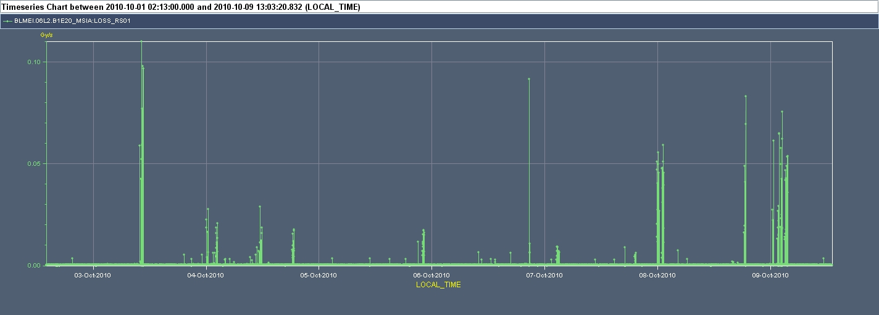
Saturday 10.10
Injection losses (B. Goddard)
MSIA entrance OK

Slide 3
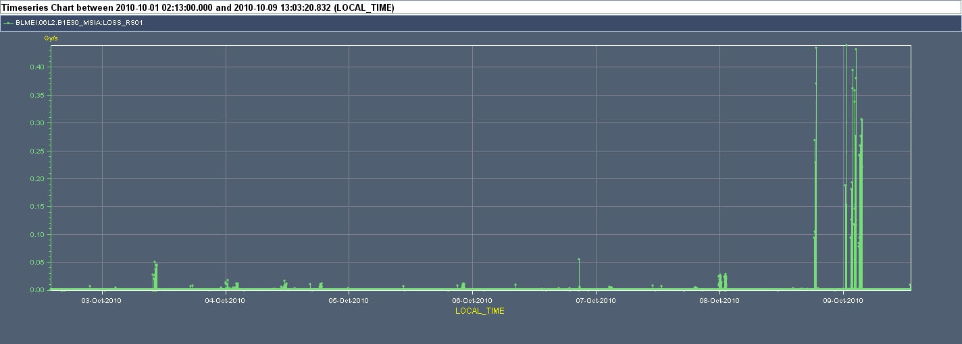
Saturday 10.10
Injection losses (B. Goddard)
End of last MSIA– not OK → seems loss location is at / near end of that last MSIA. BTs would be candidates, not the positions are apparently OK – to be checked with beam.

Slide 4
Today
Injection check – aperture & losses.
Then hopefully physics with 248 bunches.

