Slide 1
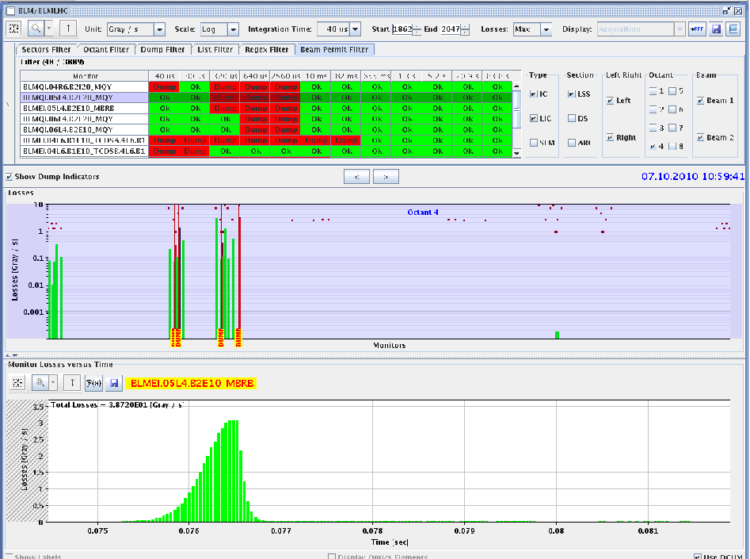
Thursday 7/10/10 - Morning
Finish fill #1397 – 2 x 200 bunches
7:50: Start to move in the different Totem Roman Pots: OK
10:26: All pots in
10:59: Fly the wire; dumps beams by BLMs, no quenches
Delivered Lumis nb⁻¹
ALICE 1.52
ATLAS 1376.018
CMS 1090.945
LHCB 1279.718
Wire almost entirely through beam before BLM triggers dump

Slide 2
Thursday 7/10 AM/PM
Prepared for injection studies 24 bunches
Problem PS cavities: decided to go for access
13:30 Access:
- BBQ (reason for access)
- ALICE
- ATLAS
- AC dipole (fixed)
- DC BCT
- RF
- CV in RR17 to check ventilation cooling circuit
TI is signaling an alarm on the cooling of the dump resistor in UA83. Piquet sent, but they can’t access. Continue without repair. Needs follow-up?
16:30 End of Access

Slide 3
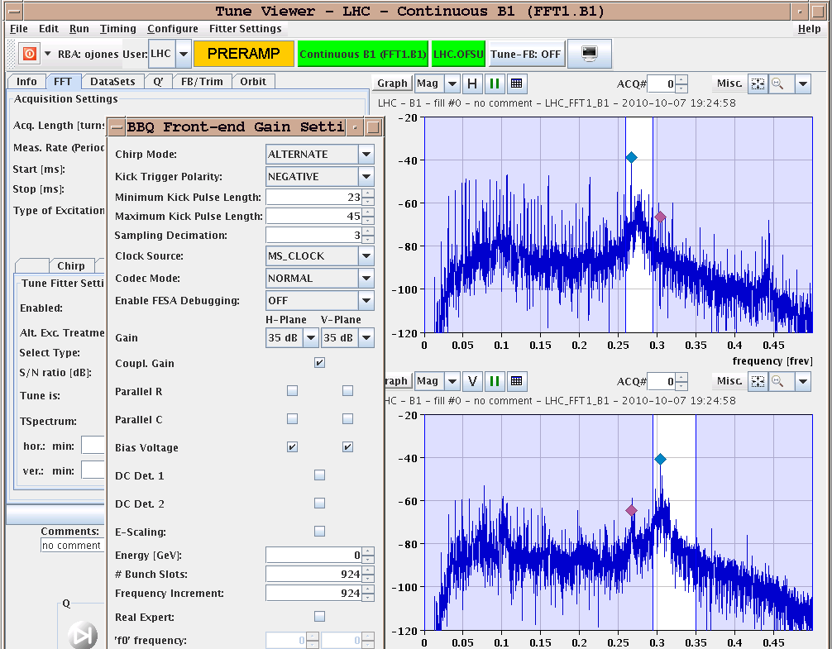
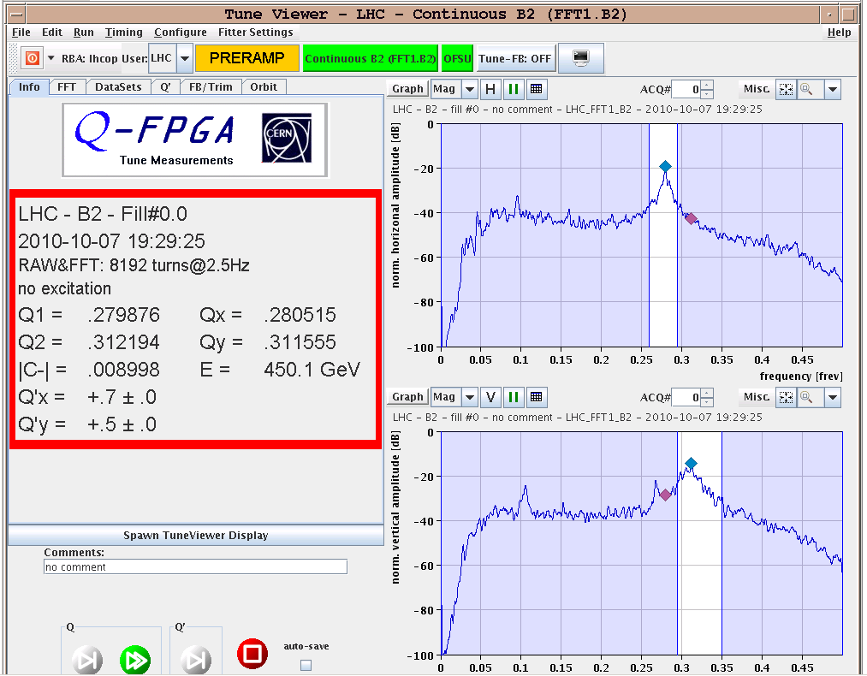
Test ramp 56 bunches
Test ramp for new BBQ front-end electronics
Don’t want to go for record beam intensities with ‘new’ system
Check that it is at least as good as before the intervention
19:30 Ramp. OK with 56 bunches
Tune feedback locked over the complete ramp
Before ramp: ‘Expert check’ simulating larger signals (resistors off) = higher beam intensities: all fine
With Median Filter

Slide 4
Tune Feedback Ramp 56 Bunches

Slide 5
Injection Studies 24 Bunches
21:00 Ready with LHC for Injection Studies but suffering from SPS MD
SPS Coming out of access
SPS RF problem
23:00 – 00:300 Pilots in – test 24 bunch injection
B1: clean injections and good trajectories (no steering needed)
B2: bad losses and trajectories in transfer line (also for 8 bunches injection), however we did not see big losses in the LHC.
Trimmed in the first part of the line with 2 correctors
Horizontal trajectory improved and losses reduced by a factor of 2-5.
Losses from uncaptured beam as usual at the end
- BPMS IP6 interlock test OK: beam dumped almost at the reading
Globally injection with 24 bunches looks fine.
W.Bartmann, C.Bracco

Slide 6
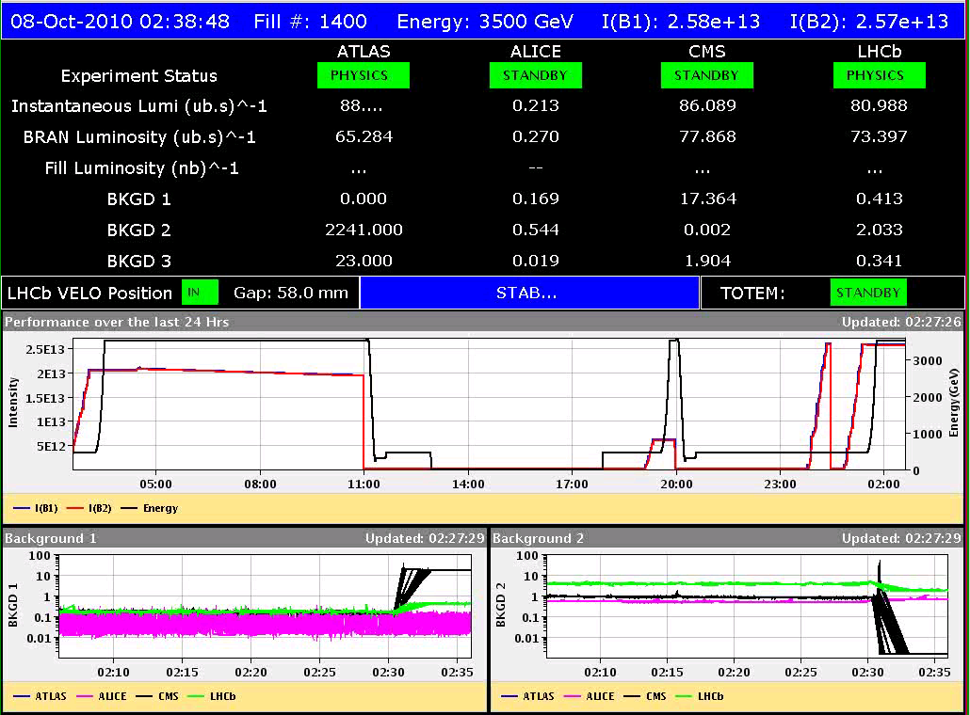
Fill 1400 with 2 x 248 bunches
Injection 24 bunches ok again
Tune Feedback stayed on through the ramp !!
At 1.8 GeV we had strange activity on beam 1, V...
2:36 Stable beams
Maximum lumi 8.8e+31
ATLAS high background (BKGD 2 larger than 2000).

Slide 7
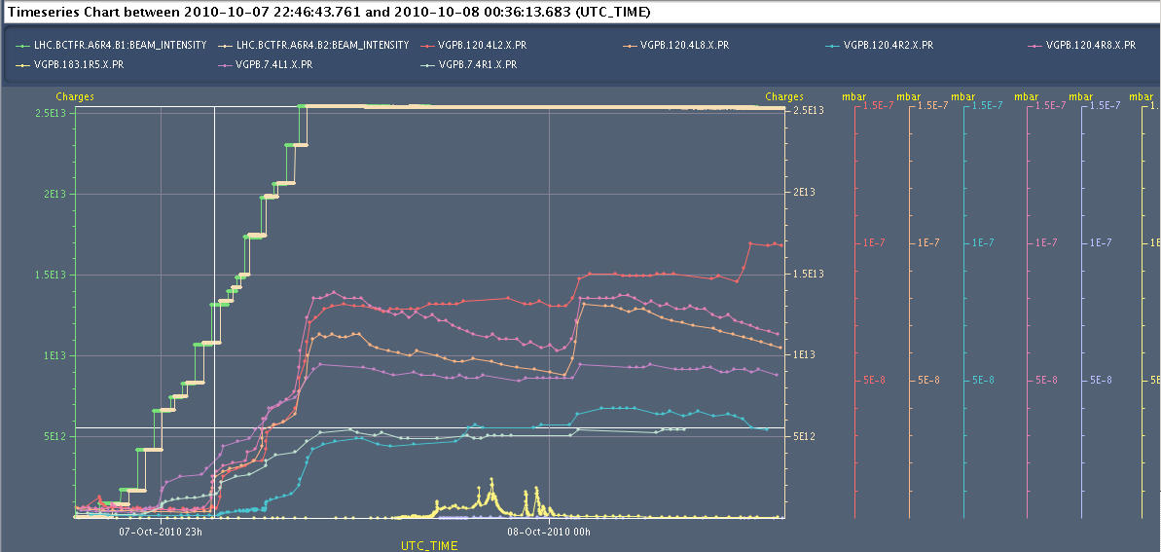
Vacuum During Injection and Ramp

Slide 8
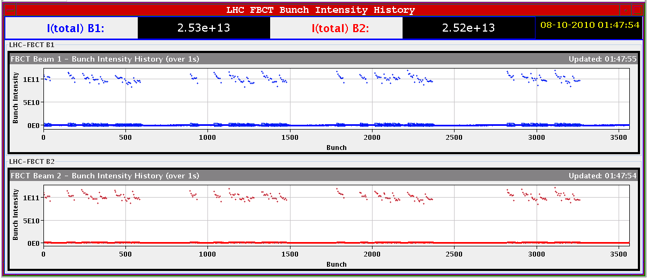
Bunch intensities for fill – 1.0e11/bunch

Slide 9
Planning for the coming days
Physics 248 bunches
Change LHCb polarity some time
Possible studies
Injection Studies 24 Bunches ?
PLL Studies in Ramp, not that urgent anymore
Other BI Checks, see next slide
V/d Meer Scans next Tuesday

Slide 10
BI Checks
Measure the sensitivity of Marek’s new beam presence detection system
Check the linearity of the fast BCT’s in the new configuration for nominal bunches
Tune the High BW/Low Gain fast BCT calibration for the coming ion run
Measure the High BW/Low Gain fast BCT sensitivity limit and linearity for low intensity bunches (ion run)
Re-check BPM sensitivity limit
Calibrate the abort gap over the whole ramp
Check the abort gap acquisition gate timing resolution and stability
Commission BGI in preparation to ions
Check BSRT/BGI/BWS cross-calibration including corresponding emittance logging
Test and compare bunch/bunch profile measurement via BWS and/or BSRT
For all this, we would need the 2 rings for a few hours at 450 GeV then a ramp and again a few hours at 3.5 TeV.
This would be really difficult to fit in a 4 hour slot. 8 would be perfect but we could try with 6.

Slide 11
Scheduled lift maintenance
Some preventive maintenance has been requested on the LHC lifts, and agreed according to the following planning:
Tuesday 5 October: PM15 from 8h to 12h00; PM25 from 13h30 to 17h30
Wednesday 6 October: PX24 from 8h to 12h00; PZ33 from 13h30 to 17h30
Thursday 7 October: PM85 from 8h to 12h00; PZ85 from 13h30 to 17h30
Tuesday 12 October : PM56 from 8h to 12h00; PM65 from 13h30 to 17h30
Wednesday 13 October: PZ65 from 8h to 12h00; PM76 from 13h30 to 17h30
Thursday 14 October: PM45 from 8h to 12h00; PZ45 from 13h30 to 17h30
PM56
PZ85
La maintenance du PM56 aura lieu le jeudi 7 de 13h30 à 17h30, celle du PZ 85 le mardi 12 de 8h à 12h.

