Slide 1
LHC operation in week 39
Coordination: Mike Lamont, Jan Uythoven, Malika Meddahi
Thanks to OP crews, HW and SW teams + patient customers
Aims for the week
Complete 104b operation
Review MPP criteria to move to 152b operation
152b operation
Operation consolidation
Outline
Where did a week of beam time go? Some stats…
What was done in terms of operation consolidation?
Beam commissioning effort
Vacuum & background levels
What’s on the list for this week?

Slide 2
Week 39 in short
Monday 27th September |  | Day : Access and recovery Overnight: Physics fill #1375 – 104 b x 104 b
Tuesday 28th September |  | AM: Physics fill cont’d + Roman Pots in PM: Fixing HW problems + first injection tests of 152 b Physics attempt 1: Beam dump during squeeze - UFO Night : attempt 2: Beam dump during ramp – Undulator trip
Wednesday 29th Sept. |  | AM : Access + recovery PM: Injection optimisation and checks for 16b injection Night: Injection 152b for physics (16b inj) 02:25 – 05:29 : Stable beams #1381 beam dump – UFO
Thursday 30th Sept. |  | AM: Injection and de-bunching tests + AGC tests PM + night: Physics fill attempts (injection checks for increases vacuum pressures around ATLAS) Tests ramp for chromaticity measurements
Friday 1st October |  | Vdm scans – Fill dumped due to electrical perturbation Overnight: machine recovery and Physics fill preparation
Saturday 2nd October |  | Physics fill # 1387: ~2h10 – Dump due to UFO Physics fill # 1388: ~2h15 – Dump due QPS PM: Access for QPS Night: No beams from SPS : Mains PC problems
Sunday 3rd October |  | AM: Injecting 152b x 152b – Tune FBK problems PM: Stable beams # 1389 - Dump on BLM triplet R1 Night: Physics attempt –dump at ramp start on RCBH15L1

Slide 3
Week 39 in short: not making it to Physics
Date | Fill # | Bunch # | Inj. | What happened?
28 /09 | 1377 1378 | 152 152 | 8b 8b | Dumped during squeeze – UFO#1 with 152 b on BLMQI.4L2B1 Undulator trip during ramp – U_res above threshold
30/09 |  | 152 | 8+8 | Long injection process (MBB TT60) + Q-FB not ON – Decided not to launch the ramp
4/10 | 1390 | 152 | 8+8 | Before ramp launch trip of RCBH15.L6B1

Slide 4
Week 39 in short: made it to stable beams
Date | Fill # | b # | Inj. | Fill dur. | Peak L | Fill L nb-1 | Dump
27 Sep. | 1375 | 104 | 8b | 9h | 3.5e31 | ~950 | Programmed dump
29 Sep. | 1381 | 152 | 8+8 | 3h | 4.9e31 | ~508 | UFO#11 – UFO #2 with 152b on BLMQI.25R8.B1 ATLAS bckgd higher
1 Oct. | 1386 | 19 | 1 | 3h | 1.3e30 | ~10 | Dump by QPS For van der Meer scans
2 Oct. | 1387 1388 | 152 152 | 8+8 8+8 | 2h10 2h15 | 3.9e31 4.4e31 | ~275 ~360 | UFO#12 – UFO#3 with 152b on BLMQI.04R2.B2 Dump due QPS communication
3 Oct. | 1389 | 152 | 8+8 | 7h10 | 5.1e31 | ~1110 | Dump due to BLMQI.02R1.B1

Slide 5
Week 39 in numbers
System faults : 25%
Stable beams : 16%
Setting-up without beam ~14%
Setting up with beams : 45%
Beam commissioning: 0.03%
Week 39 delivered luminosity: ~ 3.8 pb⁻¹
LHC total integrated luminosity above 10 pb⁻¹
Mirko Pojer

Slide 6
Week 39 – Operation consolidation
Tune FB – R. Steinhagen: Tune tracking during ramp and squeeze. Much work done, further analysis required. Urgent to give them dedicated beam time for a robust system!
RF work – P. Baudrenghien – O. Brunner: noise – module trips
Beam preparation in the injectors – OP crews
Injection qualification for 16b – B. Goddard and team
16b injection fine = injecting above SBF limit
Beam 2 chromaticity measurements at flat bottom – M. Pojer

Slide 7
Friday 1st October – Recovering
.
Mirko Pojer

Slide 8
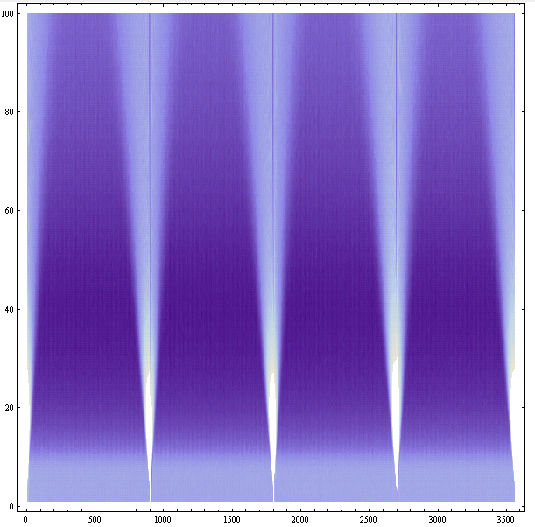
Week 39 – Beam commissioning effort cont’d
De-bunching test – Brennan Goddard + Philippe Baudrenghien
Inject 2.6e10 B1 and B2 3e10
RF off and leave the beam to de-bunch for an hour
Preliminary conclusions:
With present BLM thresholds, can tolerate maximum 1e11p+ un-captured beam, if equally spread around the ring.
The local density should not exceed
3e6 p+/m, which is about 2.4e7 p+/25ns,
or 0.02% of injected intensity (!).
At present, injecting 154 bunches,
the un-captured beam level is maybe 0.3%

Slide 9
Week 39 : Beam commissioning effort Abort gap cleaning tests
Wolfgang Hofle, Daniel Valuch, Andrea Boccardi, Federico Roncarolo, Adam Jeff, Brennan Goddard, Malika Meddahi, Jan Uythoven, Eliana Gianfelice, Elena Shaposhnikova
kick delay between abort gap cleaning pulse and bunch 1 adjusted for all dampers
Injected two nominal bunches in each beam bucket 1 and bucket 1201
Adjustment of the cleaning pulses parameters - saw detrimental effect on beam (emittance increase, lifetime drop at large amplitude excitation)
Reduced pulse length flat top and adjusted position to minimize effect on bunches - better preservation of emittance for hor. than for ver. Cleaning
Switched on cleaning program (20 steps, 0.001 in tune, horizontal beam 1 covering 0.27 to 0.29 in tune, reduced kick amplitude) . No more emittance increases than natural blow-up.
Created losses from bucket by reducing RF voltage in steps (with cleaning on or off). Nicely saw un-bunched beam passing abort gap and being cleaned
If emittance increases are confirmed to be acceptable, go with these settings for a test during a real fill.
Wolfgang Hofle

Slide 10
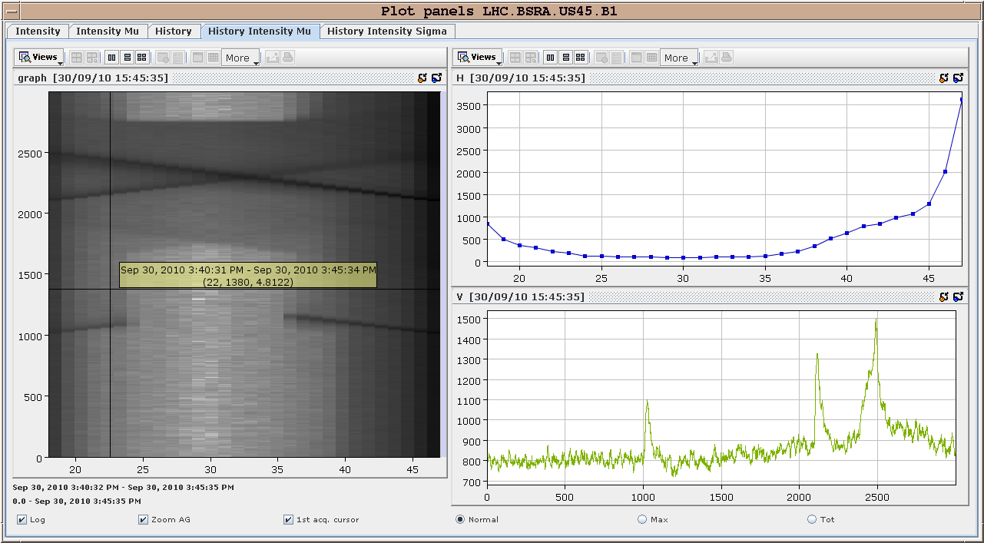
Results
cleaning on
unbunched beam created
by lowering RF voltage
cleaning off
time
time in abort gap
Wolfgang Hofle
Andrea Boccardi

Slide 11
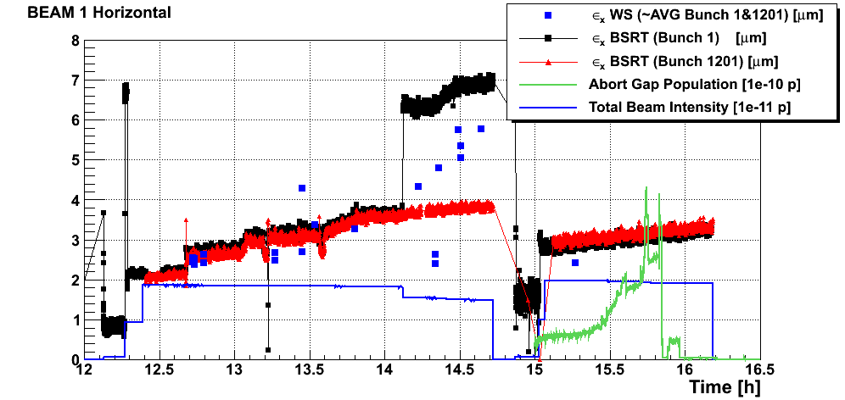
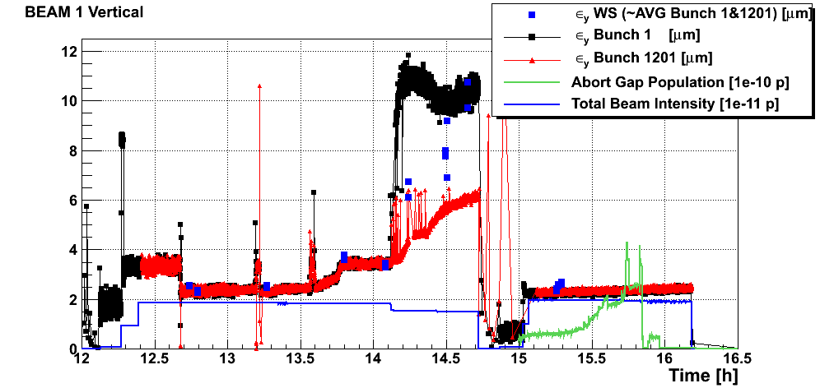
Federico Roncarolo
FILL 1: Setup
FILL 2: AGAP cleaning

Slide 12
Week 39: Van der Meer scans – Part 1
Long filling process for the 19 single bunches/beam, ~8e10p/bunch.
TT60 MBB PC tripped due to over temperature.
Communication between the database and the injection sequencer
3 hrs of stable beams.
Completed ATLAS vdm scans
Only ½ of the CMS scans.
Not done: vdm scans in LHCb and ALICE, and also length scale calibrations, longitudinal scans, etc.
Note : Excellent coordination by Massi and great support and participation from BI and ABP
online indications that beam current errors are small
More time needed – to be scheduled

Slide 13
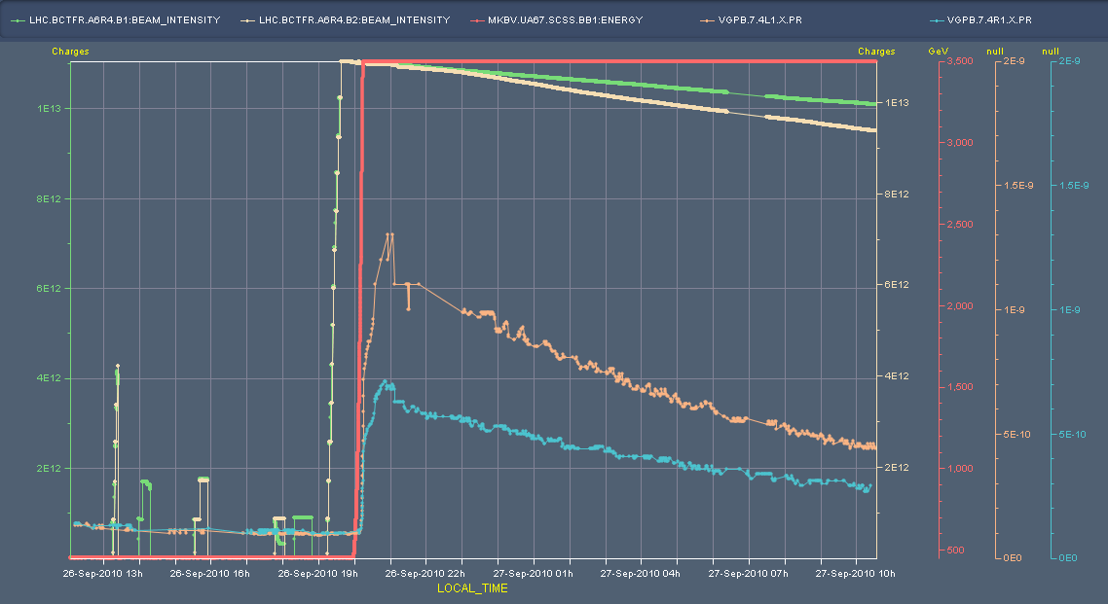
Week 39: vacuum observations – 104b
104 b operation, straight 8b injection: relatively low increase of vacuum pressure at point 1 during ramp – Nothing at injection – Gauges between DFBX & D1 @ ~59m from IP1

Slide 14
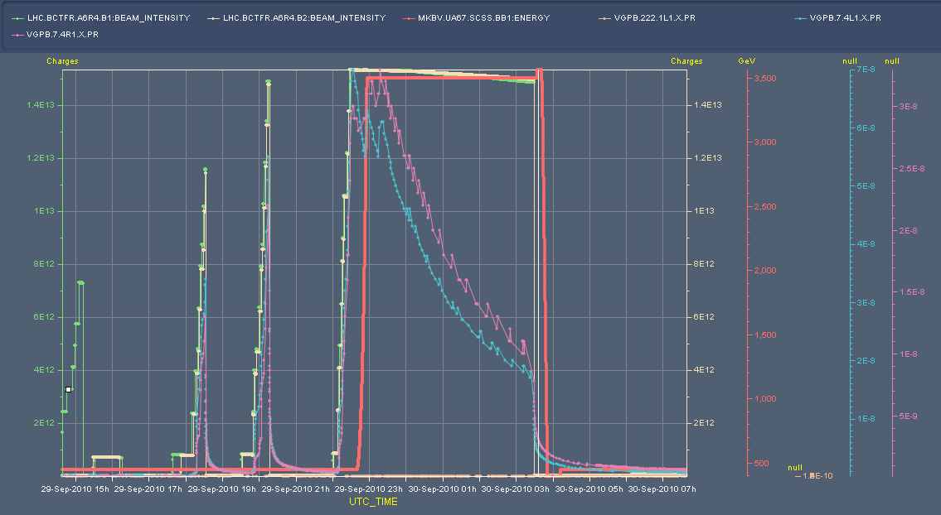
Week 39 – Vacuum observation – 152b
Beam 1 only
8+8
Beam 1+2
8+8
Note spikes during injection tests when b1 AND B2 are injected

Slide 15
And wider context still
104
104
104
152 attempt
#1381
Beam 1 +2
8b only
Beam 1 +2
8+8b only

Slide 16
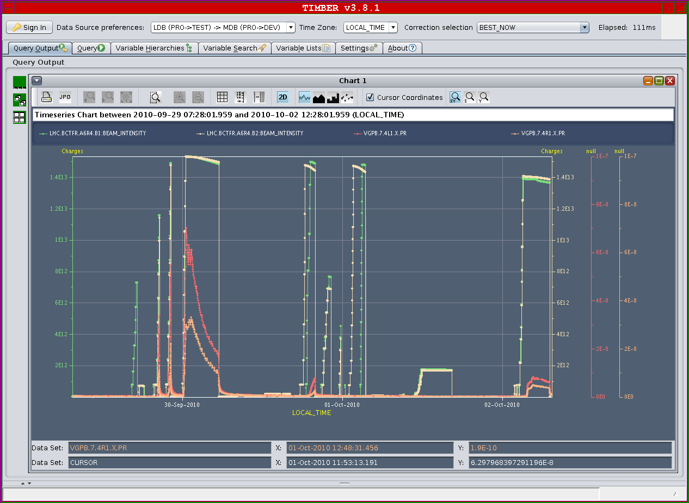
Week 39: vacuum observations – better
Alick Macpherson
G. Schneider

Slide 17
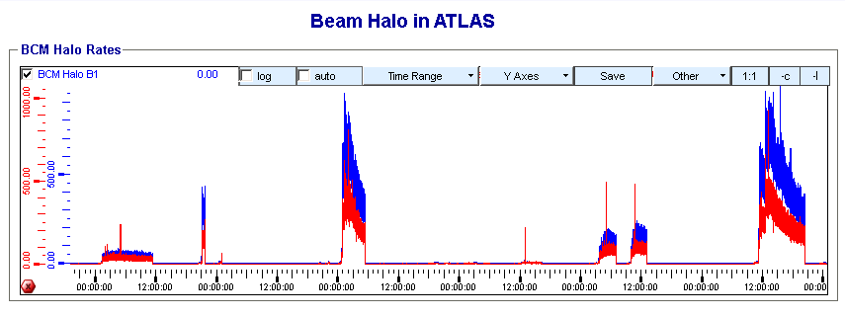
ATLAS
Witold Kozanecki

Slide 18
Week 39: vacuum observations – fill 1389
Verena Kain
Thanks to Alexis Vidal
ramping

Slide 19
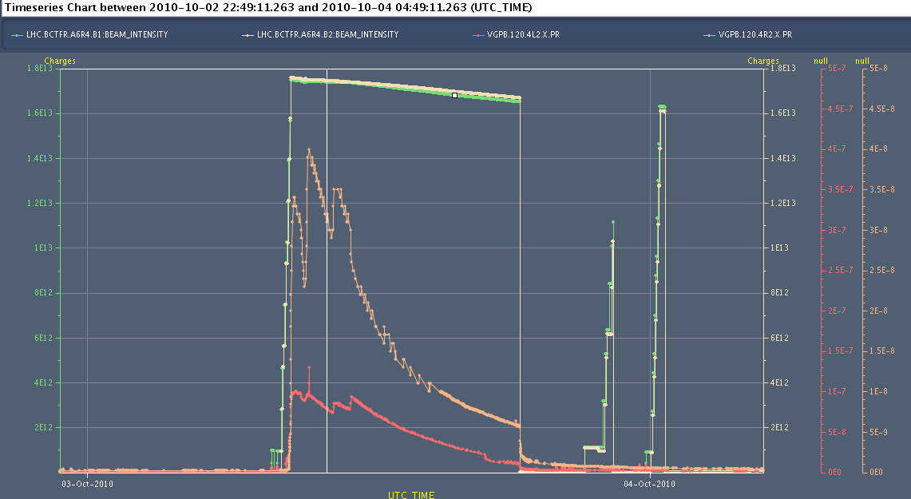
Week 39: vacuum observations – fill 1389
Alick Macpherson

Slide 20
Week 40
Coordination: Roger Bailey, Joerg Wenninger, Jan Uythoven
Goal: 200b operation
End ion run
152x152
200x200
248x248
296x296
344x344
Xmas Day
IONS

Slide 21
On the list
Checks for 200b operation (Interlocked BPM, 200b injection) – Brennan Goddard
OP consolidation (squeeze & coupling) – S. Redaelli
Q-Fdbck – R. Steinhagen + PLL : Marek Gasior
Intensity effects & vacuum - SVC
Quench test (Wedn. – TBC) – Coord.: Joerg Wenninger
Vdm scans – Coord.: Massi
Transverse damper – 2 h without beam – no access W. Hofle
MKQA & AC-dipole – will need another access – E. Carlier
Voltage rampdown@injection
Lift maintenance – this week.
Test of new beam presence flag system – M. Gasior
CO security intervention to be scheduled - A.Bland
BI – Coord. J. J. Gras

Slide 22
BI MD - c/o JJG – One Shift
PLL studies
Measure the sensitivity of Marek’s new beam presence detection system
Check the linearity of the fast BCT’s in the new configuration for nominal bunches
Tune the High BW/Low Gain fast BCT calibration for the coming ion run
Measure the High BW/Low Gain fast BCT sensitivity limit and linearity for low intensity bunches (ion run)
Re-check BPM sensitivity limit
Calibrate the abort gap over the whole ramp
Check the abort gap acquisition gate timing resolution and stability
Commission BGI in preparation to ions
Check BSRT/BGI/BWS cross-calibration including corresponding emittance logging
Test and compare bunch/bunch profile measurement via BWS and/or BSRT
For all this, we would need the 2 rings for a few hours at 450 GeV then a ramp and again a few hours at 3.5 TeV.
This would be really difficult to fit in a 4 hour slot. 8 would be perfect but we could try with 6.

Slide 24
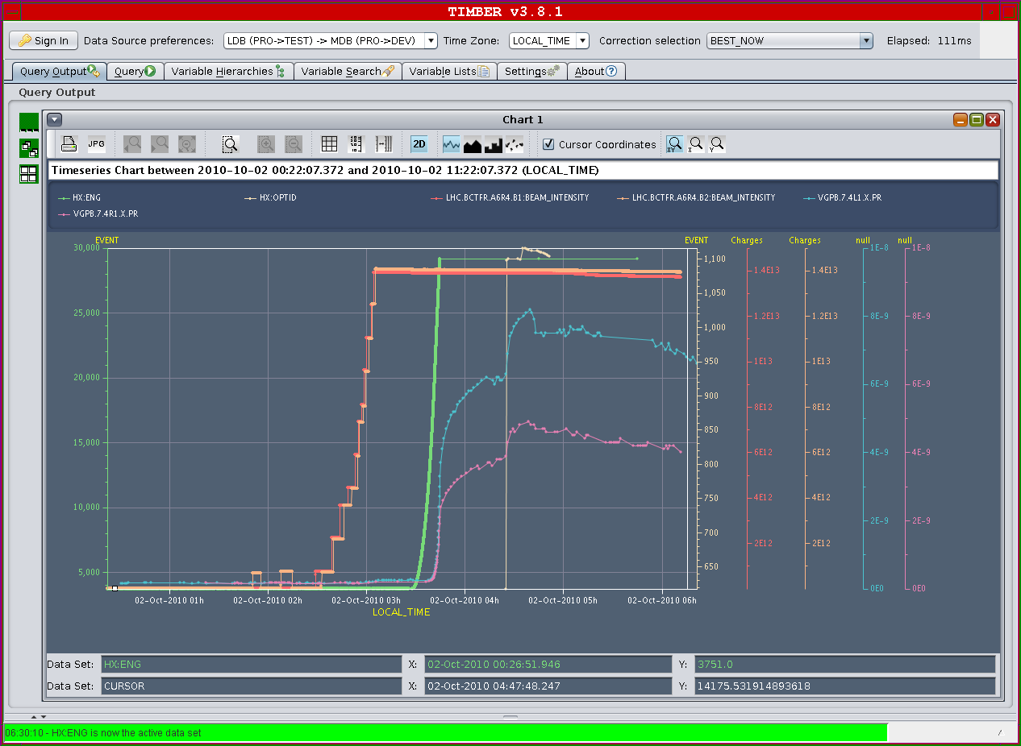
ATLAS

Slide 25
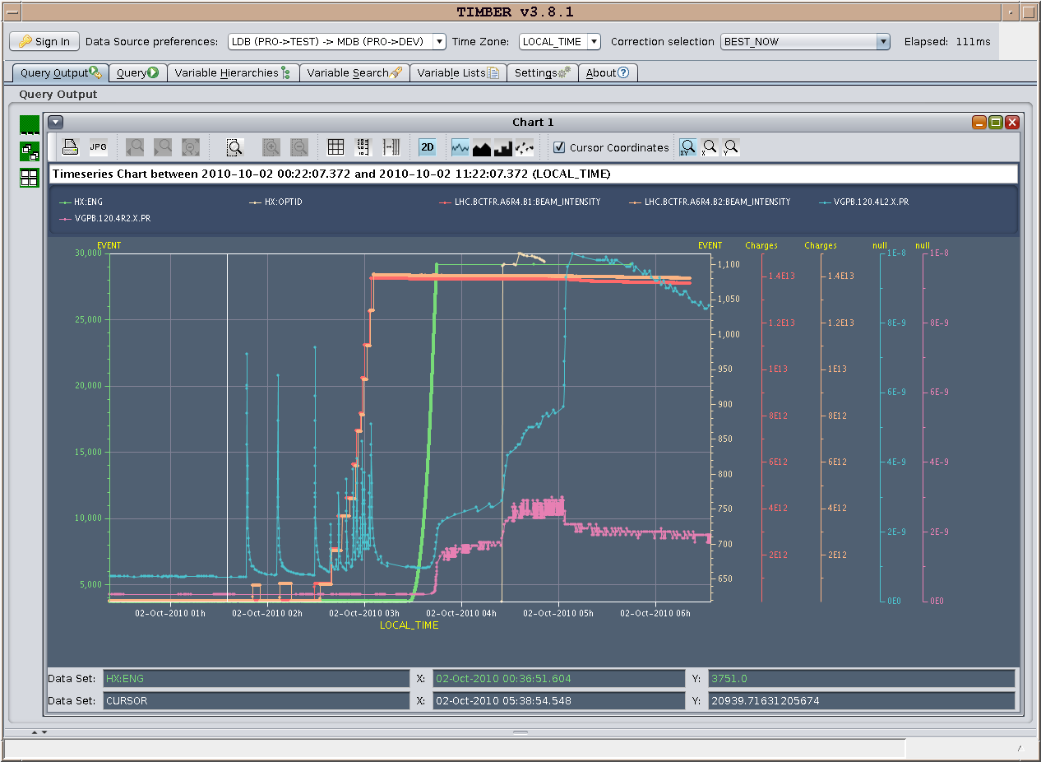
ALICE

Slide 26
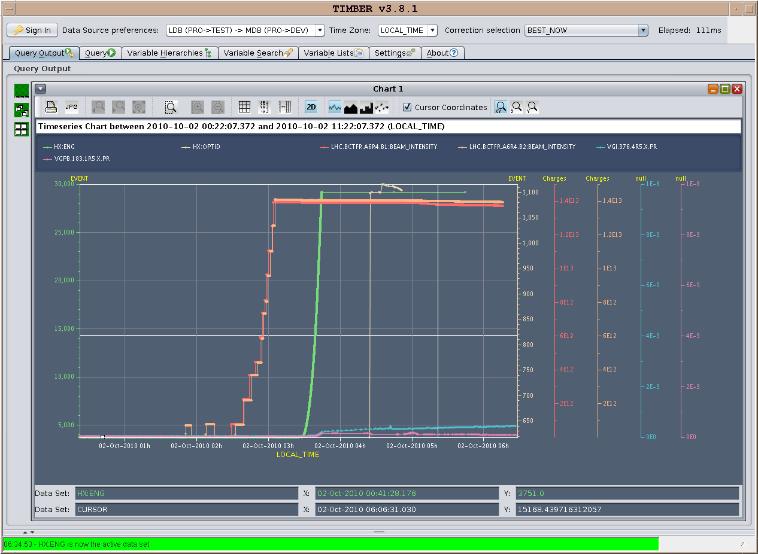
CMS

Slide 27
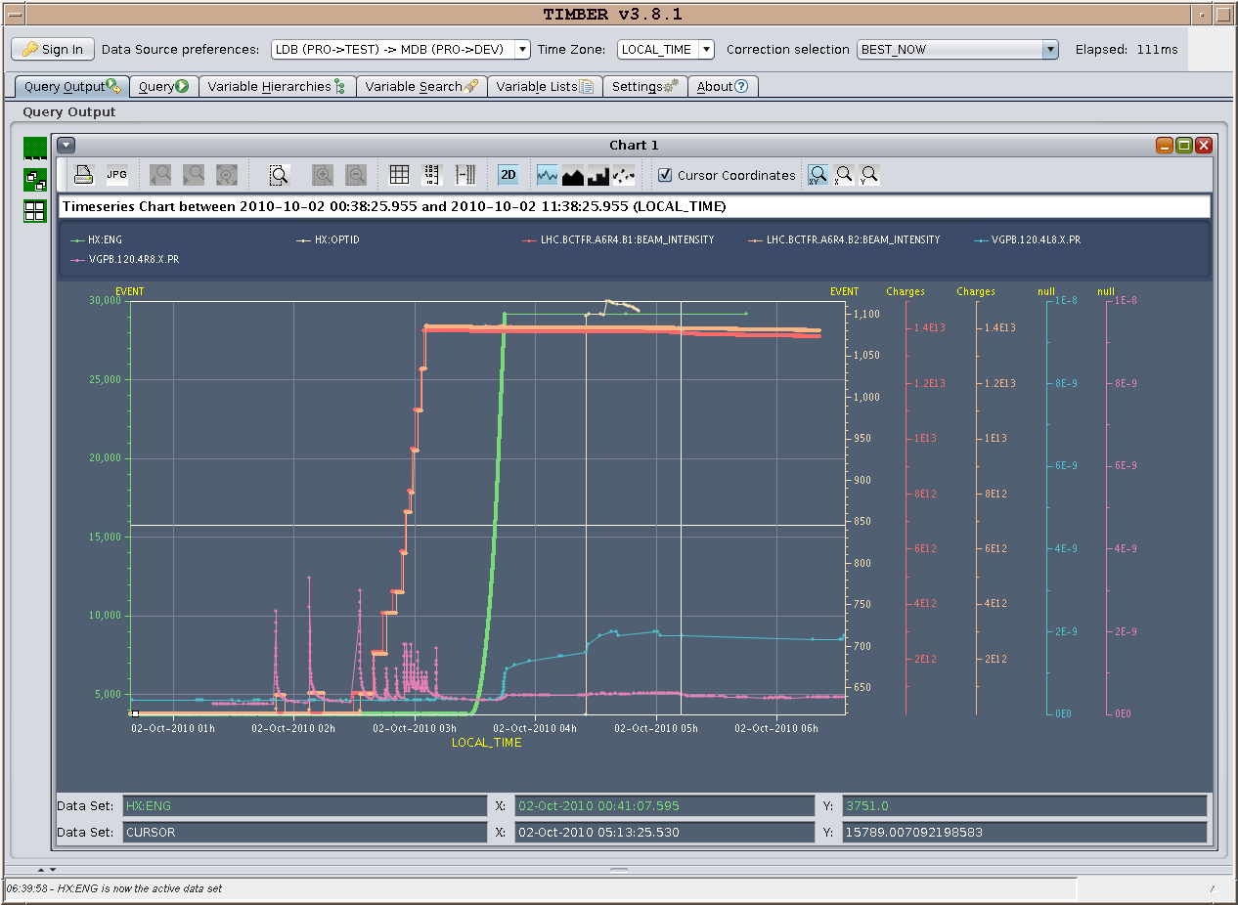
LHCb

