Slide 1
Wednesday 15.9
08:00 Injection
2 low probe bunches.
10:30 Ramp and squeeze
Strange orbit structure in IR2 and IR8 at 7 m. The structure in IR2 vanishes almost completely after some minutes without action by the OP crews ??
Lifetime dips below 1 hour towards end of squeeze.
Beam fully coupled at 3.5 m. Corrected.
Need to re-visit orbit at 7 and 3.5 m in ALICE/LHCb.
13:30 Collisions
Smooth transition to collisions.
Some rate visible in ATLAS and CMS, difficult to tune due to low intensity. BRAN rates too low to find ALICE and LHCb.
Dump at 14:50.

Slide 2
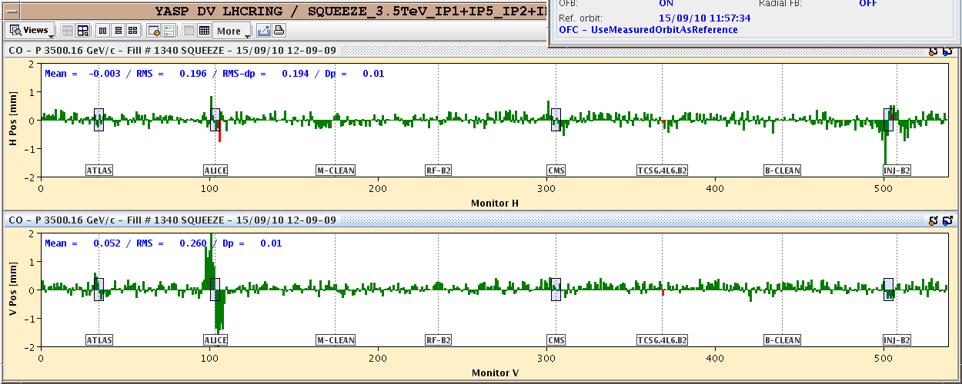
Orbit at 7 m
Vertical structure in IR2 comes down by factor 2 after a few minutes…

Slide 3
Wednesday 15.9
16:00 RCBCV9.R1B2 fault – FGC broken
Access required.
Continue operation as kick only 5 microrad (fix today).
16:40 Injection protection validation B2
Probing amplitudes and phases.
Several LHCb BCM beam dump triggers.
20:30 Injection protection validation B1
QPS_OK issue with MB.A9L2 correlated to beam loss. Same signature as in IR8 during similar losses at injection.

Slide 4
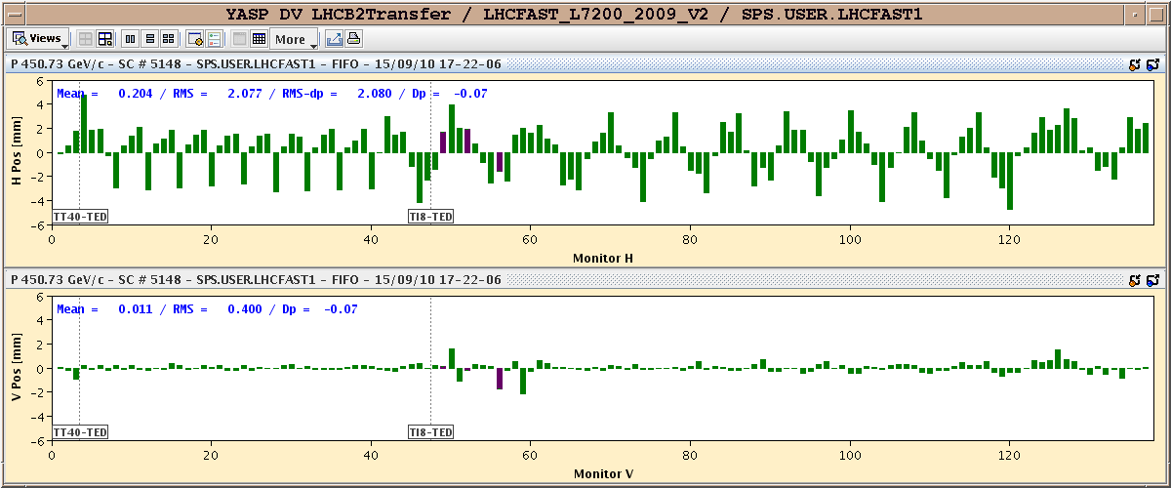
Protection validation - example
4 sigma amplitude oscillation through TI8.
Must scan all phases

Slide 5
Summary of Injection Protection Validation Studies
Oscillation scans performed in both TL
Collimators in TL set to 5 sigma and thresholds to injection settings ==> interlocking
Scanned phases from +/-0 to +/-180 deg (30 deg steps) by varying the amplitude until recodring losses of ~5mGy in the TL
For all but one phases (Ti2 120deg) we saw reasonable losses for amplitude smaller than 5 sigma
Ti2 120 deg phase knob to be rechecked and (eventually) repeat measurement
We closed vertical TCP in point 7 ( for beam 2) and in point 3 (for beam 1) ==> aim: try to define number of p+ entering in the LHC
We checked the 7.5sigma amplitude for selected phases: in some cases losses at TCLIB and downstream quads ==> off line analysis needed (loss locations, beam intensity.....).

Slide 6
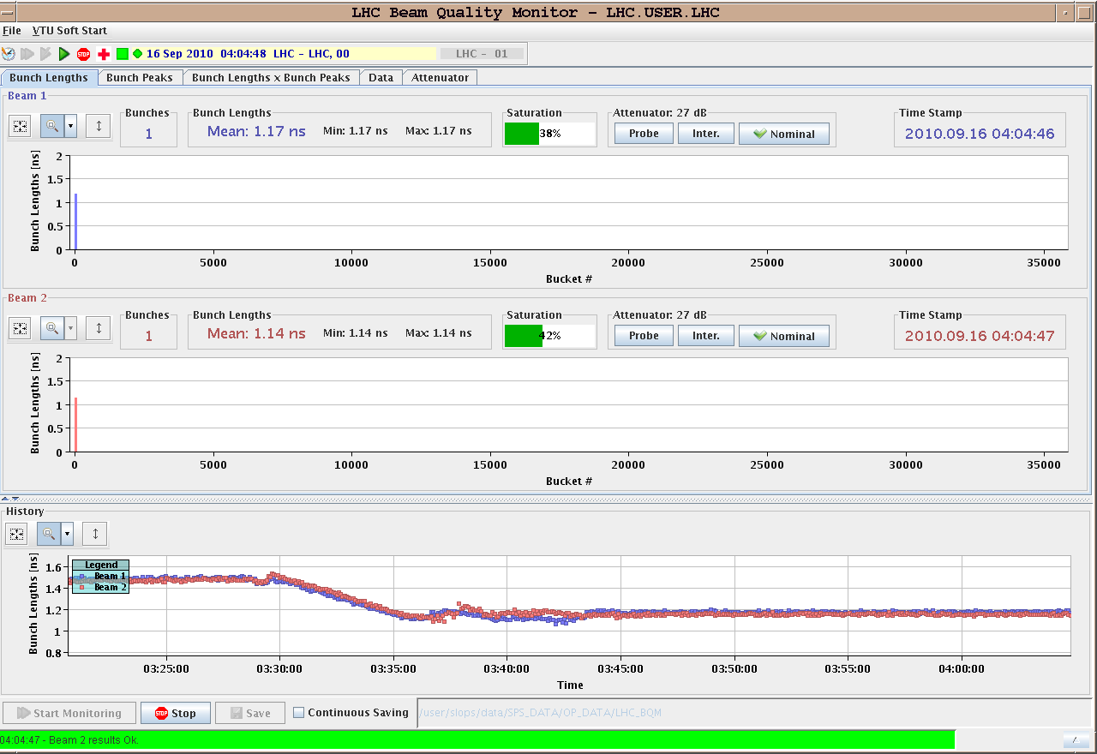
Thursday 16
23:30 Access for QPS in Pt2
Injection delayed by faults on SPS extraction septum for B1.
03:00 Injection
03:30 Ramp – bunch length 1.2 ns.

Slide 7
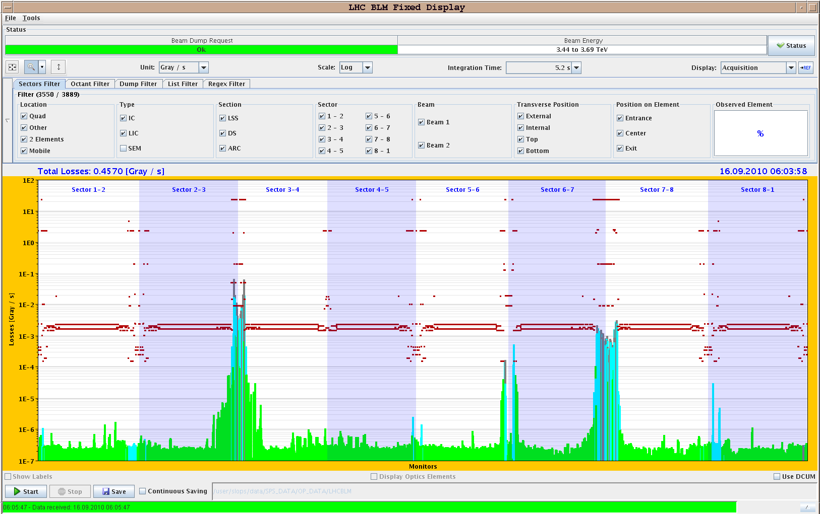
Thursday 16
05:30 Loss maps with Xing to 100/110
All maps done. Online analysis looks OK.
B2 off-momentum seems to be fixed after realignment.

Slide 8
Today
Access:
LHCb, ALICE
RCBCV9.R1B2
MKQA PLC
Interlock BPMs IR6
Collimator setup for collisions and collision setup
Check squeeze (orbit, coupling) on the way.
Tuning of longitudinal blowup.
Setup of SIS interlock for TCDQ, orbit and CODs for stable beams.
Loss maps and asynchronous dump tests

Slide 9
Outlook
Mon | M | 8 | Injection protection qualification for injection of unsafe beam part 1
Mon | A | 8 | Loss maps at 3.5TeV (end of ramp)
Mon | N | 8 | Collimation set up at 3.5TeV (TCTs at end of ramp and with reduced Xing)
Tue | M | 8 | Access system problem - recovery
Tue | A | 8 | Injection protection
Tue | N | 8 | Collimation set up at 3.5TeV
Wed | M | 8 | Squeeze and collision – sequence test
Wed | A | 8 | Injection qualification
Wed | N | 8 | Loss maps at 3.5TeV 100/110 urad no collisions
Thu | M | 8 | Access Collide with higher intensity, squeeze check
Thu | A | 8 | Collimator set-up at 3.5 TeV – separation off
Thu | N | 8 | Loss-maps
Fri | M | 8 | Loss maps, asynch dump tests
Fru | A
 |  |  | Collimation integration into sequencer and tests
 |  |  | Ramp and squeeze bunch trains - collisions with 3 trains of 8
 |  |  | Quench test at 450 GeV

