Slide 1
Tuesday 17.8.
Morning: Bunch Train Studies:
08:00: Ramp down after unsuccessful ramp for Beam2 loss maps (Beam2 dumped by SIS);
QPS errors: RQTD_A56B2 & RQTL11.L5B2. (resolved by swapping boards);
09:30: injection of probe beams: XPOC error due to wrong published energy (4106 GeV);
09:00 to 11:00: Setting up of the SPS for new Hyper cycle for bunch trains.
11:00: Setting up the SPS for injection into LHC (orbit & transfer line trajectories etc.)
12:30: QPS problem for RQTF.A81B1 ➔ switch boards;
12:50: Injection of first train into LHC ➔ (injection into wrong bucket traced back to missing seyting needed in the rephasing)
14:40: First Successful injection of train into LHC
Switching on the crossing angle in Pt 2 at 100 urad, in steps of 50 urad (target 170 urad). Worked O.K. but losses above dump threshold observed in Pt 2 with the 100 urad settings.
➔ ready for other systems (ADT, RF…) to make test on 1 train of 4 bunches ( B1)

Slide 2
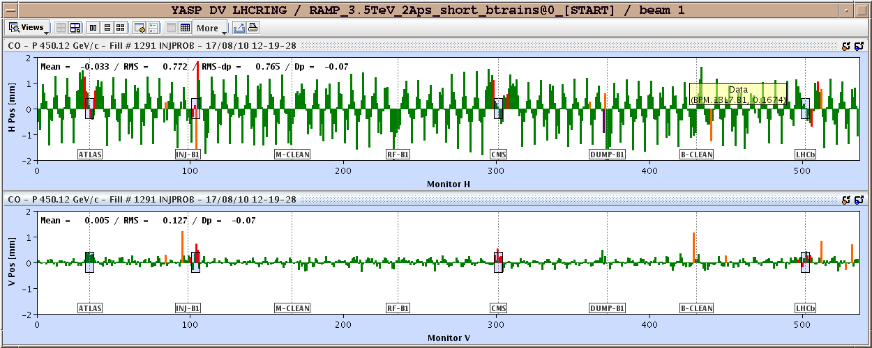
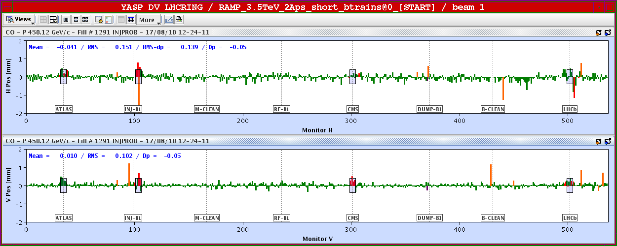
Orbit in the LHC for injection with bunch trains:
Orbit after LHCb
spectrometer
polarization
change:
Top: initial orbit
for new polarity
Bottom:
After correction.

Slide 3
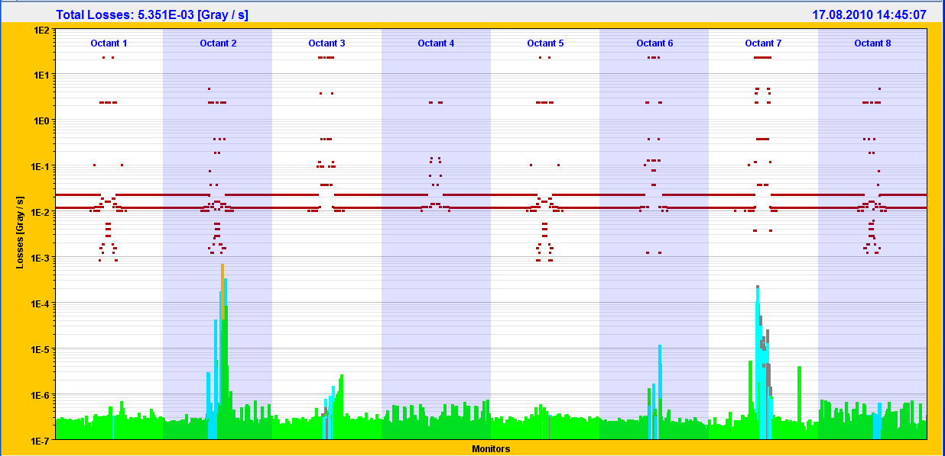
Beam Losses in the LHC during injection with bunch trains

Slide 4
Tuesday 17.8.
Afternoon:
Dispersion measurement IR3 & loss map for Beam2 at 3.5 TeV:
16:00: Lost beams when turning on the Q feedback (locked onto hump).
Lost Beam 1 during orbit corrections ➔ unclosed spectrometer bump with inverted LHCb spectrometer polarity (new know for closing the bump in IR8).
18:20: Start ramp.
20:00: End of squeeze and adjust.
20:20: Dispersion measurement for both beams:
Dispersion beat for Beam1 slightly larger than for Beam2.
21:00: Measuring loss map for Beam2 with ΔF_{RF} = -1000Hz (beam moves outwards) ➔ Hierarchy for Beam2 seems to be violated.

Slide 5
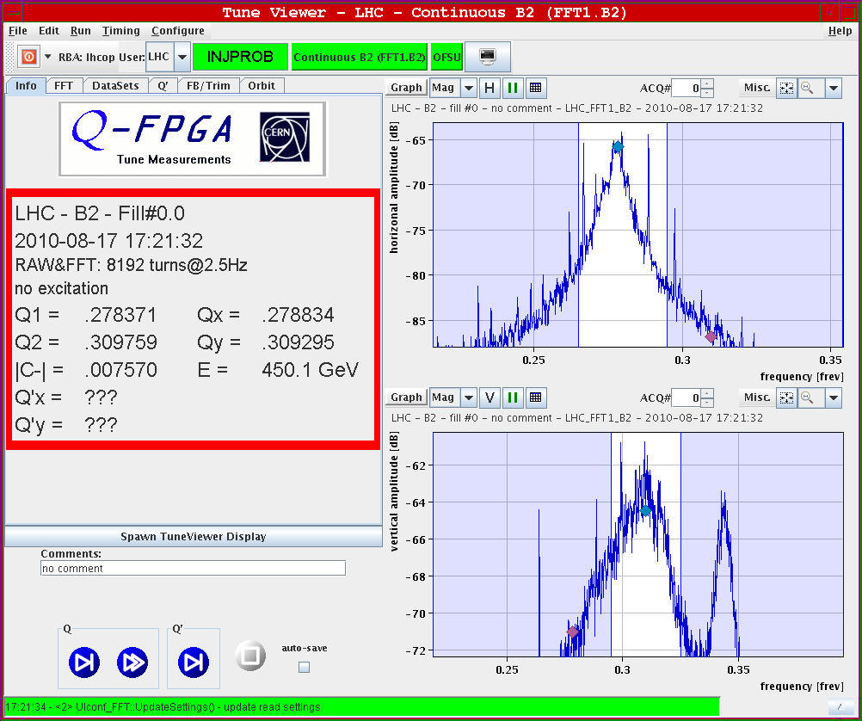
Tune and Hump with damper on:
Beam 2: Vertical tune and Hump signal
are approximately equally
strong with damper on.

Slide 6
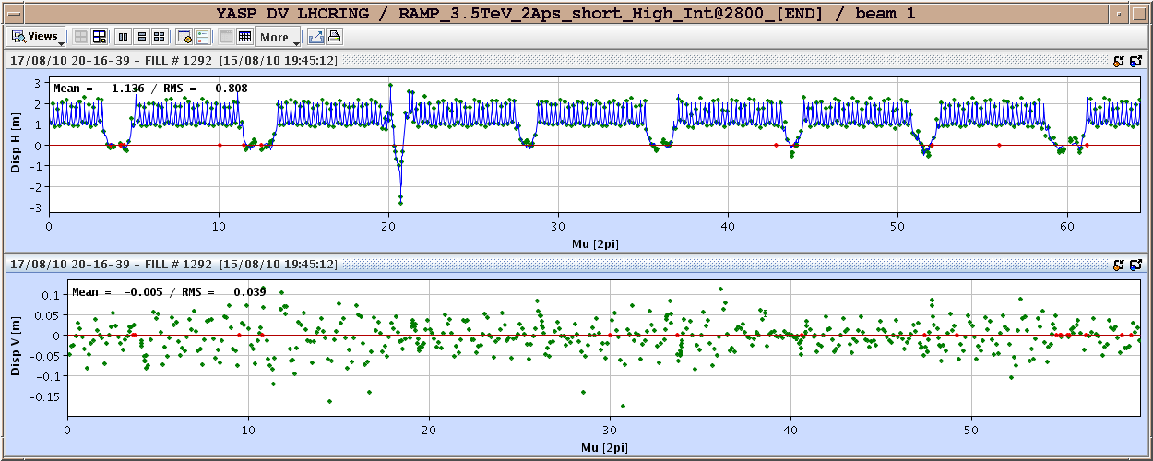
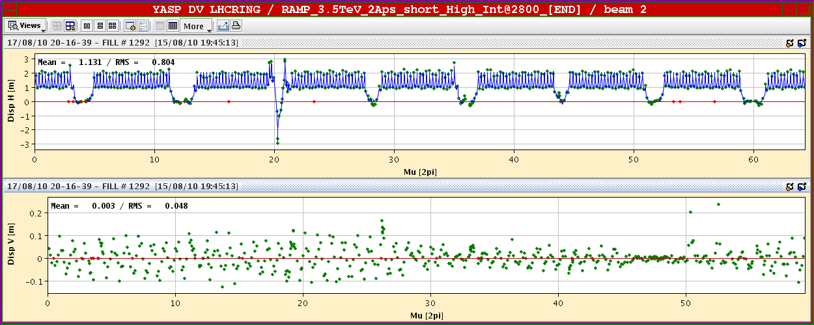
Dispersion measurement:

Slide 7
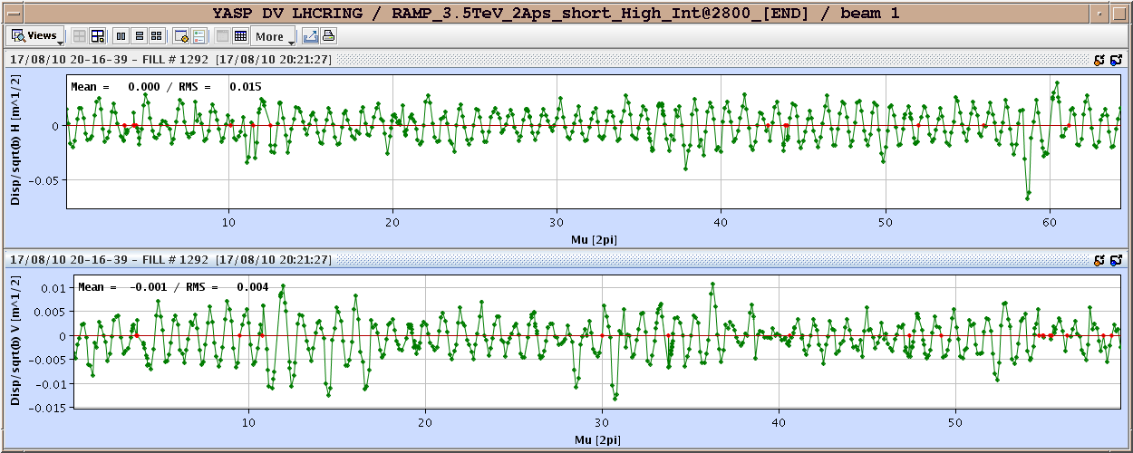
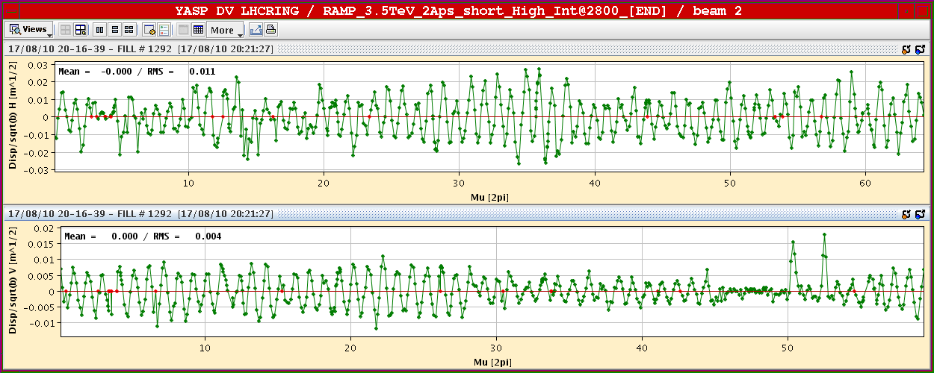
Dispersion measurement: Beat in normalized Dispersion

Slide 8
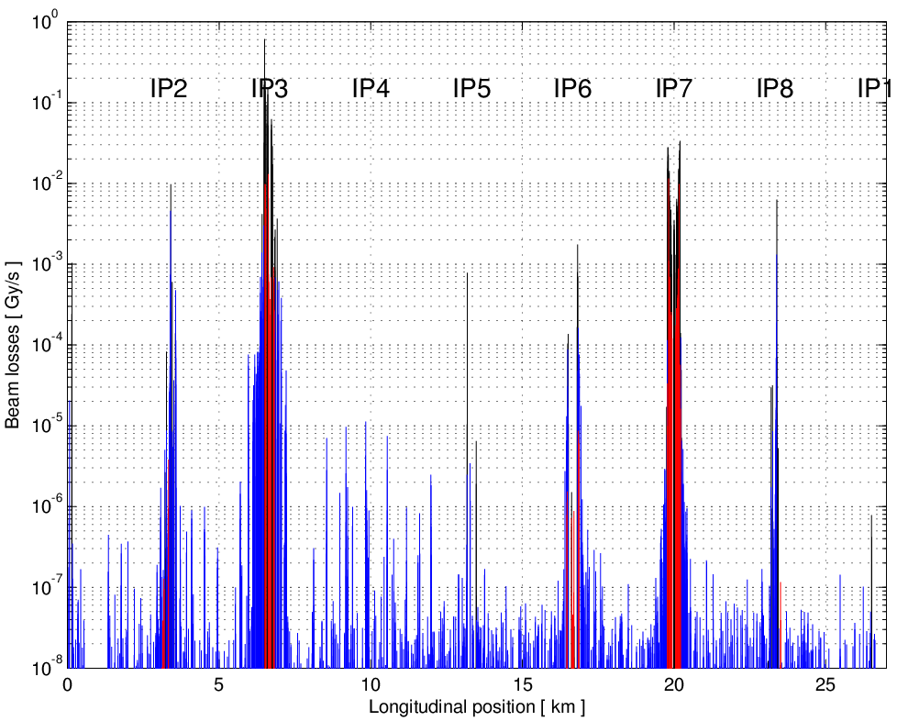
Collimators – Loss maps on momentum Stefano Redaelli, Walter Venturini, Joerg Wenninger
BLACK = collimators
RED = warm elements BLUE = cold elements
1bx1b, Physics conditions -1000 Hz RF trim
TCTs see about ~0.01 of the primary loss spike and the cleaning efficiency to the cold elements is 99.25% (4 stage hierarchy is respected).
Operation with 25 bunches can continue in these conditions
To be repeated for B2

Slide 9
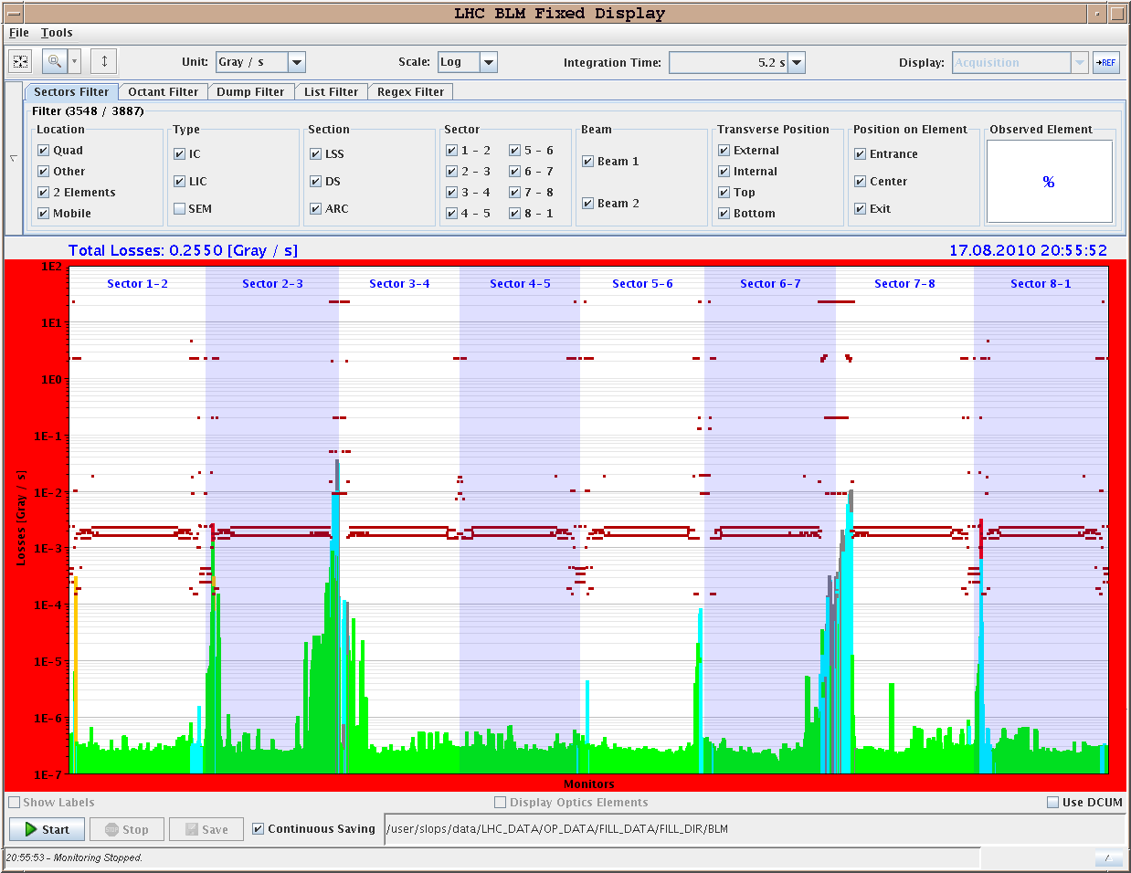
Loss map for Beam2 with RF frequency trim:
Beam 2 loss
map for
ΔF_{RF} = -1000Hz

Slide 10
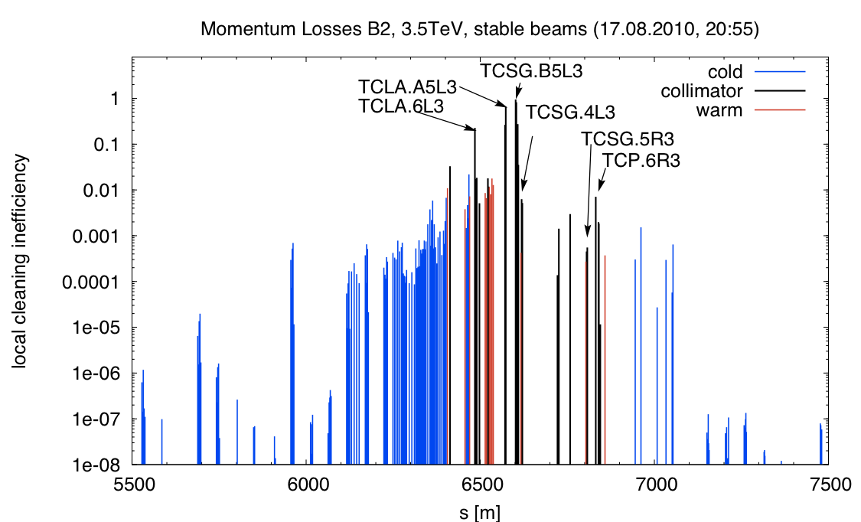
Beam Losses in the LHC during injection with bunch trains
Daniel Wollmann:
The hierarchy is violated in this case: The TCSG.B5L3.B2 acted as primary collimator.
One can also see, that the losses
on the TCLA.A5L3.B2
are quite high
(~64% of the losses at
the TCSG).

Slide 11
Tuesday 17.8.
Night: Struggling to get beam into the machine:
22:10: QPS problem on RQTD.A56B2 and RQTL11.L5B2 ➔ switched boards;
22:30: Problem with fast BCT for Beam1 ➔ no beam signal on page one;
00:20: Beam 1 probe dumped due to RQTL10.R7B2 trip (redundant power supply) ➔ could be reset after check with MP3 expert;
00:50: SPS has problems with the longitudinal blowup ➔ no nominal bunches;
01:50: Beam1 pilot dumped due to vacuum valves going in for S23; Valves closed for both B1 and B2. Problem appears to be a circuit breaker on a rack for the electronics of the gauges and pumps around Q6L3. ➔ requires access
02:50: Finished access; Fault was caused by 220V power bar trip, most likely due to overloading. They balanced the load by using an adjacent 220V power bar.
03:00: Pre-cycling S23 & S34 (RCBWV5.L3B1, XPOC, BQM in SPS);
04:00: Start new injection setup;
06:30: Loss of QPS OK on RQF.A67 stops injection (twice);

Slide 12
Wednesday 17.8.
Morning: Physics fill with 25 bunches:
07:00: Injection;
07:25: Start ramp;
09:00: End of squeeze and stable beams;
Emittances: ε_{x1} = 3.0 μm; ε_{y1} = 3.0 μm; ε_{x2} = 3.4 μm; ε_{y2} = 4.0μm;
Initial peak luminosity: L = 3 10³⁰ cm⁻² sec⁻¹;
Planned end-of-fill studies:
➔ Damper studies ay 3.5 TeV

Slide 13
Wednesday 18.8.
Morning: Keep physics fill in until afternoon.
End-of-fill studies for damper and L readjustment.
Short access for quench heater power supply repair in S12.
Afternoon:
Collimator studies for IR3.
Evening:
New Physics Fill.

Slide 14
Week 33
Open Issues for next Technical Stop:
CMS cooling for central tracker.
Ion pumps in dump line MKB (B2 only 4 out of 8 pumps working; few days intervention).
BLM racks (in buildings SR1 and SR5 and both at position BY02): would like to correct the way the power cable for the multi-plug arrives inside the rack.
QPS boards: several boards had to switch from channel A to B.
Access team to replace oxydized connectors for PAD-PX24 (3 hours).
CV needs to replace a motorization of the water valve of the sector 56 (3h).
RCBH18.R7B2 – Miguel Cerqueira Bastos.

