Slide 1
Monday 16.8.
Morning:
Took the machine over with physics fill with 25 nominal bunches;
Emittances: ε_{x1} = 2.5 μm; ε_{y1} = 2.4 μm; ε_{x2} = 3.0 μm; ε_{y2} = 3.3μm;
Initial peak luminosity of 3.4 10³⁰ cm⁻² sec⁻¹;
Terminated fill at 9:30 am and conducted end of fill studies
➔ Damper studies ay 3.5 TeV
➔ Roman pot adjustment to 20 σ (follow-up of beam loss of fill from Saturday)
Integrated luminosity of ca. 95 nb⁻¹

Slide 2
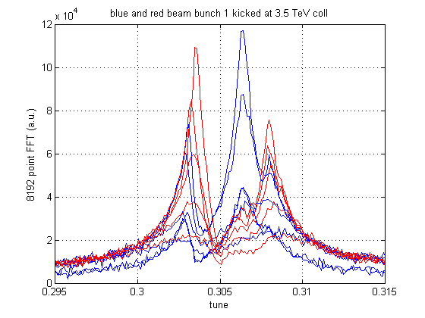
Damper used at 3.5 TeV with different gains (horizontal plane)
red: beam 2 kicked
gain beam 2 damper
increased x16
in steps of x2
blue: beam 1 kicked
gain beam 1 damper
increased x16
in steps of x2
Data from bunch 1 oscillations (8192 turns), Qkicker used at full strength
gain setting: -25 dB to -1 dB in steps of 6 dB (-19 dB used operational)

Slide 3
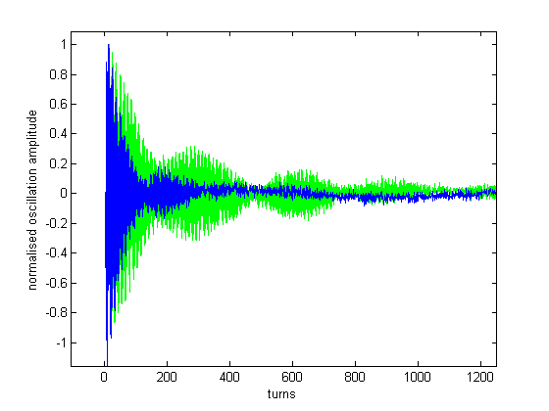
Damper used at 3.5 TeV with different gains (horizontal plane)
Time domain data (-25 dB and -7 dB gain) horizontal plane, beam 1
-25 dB
-7 dB
beating of two modes,
both well damped
data from bunch 1 oscillations (8192 turns), Qkicker used at full strength
gain setting: -25 dB and -7 dB, beam 1 kicked, horizontal plane
factor 8 gain increase on one beam does not lead to a factor 8 increase of damping
→ beams coupled, gain for damper on other beam was kept constant

Slide 4
Monday 16.8.
Noon: Beam Dump & Preparation of access:
Ramp down ALICE & LHCb magnets (LHCb with reversed polarity for next fill).
Access in Pt2 for Cryo;
Pt4 for BI (fast BCTs, BLMs, Synchrotron Light monitor…) and QPS;
Pt6 BCT in dump lines;
Pt7 BLMs;
Access Experiments ➔ CMS requested longer access related to repair of cooling for the central tracker.
RF powering test in Pt4.
Access in S56 for PO (problems for RQT13 related to water cooling circuits).
➔ Closing the machine only by 21:00 and having to give again access to S56
after problems related to the water cooling appear on RB.A56!
➔ Finishing access at 0:30 and starting pre-cycle

Slide 5
Monday 16.8.
Night: :
01:00: RQT13.L2B2 tripped during pre-cycle;
01:50: QPS problems on RQS.A12B2; RQTD.A56B2; RQTF.A81B1 ➔ OK after switching to board B;
02:00: BEM error for Beam 1 (PLC communication problem);
02:50: Beam back in the machine;
03:00: Starting BLM validation tests with beam (RF off operator beam dump; move the collimator TCP.6L3.B1 to 5mm and then r-einject ….):
Preliminary results:
all crates responded to GPM1
all channels in SR6 have data and with the expected structure.
the XPOC and PM recording functionality has been corrected. (the automatic XPOC analysis should be operational again)
None of the expected MPS functionalities have been lost.03:20.

Slide 6
Tuesday 17.8.
Morning: Dispersion measurement in IR3 and loss maps for Beam2.
06:00: Beam injection.
07:00: Beam dump by SIS due to TCDQ.
Preparatory studies for bunch train injections as soon as SPS is ready.
If SPS needs some more setup time we will try again the Beam 2 loss map measurement at 3.5 TeV.

Slide 7
Tuesday 17.8.
Plan for the coming days:
Physic fills.
Dispersion measurement in IR3 and loss maps for Beam2.
Damper studies (vector feedback system – one shift).

Slide 8
Saturday 17.8.
Open Issues fro next Technical Stop:
CMS cooling for central tracker.
Ion pumps in dump line MKB (B2 only 4 out of 8 pumps working; few days intervention).
BLM racks (in buildings SR1 and SR5 and both at position BY02): would like to correct the way the power cable for the multi-plug arrives inside the rack.
QPS boards: several boards had to switch from channel A to B.
Access team to replace oxydized connectors for PAD-PX24 (3 hours).
CV needs to replace a motorization of the water valve of the sector 56 (3h).
RCBH18.R7B2 – Miguel Cerqueira Bastos.

