Slide 1
Saturday 17.4.
06:00: Physics fill from the night shift
15:00: End stable beam mode:
problems with incorporation of settings for the squeeze
16:40: Start squeeze in IR 1 & IR5:
β* = 2m reached at 17:10 ➔ ca. 30 minutes total for squeeze
17:30: Start squeeze in IR8:
β* = 2m reached at 17:55 ➔ ca. 25 minutes total for squeeze
β-beat correction using ‘knobs’ for Q5 and Q6 adjustments done via settings.
18:05: Start squeeze in IR2:
18:30: Reached β* = 5m but encountered large losses for Beam2 (only a couple 10E9 left). Large coupling after trip of RQS .A78B2 ➔ the horizontal tune crossed the 1/3 resonance. Caused by too high dV/dt in function settings.

Slide 2
Saturday 17.4.
19:30: β-beat measurements:
β* = 5m: not sufficient intensity for Beam2 but good measurement for Beam1
➔ 20% to 30%?
β* = 3m: 20%-30% β-beating for Beam1.
RQS .A78B2 tripped again during squeeze to β* = 3m.
β* = 2m: 20%-30% β-beating for Beam1.
change of β–beat during squeeze is small!
local coupling correction
20:00: finished β-beat measurements:
23:30: Preliminary studies for TCD adjustments with Beam1 only
01:00: Preparing new fill for the night
invalid time problem for RQTF circuits of Beam2 (loading of settings).
06:00: Start lumi scans.
06:45: Beam dumped:
again COD SIS?

Slide 3
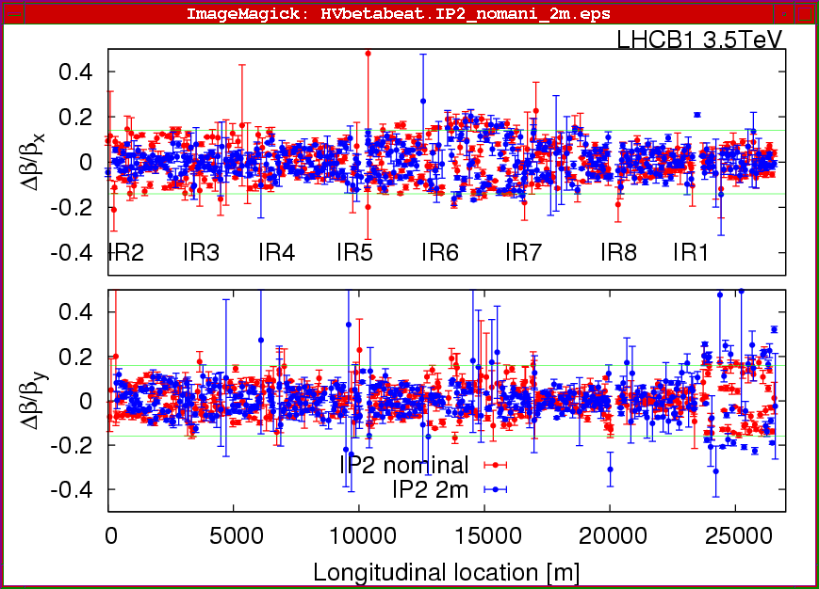
Saturday 17.4.
β-beat for Beam1 at β∗ = 2m in IR2 (all other IPS at β∗ = 2m):

Slide 4
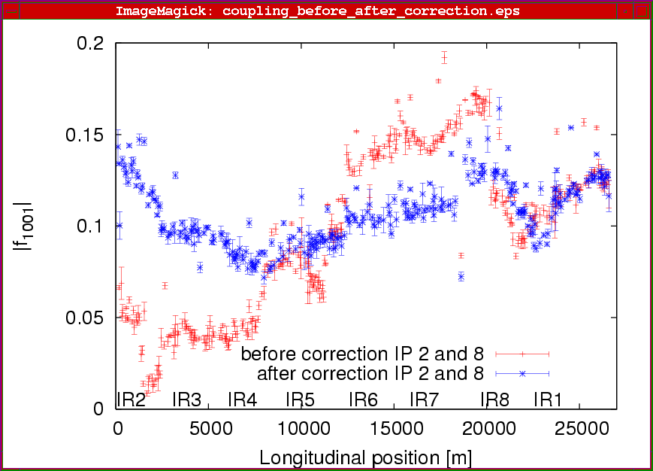
Saturday 17.4.
Coupling for Beam1 at β∗ = 2m in IR2 (all other IPS at β∗ = 2m):

Slide 5
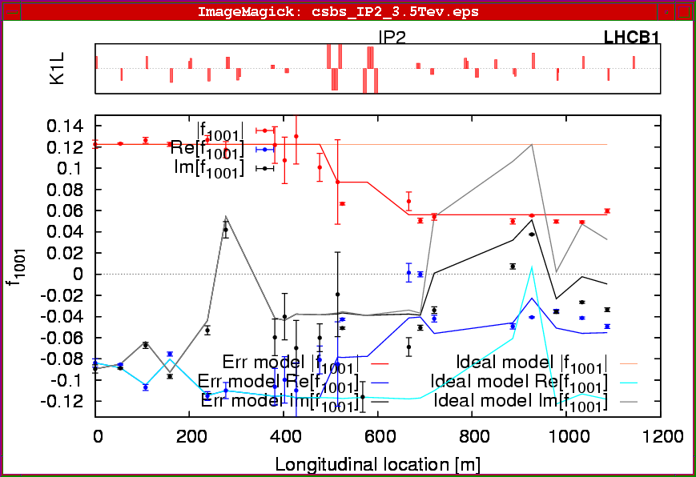
Saturday 17.4.
Coupling correction for Beam1 at β∗ = 2m in IR2 :

Slide 6
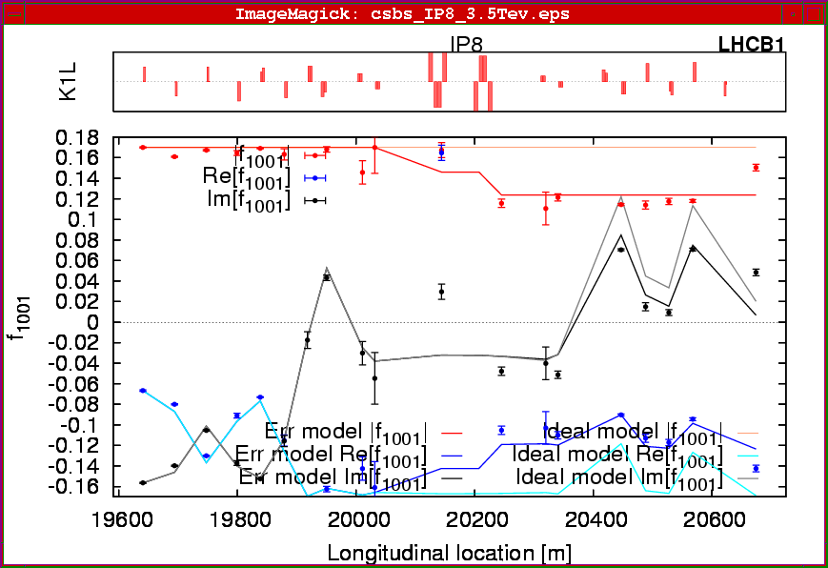
Saturday 17.4.
Coupling correction for Beam1 at β∗ = 2m in IR8 :

Slide 7
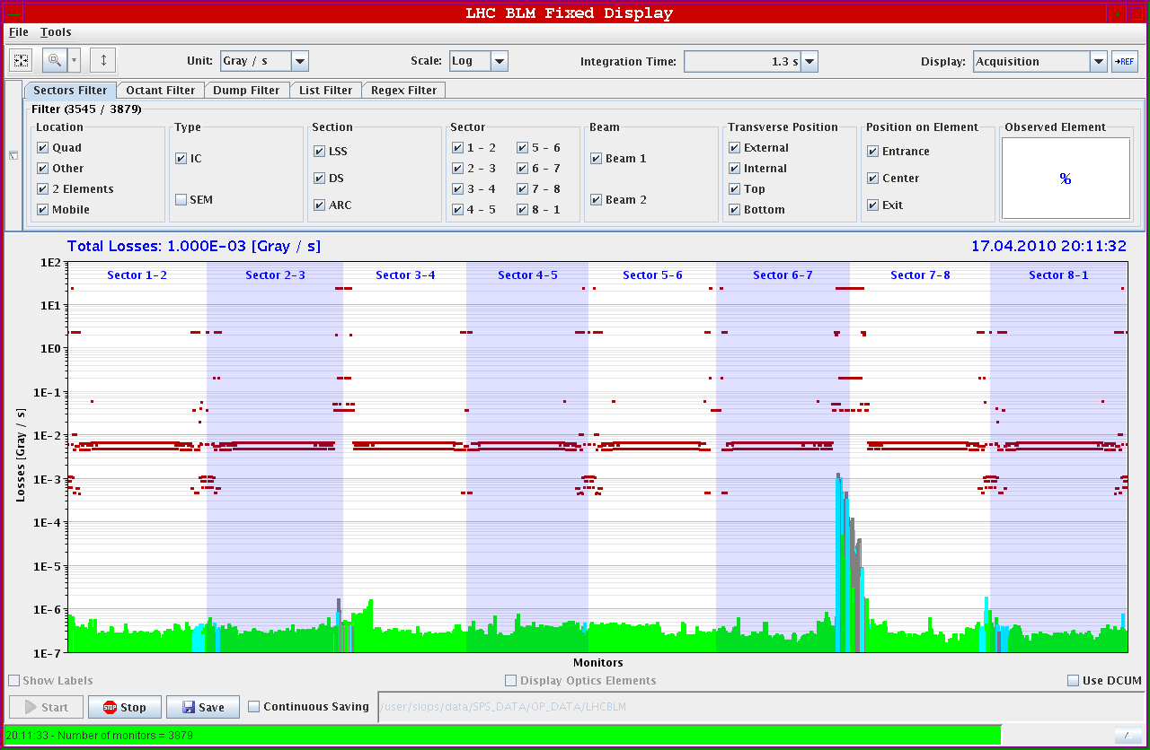
Saturday 17.4.
Losses during AC dipole measurements (β* = 3m in IP2):

Slide 8
Sunday 18.4.
Day:
Stable beam physics fill.
Repeat optics squeeze.
β-beat measurement and correction.
Optics and orbit measurements and corrections.
IP steering.
Adjustment of tertiary collimators.
Night:
Physics fill for the night.
Monday:
Repeat ramp and squeeze procedure.
End of fill studies for establishing ‘stable beam’ conditions with squeezed optics.
Damper studies

