Slide 1
Monday 12.4.
09:30: Physics fill for the day
17:30: Loss of cryo maintain
Problem with the temperature reading of the current lead for RQTL9.67 (L7). Artificial jump in temperature (immediately passing from 50 to 100 K), which lasted for a few seconds.
Reading shows similar perturbations about every 3 hours with different amplitudes.
Problem no yet understood but temporarily ‘solved’ by filtering the reading.
19:00: Request by CMS to have access in cavern for investigating water leak
intervention lasted longer than foreseen (over one hour compared to 20min).
ALICE also had access in shadow of CMS.

Slide 2
Monday 12.4.
19:00: Trip of 3 RF modules for Beam 2. OK after reset.
20:50: BIS problem related to RF for Beam2.
Latched interlock coming from a short loss of cryo OK.
21:40: SIS problem related to QPS state of RQX.L8
QPS expert confirms QPS of RQX.L8 is OK. Proceed by masking signal for injection and taking shots for beam setup with low intensities.
22:10: XPOC problem with LBDS after dumping pilot beams
Missing BCT data.
22:45: Problem related to orbit correction.
23:20: Again XPOC problem with LBDS after dumping pilot beams.
23:30: Filling in a few injections for bunch length calibration.
00:15: Problems with loading the ramp settings.
apparently caused by adjustments during orbit corrections via trims.

Slide 3
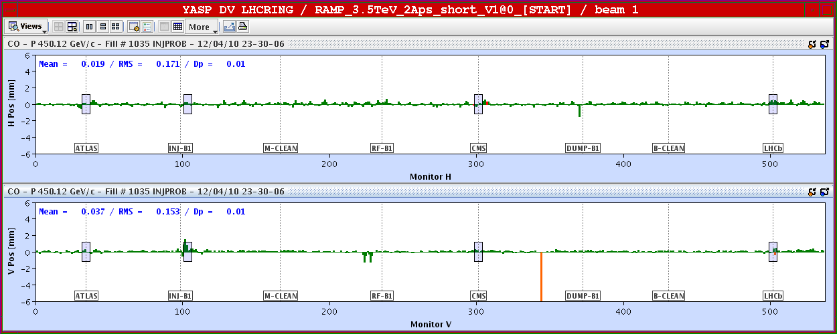
Monday 12.4.
Problem related to orbit correction:
MCBV.12L4.B1 = 14.54 μrad
➔ MCBV.16L4.B1and MCBV.8L4.B1 = -7.5 μrad

Slide 4
Monday 12.4.
02:00: Ramp settings OK
02:30: CPOC problem again
03:00: Beams circulating and ready for ramp.
04:00: Ramp finished.
05:00: Stable beams.

Slide 5
13.4.
Plan for the morning:
Squeeze in IR1 & IR5.
Squeeze in IR8.
Establishment of corrected orbit reference followed by re-adjustment of tertiary collimators.
Measurement of loss hierarchy.
Simulation of asynchronous beam dump.
Afternoon:
Damper studies at 450 GeV.
Night:
Physics fill with squeezed optics.
Wednesday:
Continuation with preparations for higher beam intensities.

