Slide 1
Friday
08:00 Quick reset RCBXV1.R1
Pre-cycle
Check of beam in transfer lines
11:00 Start inject and dump
BLMs in S56 giving no signal
wrong settings in TI8
PM from BLM 7R8
Inject and dump – only 1 turn (10, 100 demanded)
Circulate and dump
Orbit correction required – L2 – Alice?
Measure and correct tune (nominal) and chromaticity (2,2)
injection oscillations
beating not nominal – effect of access/limited precycle?

Slide 2
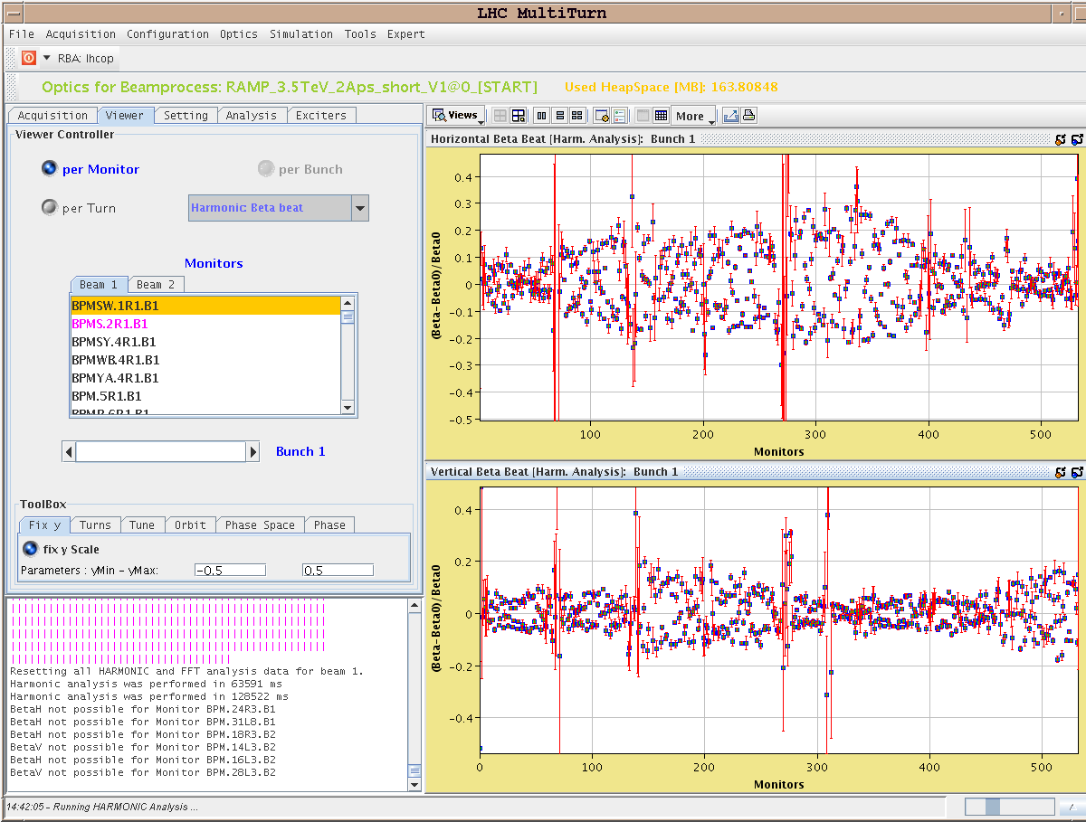

Slide 3
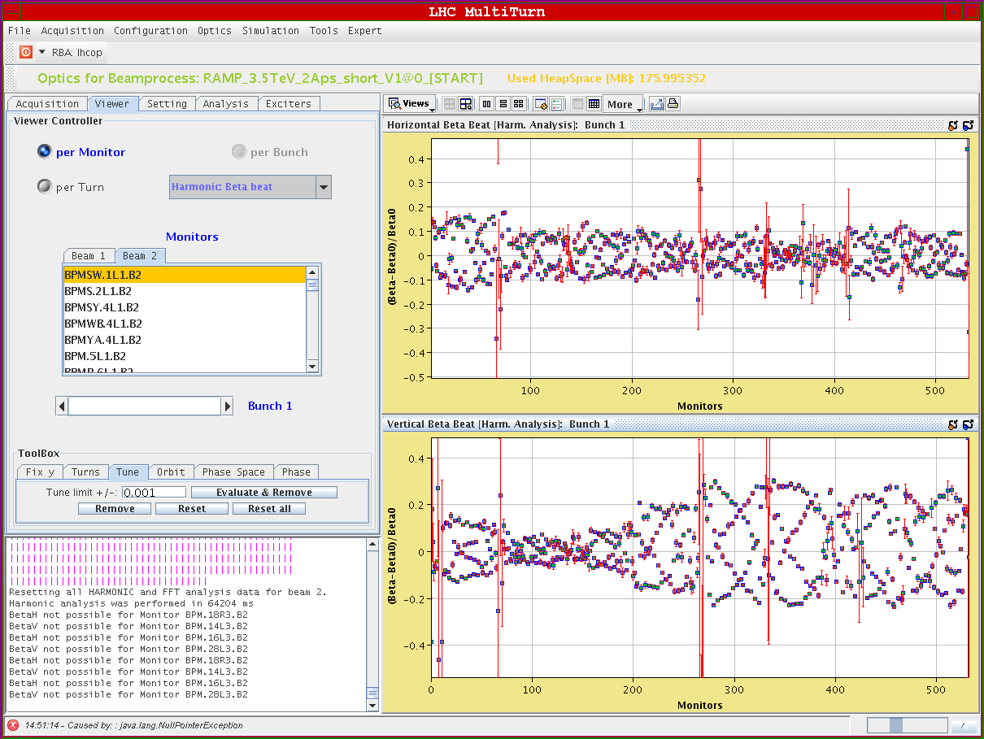

Slide 4
Friday afternoon
TDI to tight settings and re-positioned to beam
15:34: over-injecting beam 1 & 2 OK
Long voyage of discovery
Switching cycles in SPS between PROBE and INDIV
Re-phasing issues in SPS on INDIV
Transfer line trajectories different
Frustrating times as witness pilot kicked out when higher intensity beam from SPS doesn’t come(oscillating BPF – 5.2 e9 OK for flag and over injection)
20:30 – 2e10 injected with over-injection
Rough adjustment of TCDIs in line to minimize down-stream losses (clear issue)
Brennan & team…

Slide 5
Friday evening
Now working with INDIV only
inject 8e9 and QKICKER down to 5.2 e9
inject 6 e10
BPM interlock in IP6 fires (x2)
Disable interlock
Then get caught by orbit excursion interlock
Mask and BPM sensitivity set to low before injection of 6e10
00:03 6e10 in
injection losses OK
orbit good
00:30 8.8 e10
00:42 11.5 e10 in but RF loses it – beam still circulating in various buckets

Slide 6
This morning
Scrape beam on primaries and dump what’s left
6e10 circulating, lifetime around 600h. This beam is for Philippe to adjust the RF for higher bunch intensities.
01:48 11e10 injected OK
orbit tune emittances etc
6:13 STABLE BEAMS

Slide 7
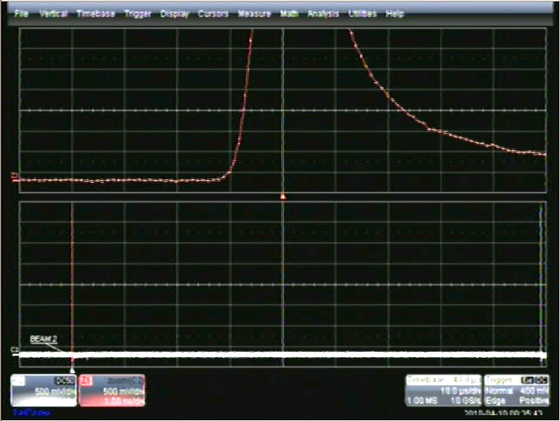

Slide 8
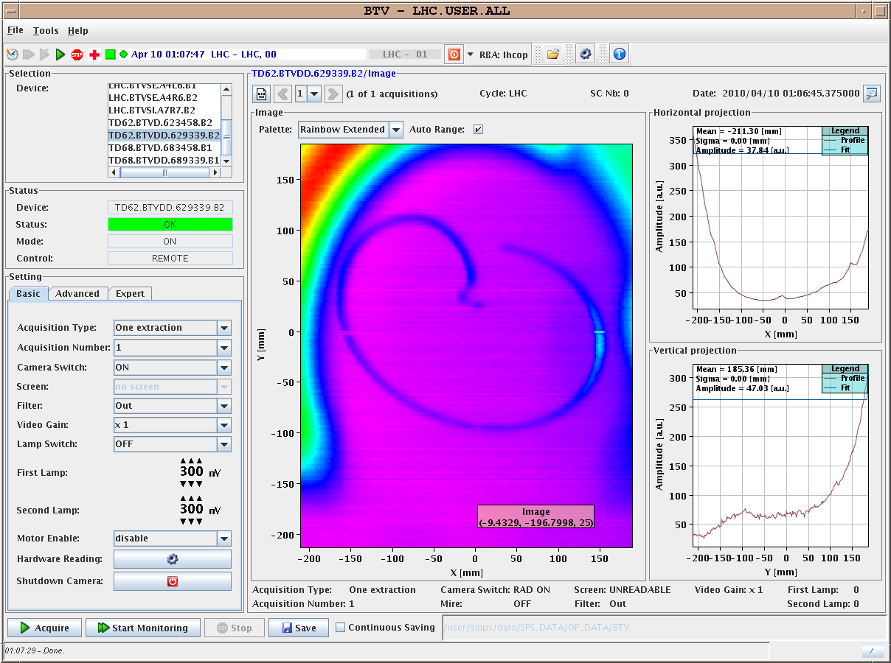

Slide 9
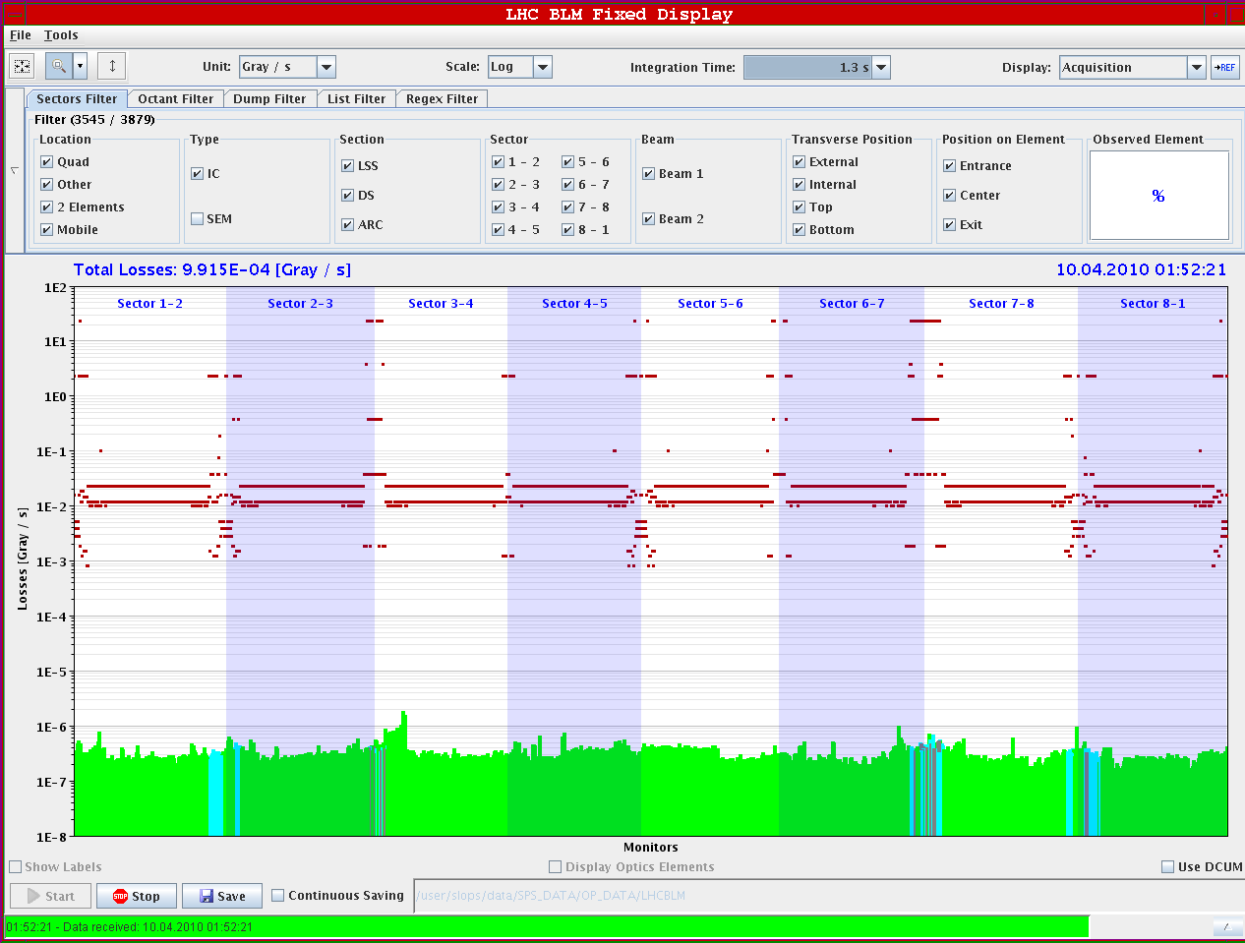
Losses around ring with 11e10

Slide 10
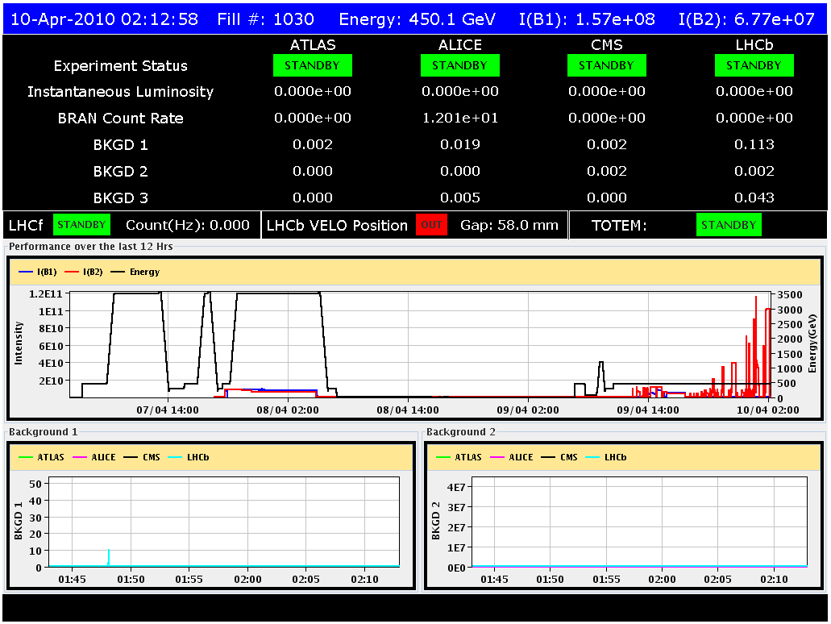

Slide 11
Program
✓
Pre-cycle
Re-establish circulating beams
new values for b3 decay and snapback in place, chromaticity to be carefully measured and corrected
High intensity tests at 450 GeV
Test ramp (check Q’ in snapback)
Leading into squeeze
quick run through to 2 m in IP 1&5
squeeze to 2 m, in IP8
Go for stable beams overnight
✓
Possibly to be on hold

