Slide 1
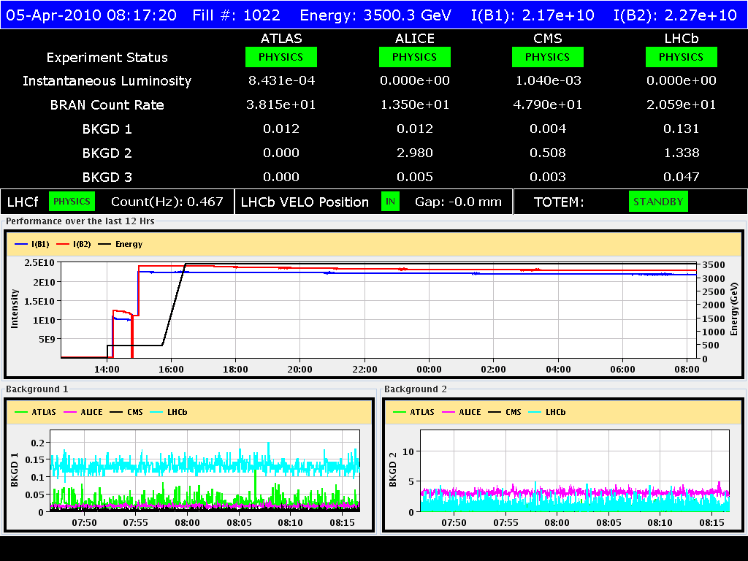
04/04/2010
Access for IT.L5 current lead temperature gauge and quench heater power supply in Sector 34 finished at ~11:30. Problem with the current lead temperature gauge not really solved ➔ to be followed up with experts (Cryo)
Injection at ~14:00. Stable beams at 17:30

Slide 2
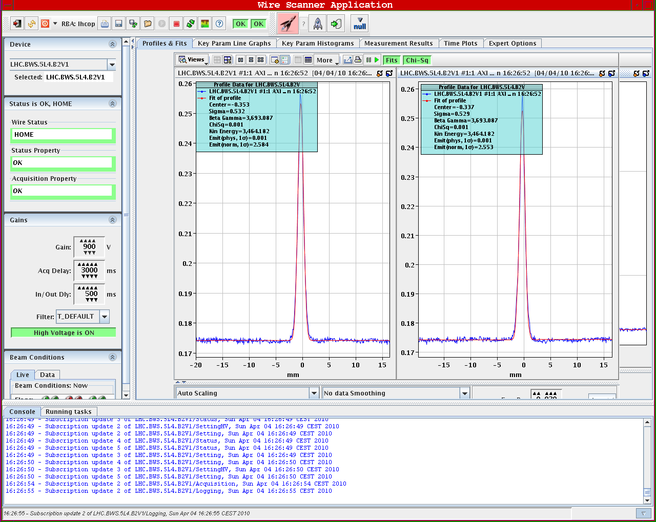
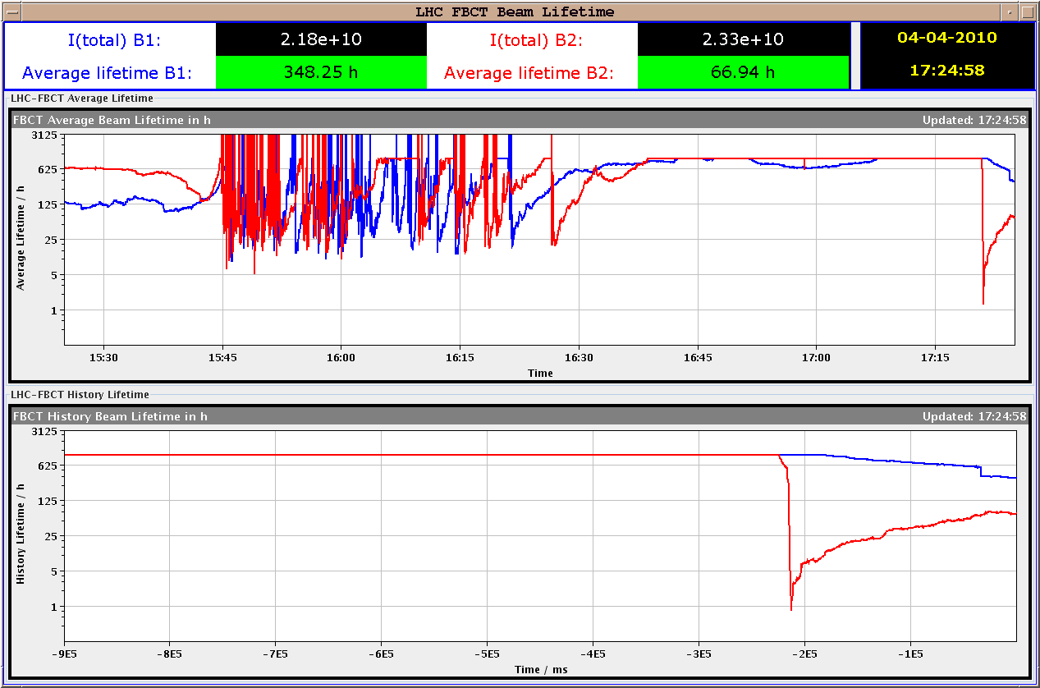
04/04/2010
Emittance (B2 – vertical not best)
Beam losses below threshold during collimator movement
Lifetime of ~1 h when moving in
Beam lifetime in collision ~70-100 h at the beginning of fill increasing after

Slide 3
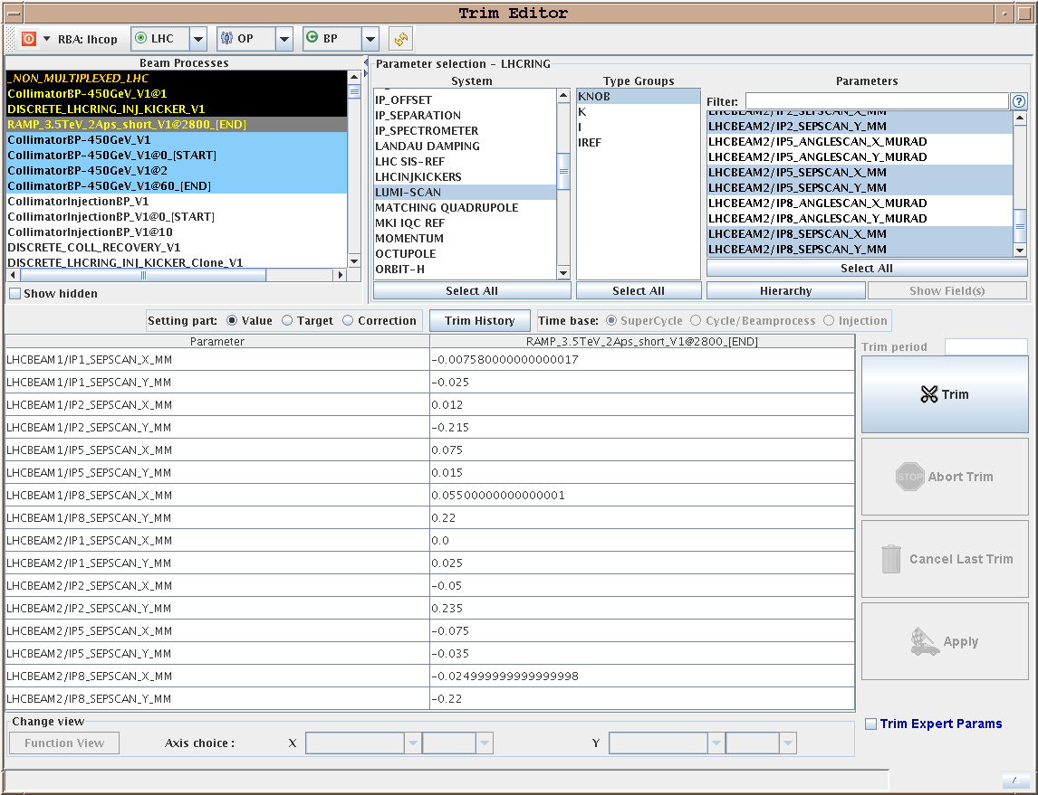
04-05/04/2010
Very good lifetime in collision
Lumi scans performed in IP5 (Luminosity increased by 50%), in IP1 (+30 %) in IP2 (100 %) and IP8 (+50 %)
Some hysteresis observed in IP8: to be understood
Reproducibility to be checked

Slide 4
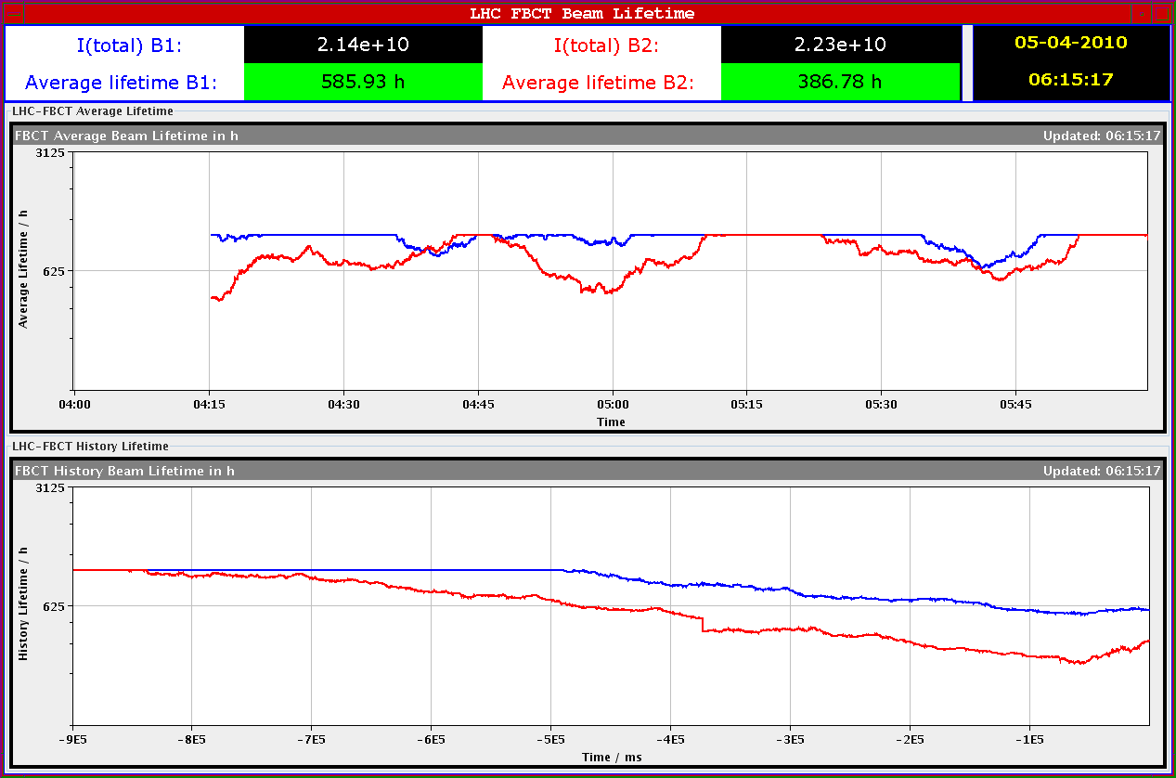
04-05/04/2010

Slide 5
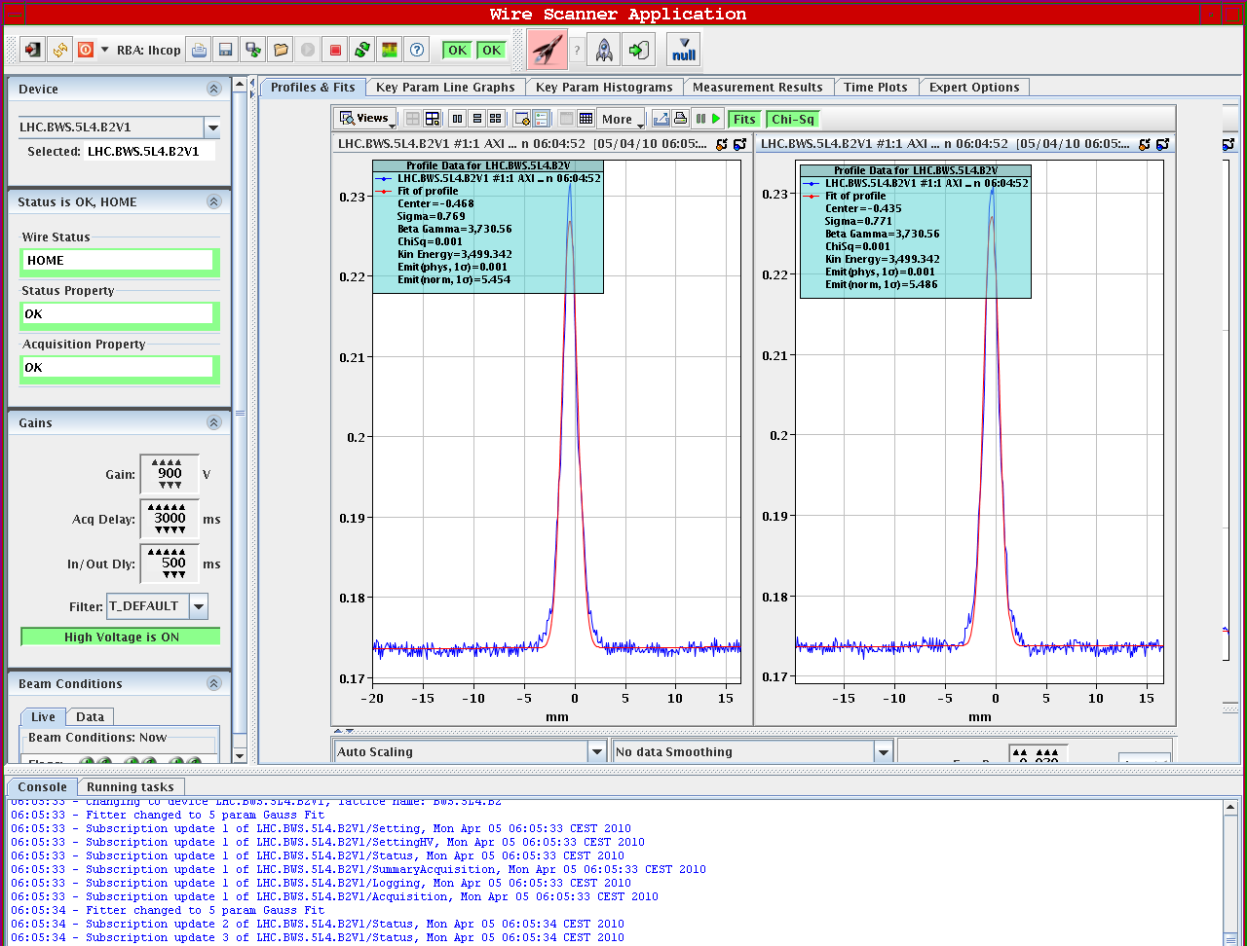
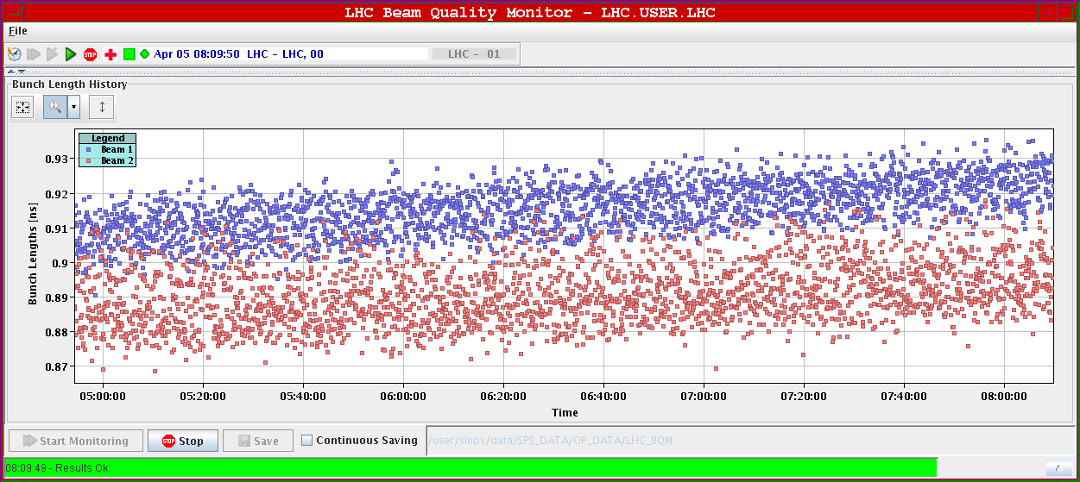
04-05/04/2010
Some transverse (up to factor 2 B2V) & longitudinal emittance blow-up visible

Slide 6
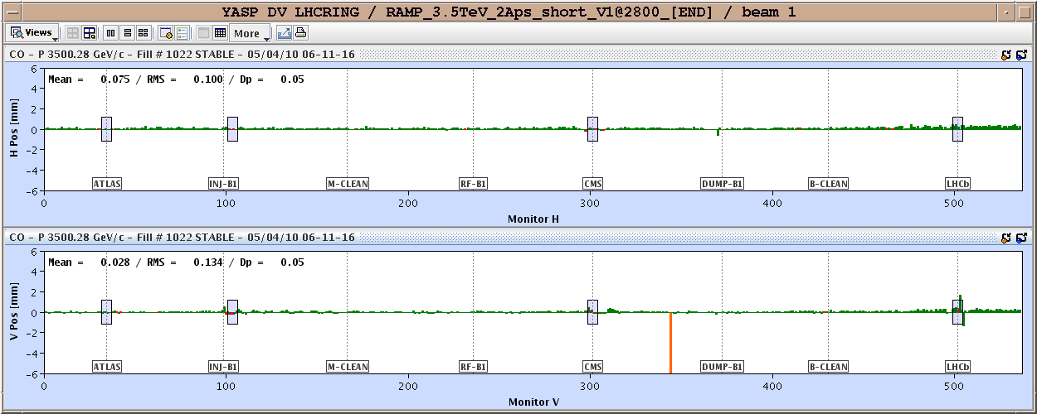
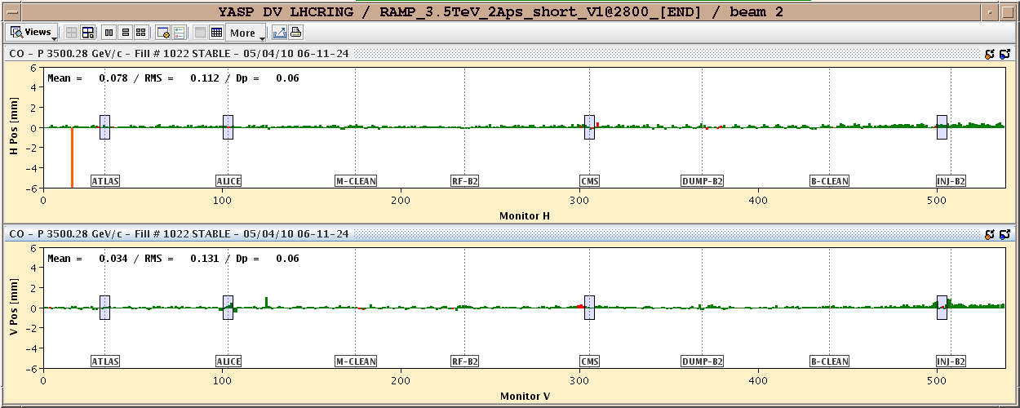
04-05/04/2010
Very stable orbit (after 12 hours)

Slide 7
04-05/04/2010
Plan for the day:
Keep this fill depending on luminosity lifetime. Experiments to tell us
Possibility to iterate on chromaticity at injection/beginning of the ramp further reduce blow-up based on measurements done

