Slide 1
Thursday - Friday
07:00 – Late Access
Thanks again to CSA and RP
Access system maintenance (patrol required), BI, EPC, cryo
nQPS patch in four sectors (S12, S23, S34, S45) deployment and powering tests for validation
Cryo de-icing in point 8
Started 04:00 Thursday
End ~11:00 Friday
01:44 Machine closed
start precycle of available sectors
RQD/F in sector 12 were tripping during the "COMBO" cycle because the reference magnets are "slightly" mixed up.....

Slide 2
nQPS
Summary of the modifications: 1) Update of DQAMGs software for 4 sectors (12, 23, 56 and 67). This includes change of threshold to 800mV. The new parameters were verified by the QPS team
Behaves as expected
2) Change of the delay of the extraction switches in sector 34 by 100ms (in total, 8 cards were modified)
Not sufficient

Slide 3
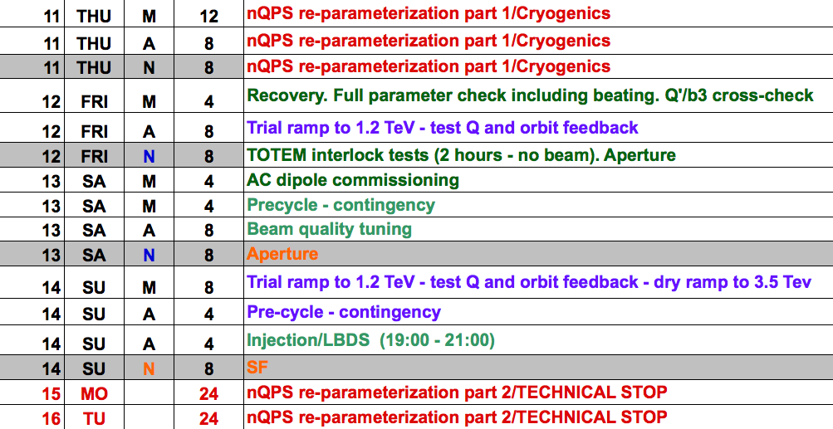
Schedule

