Slide 1
Tuesday morning
05:10 - cryogenics - lost worldFIP communication to half of sector 34 – reset by expert – back by 07:00
07:00 – sector 45
SD1.A45.B1 – current lead heater
SM45 Lift in maintenance
Problems with MAD
Block access doors
Current lead heater transformer changed, after disgnostics, returning to lab etc.
13:20 LHC closed - precycle beam by 15:55

Slide 2
Afternoon – collimation – loss studies
Goal was to validate collimation setup by generating slow losses (~2e9p/s loss) in horizontal, vertical and off-momentum phase space. Technique as last year: change Qx, Qy or RF frequency.
The orbit was corrected to the reference orbit from collimation setup. Some issues addressed, resulting from changed dipole corrector complement (a corrector became unavailable).
Collimator positions reloaded, as found on Sunday. First step without TDI, TCLIA, TCLIB and TCDQ.
We took loss maps for the horizontal, vertical and off-momentum losses. Some loss maps showed incorrect hierarchy. Found 3 collimators that were incorrectly entered (by 5.5 sigma and 2.2 sigma).
After correction, the loss maps in x, y, off-momentum show normal hierarchy and efficiency. Resolution for losses in cold arcs limited by beam intensity.

Slide 3
Collimation continued
About 40 min of beam time used for delivering the requested beam 1 and beam 2 grazing events to CMS.
Then, TDI (both beams), TCLIA (both beams), TCLIB (both beams) and TCDQ (beam2) moved to their calibrated settings.
Retook loss maps in vertical plane (both beams) and horizontal plane (beam2).
Consider collimation setup valid, based on measured loss maps. Detailed analysis to follow

Slide 4
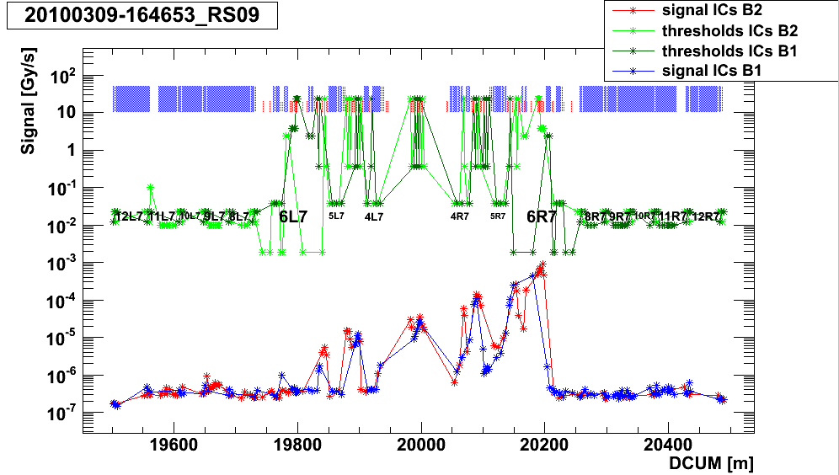
Loss map

Slide 5
Evening
21:32 Start first dry ramp - BETS
Quench QD.A12 going to start of rampdown-precycle-combo
known asymmetric quad
Midnight: 2nd dry ramp
After analysis of the event EC confirms that the BETS test was conclusive. BETS ready for ramp with beam to 1.18 TeV
Tripped again S12 when ramping to the START point of PRECYCLE_COMBO
Even though settings had been adjusted
Problems to get the RF on

Slide 6
Overnight
03:04 B1 circulating
New b2 model in place
Tunes need adjusting
Chromaticity split corrected by adjusting b3 spool pieces
Schottky commissioning continued
Beating studies
Local refinements – looking good
RF commissioning ongoing

Slide 7
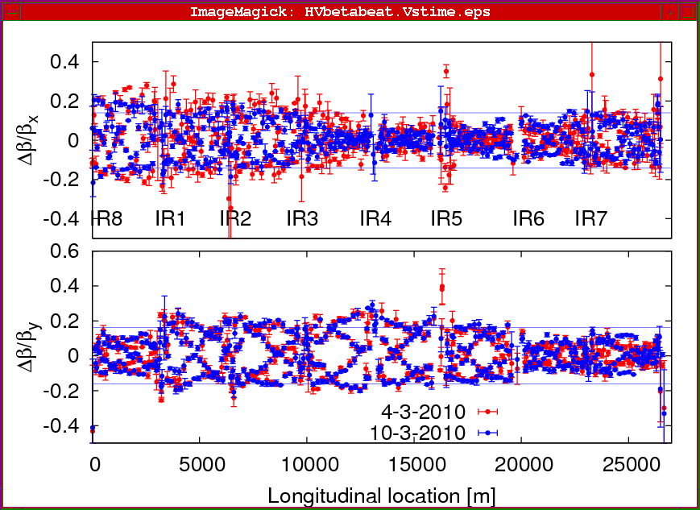
Beating
New b2
Beam2 horizontal beta-beating decreased by 5% (from 25% to 20%).

Slide 8
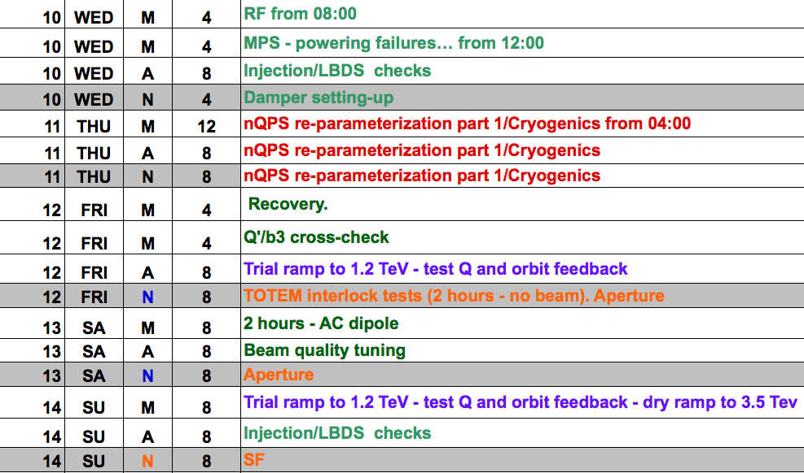
This week

Slide 9
Next week

