Slide 1
Thursday 24th January - morning
07:40 Beams dumped by QPS trigger on RQX.L8 during filling
08:50 cycling whole machine
10:05 Injecting probes
SPS commissioning new cycle for NA61
Problem with protons – chromaticity
Issues various:
LHC BPM calibration done with wrong settings
Spurious losses in SPS with ion beam
Energy mis-match between PS and SPS
Tune excursion
Chromaticty
16:00 Start ramp

Slide 2
Thursday 24th January - afternoon
Ions not happy through squeeze, low lifetime coming into collisions
Suspect big beams from SPS
(protons set to 1.5e10 ppb for this fill)
16:55 Stable beams – fill 3489
Initial luminosity: 8.55e28 cm-2s-1
ALFA and TOTEM using OP sequences – OK
22:42 Beam dumped by BPMS – argh!
5h51m in Stable beams; 1.1 nb⁻¹ in ATLAS/CMS

Slide 3
Overnight
Some delay filling:
SPS RF: It was found that for the LHCION1 and LHCION2 cycles it had been necessary to re-adjust the radial steering at flat top to obtain a smooth switch-over from radial to synchro loop. (Thanks to Thomas Bohl)
04:30 Stable beams fill 3490
Initial lumi: 1e29

Slide 4
BPMSs

Slide 5
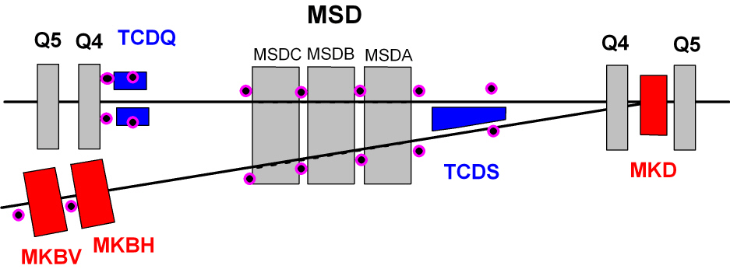
Beam instrumentation
BPM
Position Interlock BPM
BLMs
Plus – 2 BCTs per line at MKB
– 4 screens (OTR) per line at MSD, MKB, (TD), TDE

Slide 6
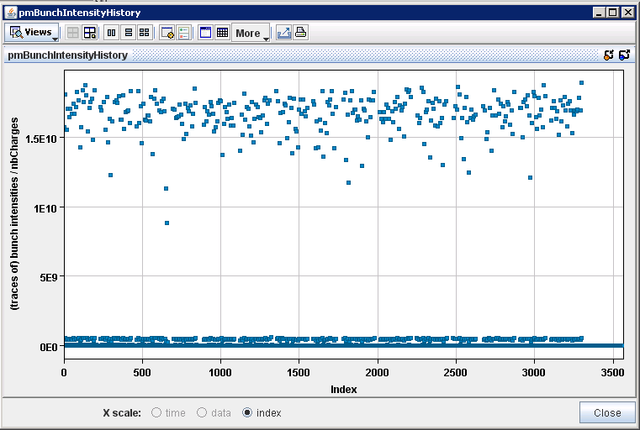
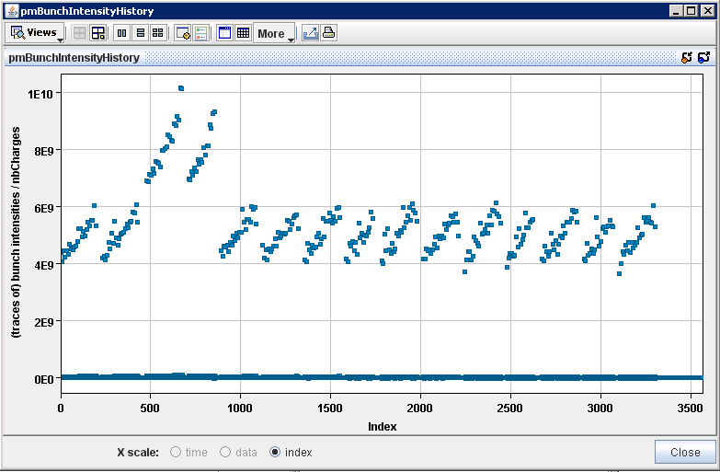
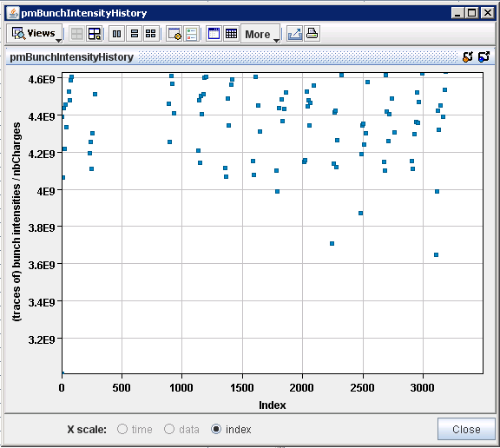
23/1/2013 @ 20:30:38 IR6 BPMs analysis
B1 and B2 bunch charges
B1
Eva Calvo
Zooming vertical axis
B2
3.65p/bunch

Slide 7
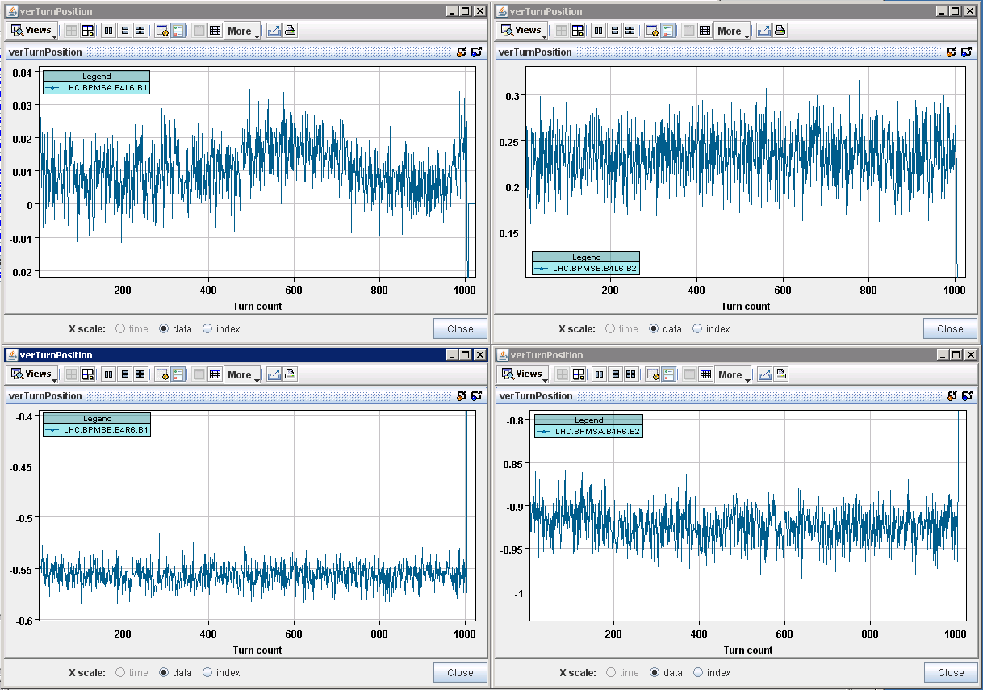
System B channels – Vertical Turn Average position
Limits: -3.26 mm & 2.74mm
Limits: -2.26mm & 3.74mm
Limits: -3.11mm & 2.89mm
Limits: -3.15mm & 2.85mm
Eva Calvo
- VerTurnPosition of system B channels. -> As for the Horizontal plane, the average position per turn seems well within the interlock limits. B2 is much more noisy than B1, what could be a symptom that we are approaching the sensitivity limits.

Slide 8
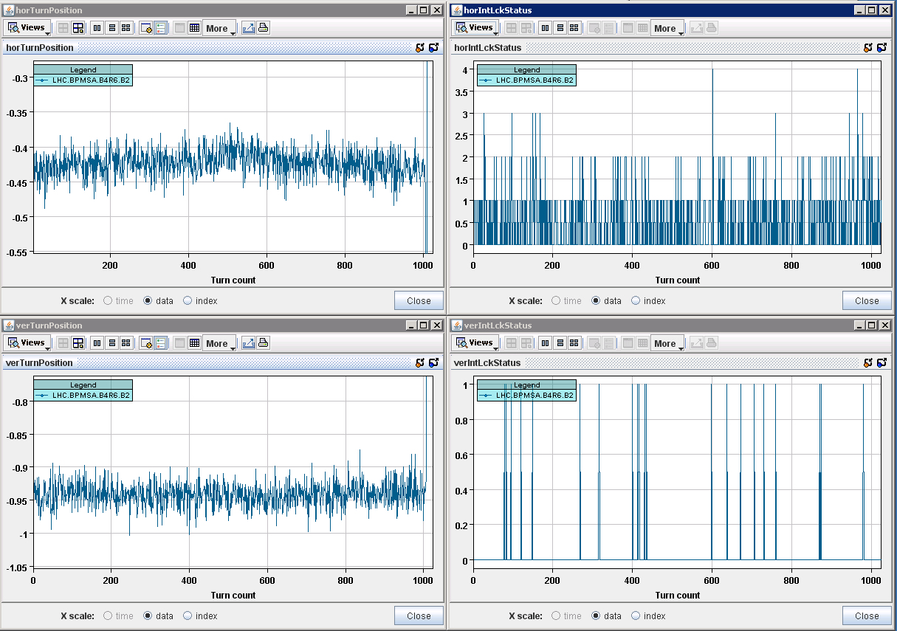
>70 !! In 100 turns
- Again the same problem in horizontal (and slightly in vertical) of BPMSA.B4R6.B2.
Only plot here this channel, since the rest of channels and variables are “clean”.
Eva Calvo

Slide 9
BPMS – change limits - discussion
All three dumps due to BPMSA.B4R6-Horizontal, between 3 – 4e9
A change of the closed orbit would be detected by the SIS, independent of the BPMS. This adds some redundancy, and orbit changes cannot be very fast.
We did not observe any bunches becoming unstable in the case of low beam intensity. There are no signs of instabilities.
In case that some bunches would become unstable, this would be a betatron oscillation that would be seen by the other BPMS.
We are operating with low beam power (although the damage of ion bunches should not be neglected).
Rudiger’s conclusion:
I would not be too worried to make the proposed change to 2000 bad readings over 100 turns, since 200 would not help. Another options is to go for the next fill for a compromise, say, to 500 bad reading over 2000 turns, and then see how we gain.
Rudiger Schmidt

Slide 10
Raising limits
After some debate:
Change BPMS interlock setting on BPMSA.B4R6.B2 H&V for both beams from 70/100 to 500/100 (JU)
Beams dumped after 5h51m

Slide 11
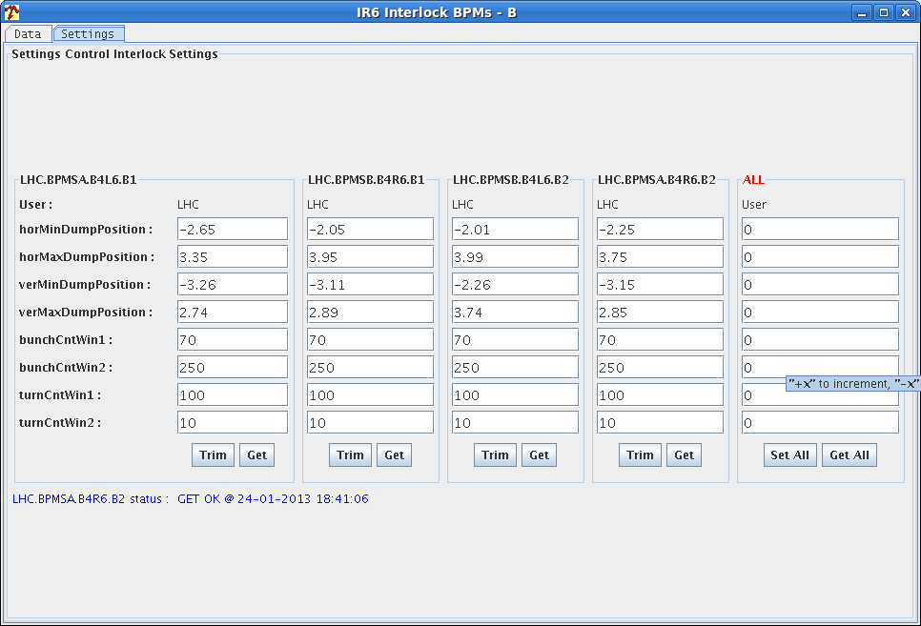
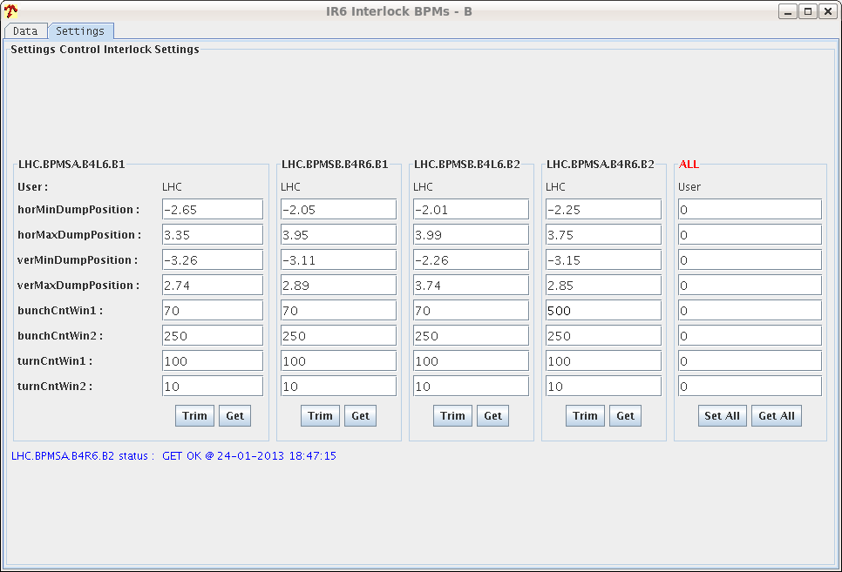
Change in BPMS interlock settings

Slide 12
Misc
New IQC version (Lene Drosdal)
The new version accepts an input on where the pilot bunch is and ignores that bucket in the analysis. Testing done on beam 2 using bucket 5131. Pilot is ignored for further filling.
Now the injection sequencer need to be modified to set this field before the injection. – Delphine to test
FBCT – phase – on-going problems – David Belohrad
Batch by batch blow-up at 450 GeV – next fill (PB)

Slide 13
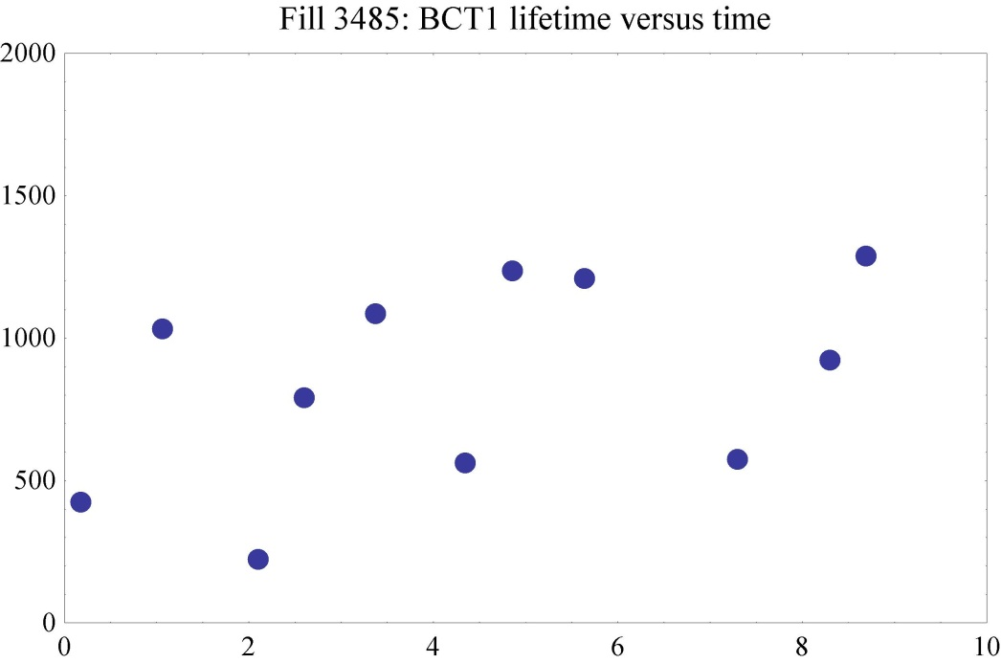
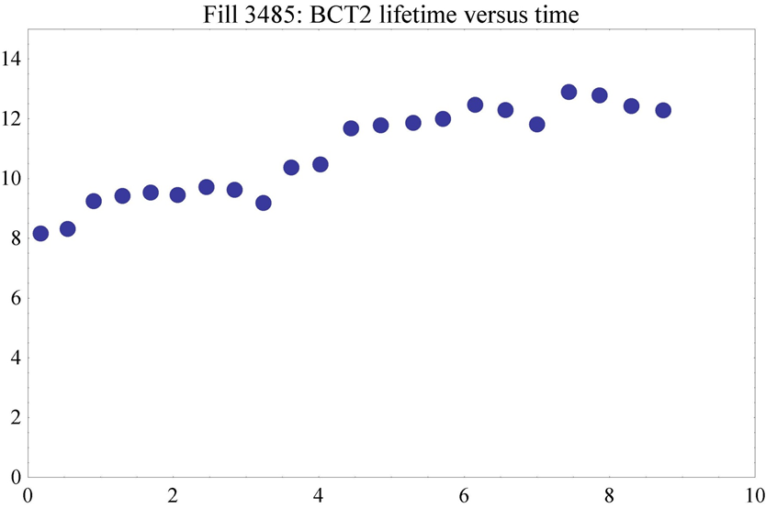
Typical beam lifetimes

Slide 14
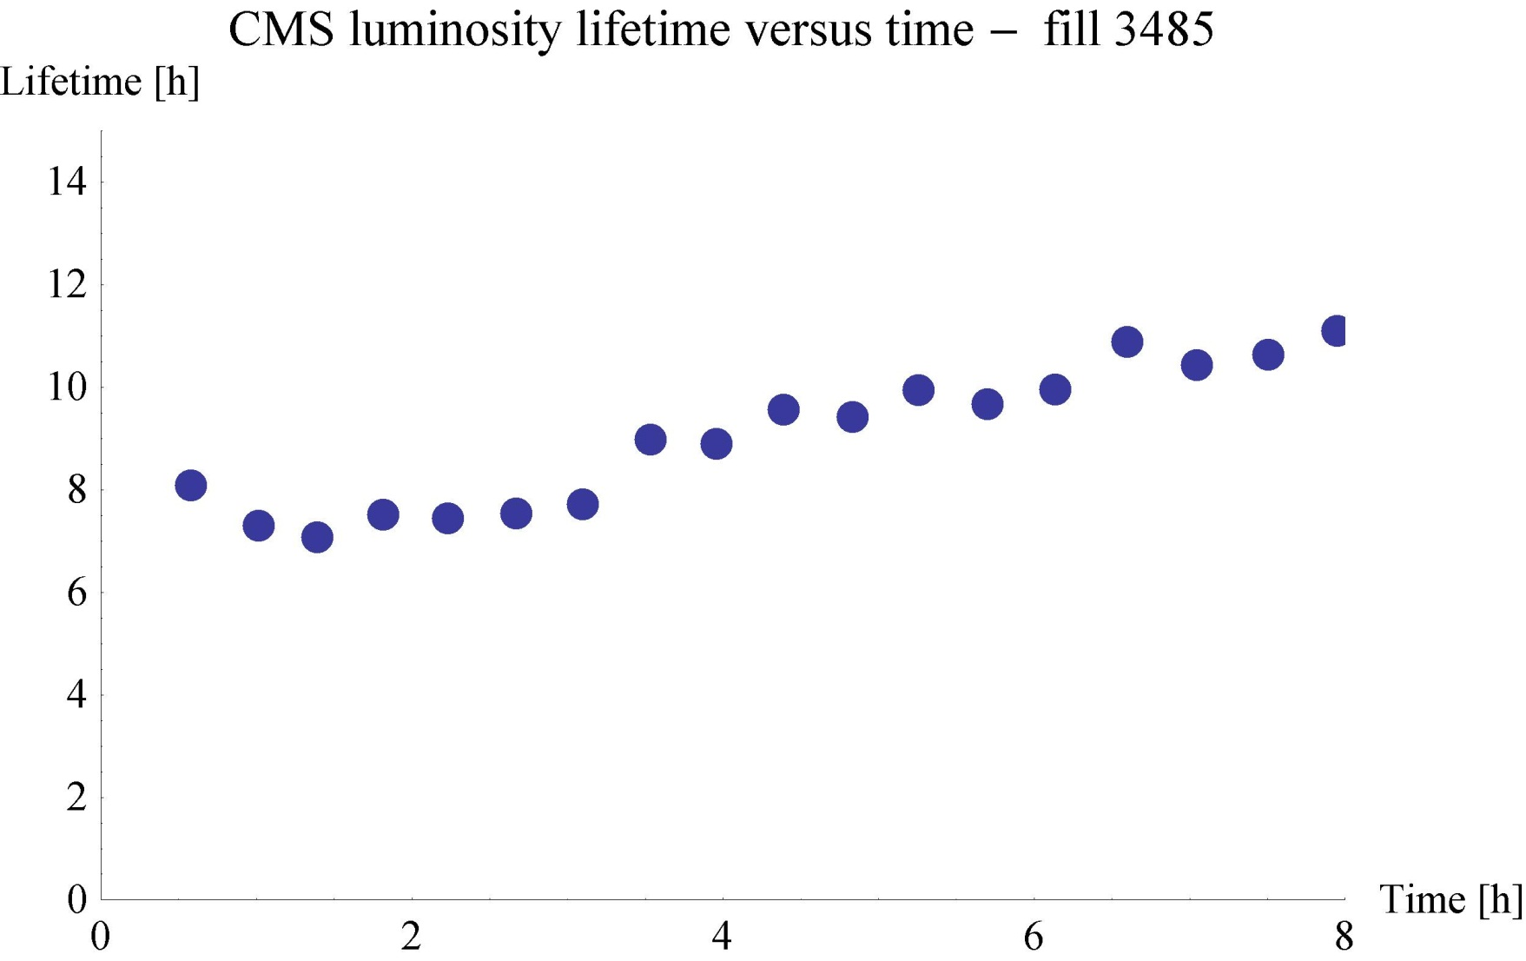
Luminosity lifetime

Slide 15
Various
Wire scanners not to be used until checked in tunnel
V/d Meer scans next week Mon/Tue
Access requests:
Wire scanner, J.Emery, point 4, 2 hours.
Collimators UJ33, test position sensors, M. di Castro, A.Masi, 20 minutes.
“Train”, B.Feral, D. Paulic, PM56/UL55, 1 h during working hours
BGI, M.Sapinski, R4, ½ h
LHCf has a problem in a part of the frontend electronics placed in the tunnel, we would like to ask a two hours access at the next opportunity in the shadow of the other activity. Takashi Sako
Quench Test on Q6.L8 – the scope is not yet in place, 1h in the UA. Mateusz Bednarek
CMS cryogenics – filter to be cleaned
Ludovic Mourier 165232 Restore pump for QRL insulation vacuum in sector 45 (which has a leak).

