Slide 1
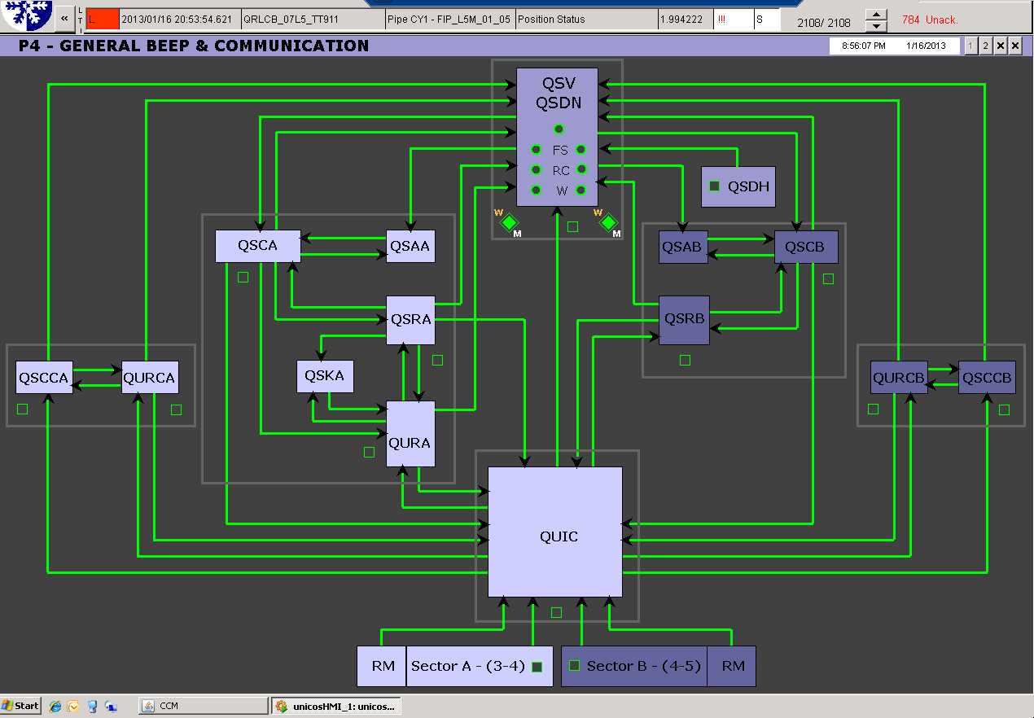
Problems encountered at P4: 1st episode
Tuesday 15th :Stable Cryogenics conditions
~ 17:00: start of having erratic losses of communication between QUI-QURCx, RM,QSRB, QURA
~ 21:00: call NetOp that sends a piquet Firstline to check the switch S2475-R-IP14
~ 23:30: Difficulties to localized the problematic switch
because not possible to make a diagnostic remotely
-> Decision to postpone it for next day
“Cryo Maintain was OK “
Wednesday 16th : communication became worse
~04:00: com. totally lost -> cryo op block interlocks..
~06:00: call NetOp for intervention
~10:30: ready on site
With help of expert switch is localized
Even with the switch changed, problem still present?
-> further investigations
~ 12:00: every that looks fine,
we decide to stop the intervention
First diagnostic from NetOP:
the problem could have been related to a number of
VME access processes that wrongly started with an automatic script(killed this morning ~11:00)
A. Suraci CCC - 8:30 Meeting January 17th 2013

Slide 2
Problems encountered at P4: 2nd episode
Wednesday 16th:In order to avoid Full stop of our Cryo plant
-> Many devices have been taken in manual mode, interlocks blocked,…
“Cryo Maintain conditions recovered”
~ 13:00: start releasing devices in Auto mode
-> during , we lost our QURCA
(machine that allows to cooldown/maintain S34 @ 1.9K)
~ 13:15: fast recovery started
Not an easy one because of
Reconnection at low pressure
Hydraulic instabilities at the inlet of CC1
Thursday 17th:
~ 06:00: Finally back on track
A. Suraci CCC - 8:30 Meeting January 17th 2013

