Slide 1
LHC Status Friday Morning 14-Dec
Bernhard Holzer, Mike Lamont
Planning:
 | WEDNESDAY | THURSDAY | FRIDAY | SATURDAY | SUNDAY | MONDAY
0:00 |  | RF
1:00 |  | RF |  |  |  | pA tests
2:00 |  | RF
3:00 |  | RF
4:00 | LOSS MAPS |  |  | 25 ns
5:00 |  | LONG RANGE MD |  | PHYSICS
6:00
7:00
8:00
9:00 |  |  | CYCLE
10:00
11:00 | TDI checks
12:00 |  |  | e-cloud
13:00 |  |  | 450 GeV
14:00 | DAMPER SETUP | 25 ns at flat-top | calibration
15:00
16:00
17:00 | Injection
18:00 | Injection |  | e-cloud | 25 ns | RAMP DOWN
19:00 | Injection |  | 450 GeV | PHYSICS | ACCESS
20:00 | RF |  | calibration |  | CYCLING
21:00 | RF |  |  |  | pA tests
22:00 | RF
23:00 | RF
Next step:
Fill with 4 trains of 288 bunches to get final reference for heat load in steady state (~1 hour)
Then go for physics (BCMS)
2*48b – short fill as test
25ns_396b_372_348_372_96bpi5inj

Slide 2
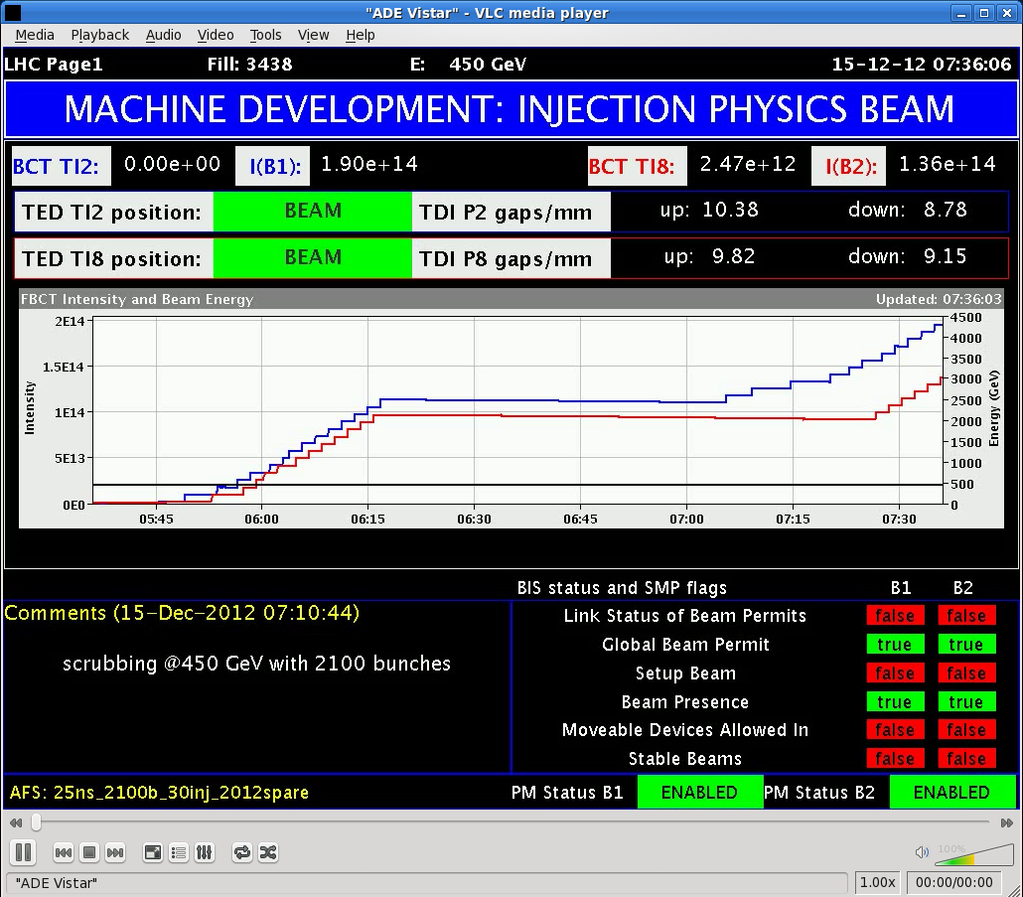
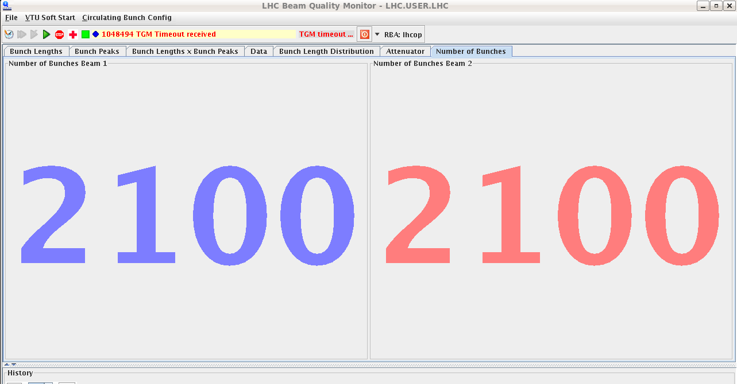
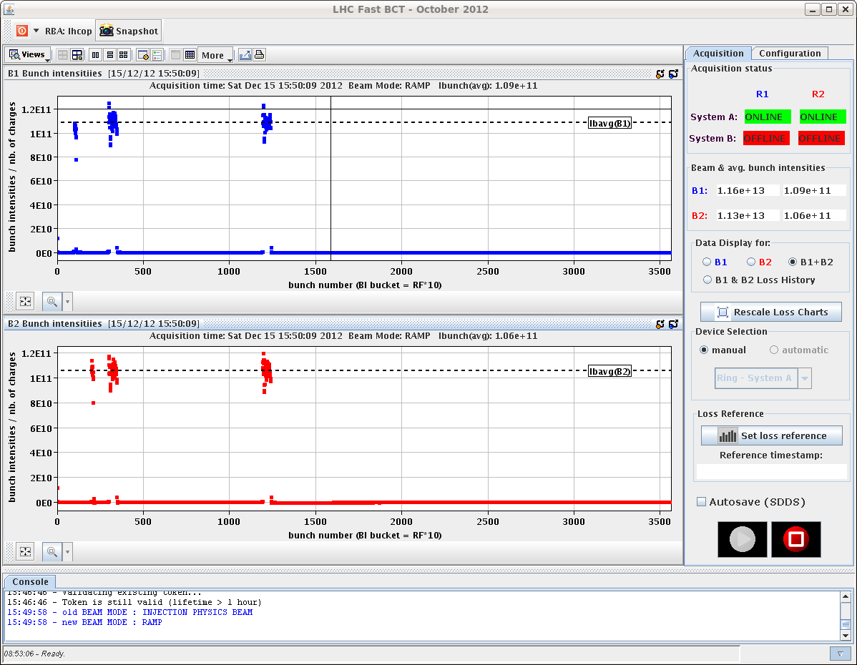
LHC Status
Saturday Morning:
... 8:30h
07:00h 2100 bunches for scrubbing at 450 GeV
11:00h beam dump: power converter RCBYH4R5.B2
-> short access
13:14h pre-cycling ... and waiting for the POPS.
15:00h injection 12+2*48 in h9
16:00h ramp – squeeze – adjust
16:30h stable beams
18:05h beam dump (Operation)

Slide 3
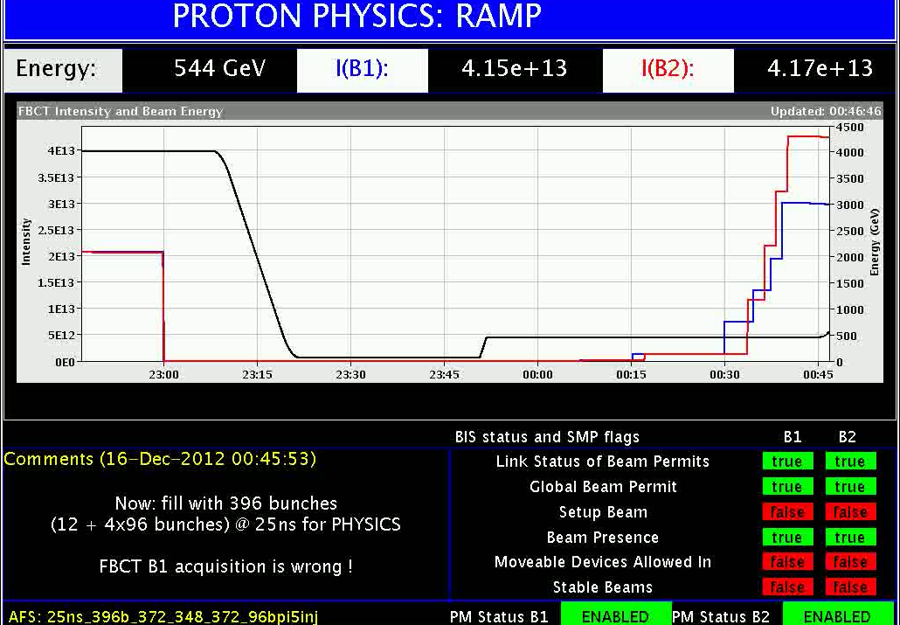
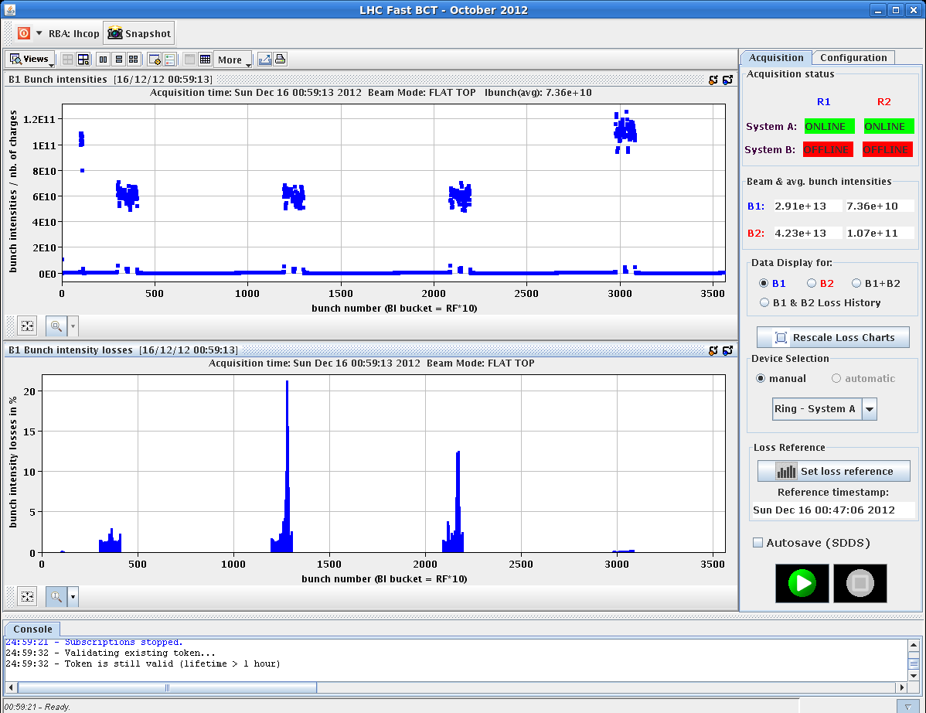
LHC Status
Saturday Late / Night:
... 8:30h
20:00h new injection for physics
20:50h r – s – a stable beams: 12 + 4 * 48 bunches
23:00h beam dump (Operation)
00:00h new injection: 12 + 4 * 96 bunches
considerable losses on ramp
01:13 r –s –a –luminosity
... but: first three 96b-batches are off by 4 buckets
called RF piquet
01:35h beam dump (Operation)
20%

Slide 4
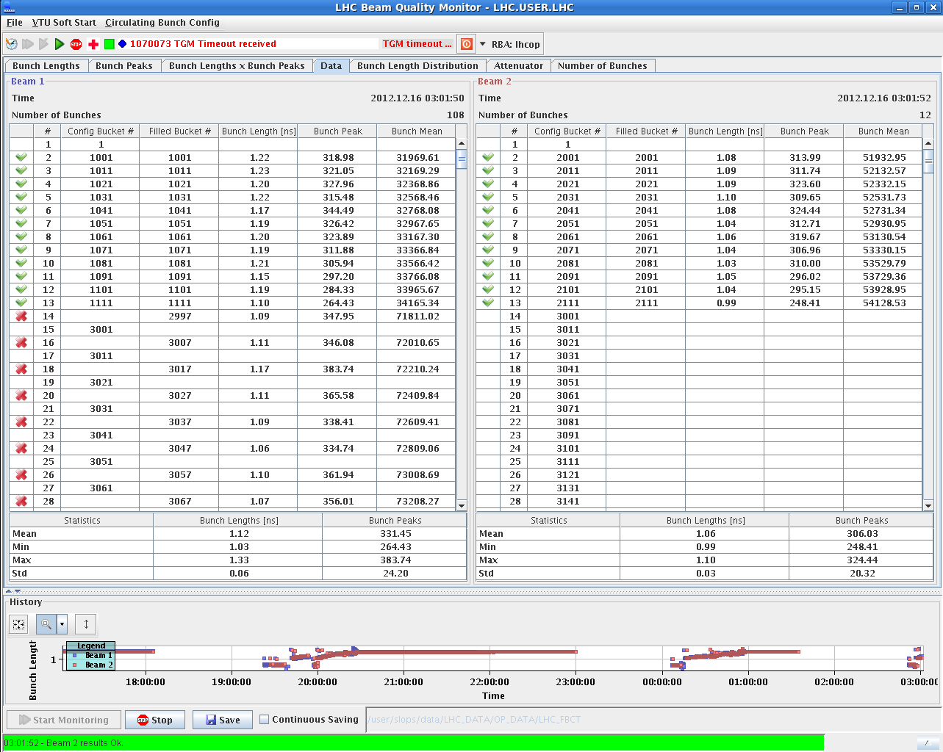
LHC Status
Saturday Night:
02:55h once again: new injection for physics
and again: beam 1 is off by 4 buckets.
03:30h Philippe on phone ...
04:53h ... & on site to check
05:20h error on FMCM, called I. Romera
... and again 06:43h
05:24h XPOC error on B2: called E. Carlier to reset
06:43h Timing (RF-) problem solved: temperature compensation of the optic fibre link
was at limit
06:46h SPS lost patrol, no beam

Slide 5
Sunday
MDs starting Sunday, at ≈ 12:00h
Global aperture measurement at 450 GeV (MG – 4 hrs)
Ralph Steinhagen – 1hr
RF: longitudinal feedback and fast BQM ~ 2 hrs
19:00 start access for BI (attenuators BPMS point 6 (and schottky)
Pre-cycle
Verification of BPMS
pA MD until 06:00

