Slide 1
Tue 13/11 – Wed 14/11
06:30 Cryogenics back – pre-cycle.
08:00 Injecting pilots, steering.
09:00 No beam from injectors, problem with Booster distributor.
11:35 Booster back. Check injection 144 bunches: OK.
12:00 Set-up of gated BBQ for B2.
12:30 Continue filling for physics: very clean.
13:00 Start ramp fill 3285. Good signal on gated BBQ for both beams without chirp. Some losses on the B2 6 bunches (lower gain – factor 2 -of the damper as compared to B1)
13:56 Stable beams, initial lumi's around 7.2 e33, ALICE 3.3e30 cm-2s-1.
24:00 End of fill 3285. OP dump.153 pb-1 in ~10 h.
03:30 Stable beams #3286, initial lumi's up 7.5 e33 cm-2s-1.

Slide 2
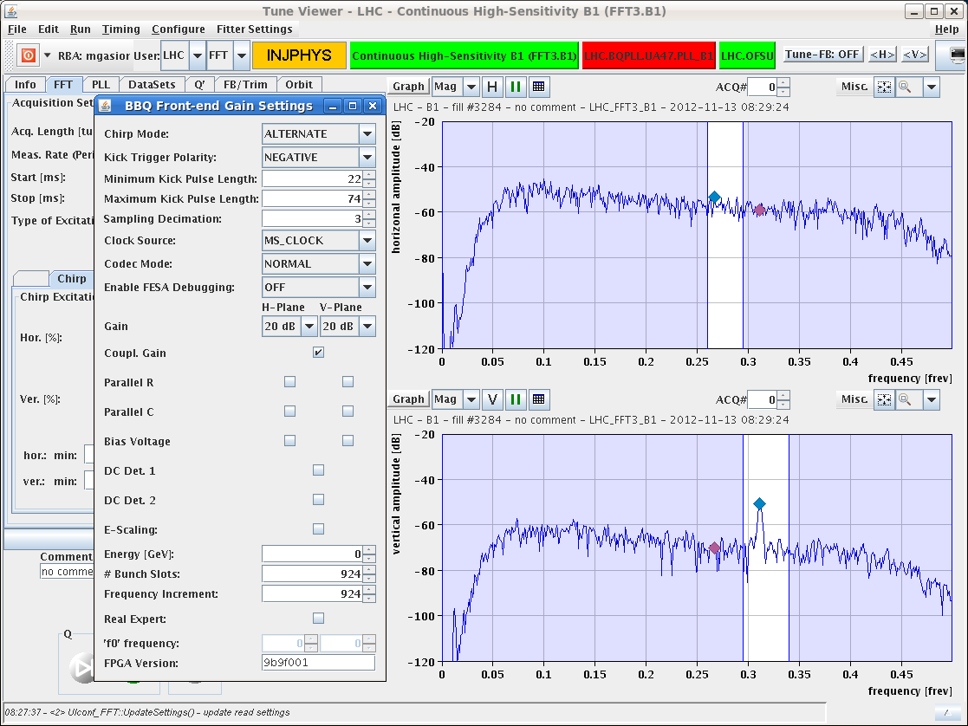
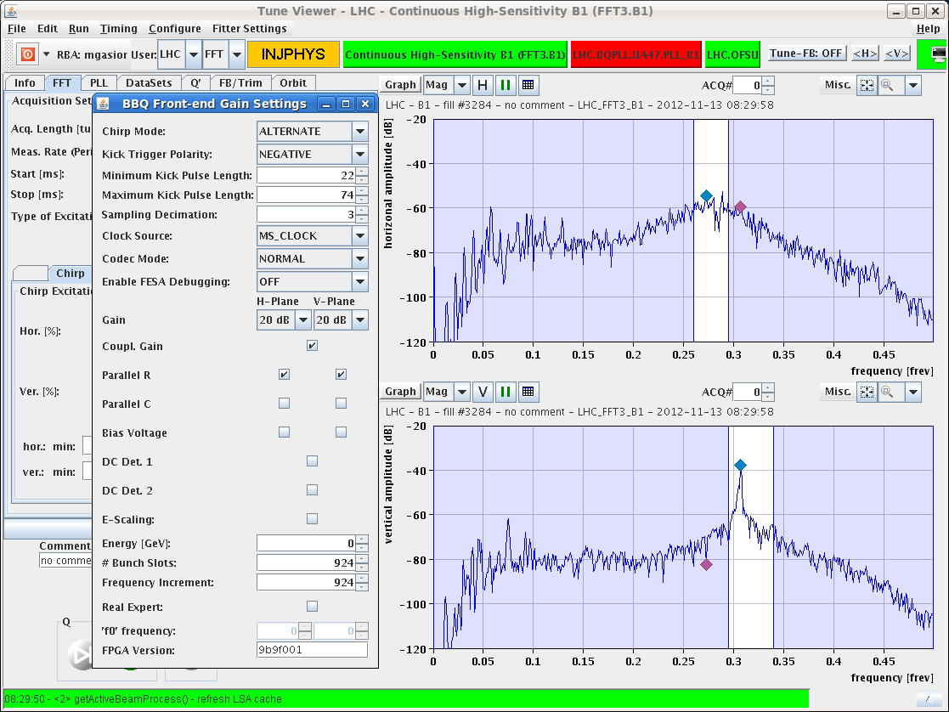
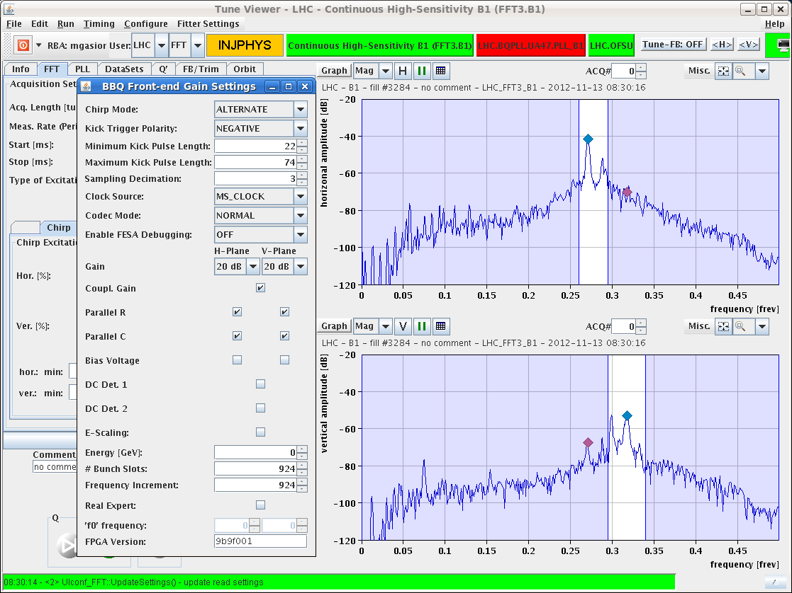
Optimization BBQ-high sensitivity
Not yet ideal for all possible bunch configurations from nominal to full machine but good settings for ramp found. Ramp without chirp.
M. Gasior, R. Steinhagen

Slide 3
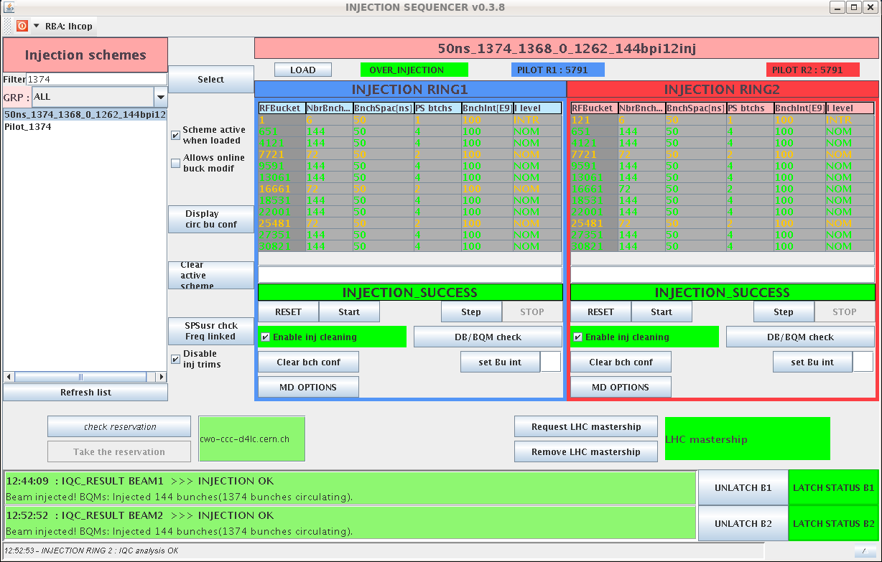
Injection
For the time being running with satellite enhancement OFF in the PS and no controlled longitudinal blow-up at injection
Very clean injections

Slide 4
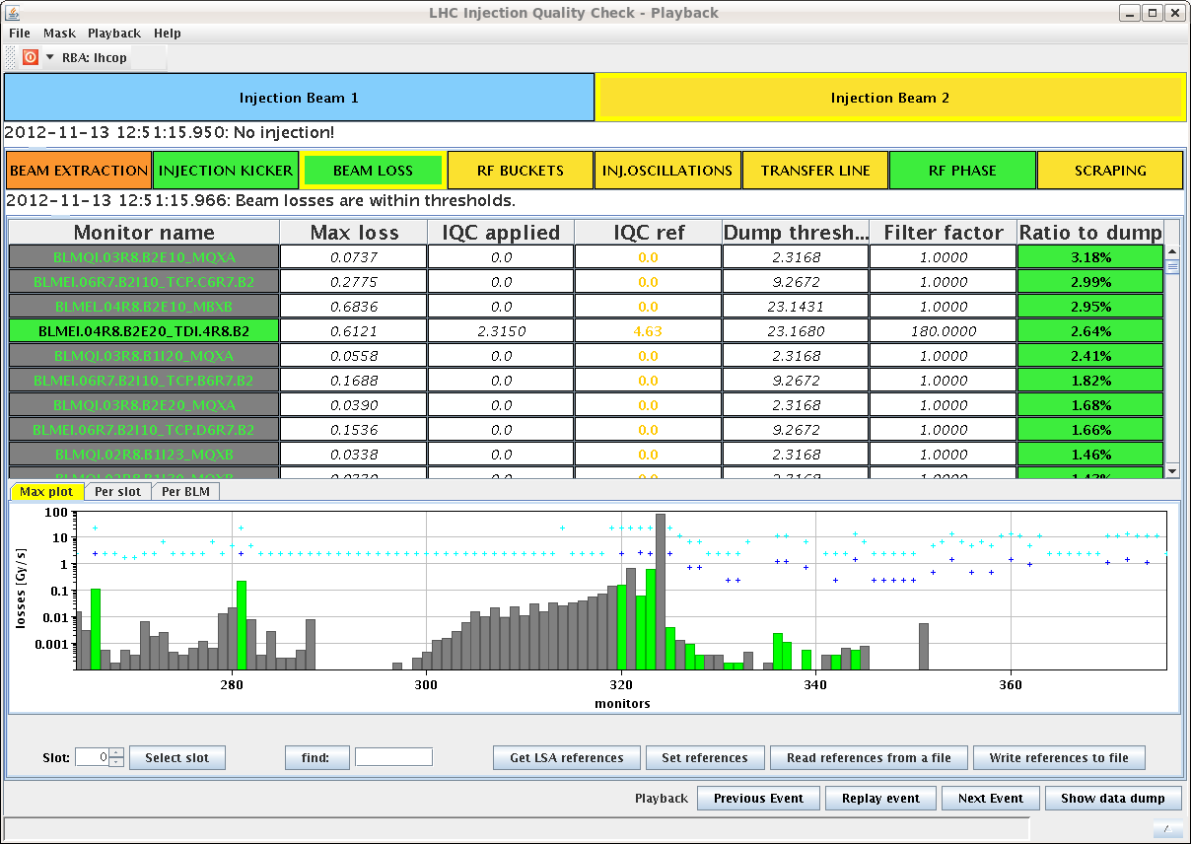
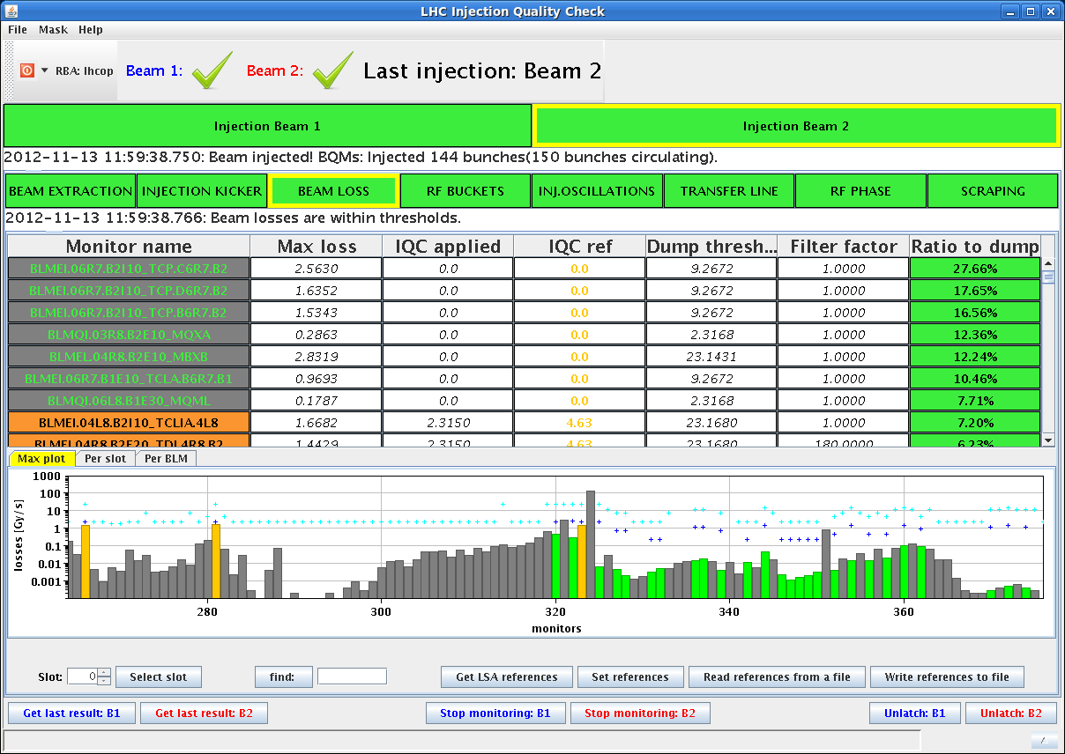
Injection
No beam injected but MKI firing
Beam injected
This indicates that the observed losses on Monday are likely due to the injected beam (satellites) and not to uncaptured beam kicked out at the moment of injection ➔ Next step switch-on longitudinal blow-up to 1.4 ns to confirm that

Slide 5
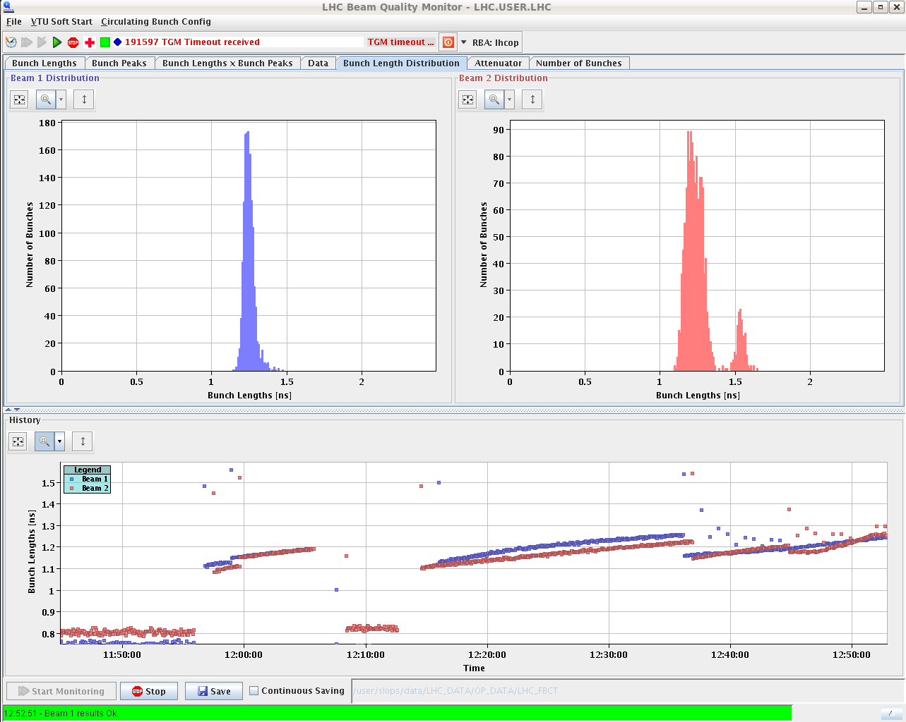
Longitudinal blow-up
Still unwanted longitudinal blow-up on B2 even after reset of (we thought) all parameters. But due to a bug this was not the case.
Another version of the longitudinal blow-up deployed for the last ramp with initialization of gain parameters at every new injection ➔ Fixed

Slide 6
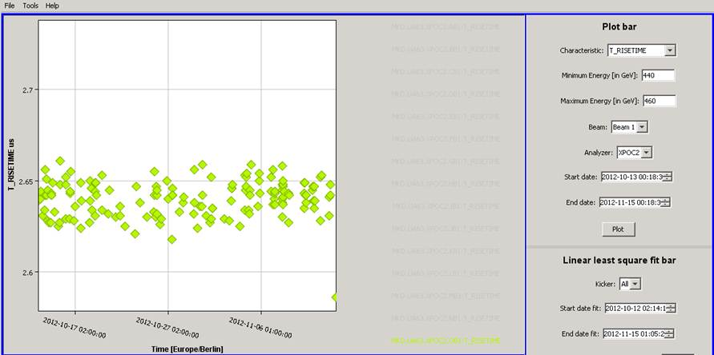
Too short rise-time observed on dump at injection (programmed dump of circulating pilot after machine parameter verification). Following verification dumps requested by Jan did not show any problem. Will be followed up today

Slide 7
Fill #3286
Last ramp with increased gain of damper during the whole ramp (factor 2) and no chirp. Well behaved.
Some losses at the end of the squeeze (instability still there)
Stable beams #3286
ALICE up to 6.5x10³⁰ cm⁻²s⁻¹ with natural satellites

Slide 8
Plan
Physics:
Parameters being scanned (one at a time):
Longitudinal blow-up at injection (next fill 1.4 ns)
Damper gain during the ramp to try and minimize blow-up now that gated BBQ is operational
Tune split during the squeeze to get rid of instability at the end of the squeeze
Pending access:
PM32 : CV to check / remove sand.
Access system

Slide 9
Tue 13/11
BBQ "high sensitivity" systems are now optimised for pilots and to operate correctly with high intensity nominal bunches the frond-end settings have to be changed. In the attached plots are shown spectra for 6 nominal bunches for B1 and three values of the diode detector time constants. The first plot shows the spectra for the "standard pilot settings", that is with the largest time constant. For nominal bunches in those conditions the bunch intensity variations may cause the detectors to trigger on different bunches, resulting in the noisy spectra. When the time constant is reduced (second plot), the steady-state peak detector voltage is lower, making the detectors to trigger also on less intense bunches, resulting in cleaner beam spectra. Reducing the time constant further (third plot) lowers again the steady-state detector voltage, causing the system to detect bunches with yet lower intensity. This setting may be optimal when operating with the full machine but is not optimal for pilot beams. An optimisation of the operation of the "high sensitivity" systems in different beam conditions requires software changes. Marek and Ralph

