Slide 1
Last 24 hours
TOTEM operator dump
LHC operator dump

Slide 2
Wednesday 14th November
03:30 Stable beams fill 3286, initial lumi's up7.5 e33 cm-2s-1. ALICE at 6.6e30 cm-2s-1
13:52 Beam dump when moving TOTEM Roman Pot in to 30 mm setting. 162 pb-1 in 10h20m.
14:45 No beam fron LINAC2.
16:13 Problem with PS water cooling.
17:07 Injectors back. Optimising beams in injectors. Steering.
19:31 Stable beams fill 3287, initial lumi's around 6.4e33 cm-2s-1. ALICE 5.6e30 cm-2s-1
04:32 Operator dump. 137 pb-1 in 9h01m
Dump early because of SPS stop this morning
No transfer line steering. Profit from reduced PS extraction kicker pulse length
06:57 Stable Beams fill 3288. Initial lumi 6.6e33 cm-2s-1.

Slide 3
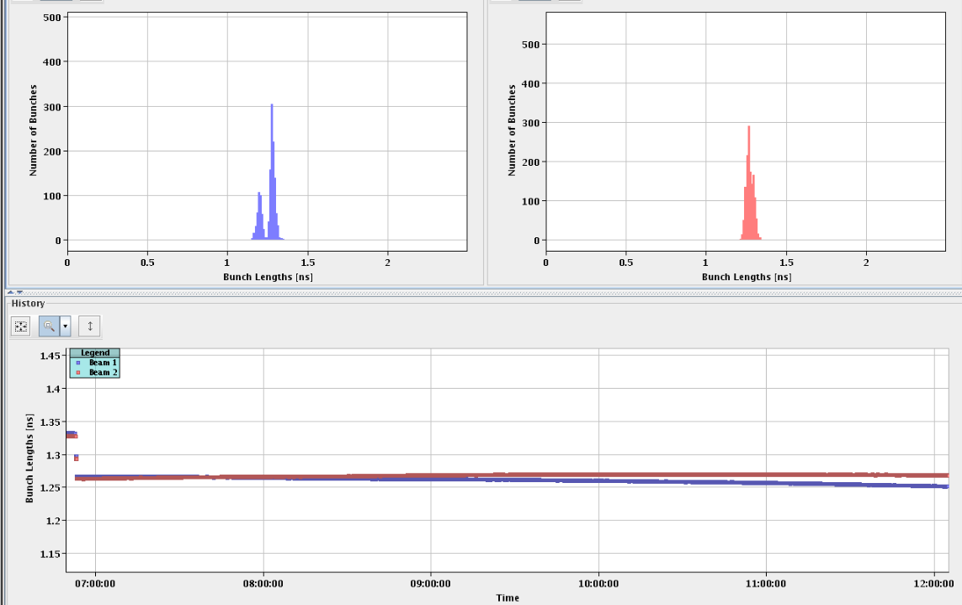
Fill 3286
Bunch lengths behaving differently B1 and B2
B1 bunches getting shorter over the batch

Slide 4
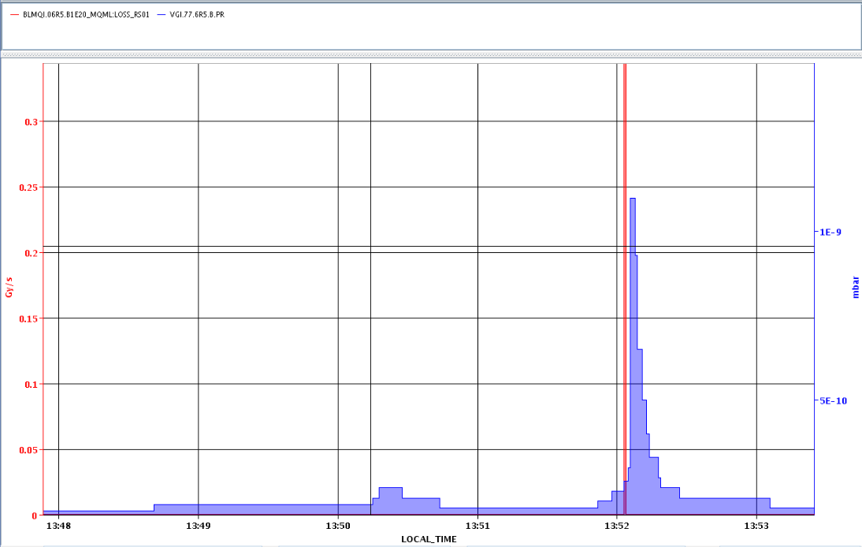
Dump by TOTEM Roman Pots
End of fill test
First moved out the TCLs
Beam losses on BLM at 6R5 when moving TOTEM horizontal RP from 35mm to 30mm (just out of garage) resulting in beam dump
Beams not yet separated
Vacuum spike some seconds after the beam loss spike

Slide 5
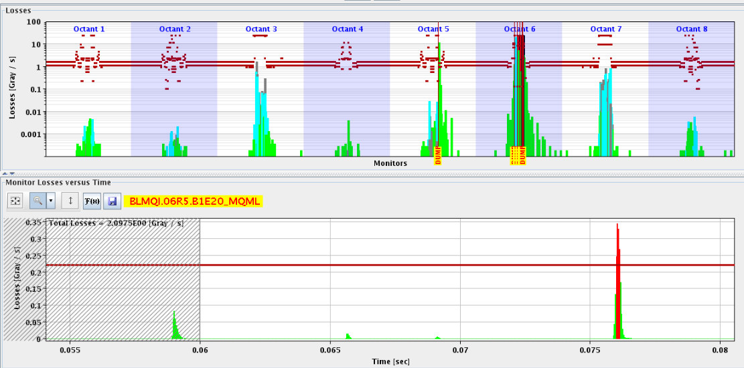
Losses at moment of dump

Slide 6
Fill 3287
Different
Tune split during the squeeze taken out
Batch-by-batch blow-up on again with target value of 1.4 ns
Injection relatively clean, but bit worse than prev. fill
B1V instability during squeeze
Average bunch current at injection a bit lower:
1.64e11 compared to 1.69e11 on previous fill
This explains a reduction in luminosity of 5.5 %, so under same conditions 0.944 * 7.5e33 = 7.08e33
Initial luminosity unexpectedly low: 6.4e33 cm-2s-1
ALICE 5.6e30 cm-2s-1

Slide 7
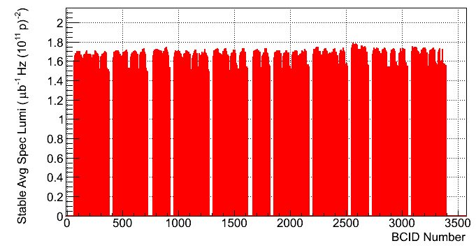
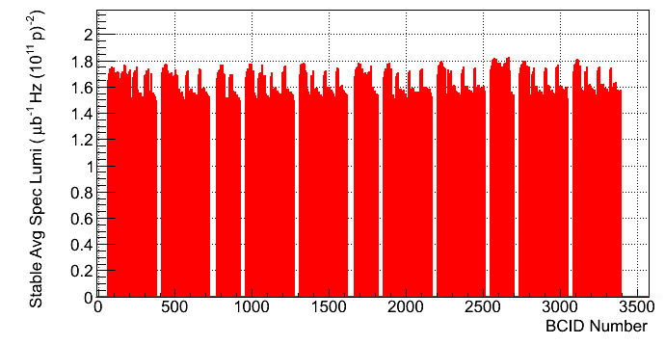
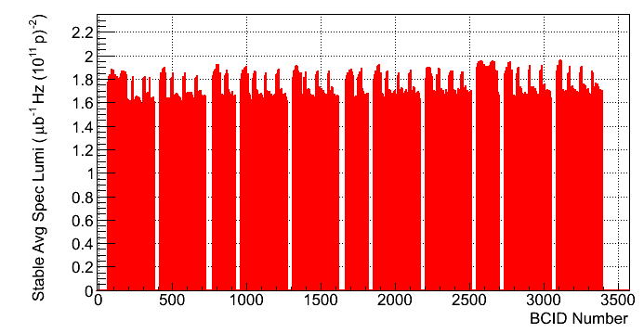
Specific Lumi (from ATLAS)
Fill 3286
No bbb blow-up
Fill 3287
With bbb
Fill 3288
With bbb

Slide 8
Fill 3288
Tune split back
Bbb blow-up still on
No transfer line steering. Oscillation and losses ok. 2h25m turn around.
06:57 Stable Beams fill 3288. Initial lumi 6.6e33 cm-2s-1
Same bunch current, slightly higher initial lumi, but lower than the 7.5e33 cm-2s-1 seen two fills before
Alice at 5e30 cm-2s-1
For coming fill reduce the batch-by-batch blow-up to 1.1 ns, basically making it none effective and check on the effect.

Slide 9
Not as it should be…
Wire Scanners, early evening
B1H1 & B2H2 have both broken wires. The breakage happened after both scanners did not come back to the home position.
It is not clear whether the 144 bunches had already been injected.
All WS have been disabled until the causes of the breakage are analyzed tomorrow morning. Ana
LHCb, early evening
Richard just called informing us that the emergency stop has been accidentally pushed in the LHCb control room. We turned the leveling OFF until they regain control of the detector.
Back 02:43

Slide 10
Outstanding
Physics
Batch-by-batch blow-up
Off on the next fill, so see if we can recover peak lumi.
Satellite enhancement in PS
Switch back on again towards the weekend if necessary. ALICE lumi does not seem to be that much lower at the moment
Switch back off again when injection problems reoccur
Swap position first 6 non colliding bunches on request of ATLAS?
To be confirmed
Need to change BBQ settings and AGC and Big Sister thresholds
Tests of injection gap and abort gap cleaning
Pending access:
PM32 : CV to check / remove sand.
Access system
BI, IP4 RF zone for wall current monitor

