Slide 1
Thursday 8.11. – Morning
Energy matching at injection with H CODs
Afterwards transfer line steering by injection team
In parallel:
Moderate ADT gain increase for the ramp (horizontal plane from 0.02 to 0.04)
Batch-by-batch blow-up ON again with moderate 1.4ns target length
12:00 Filling for physics
Emittances of 144 bunches
B1H = 1.72
B2H = 1.67 B2V = 1.91
13:30 Stable Beams fill 3272, initial L ~7.3e33 cm-2s-1
CMS not publishing lumi data at the beginning
14:00 TCLs opened to 60 sigma, to measure the cryo load

Slide 2
Afternoon
16:25 increase RF voltage to 12 MV (reduce bunch length)
17:00 Beam dump, COD trip. Integrated L ~69 pb-1 in 3:23 hours
Access for ALICE and for ROD/F in sector 56 (which had tripped earlier at 15:00)
In parallel to the access
LHCb polarity inverted for next fill
Increasing BLM MF from 0.3 to 1.0 for TOTEM roman pots – BLMEI.06L5.B2E10_XRP and BLMEI.06R5.B1E10_XRP
19:30 intervention for octupoles finished
22:12 ALICE intervention finished
Pre-cycle
No test ramp – straight to nominal physics

Slide 3
NIght
Emittances, 144b, at injection:
B1H = 1.72 B1V = 1.63
B2H = 1.93 B2V = 1.92
2:38 colliding in IP1, IP2 and IP5 (CMS not publishing lumi values)
2:47 IP8 set-up finished; stable beams fill 3273
Initial luminosity ~6.9e33 cm-2s-1
5:49 RF voltage to 12MV

Slide 4
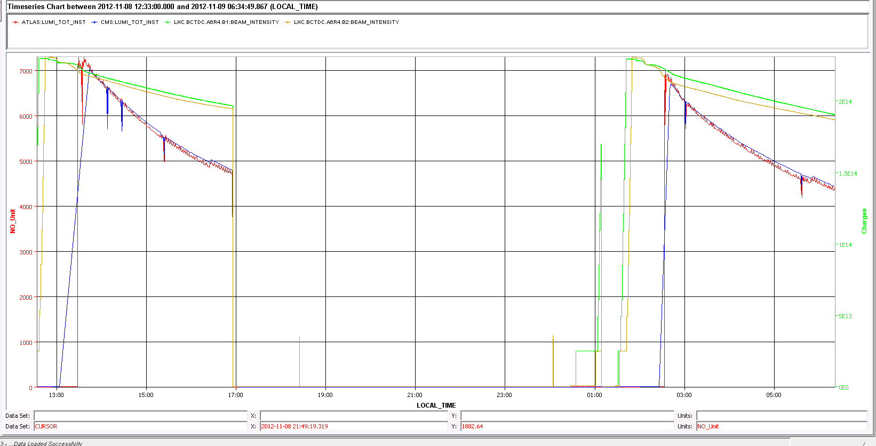
Last two fills

Slide 5
Access
RF (Pierre Measen) UX45 during turn-around (IMPACT 21809)
QPS for RB.67 (2 hours working hours)
Wall Current Monitor (Pt 4 RF zone – RP piquet) R. Steinhagen

Slide 6
Pending
4 BPMs left of IP5 around TOTEM needed to be masked last night – to be looked at further
Further increase ADT gain B1 during ramp (now that the tune is measured on the first 6 bunches, which are not damped by ADT) to reduce blow-up
TOTEM tests at end of fill (separate CMS to reduce lumi by at least a factor of 10) - ~1 hour
Slight tuning of tune splitting B1 (Vertical tune B1 trimmed down by 0.003)
Following week(s):
Loss maps (periodic)
Heating test at 450 GeV
TCP IR3 more closed (end of fill)
Bunch length investigations
Tuning of the mask for abort gap/injection cleaning to try to reduce influence on the rest of the beam

