Slide 1
Wednesday 3rd October - morning
12:15 Fill 3126 dumped by RQF.A45 QPS trigger
113 pb⁻¹ in 6h22m
Ramp down & the access:
cryogenics in triplet R2
BI in point 4 (BSRT/BSRA)
exchange of RQTD.A45 power converter in point 4
vacuum interlock reset in point 4
BI (BRAN in point 8)
BI (BLM diamonds) in point 8
ATLAS
TOTEM and QPS in point 5
Ventilation door S23 – thanks RP
QPS into S81 for a local power cycle on controller of RB.A81.

Slide 2
BSRT B2 intervention summary
re-checked full alignment with calibration laser. Laser spot found at camera centre exactly with last steering values used for beam --> no evidence of optical line misalignment after TS#3
steering mirror (first mirror after viewport, only optical line mirror not used for imaging calibration target) replaced with new mirror even though there was no evidence of scratches or dust on the mirror.
All this would exclude any possible cause for the image distortion apart from the BSRTM mirror (in vacuum) or some mechanical misalignment of the BSRTM itself. TBC when beam is back.
Federico Roncarolo and team

Slide 3
And…
AGM B1 intervention summary
found (and corrected) wrong cabling of the attenuation filter wheel.
This would explain the unexpected factor 200 less in light intensity at AGM PM after TS#3. TBC when beam is back.
BQBBQLHC
Deployed new version of FESA process which fixes a bug in new bunch gating functionality added during TS.
Stephen Jackson, Marek Gasior & Ralph Steinhagen

Slide 4
Wednesday 3rd October - evening
17:25 Access finished – start pre-cycle
19:00 probes in
B2 injection steering bad; steering required in TI8
problems with the vertical QFB on B2; although chirping at 3% the Q-stability doesn't improve and therefore the QFB keeps switching off...Ralph adjusted the chirp windows for B2
Injecting1.6e11 ppb
21:30 Start ramp
22:35 Stable beams fill 3128
Initial luminosity: 6.42e33 cm⁻²s⁻¹
A. Boccardi verified the signal of the BSRA on B1 at FT and confirmed that the acquisition works well.
initiated a gently cleaning after declaring SB and could get the level below 1e10.

Slide 5
Wednesday to Thursday
22:51 Beams dumped by:
RCBH29.R6B2 tripped on communication fault
Caught by software trigger was on "out of tol BPM“
PC taken out of operation
01:40 Injecting probes
03:50 Stable beams fill 3129
Injected 1.63e11 ppb
Initial luminosity: 6.72e33cm⁻²s⁻¹
83 pb⁻¹ delivered
Beams dumped at 08:25 – cryo: lost communication with main refrigerator point 4
Lost cold compressors – first estimate 10-12 hours to recover

Slide 6
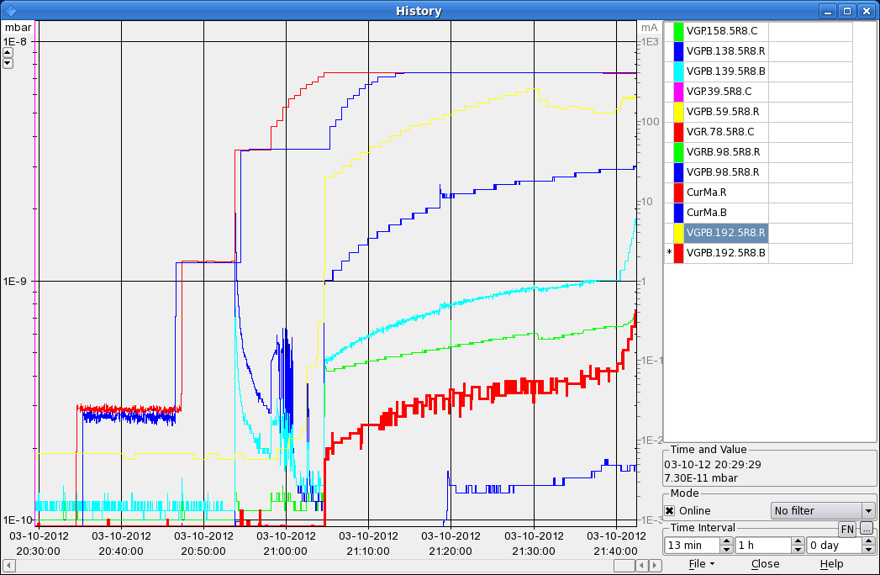
Vacuum at injection

Slide 7
Miscellaneous
Scrubbing run postponed until before MD4 following discussion in LMC yesterday afternoon
V2.5 of LHC schedule on the web
New MD schedule available (FZ/GP) – start MD 08:00 Monday, dump beams at 06:00
EOF:
Bunch length variation
OD
Batch by batch blow-up
TOTEM in during Stable beams
Follow-up
Défaut PLC vide QRL en UJ76: PLCS_UJ76_1 replaced

