Slide 1
Tuesday 11th September
Vacuum intervention Point 4 following leak wire scanner beam1
Bake-out of pumping group during the day
Removal of wire scanner early evening
Pumping over-night, opening of valves early morning
VIP visit IP2
Test of different beam modes and state machines for experiments
Access:
ATLAS, LHCb
RD1.LR5 for quench MD preparation
Removal of bake-out jackets two MKI tanks IP2
LBDS pulsing in local
BI for head-tail monitor
RF investigations of SPS re-phasing FESA class problems with (p, Pb)
TI8 extraction tests for MKE stability tests with INDIV beam
LHCb dipole presently fault off

Slide 2
Wire Scanner – Bernd Dehning & BI team
the scanner is dismounted and a closing flange is mounted
the wire has been recuperated for analysis
the resistivity of all b1 scanners have been measured before and after the opening of the vacuum, integrity check
the number of the scans of all LHC scanners see below
the broken scanner has had 10000
we are intending to switch all scanners tomorrow morning to the spare scanner, which are less often used
the scanner mechanics is in the radioactive equipment storage to be released by RP
LHC.BWS.5L4.B2H1:NB_PTS_SCAN_IN----3768 LHC.BWS.5L4.B2H2:NB_PTS_SCAN_IN----8124 LHC.BWS.5L4.B2V1:NB_PTS_SCAN_IN----3541 LHC.BWS.5L4.B2V2:NB_PTS_SCAN_IN----6690 LHC.BWS.5R4.B1H1:NB_PTS_SCAN_IN-----781 LHC.BWS.5R4.B1H2:NB_PTS_SCAN_IN---10247 LHC.BWS.5R4.B1V1:NB_PTS_SCAN_IN-----651 LHC.BWS.5R4.B1V2:NB_PTS_SCAN_IN----9468

Slide 3
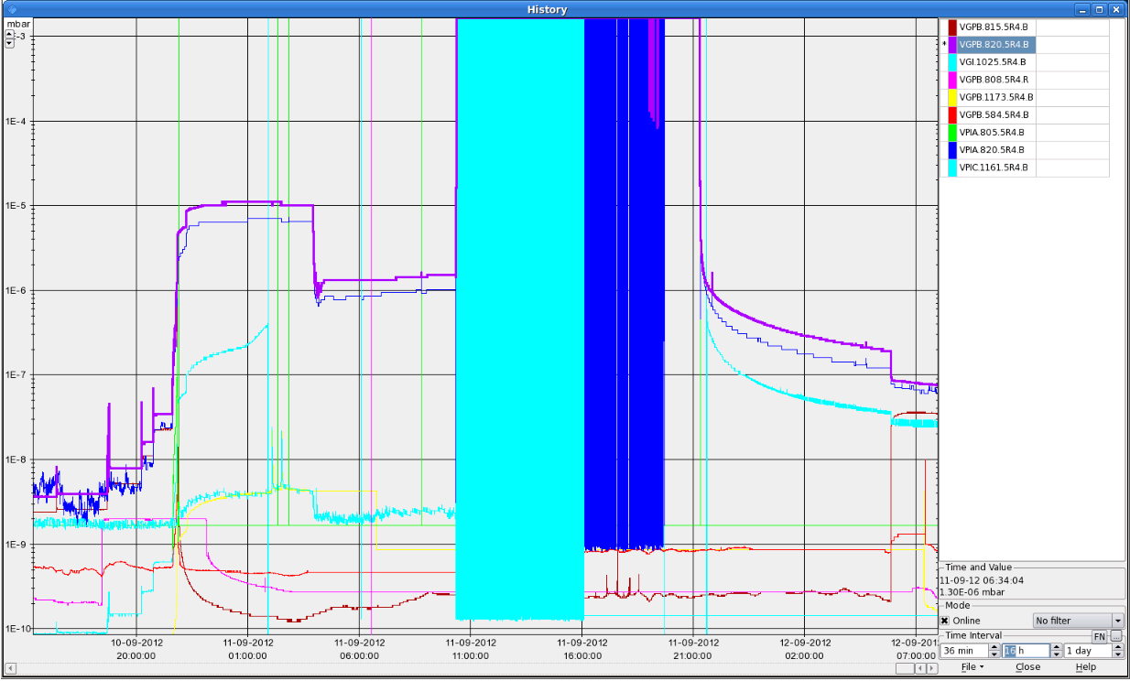
Vacuum status

Slide 4
The Plan
Wednesday, today
08:30 Vac back in to Point 4 for final checks and equipment removal. Expect to be back in business towards the end of the morning
When vac is out, RF tests with higher HV on the klystrons for about 1 h (parallel to pre-cycle)
pPb pilot run – 13 bunches each beam (max 24 h)
Thursday
1000 m beta*, few bunches (max 24 h)
Friday
AM: pPb MD with 318 p+ bunches w. 4 Pb bunches (1 shift)
Test ramp, reversed LHCb polarity and split collision beam process
SPS switched over to Q20 optics
Physics

