Slide 1
Friday 7th September - morning
11:28 Lost fill 3036
PC fault on IT R5. The BLM trigger came once more before the PIC, the orbit oscillation on B2 exceeded 0.1 mm peak (see presentation by Markus Zerlauth)
102 pb-1 in 5h 34m
The reset of the RQX5.R5 took longer than normal due to the reset of the converter, a problem with the communication between the UPS and the PIC for point 5, and a problem on the RQX5.R5 QPS board B that required a reset.
The QPS reset could not be done remotely, and so a short access was needed.
15:00 Start pre-cycle

Slide 2
Friday 7th September - morning
16:30 three INDIVs in for separated collision beam processes commissioning
Ramp, squeeze, collide, collide… (see over)
19:15 Beams dumped
Access for LHCb
21:40 probes in
Daniel loaded new settings for the ADT beam position modules for 1.7e11 ppb.
They will saturate at around 2e11 ppb.
He checked all front-ends and signal processing and all is ok.
23:50 Stable beams – fill 3039
Initial luminosity: 7.44e33 cm-2s-1
Total intensity 2.22e14, ~1.62e11 ppb

Slide 3
Saturday 8th September – early morning
00:39 Lost 3039
lost communication with RCS.A67B1 switch controller
19.2 pb⁻¹ in 48 minutes
Access required for QPS piquet
(Stephen Pemberton again)
02:45 start pre-cycle
Injection steering
04:45 “TI and fireman inform us on a fire detection alarm in UW25. Fireman managed to reset the fault on site, so for the time being we postponed the access, In case it comes back, we will have to dump and give access”
04:55 Flat-top – nice beams

Slide 4
Saturday 8th September – early morning
05:09 RQF and RQD S23 trip
05:13:18 - Result for device RPHE.UA27.RQD.A23 : SUB1 :WATER FLOW :FAULT :UT:LT, SUB2 :WATER FLOW :FAULT :UT:LT, SUB3 :WATER FLOW :FAULT :UT:LT, SUB4 :WATER FLOW :FAULT :UT:LT, SUB5 :WATER FLOW :FAULT :UT:LT, VS :EXTERNAL FAST ABORT :FAULT :UT: , VS :EXTERNAL DC CABLE WATER FLOW :FAULT :UT:LT, VS :FREE WHEEL DIODE WATER FLOW :FAULT :UT:

Slide 5
Saturday 8th September – morning…
Intervention by CV piquet for demineralised water pump in pt2 ...
Motor for the demineralised water pump C211A ( pump for all of sector 23 and 34) needs to be changed. Experts working and transport being arranged ... the motor is a 1.5 ton object
replacement motor identified
transport arranged, and replacement pump expected to be in place at pt 2 and ready to be connected by ~10:45 am
tools for alignment of motor with pump still being prepared
No time estimate yet for connection and validation of motor

Slide 6
Summary of the test with 2 collision BP:
Technically everything worked well, with 2 minor exceptions:
In the first BP the beams were brought into collision in IR1, 2 and 5, while IR8 remained at end of squeeze settings. This was obtained using the standard physics settings, but with the LHCb bumps (crossing and sep) restored to end of squeeze value.
During that BP rather large transients were observed (--> FF for next time). At the end of BP, there were global and local orbit perturbations from IR8 (as expected). Those perturbations were corrected (and incorporated) and the lumi scans performed (there was non-zero lumi to start with).
The second BP was very smooth. Orbit perturbations appeared again (sources as expected in IR8), but were rather gentle, the luminosities in IR1,2 and 5 were barely affected. This should improve further after FF. At the end of the BP, lumi scans were repeated in IR1, 2, and 5: almost no changes. IR8 lumi scan settings had been zeroed, and were re-established. For the moment IR8 is set to full head-on in the functions. The offsets will be introduced during the intensity ramp up.
Next step:
Offline FF.
Then repeat with 3 bunches (easier for interlocks). Another FF iteration.
Then switch to 84 bunches. FF iteration if needed.
Intensity ramp up.
Jorg, Laurette, Giulia, Markus

Slide 7
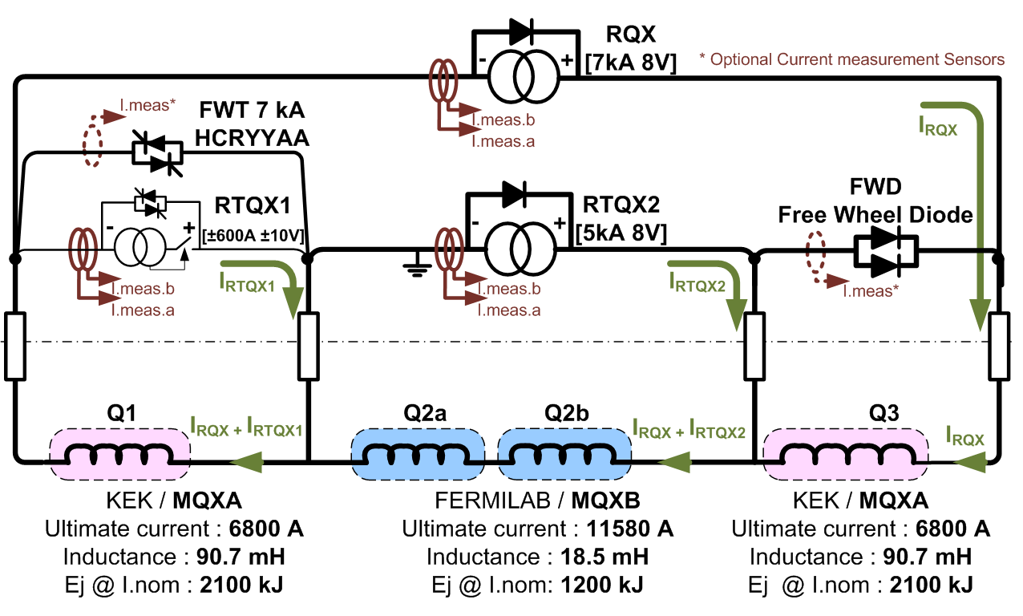
Inner triplet…

