Slide 1
Thu 30/8
08:30 Access for vacuum in IP4 to get vacuum equipment out.
09:00 Compensator point 2 (V. Montabonnet)
Reason of the trip of the Static VAr Compensator in Point 2 not found. Investigations to continue.
TCR (Thyristor controlled reactor) not restarted , which is still off today, without any explanation of the trip. Our fear is to lose again the cryogenics in Pt 2.
Propose to wait for the TS3 for the restart of the TCR.
As compensatory measures, the converters of TI2 shall not continue to pulse when the LHC is full to avoid variations on the network. The converters can be kept in standby without stopping them in 'off' state. Restarting the converters from 'off' state can lead to additional faults.

Slide 2
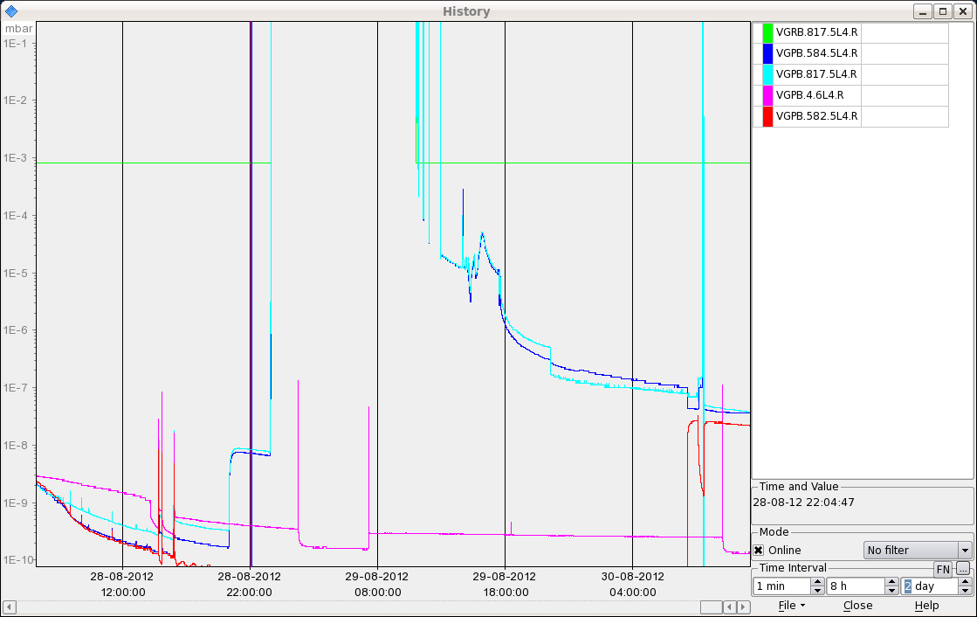
BSRT Vacuum (G. Bregliozzi)
11:00 Intervention in vacuum sector D5L4.R finished.
The pressure is in the range of 4E-8 mbar and an equivalent pressure increase is recorded also in the adjacent vacuum sectors E5L4.R and C5L4.R (D3) when we had open the sector valves.
All the interlock levels of the sector valves are increased up to 6E-6 mbar.

Slide 3
Thu 30/8
12:14 Problems to restart RF module M2B1. Piquet called. Access required.
13:40 Start injection fill 3014 - pilot ramp for LHCb polarity check (2x6 on 2x6 bunches)
16:30 Setting-up completed- OP dump
17:25 Filling #3015. Problem with TI2 power converter. OK
18:49 TI2 Ok. Filling. OK for high intensity fill from vacuum and BI.
Rather high intensity from the injectors (creeped-up to 1.67x10¹¹ p/b after initial adjustment to ~ 1.6x10¹¹ p/b )

Slide 4
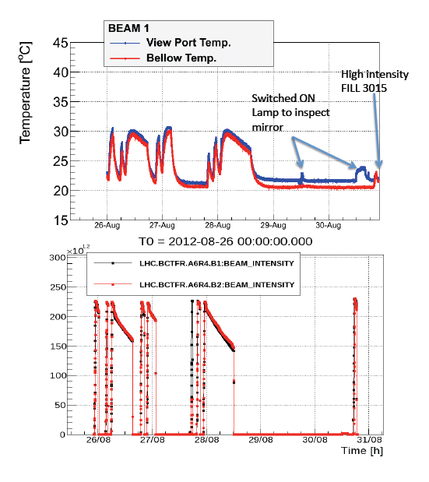
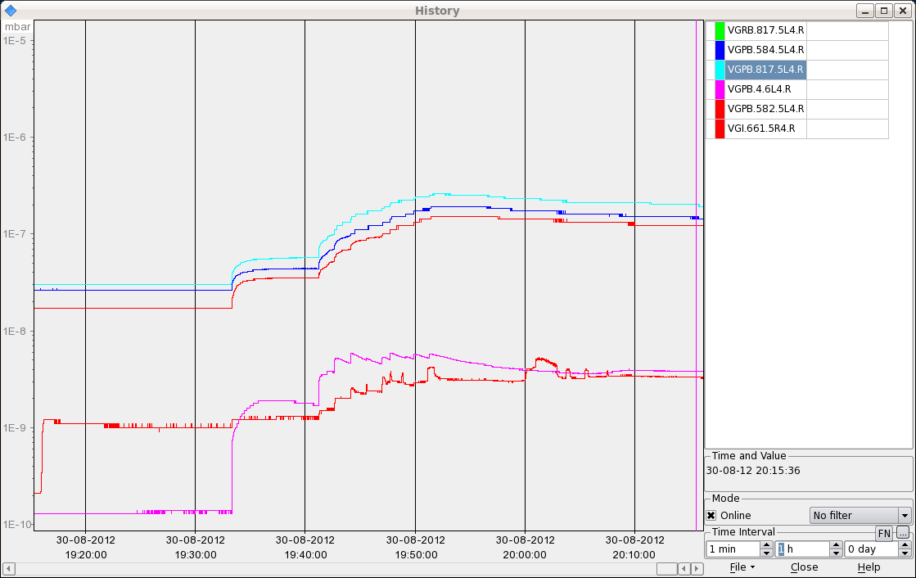
BSRT
BSRT B1 temperature.
Vacuum during injection ramp
F. Roncarolo

Slide 5
BSRT B1
Motor for BSRT B1 to be blocked this morning

Slide 6
Thu 30/8
20:39 Stable beams #3015. Initial luminosity ~6.9x10³³ cm⁻²s⁻¹.
20:39 Trip of RQTL7.L7B2 (likely SEU). Beam dump after ~10-20 s.

Slide 7
RF Monitoring for Abort Gap (P. Baudrenghien)
Monitoring of the detected RF voltage. If the difference between two consecutive readings is more than 1% amplitude or 2 degrees phase ➔ warning (Big Sister). The limit of this supervision is that it uses in-loop signals (that is the same demodulators as the operational LLRF).
Independent supervision of the cavity sum (vector sum 8 cavities per beam) phase noise. This measurement shares no part with the operational LLRF, except for the cavity antenna and cable. This signal is available as an RF fixed display. I talked to Fabio and we propose to continuously compare the measured spectrum to a reference and generate a Big Sister warning if it exceeds by say 6 dB. As the signal is rather noisy during filling (beam induced transients) and in the ramp (effect of long. blow-up) I propose to start monitoring only on flat top.

Slide 8
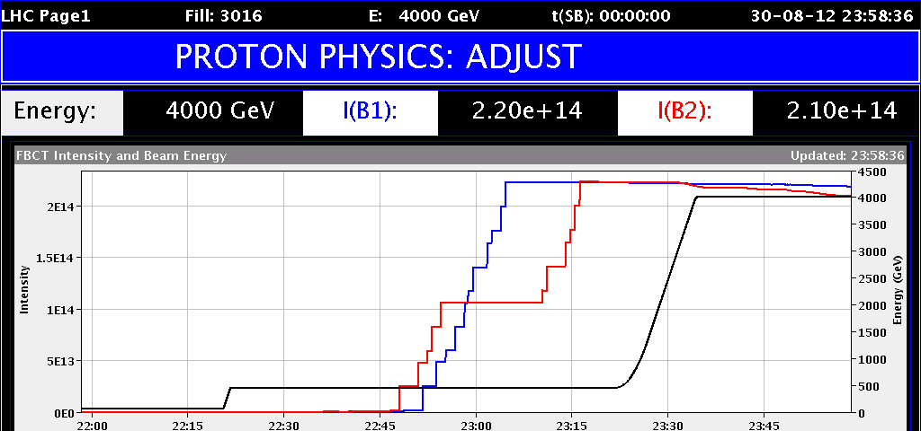
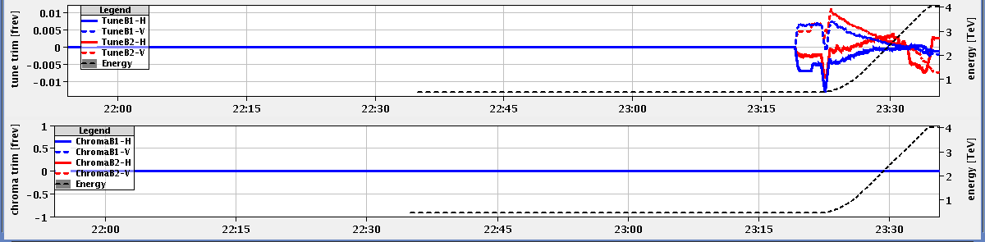
End of ramp - Squeeze (losses)

Slide 9
Fri 31/8
00:03 STABLE BEAMS #3916. Initial luminosity up to 6.7x10³³ cm⁻²s⁻¹
The abort gap cleaning strategy was first to keep cleaning on LOW and regularly (30min interval) increase the level to MEDIUM. We observed a reduction of lifetime when switching to medium along with very limited changes in the BLM levels.
We then changed the strategy by keeping the cleaning OFF most of the time and switching the cleaning at LOW level every 30 mins or so. The same effect was seen on lifetime when the cleaning was ON. Some of the BLM levels do increase when cleaning is OFF. When cleaning is turned ON the same BLM signals go down significantly but others do go up.

Slide 10
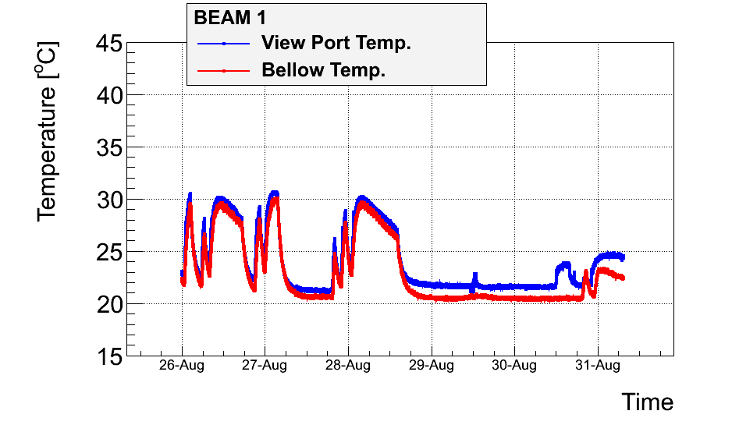
BSRT
Lamp ON
3015
3016
F. Roncarolo

