Slide 1
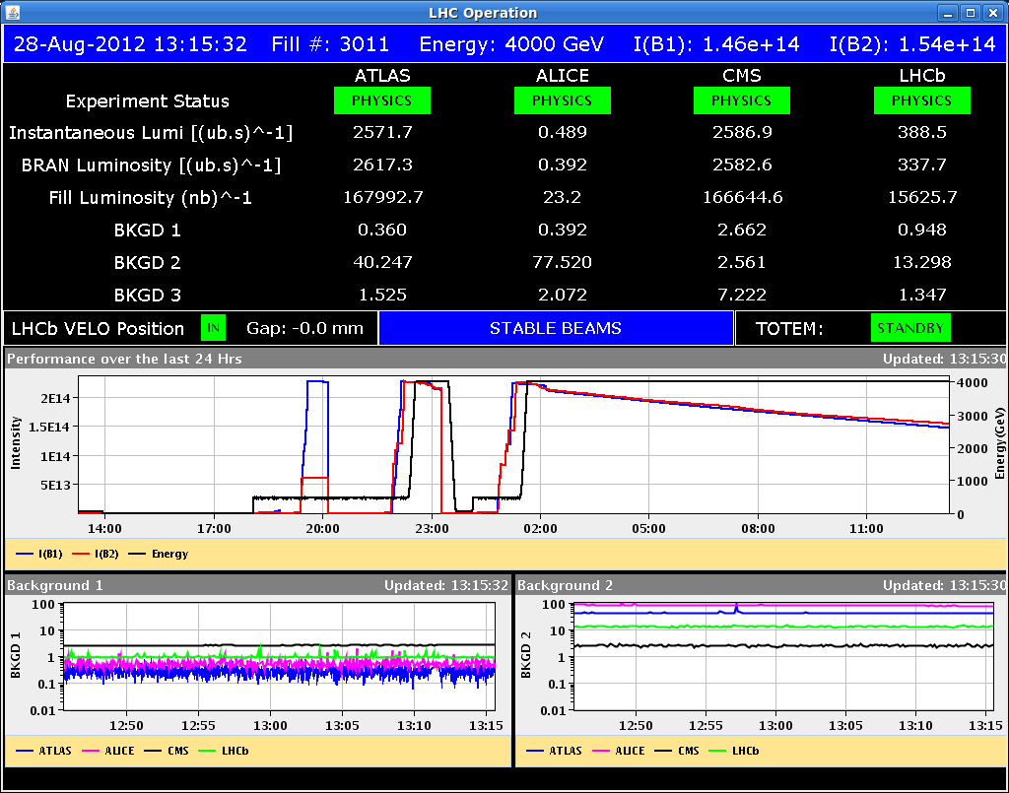
Tue 28/8
Morning: Physics fill #3011 since 02:09. Producing good luminosity.

Slide 2
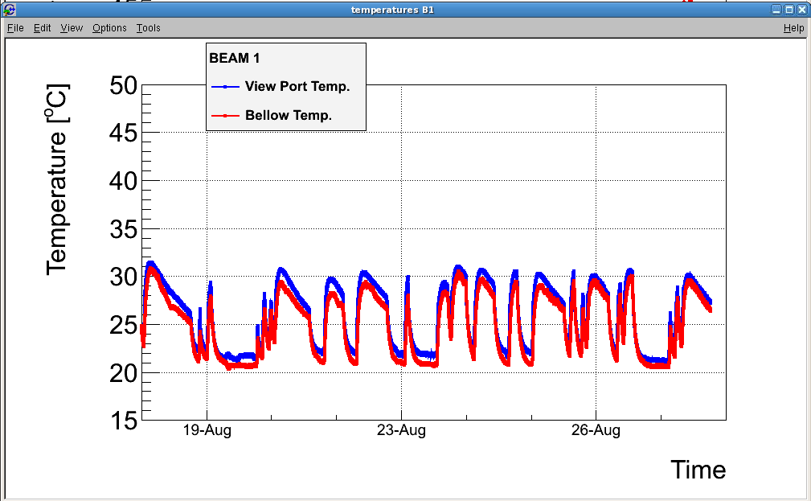
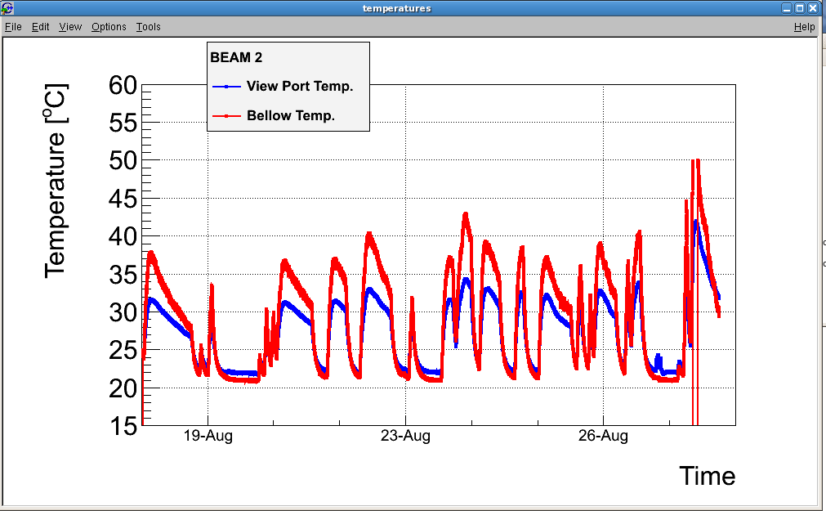
Tue 28/8
Lost BSRT image for Beam 2 during the night. BI expert investigating. Significant temperature increase observed during fills in the last 10 days due to beam induced heating (likely trapped modes). Increased even more in the last fill (>50 C)

Slide 3
BSRT
Observed movements of the mirrors for the synchrotron light monitors as a function of the temperature requiring automatic readjustments of the light collecting optical system
For B1 reproducible movements vs temperature. For B2 lost reproducibility in the last few days ➔ Possible symptom of permanent deformation of the mirror or the system holding the mirror
Potential risk: mirror movement on beam and/or falling on underlying glass window port ➔ loss of vacuum.

Slide 4
BSRT
Decided to retract mirror in parking position after beam dump foreseen for 14:00. In this position expected reduced heating from measurements conducted on MDs. Implications:
No continuous emittance measurements for B2
No abort gap monitoring ➔ agreement of rMPP to run if regular cleaning of the abort gap and monitoring of the losses at collimator
15:08 Mirror retracted after having closed vacuum valves in the area and after consultation with vacuum experts. Motors blocked to prevent insertion. Monitoring of the image of the BSRT screen by available observation camera.

Slide 5
BSRT

Slide 6
BSRT
!6:00 Detected movement of the screen without external action. Pilot beam was circulating in the machine (preparation for pilot ramp for LHCb polarity switch).
OP dump.
Vacuum expert contacted to close vacuum valves in the area

Slide 7
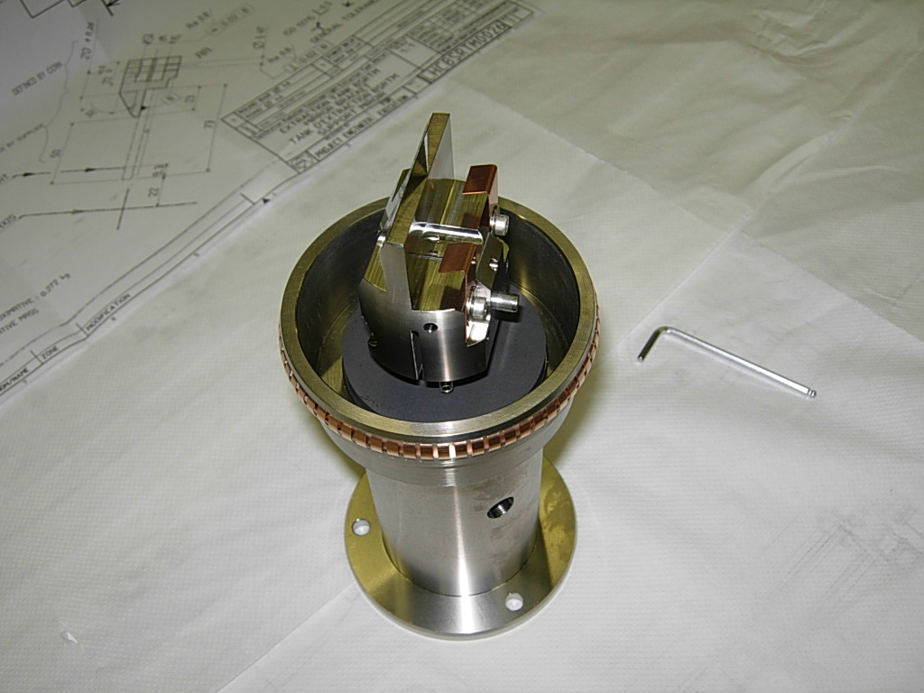
BSRT
Remote verification of the optical system outside vacuum to discard other causes of the observed movement. No other potential explanation found. Suspected damage to clamps
Even in parking position the possibility of mirror falling in the beam aperture and on glass view port cannot be excluded ➔ need intervention

Slide 8
BSRT
Remote verification of the optical system outside vacuum to discard other causes of the observed movement. No other potential explanation found
Even in parking position the possibility of mirror falling in the beam aperture and on glass view port cannot be excluded ➔ need intervention
19:00 Access for BI visual inspection and preparation of intervention for the extraction of the mirror and supporting device. 21:00 BI access finished
23:00-02:00 access of vacuum team for Ne injection in the area to minimize potential impact of glass view port failure and prepare for intervention

Slide 9
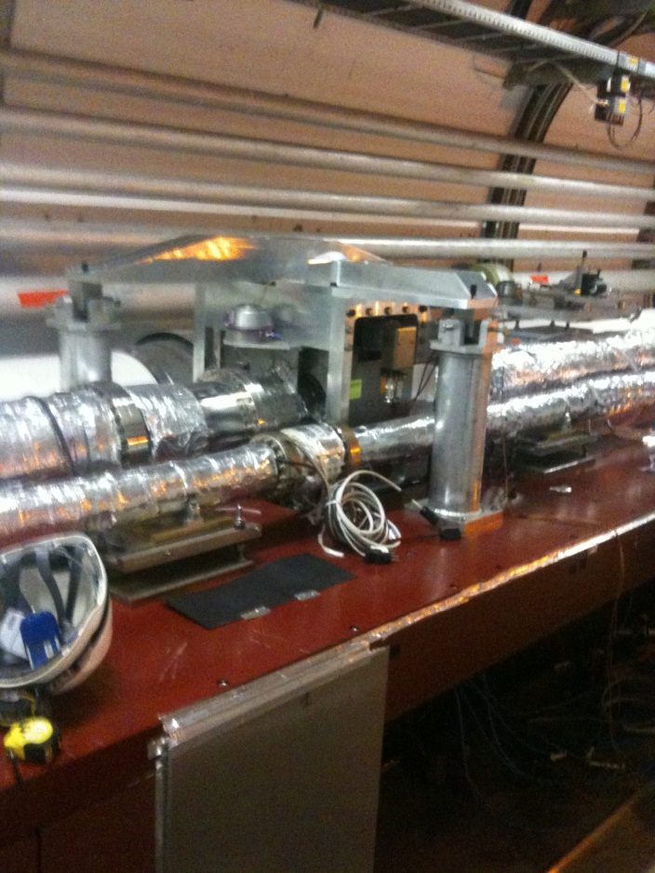
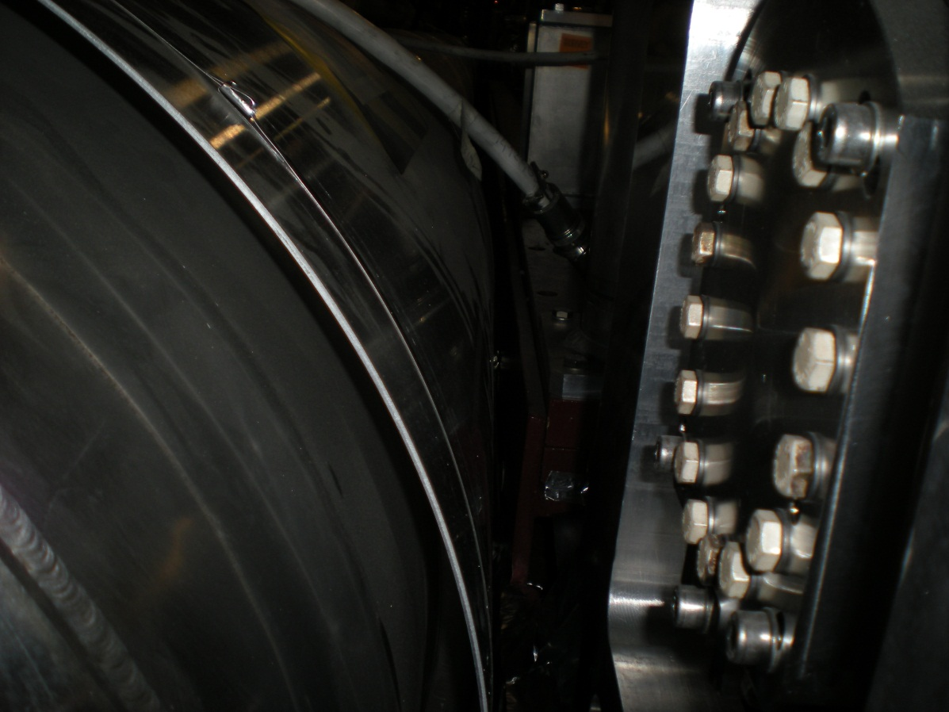
BSRT
Given the area of the intervention close to QRL and QRL bellow after discussion with cryo expert decided to plan the intervention for the morning with presence of safety coordinator and experts

Slide 10
Wed 29/08
04:00-07:00. Injected B1 (pilot) for MOD.A23.B1 polarity check (Rogelio Tomas). No polarity inversion detected. Probable human error in the previous measurement.
07:30 Access for:
BI, Vacuum, cryogenics, safety coordinator, RP
Intervention in the morning
Recovery time (1 day?) depending on the duration of the intervention. Window port might have to be replaced.
More detailed presentation at the LMC this afternoon (results of the intervention, implications for B2 and B1, abort gap cleaning).
Possibility of additional B1 studies during recovery being investigated

Slide 11
