Slide 1
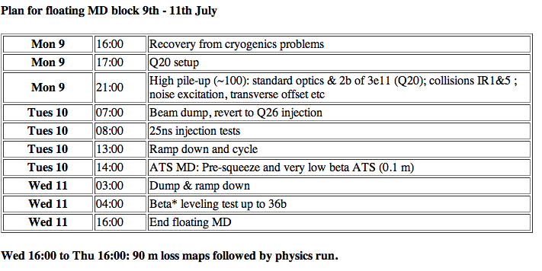
LHC Status Thu Morning 12-July
Bernhard Holzer, Jan Uythoven

Slide 2
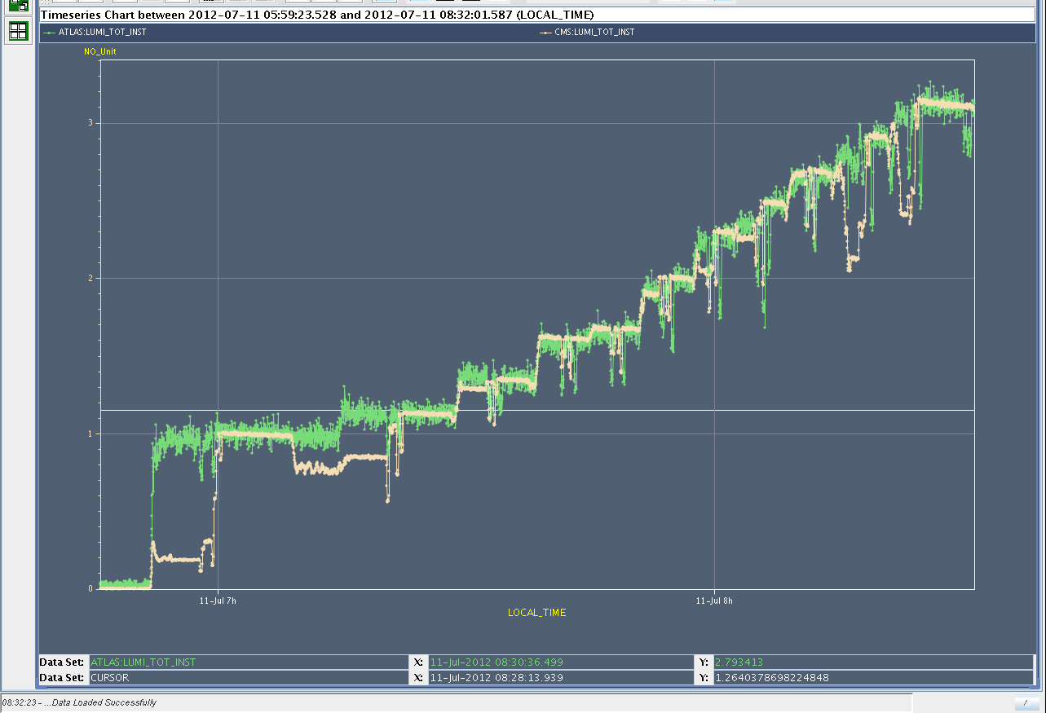
Wed Morning
06:30h beam for β* leveling studies
squeeze to 3m, then start levelling to 0.6m
luminosity
lifetime
bunch losses

Slide 3
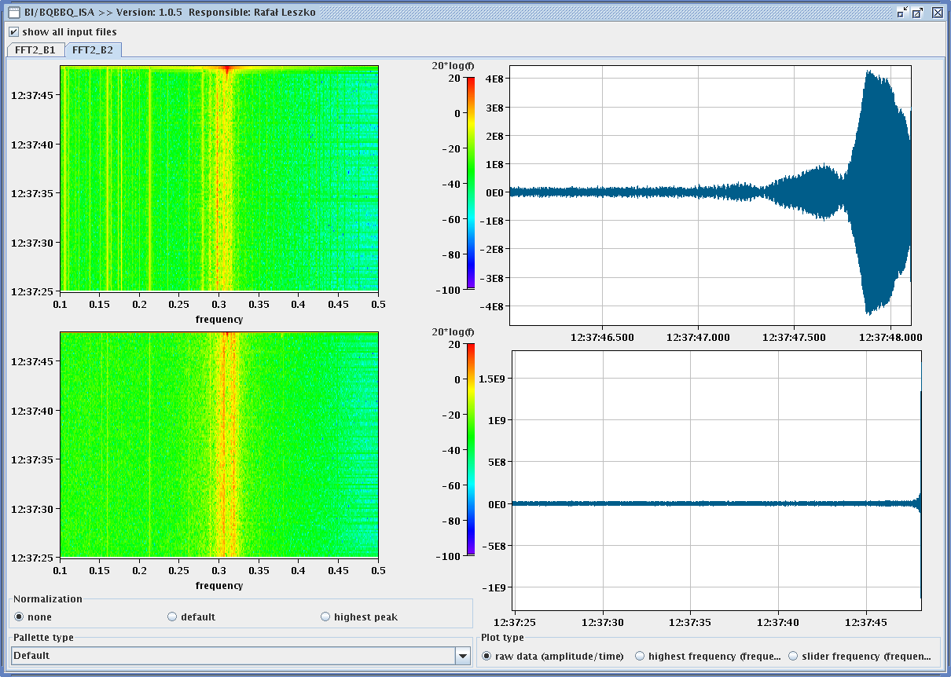
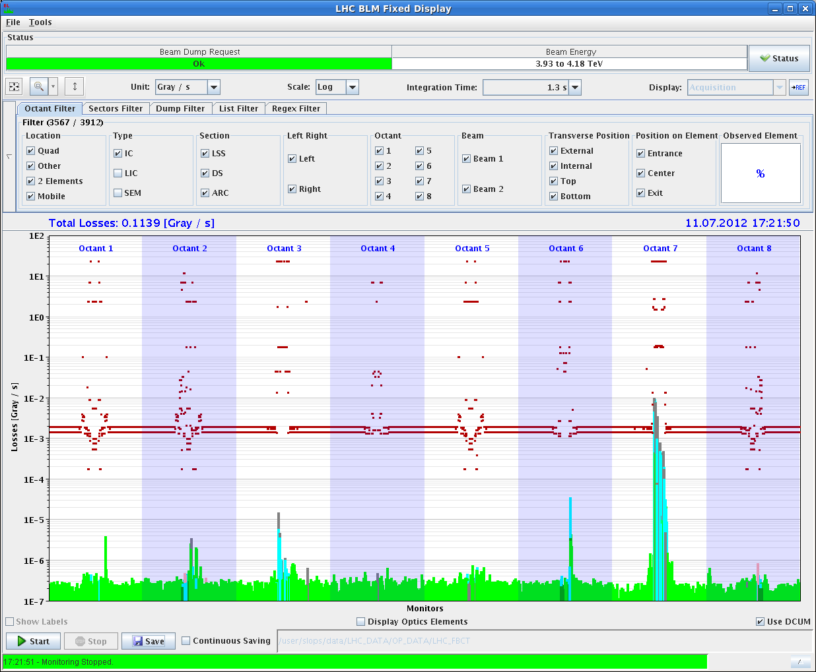
Wed Morning
12:41h
15:04h injection physics beam for 90m
loss maps with ADT
Betatron loss maps at the end of the squeeze
(separated beams)
positive off-momentum in physics
Asynch dump in physics (with Roman pots in).
B2 instability during VdM at +3 sigma separation ...

Slide 4
Wed Late / Night
22:32h injection 112 bunches for 90m physics
... but: Problem with injection trajectory for B1. We call Chiara
“IQC latches on B1 on almost all injections”
00:08h start ramp ... beam dump due to Orbit excursion interlock
(BPMs in IR6)
02:31h new injection, ramp, un-squeeze
03:55h beam dump:
COD settings b2 v at around 40m beta*
of the unsqueeze.

Slide 5
Wed Night
06:04h new injection, ramp
... and again beam dump, QPS trigger trip of RSD1.A45B2
PLAN:
still ... 90m physics run
test octupoles with inverted polarity
back to standard physics run

