Slide 1
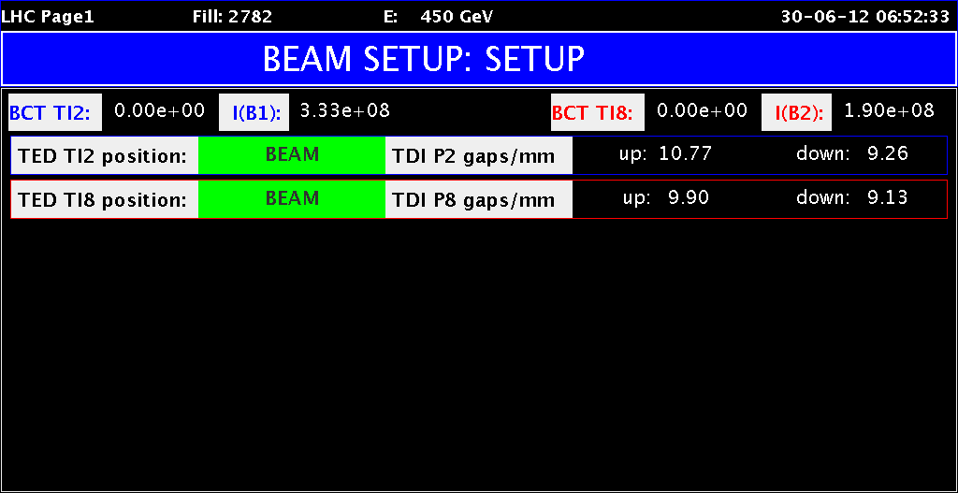
LHC Status Sat Morning 30-June
Bernhard Holzer, Jan Uythoven
Status
Friday Late: preparing restart
some issues ...
LHCb dipole tripped / router problem in US25 / no BLM data
received / ...

Slide 2
Fri Late / Night
19:50h starting a test-cycle ramp and squeeze
ALFA movement tests ... -> problematic station A7L1
20:00h trip of RQX.L8 at about 1500 A
20:25h switch closure problem on RCS.A23B2. Access needed
21:44h repeating the ramp on RQX.L8 -> trip at 1100 A
... problem of temperature on the current lead ... (Quench ! )
investigatibg on site (i.e. in tunnel)
exchangning cards ... error moves with the card
error located at a cable
23:03h problem in trimming the RF frequency -> fixed by Greg
04:43h RQX.L8circuit back in business
04:44h ice on a He valve ... checked by cryo ... to be followed up

Slide 3
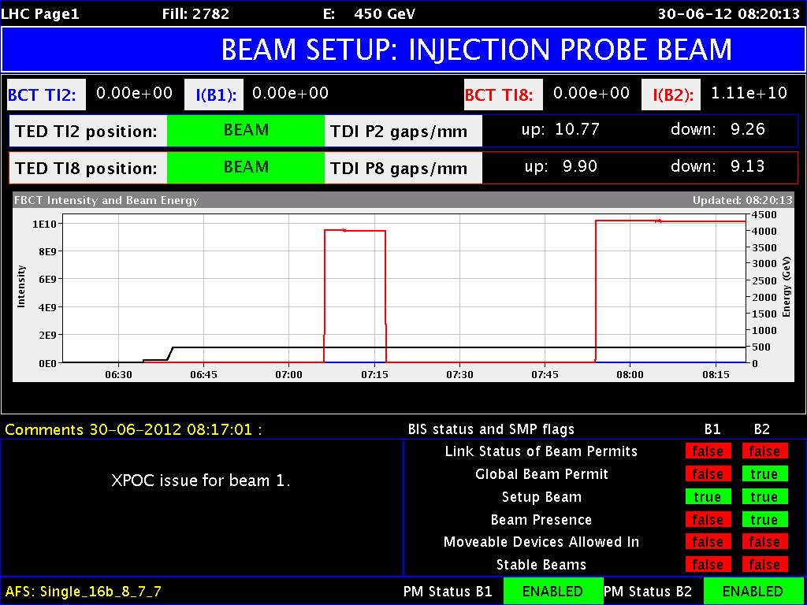
Sat Morning
06:09h Unable to change the beam mode;
“With Greg's help via telephone (he was at the airport) we managed
to fix the problem which prevented us from changing the beam mode
(the library junit.jar was missing in the LSA library folder).”
06:54h injection probe beam !!
at present: XPOC latched for
beam 1 and beam 2
after programmed dump.

Slide 4
Plan for start-up with beam
Machine closed. Ramp for powering tests & pre-cycle
Pilots through nominal cycle up to collisions. Measure chroma during squeeze. Check dump of pilots
If time left over night: second ramp with pilots. Open primary collimators at flat top for manual chroma measure at collision
Check BPMS.
3 nominals. Interlocking with bump and scraping
BPMS – TCSG. Measure beam position w 12 nominals. Call Jorg. If position changed, check TCSG alignment
Ramp into collision 2 – 3 nominals (< 3e11) for Roman Pot alignment. In principle only Totem alignment, max 5 hours alignment. Finish fill with
Betatron loss maps with resonance crossing
Asynch dump tests

Slide 5
Plan for start-up with beam
Fill with 3 nominal bunches for loss maps (<3e11 p)
Betatron loss maps at the end of the squeeze with separated beams (using the ADT on bunch 1 and 2)
Possibly repeat betatron loss maps in physics (resonance) if not enough beam was left in the alignment fill.
Negative off-momentum in physics (Roman pots IN)
Sunday
02:00 No beam in the machines for the leap second
Repeat another fill for asynch dump tests with Roman Pots in if there was not enough beam left after RP set-up
injection loss maps with ADT method at injection – can also be done during the intensity ramp up
If things go extremely well already start the intensity ramp up

Slide 6
Intensity ramp-up
84 bunches: 2 hours Stable Beams
480 bunches: 6 hours Stable Beams for ATLAS (but don’t refill)
840 bunches + 12 non colliding: Production fill
1380 bunches: Production fill

