Slide 1
MD#2 News & Plan Tue – Wed (19. – 20.6.)
Day | Time | MD | EiC | MP
Tue | 06:00 | 450 GeV → 4 TeV: Ramp for chromaticity (done later) |  | A
 | 08:00 | Ramp down
 | 10:00 | 450 GeV: Large Piwinski Angle MD + precycle 2 bunches 2.4e11 – started with 3:30 h delay |  | A
 | 18:00 | 450 GeV → 4 TeV: Octupole instability threshold Single full physics beams Ramp for chromaticity + octupole effect |  | C
Wed | 02:00 | Ramp down
 | 04:00 | 450 GeV → 4 TeV: Longitudinal dynamics studies– |  | B
 | 10:00 | Ramp down
 | 12:00 | 450 GeV → 4 TeV: Beta* leveling 2 nominal bunches |  | C
 | 20:00 | Ramp down
 | 22:00 | 450 GeV → 4 TeV: Long-range beam-beam with high bunch intensity 84b 50 ns 1.7e11 |  | C
Giulia
Alick
Ghislain
Giulia
Mirko
Alick
Ghislain

Slide 2
Draft MD Planning Thu – Fri (21. – 22.6.)
Day | Time | MD | EiC | MP
Thu | 06:00 | Ramp down
 | 08:00 | 450 GeV → 4 TeV: High beta* (1) |  | A
 | 16:00 | Ramp down
 | 18:00 | 450 GeV: MKI UFO studies |  | C
Fri | 04:00 | 450 GeV → 4 TeV: Scraping, diffusion and Repopulation Study and fast losses (with ADT) |  | C+C
 | 12:00 | Ramp down
 | 14:00 | 450 GeV: Injection and Q20 optics |  | A
 | 22:00 | 450 GeV: RF cavity phase modulation for 25ns |  | B
Ghislain
Mirko
Alick
Ghislain
Verena
Mirko

Slide 3
Draft MD Planning Sat – Mon (23. – 25.6.)
Day | Time | MD | EiC | MP
Sat | 06:00 | 450 GeV → 4 TeV: High beta* (2) |  | A
 | 14:00 | Ramp down
 | 16:00 | 450 GeV: Transverse Damper studies – cancelled
 | 22:00 | Ramp down
Sun | 00:00 | 450 GeV → 4 TeV: Collimation (impedance, nominal settings) |  | C
 | 06:00 | Ramp down
 | 08:00 | 450 GeV: Beam Instrumentation (BSRT, BGI, wire scan, BPM nonlinearities) |  | A/B/C
 | 16:00 | 450 GeV → 4 TeV: Test ramp for emittance calibration |  | B/C
 | 20:00 | Ramp down
 | 22:00 | 450 GeV: Dynamic Aperture MD |  | D
Mon | 06:00 | Technical Stop
Alick
Enrico
Mirko
Alick
Enrico
Mirko
Alick

Slide 4
Draft MD Planning Sat – Mon (23. – 25.6.)
Day | Time | MD | EiC | MP
Sat | 06:00 | 450 GeV → 4 TeV: High beta* (2) |  | A
 | 14:00 | Ramp down
 | 16:00 | 450 GeV: Transverse Damper studies – cancelled → instability studies (octupoles, ADT, Q’)
 | 22:00 | Ramp down
Sun | 00:00 | 450 GeV → 4 TeV: Collimation (impedance, nominal settings) |  | C
 | 06:00 | Ramp down
 | 08:00 | 450 GeV: Beam Instrumentation (BSRT, BGI, wire scan, BPM nonlinearities) |  | A/B/C
 | 16:00 | 450 GeV → 4 TeV: Test ramp for emittance calibration |  | B/C
 | 20:00 | Ramp down
 | 22:00 | 450 GeV: Dynamic Aperture MD |  | D
Mon | 06:00 | Technical Stop
Alick
Enrico
Mirko
Alick
Enrico
Mirko
Alick

Slide 5
ADT Fast Losses
excitation for fast losses using ADT with sign flip
450 GeV: fast losses with asymmetric collimator settings
4 TeV: 10 pilot bunches / beam; only beam 2 used; bunches excited with increasing gain; at 200% warning; finally beam dumped at 400% of ADT gain;
no leaks to coils observed
M. Sapinski, A. Priebe, B. Dehning, et al

Slide 6
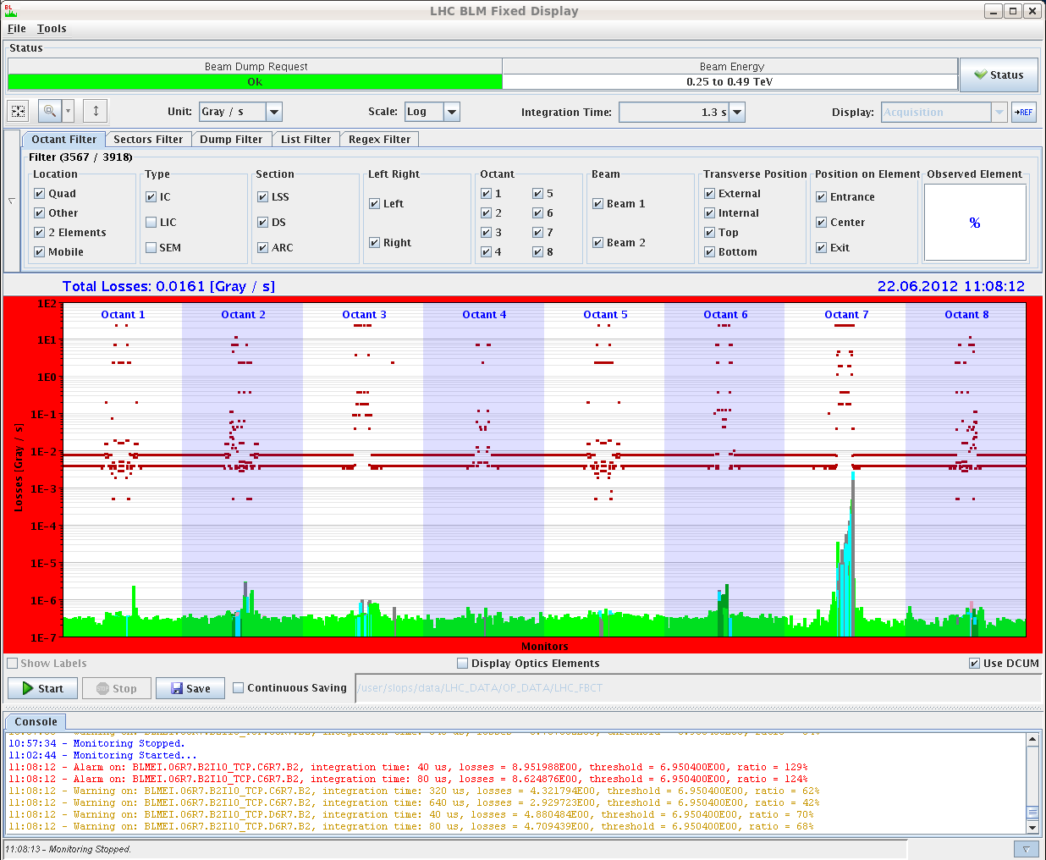
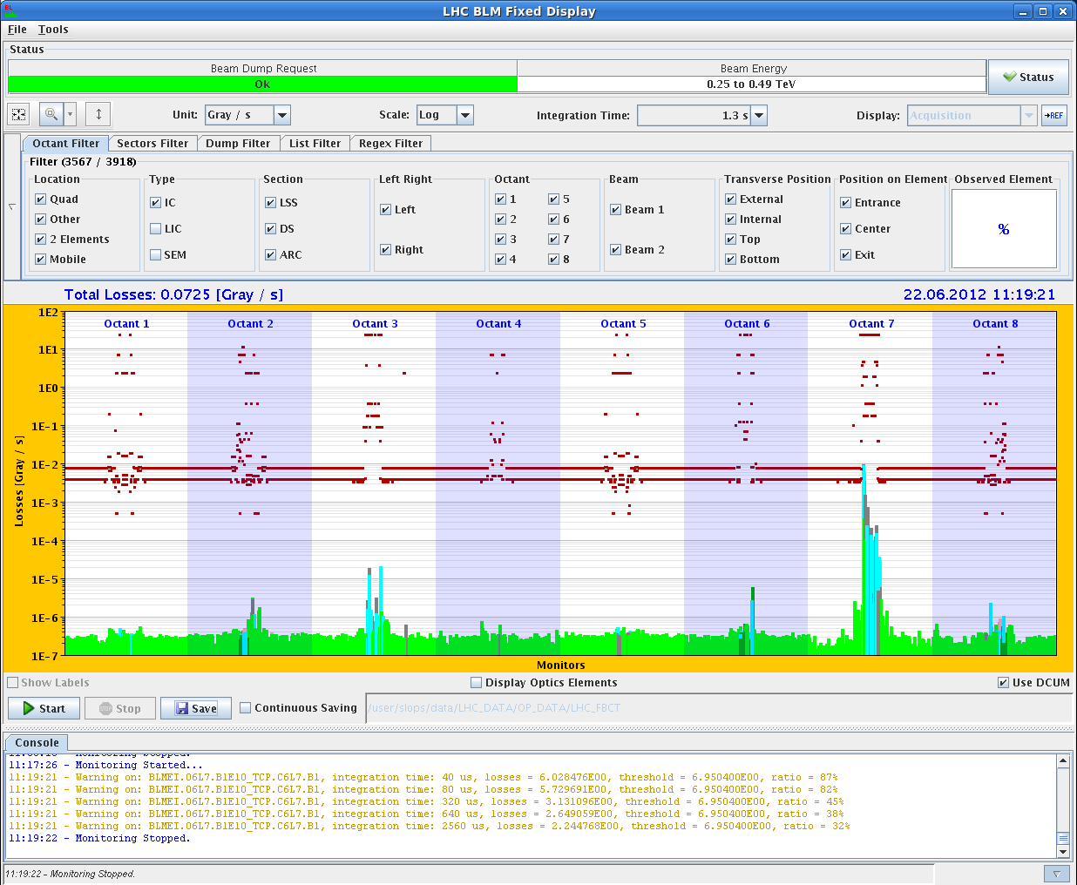
ADT Fast Losses – 450 GeV examples
ADT excitation in vertical plane B2; 11:08:12 TCP.D6R7.B2 set to 5.7 sigma, 11 sigma 129% of threshold of TCP.C6R7.B2 (still at 5.7 sigma)
Excitation of B1 in horizontal plane, TCP.C6L7.B1 set to 4 sigma and 5.7 no dump! at 11:19:21

Slide 7
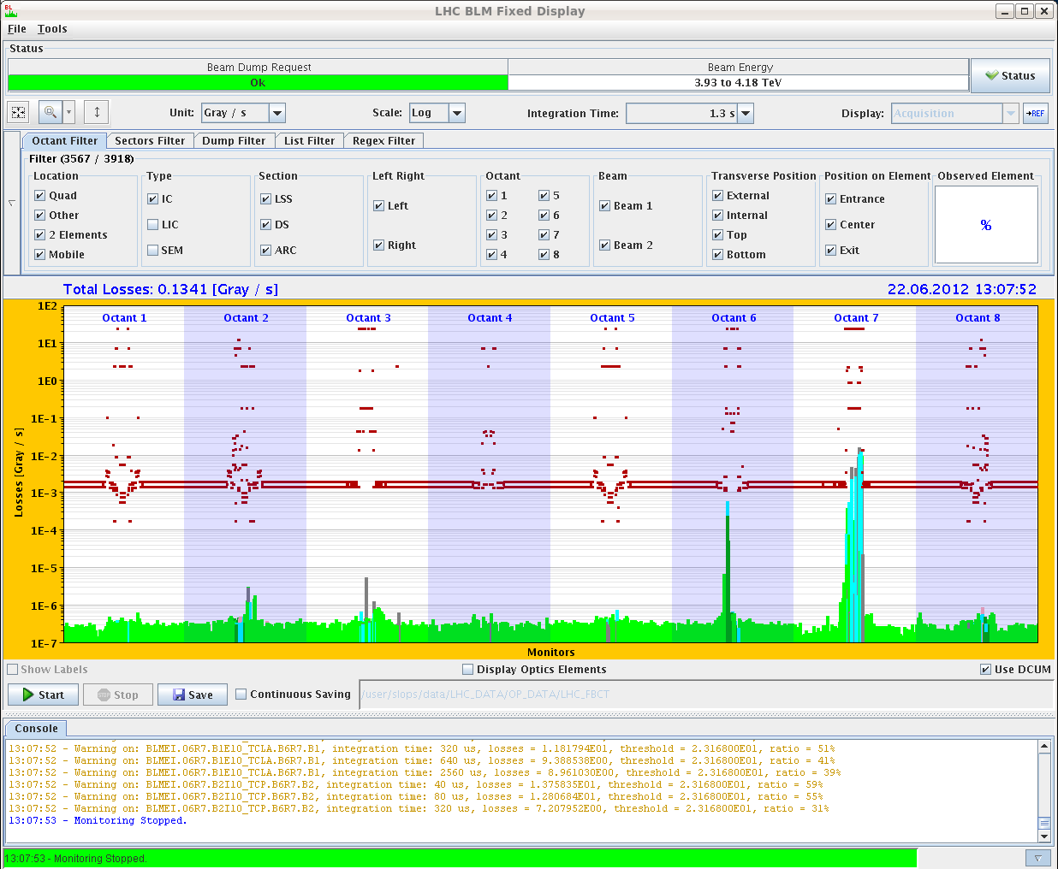
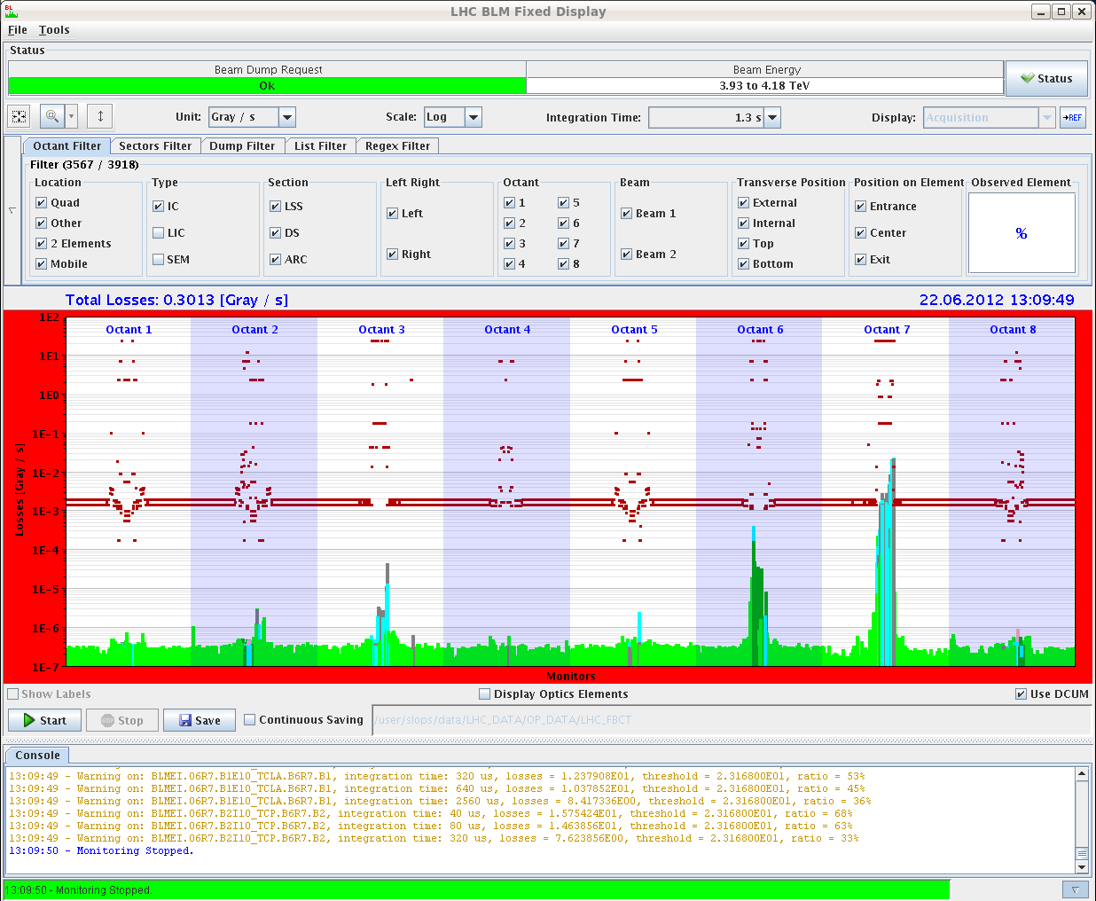
ADT Fast Losses – 4 TeV examples
200% warning
400% dump

Slide 8
Injection with SPS Q20 optics
Started with pilot injections and steering of the lines
Both beams went in, B1 Vertical plane with big oscillations in the line, was due to polarity switch on a corrector after HiRadMat
Steered both lines
Injected INDIV - OK as well
Injected higher bunch intensities up to 3e11 and measured emittances in SPS and LHC for several bunches - to be checked offline from wire scanner and BSRT data
Switched back to pilot for dispersion mismatch measurements - very nice for B1, but quite big mismatch for B2 - more time will be needed during the next MD to investigate the B2 mismatch
C. Bracco, V. Kain, L. Norderhaug Drosdal, et al

Slide 9
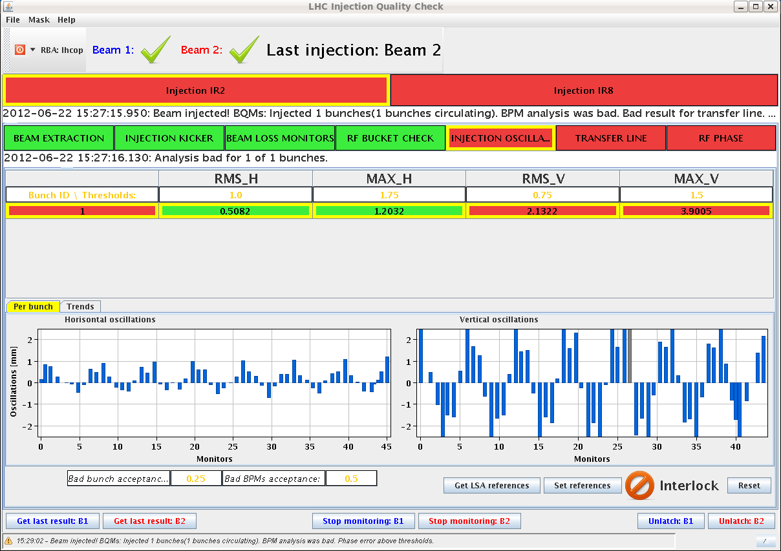
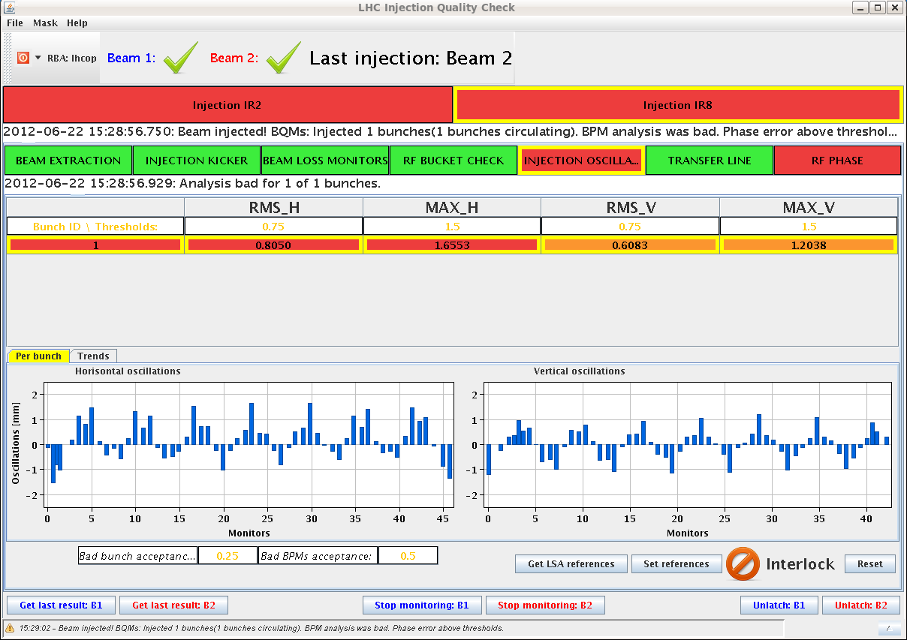
First Q20 beam injection into LHC
Beam 1 in...vertical oscillation due to wrong polarity switch on MDAV.610013 (HiRadMat)
B2 went in better. Both planes good from injection oscillations.
correct injection phase, +15 both beams

Slide 10
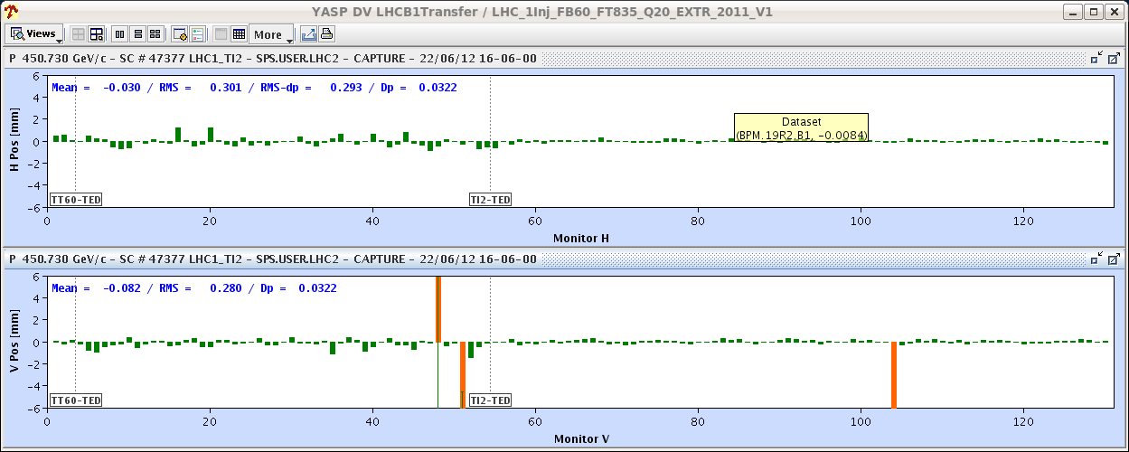
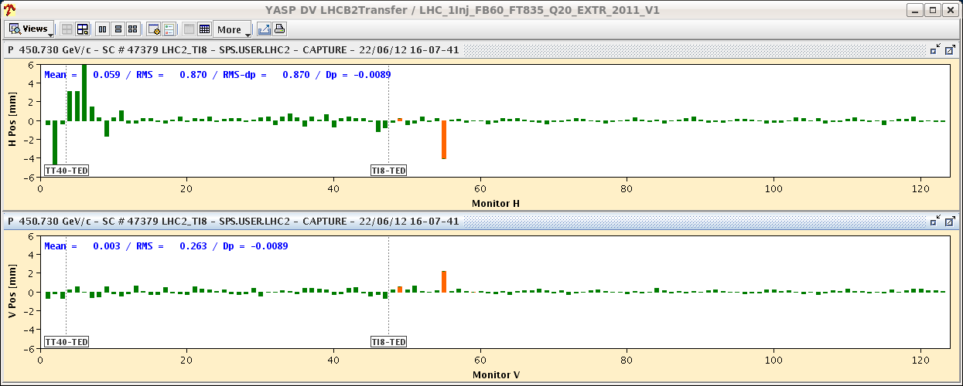
Q20 beam trajectory after correction
“both look very good”

Slide 11
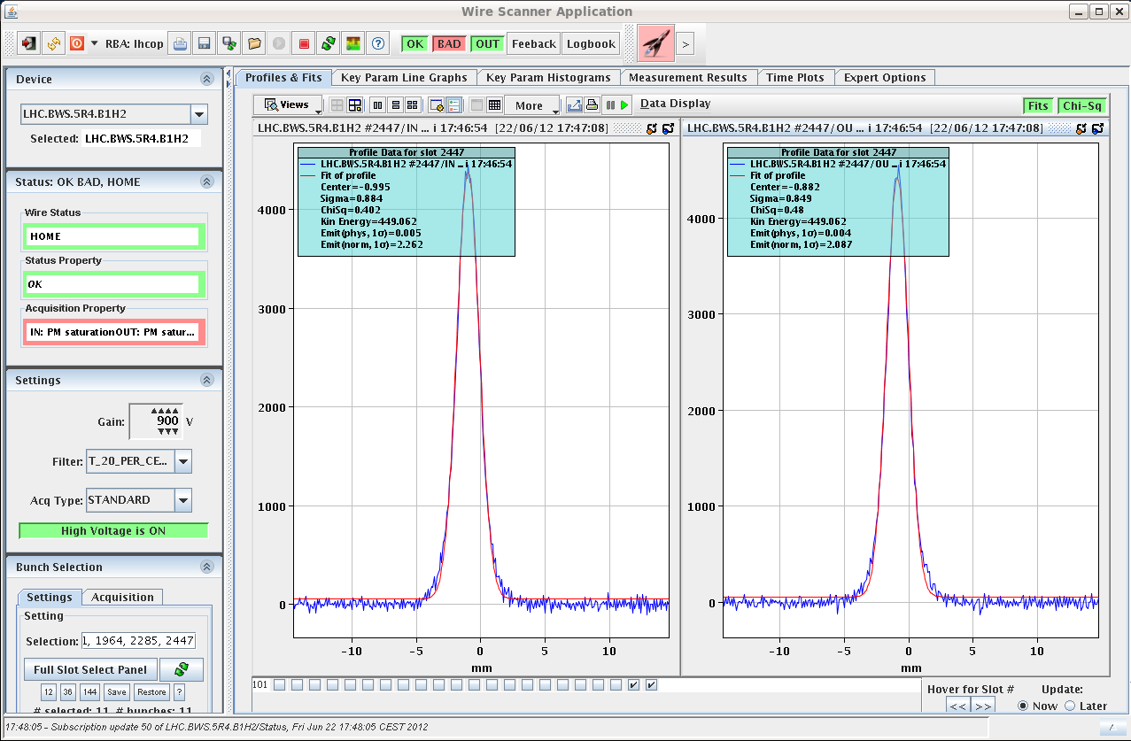
Q20: emittances of 3e+11 bunch in the LHC
ε~2 μm (both planes)

Slide 12
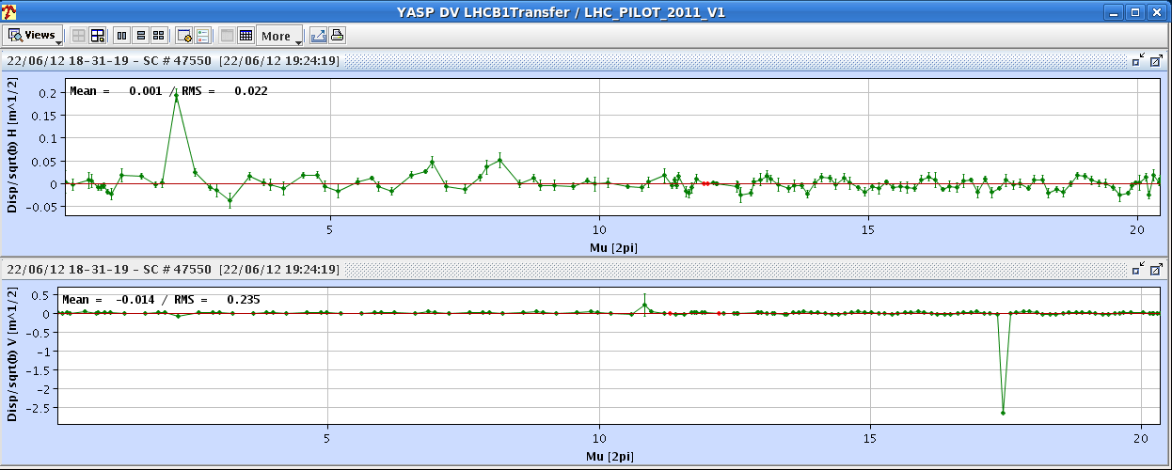
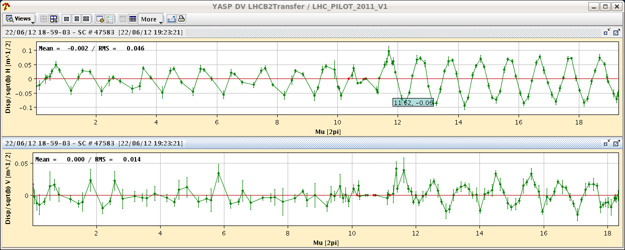
dispersion into LHC w Q20 optics

Slide 13
additional injection studies
wire scan measurements at each transfer for 12 bunches in SPS and LHC for Q26 to compare later on with mismatch from Q20 measurements
tried to reproduce injection quality issue from beginning of May: change of supercycle, removing CNGS in front of LHC1
this had caused a severe increase of the losses especially for TI 8 on 11th of May. We could not reproduce the phenomenon. Q5 losses only increased slightly. We will have to analyse the scraper data. The scraper had been set up for the nominal condition and was left in position. Possibly fixing the supercycle is not entirely necessary for filling.
- Will ask for some time with SPS scraper to scan the beams with different supercycles.
- TCDI automatic setup tool check could not be fitted into the time of the MD. Will request time with beam up to the TED during a physics ramp down. Only one collimator in TI 2 can be checked in that way. That's enough for tool qualification.
C. Bracco, V. Kain, L. Norderhaug Drosdal, et al

Slide 14
RF cavity phase modulation for 25ns
motivation: present mode of RF operation imposes a constant voltage set point limiting the scheme to ~ nominal beam current (0.55 A DC); alternative is to modulate the set point during the turn resulting in a constant klystron drive and a klystron power independent of beam current
during the MD injected beam with constant set point, then slowly modified the set-point in two steps:
Step 1 slowly applies the transient beam loading calculated from the beam current (bunch intensity and filling) plus cavity response (QL)
Step 2 is an iterative algorithm that measures the difference between cavity voltage and set point, and adapts the set point to minimize it
Both steps are implemented in Matlab
P. Baudrenghien et al

Slide 15
RF cavity phase modulation for 25ns
first half of the MD: debugging the algorithm
meaningful results with 156b and with 732b (ring half full)
observed reduction of the average klystron current and a flattening of the demanded klystron power over one turn
convergence of step2 not very convincing for some cavities; latency between iterations is 20 s and need to make large corrections at each iteration to achieve some effect in a reasonable time
next step: implement the algorithm in the firmware, allowing for a very small amplitude correction at each turn, thereby improving the stability of the algorithm, while achieving a faster overall convergence rate.
P. Baudrenghien et al

Slide 16
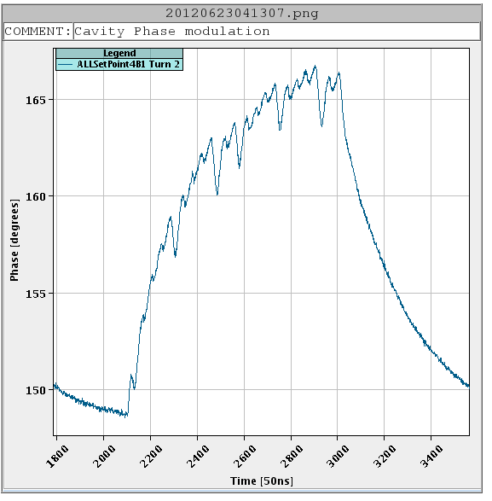
RF cavity phase modulation for 25ns
16 degree phase modulation applied
modulation of the cavity phase with ring half full

Slide 17
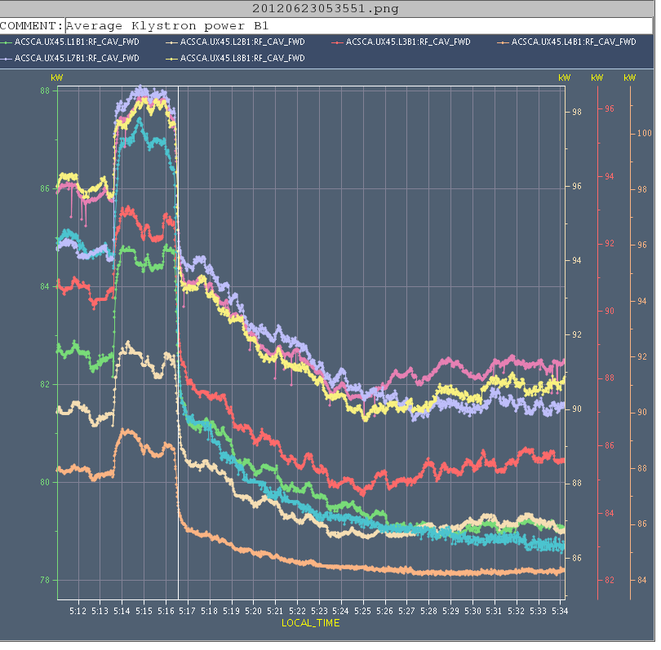
RF cavity phase modulation for 25ns
modulation with 1-T fdbk on: 12b +144 b
decreasing klystron power as set point is adapted

Slide 18
High beta* (2)
H. Burkhardt,
J. Wenninger,
et al
since ~6:00, pre-cycle had been needed due to change of
hypercycle – due to controls issue ;
quadrupole trip RQTL11.L2B2,…

